Slide 1
ScholarSphere 4.0
Seth Erickson
Research Data Librarian (Social Sciences)
Research Informatics and Publishing
https://scholarsphere.psu.edu

Slide 2
The ScholarSphere Team
Development
Dann Bohn Dan Coughlin Briana Ezray Binky Lush Ryan Shenk Adam Wead
Policies
Ana Enriquez Briana Ezray Kathleen Phillips Xuying Xin
Curation
Allis Choi Briana Ezray Hannah Hadley Xuying Xin

Slide 3
ScholarSphere Overview
Institutional repository by Penn State Libraries
Self-deposit, content agnostic.
Facilitates open access scholarship
Launched in 2012, one of the first OA IRs
Currently 7,829 deposited works
https://scholarsphere.psu.edu

Slide 4
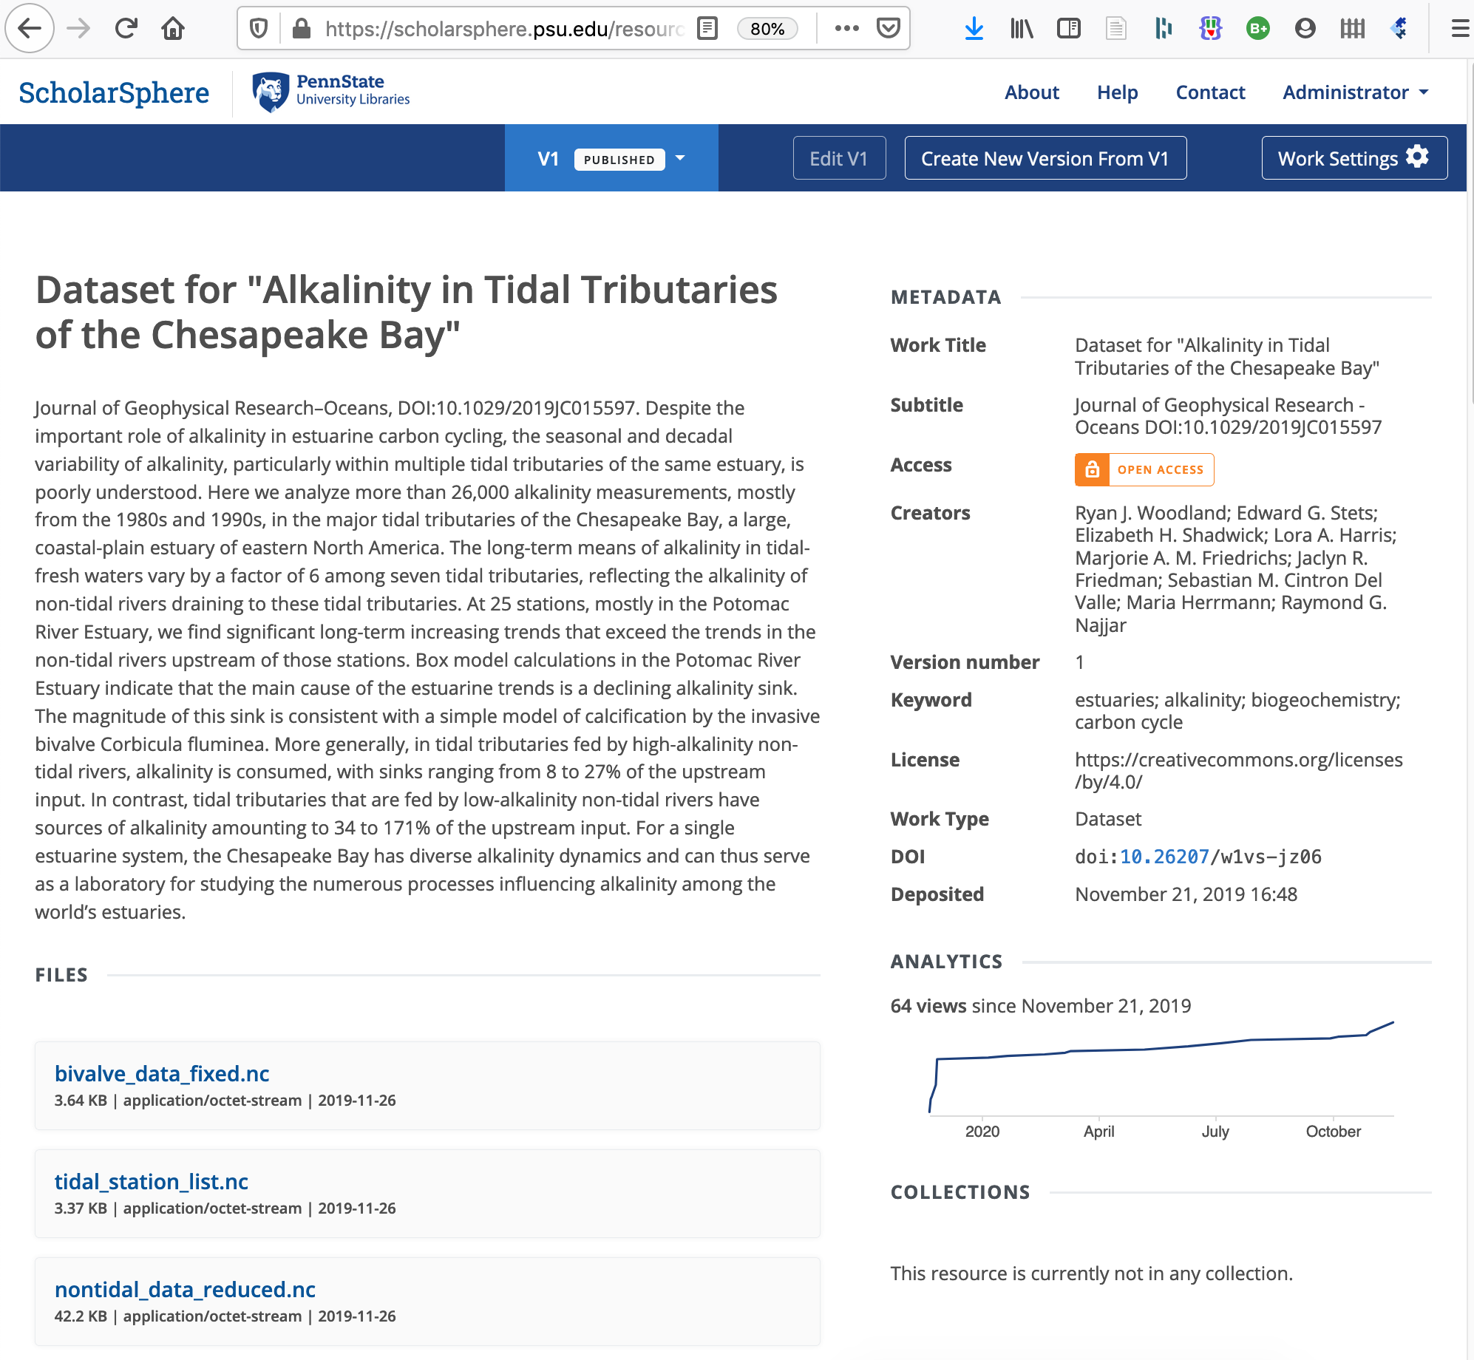
doi:10.26207/w1vs-jz06

Slide 5
ScholarSphere 3.0
Difficult to maintain
Not readily scalable
Hard to integrate with other systems
Missing some important features
Lacking policies for curation

Slide 6
ScholarSphere 4.0
Updated software stack
“Cloud native” approaches
API for better integrations
Supports versioning and drafts
New policy framework

Slide 7
Software Stack
Ruby on Rails framework Blacklight UI Bootstrap UI PostrgreSQL Database AWS S3 File storage Solr Indexing & search Redis/Sidekiq Asynchronous tasks Kubernetes Production deployment DataCite DOI minting
https://github.com/psu-stewardship/scholarsphere Open sourced under an MIT License

Slide 8
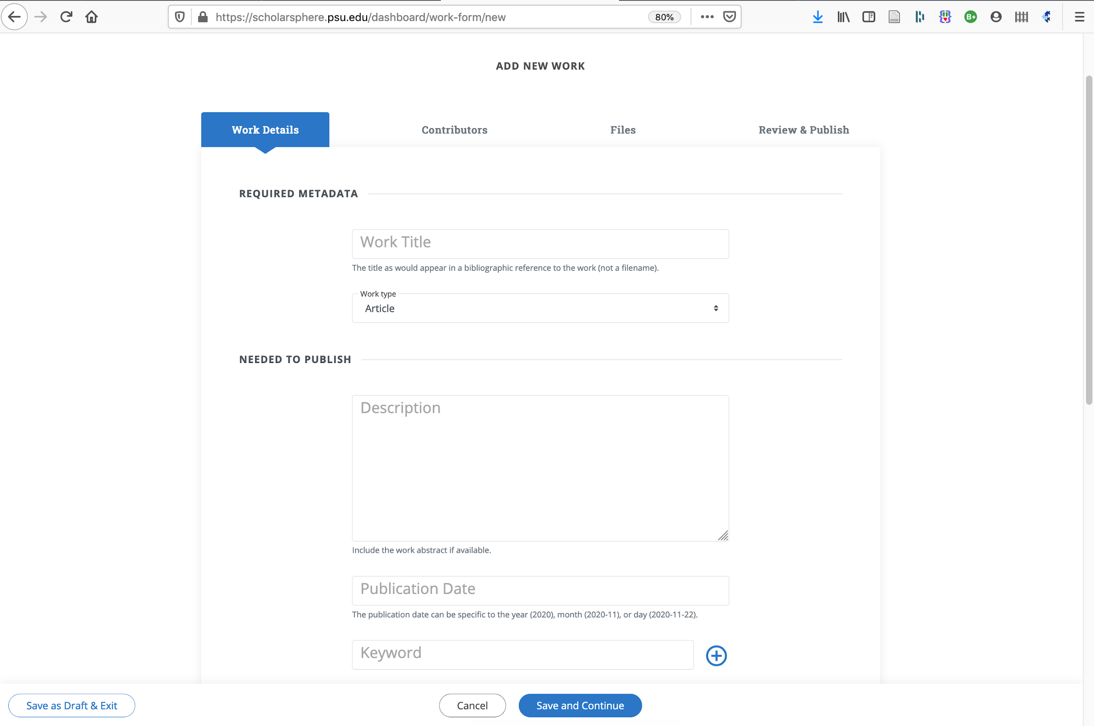

Slide 9
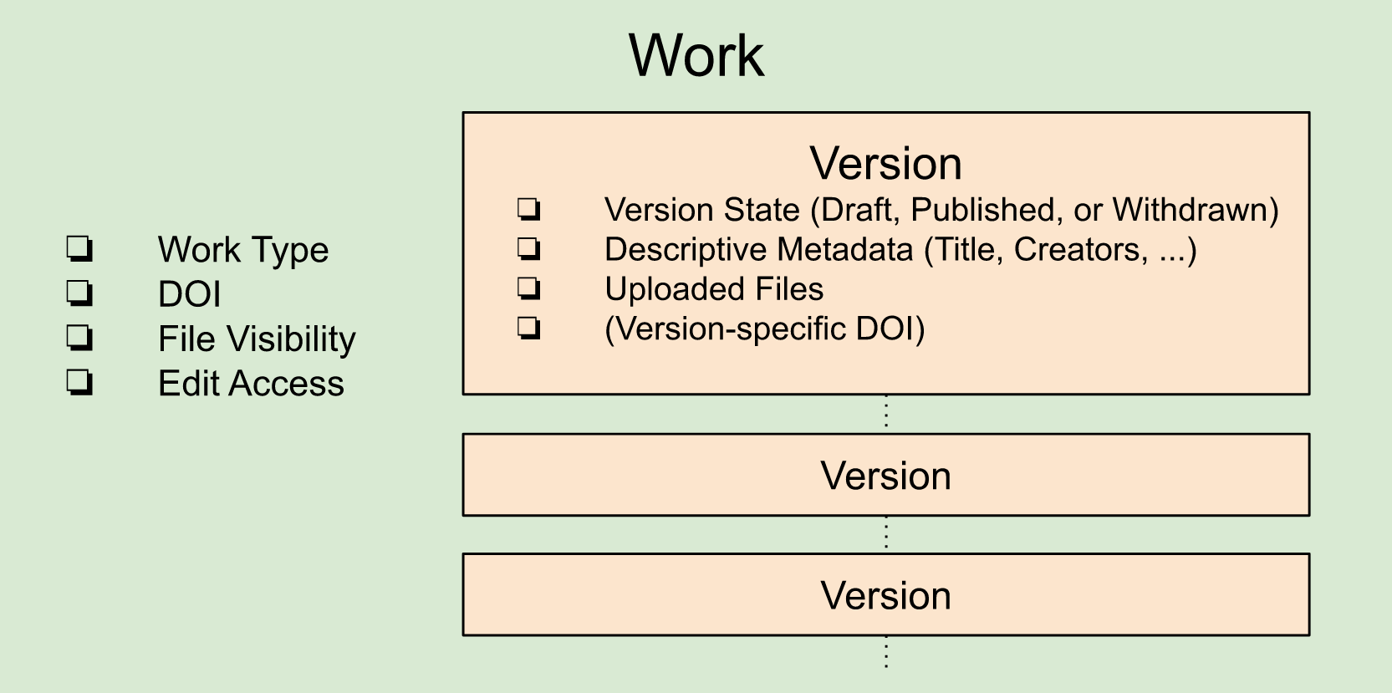
Drafts & Work Versions
Work Version States
Draft: Files and metadata may be modified by the Work creator or repository administrators only.
Published: files and metadata may be accessed according to the access settings of the Work the Version belongs to. Once published, only admins can delete or withdraw.
Withdrawn: metadata (but not files) may be accessed according to the access settings of the Work the Version belongs to.
https://github.com/psu-stewardship/scholarsphere/wiki/Architecture-Overview

Slide 10
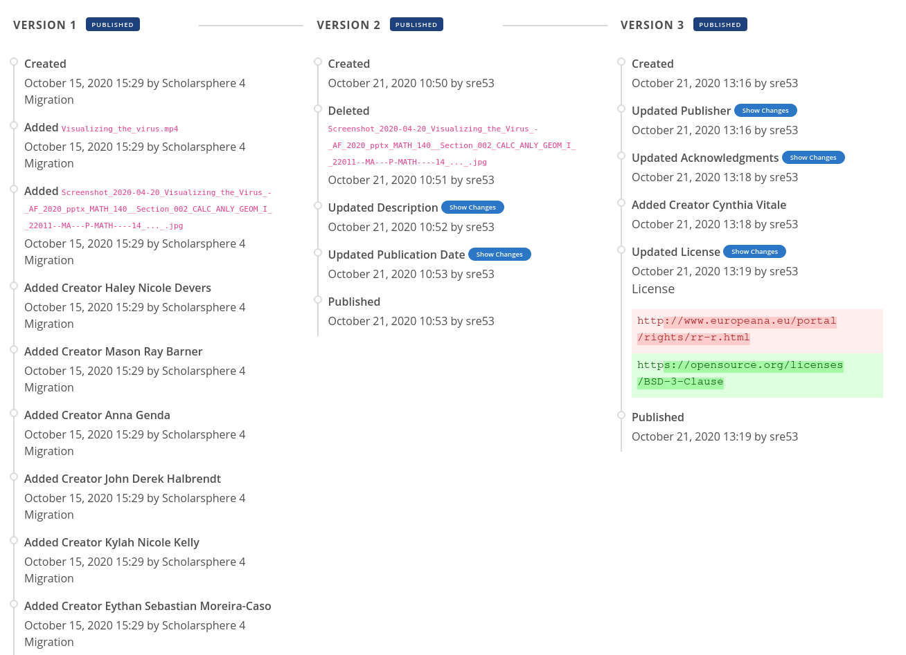

Slide 11
New Policies
Once a version is published, it can only be modified or deleted by administrators. (You can always create an updated version)
Deposits larger than 100 GB require approval from repository managers.
The minimum preservation timeframe is ten years. After that period, the Libraries may remove content that does not warrant continued preservation.
to improve discoverability and accessibility of deposited content, curators may enhance metadata and make available derivatives of deposited files in open, non-proprietary file formats

Slide 12
Thank You!
Development
Dann Bohn Dan Coughlin Briana Ezray Binky Lush Ryan Shenk Adam Wead
Policies
Ana Enriquez Briana Ezray Kathleen Phillips Xuying Xin
Curation
Allis Choi Briana Ezray Hannah Hadley Xuying Xin

Slide 13
How may curators alter or augment deposits?
In order to improve discoverability and accessibility of deposited content over the long term, Penn State Librarians may perform the following actions without permission from the depositor:
correct and enhance metadata of deposited works (for example, the title, abstract, keywords, and publication date, as entered in the deposit form) in order to more accurately describe the work
create and make available derivatives of deposited files in open, non-proprietary file formats (without affecting the content of the deposited files)
migrate content to new versions of ScholarSphere or its successor repository

Slide 14
Minimum preservation timeframe
TRUST Principles for digital repositories encourage explicit statement on minimum digital preservation timeframe
Policy:
Deposited files and metadata are generally retained for the lifetime of the repository, however the guaranteed minimum preservation timeframe for work deposited to ScholarSphere is ten years. After that period, the Libraries may remove content that does not warrant continued preservation
Lin, D., Crabtree, J., Dillo, I. et al. The TRUST Principles for digital repositories. Sci Data 7, 144 (2020). https://doi.org/10.1038/s41597-020-0486-7

