Slide 1
Digital Collections
Indiana University’s Image Repository Demonstration
Nick Homenda
Indiana University Bloomington
September 11, 2020
INDIANA UNIVERSITY BLOOMINGTON

Slide 2
Agenda
Project History
Feature Demonstrations
Next Steps

Slide 3
Project History
1.

Slide 4
Who are we?
Nick Homenda, Digital Initiatives Librarian, IU Libraries, Co-Product Owner
Mairelys Lemus-Rojas, Open Knowledge Librarian, IUPUI, Co-Product Owner
Jim Halliday, Head, Repository Technology Development, IU Libraries
+ 6 software developers at IUB/IUPUI/UITS and 1 project manager/scrum master

Slide 5
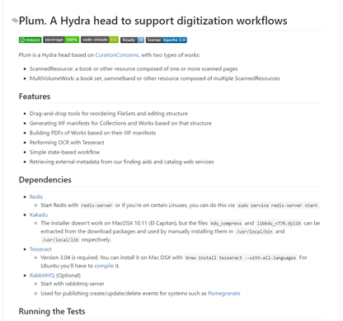
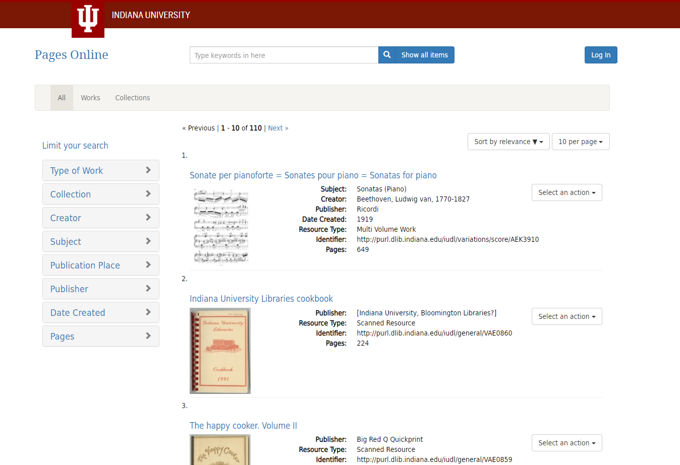
PLUM → Pages Online

Slide 6
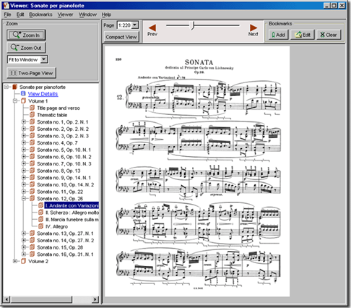
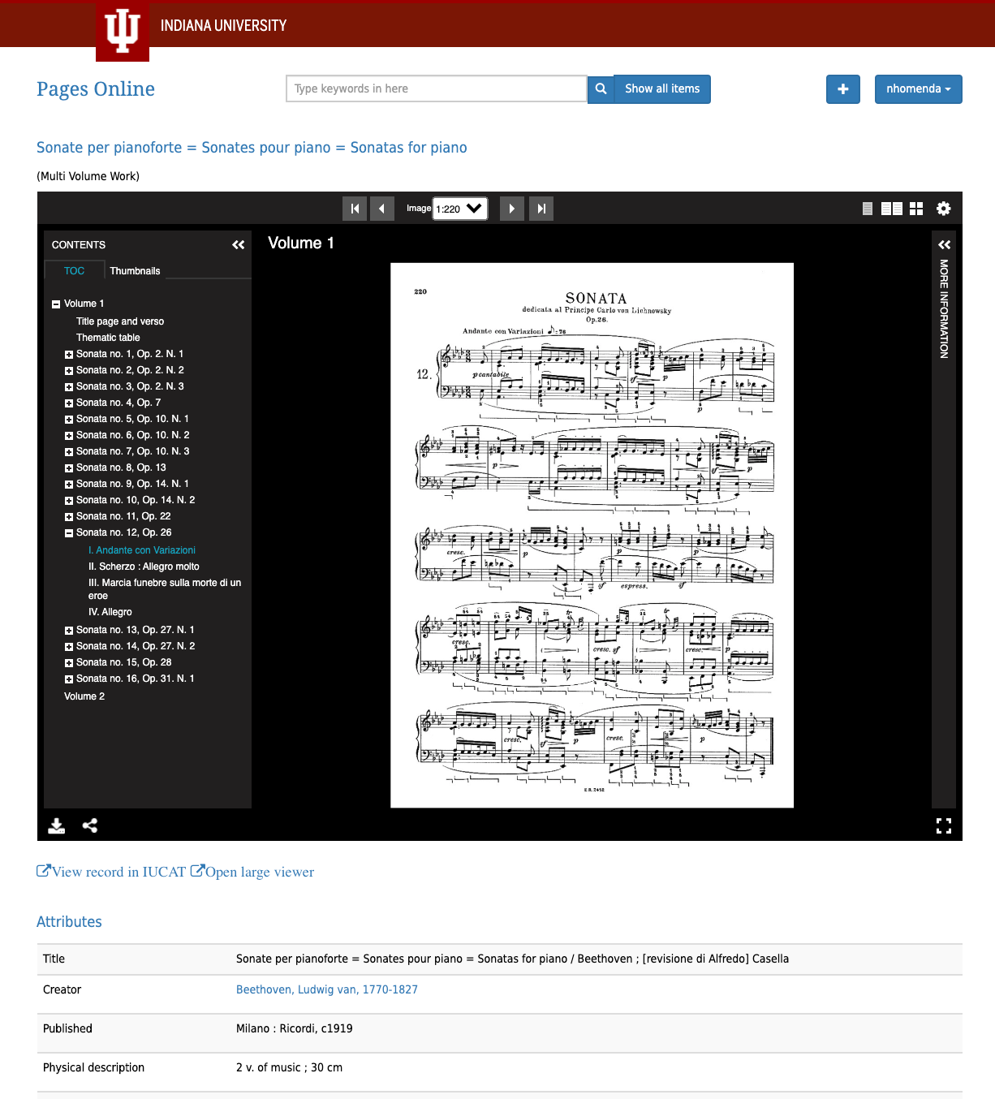
Pages Online Migration
Variations Scores
Pages Online

Slide 7
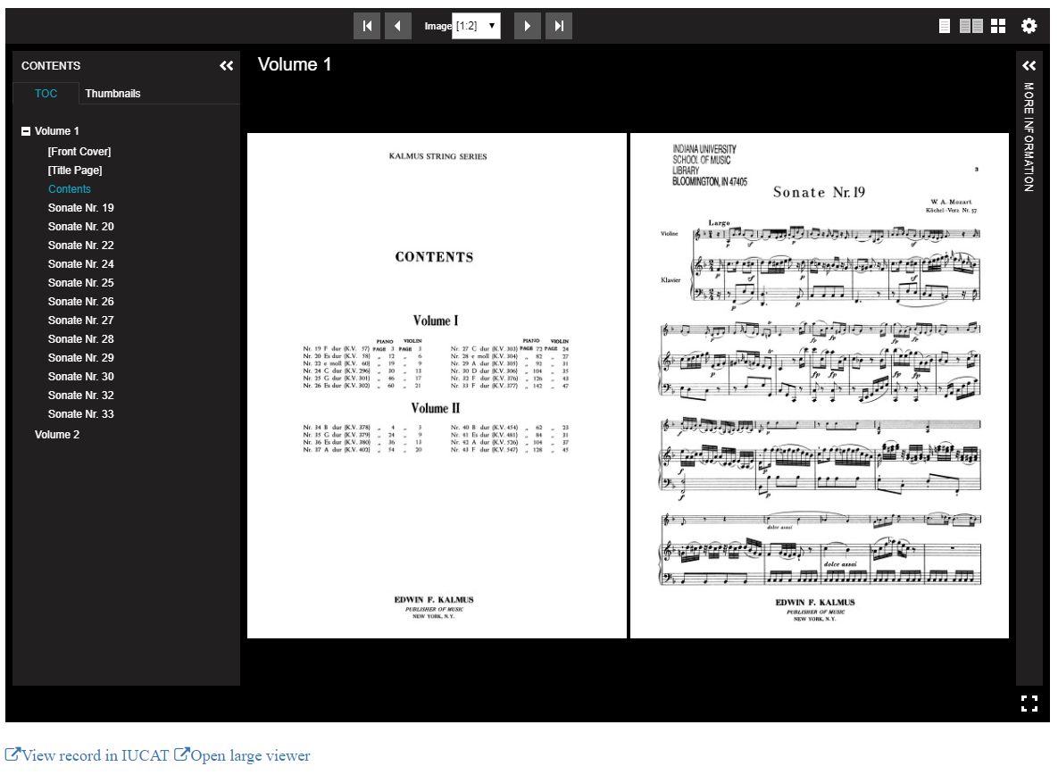
New Charge
November 2018
Expand Paged Media Project to include image collections features

Slide 8
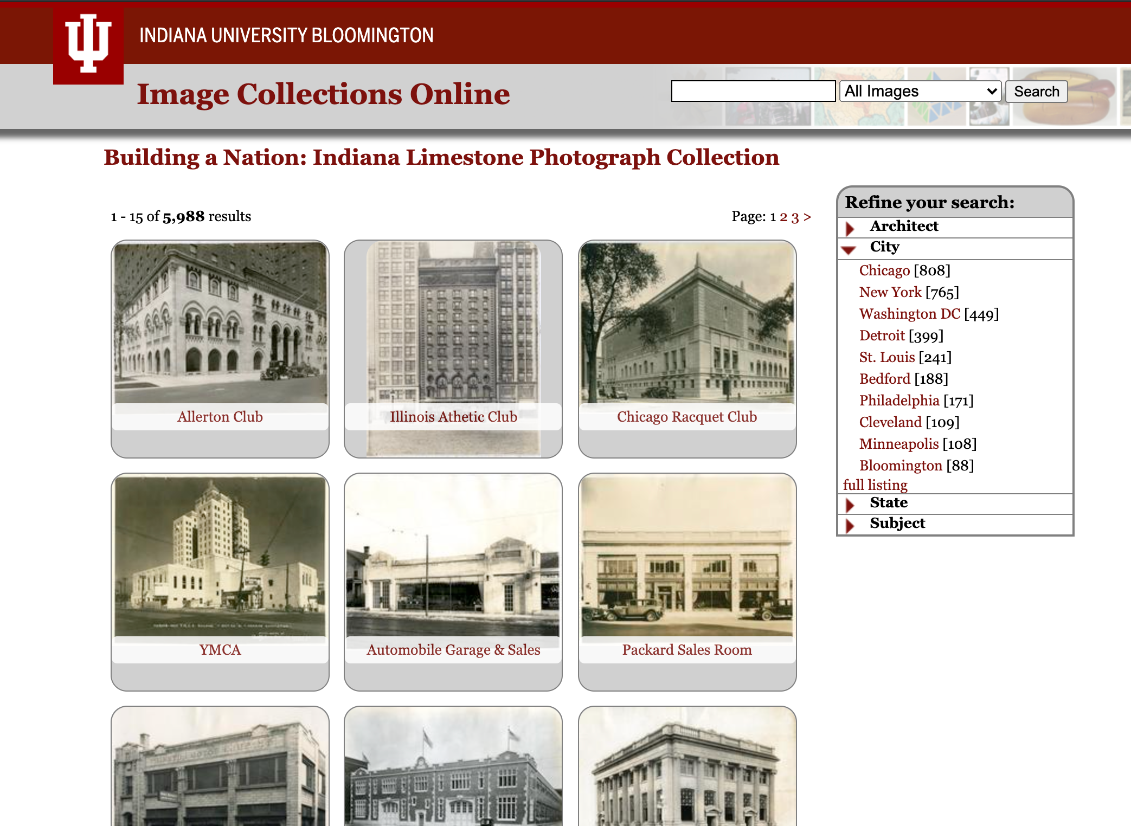
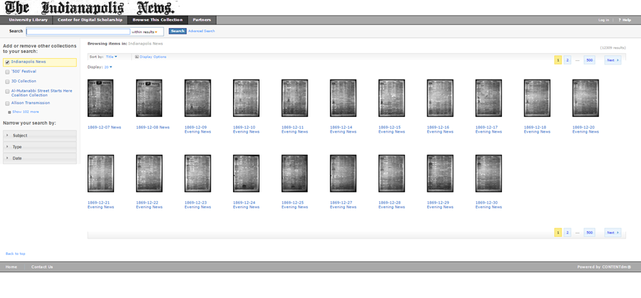
Legacy Services
Image Collections Online
CONTENTdm

Slide 9
Feature Demonstrations

Slide 10
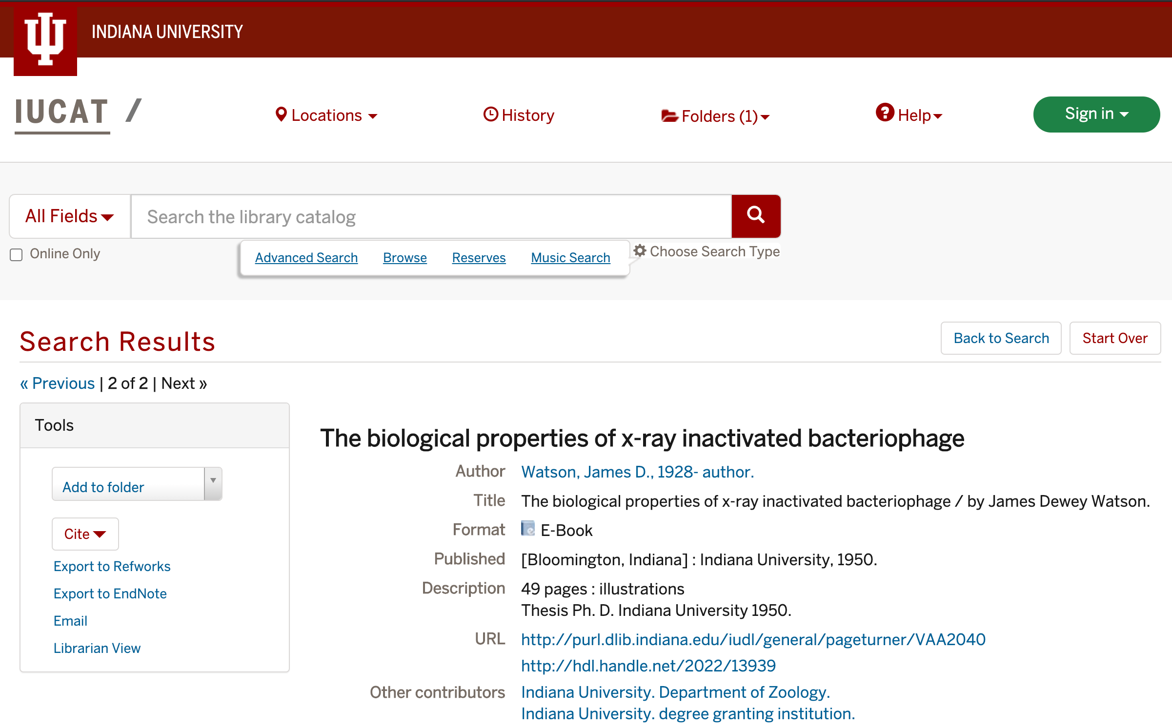
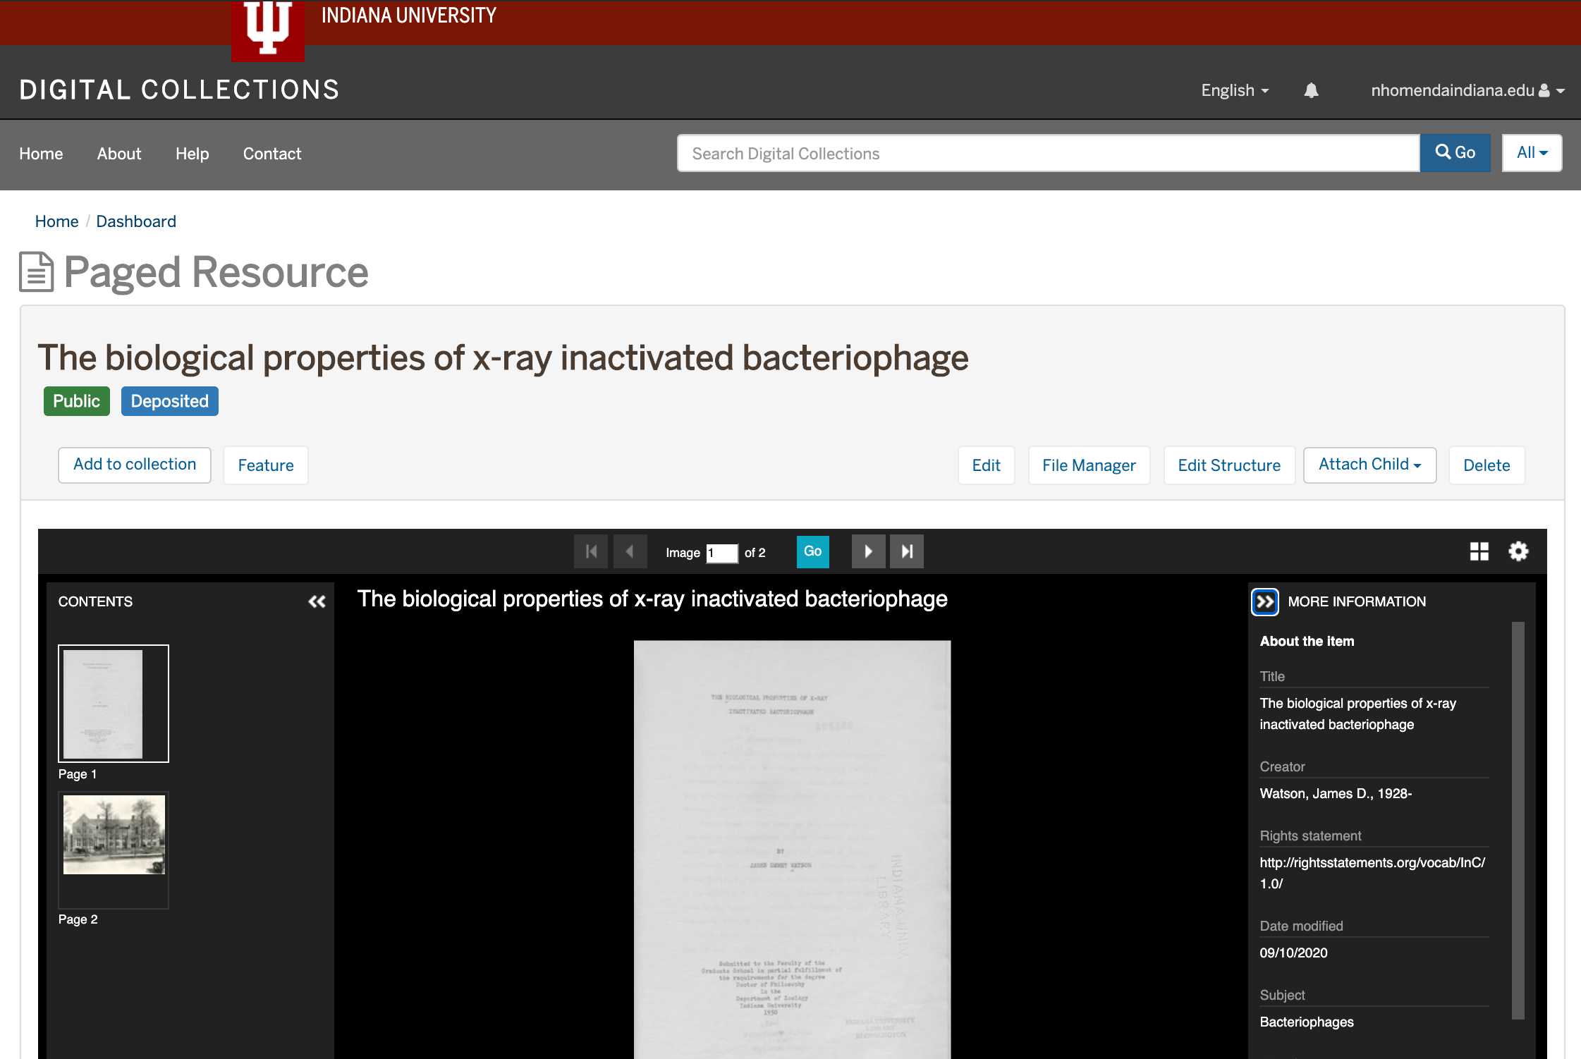
Digital Collections Metadata Import
Fetch library catalog data for items by unique identifier
https://iucat.iu.edu/catalog/5986457
https://essi-stage.dlib.indiana.edu/concern/paged_resources/fb4948667?locale=en

Slide 11
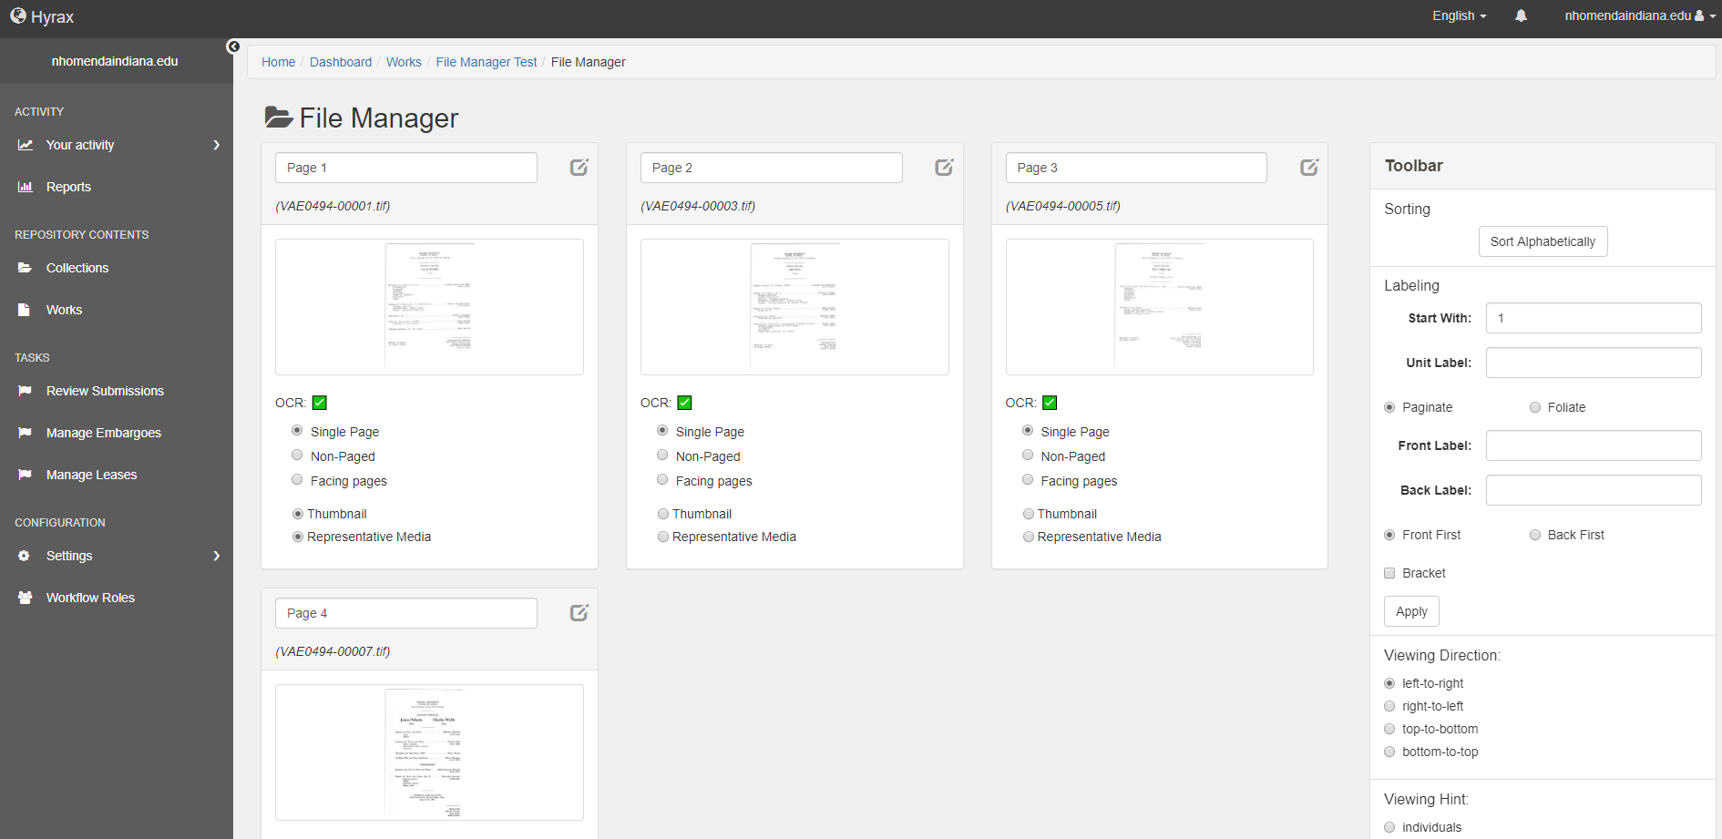
Digital Collections File Manager
Apply labels, ordering, and pagination

Slide 12
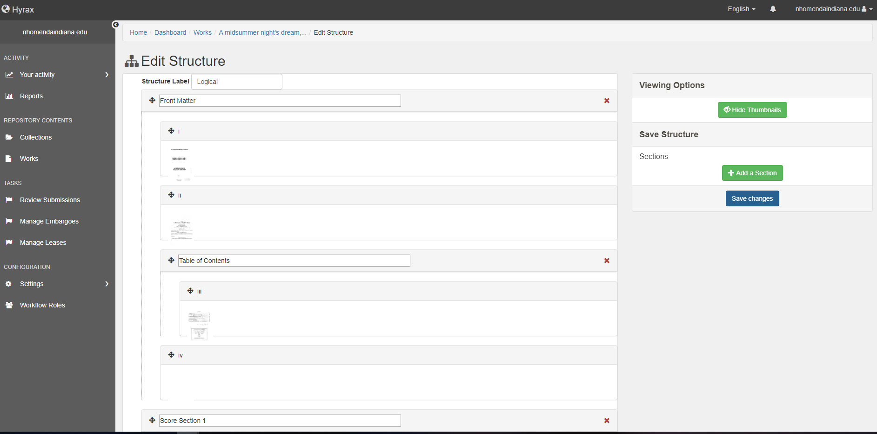
Digital Collections Structural Editor
Add hierarchical structure
https://essi-stage.dlib.indiana.edu/concern/paged_resources/3j3332392?locale=en
12

Slide 13
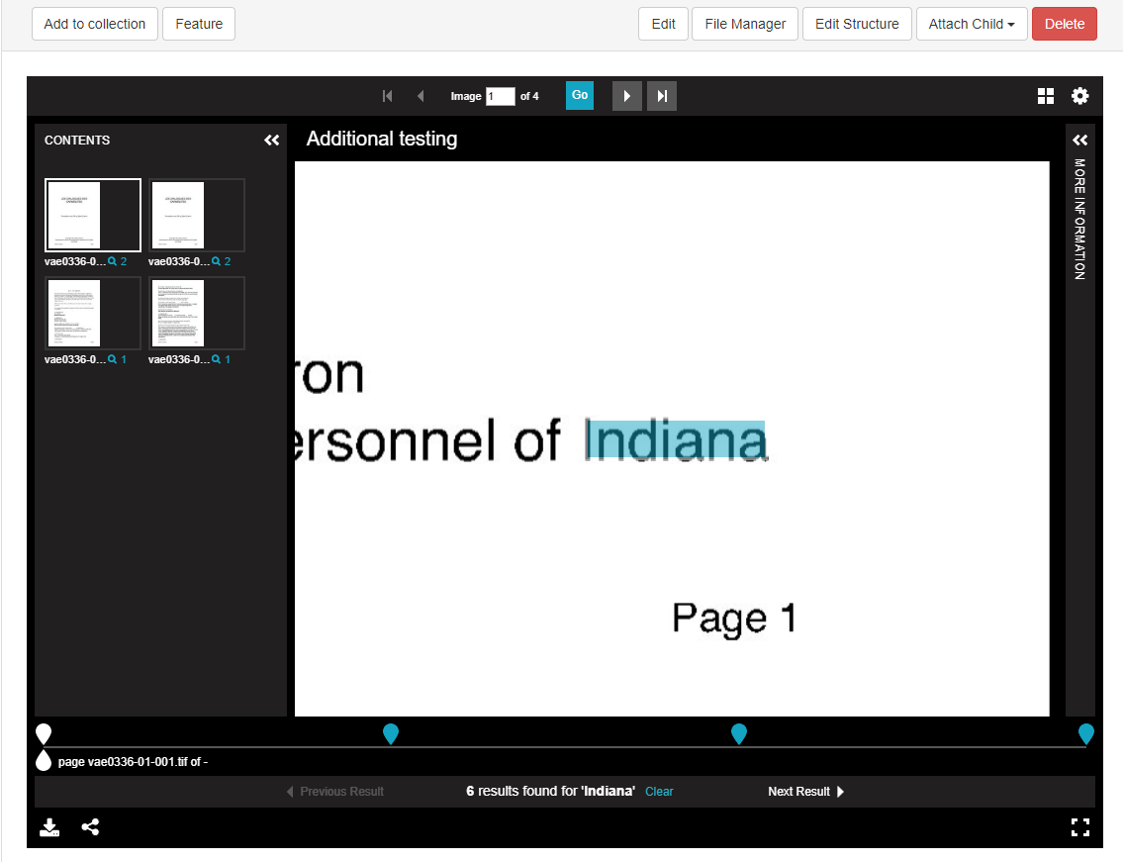
Digtal Collections Search Within
Based on community work around IIIF

Slide 14
Bulk Import/Export, PDFs, and Allinson Flex

Slide 15
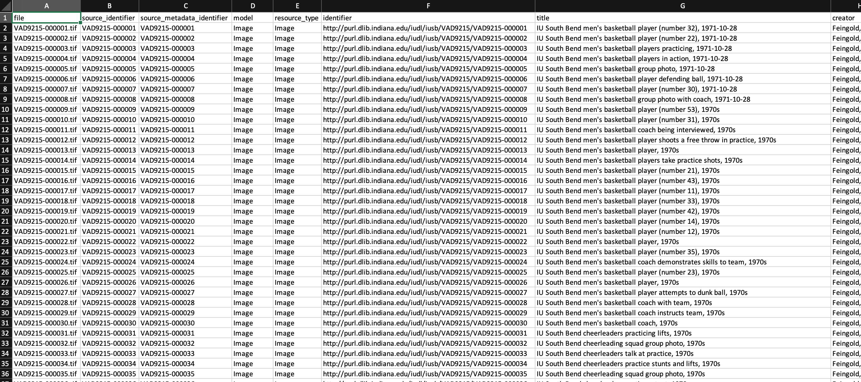
Bulk Import and Export
https://github.com/samvera-labs/bulkrax
Completed Batch

Slide 16
PDF Generation
https://essi-stage.dlib.indiana.edu/concern/paged_resources/fb4948667?locale=en

Slide 17
Allinson Flex
https://github.com/samvera-labs/allinson_flex
Gem implementing Machine-readable metadata modeling (M3) specifications found in Houndstooth
Reads M3 schema and a profile YAML file
Graphical interface in Hyrax
Properties defined dynamically and stored as data

Slide 18
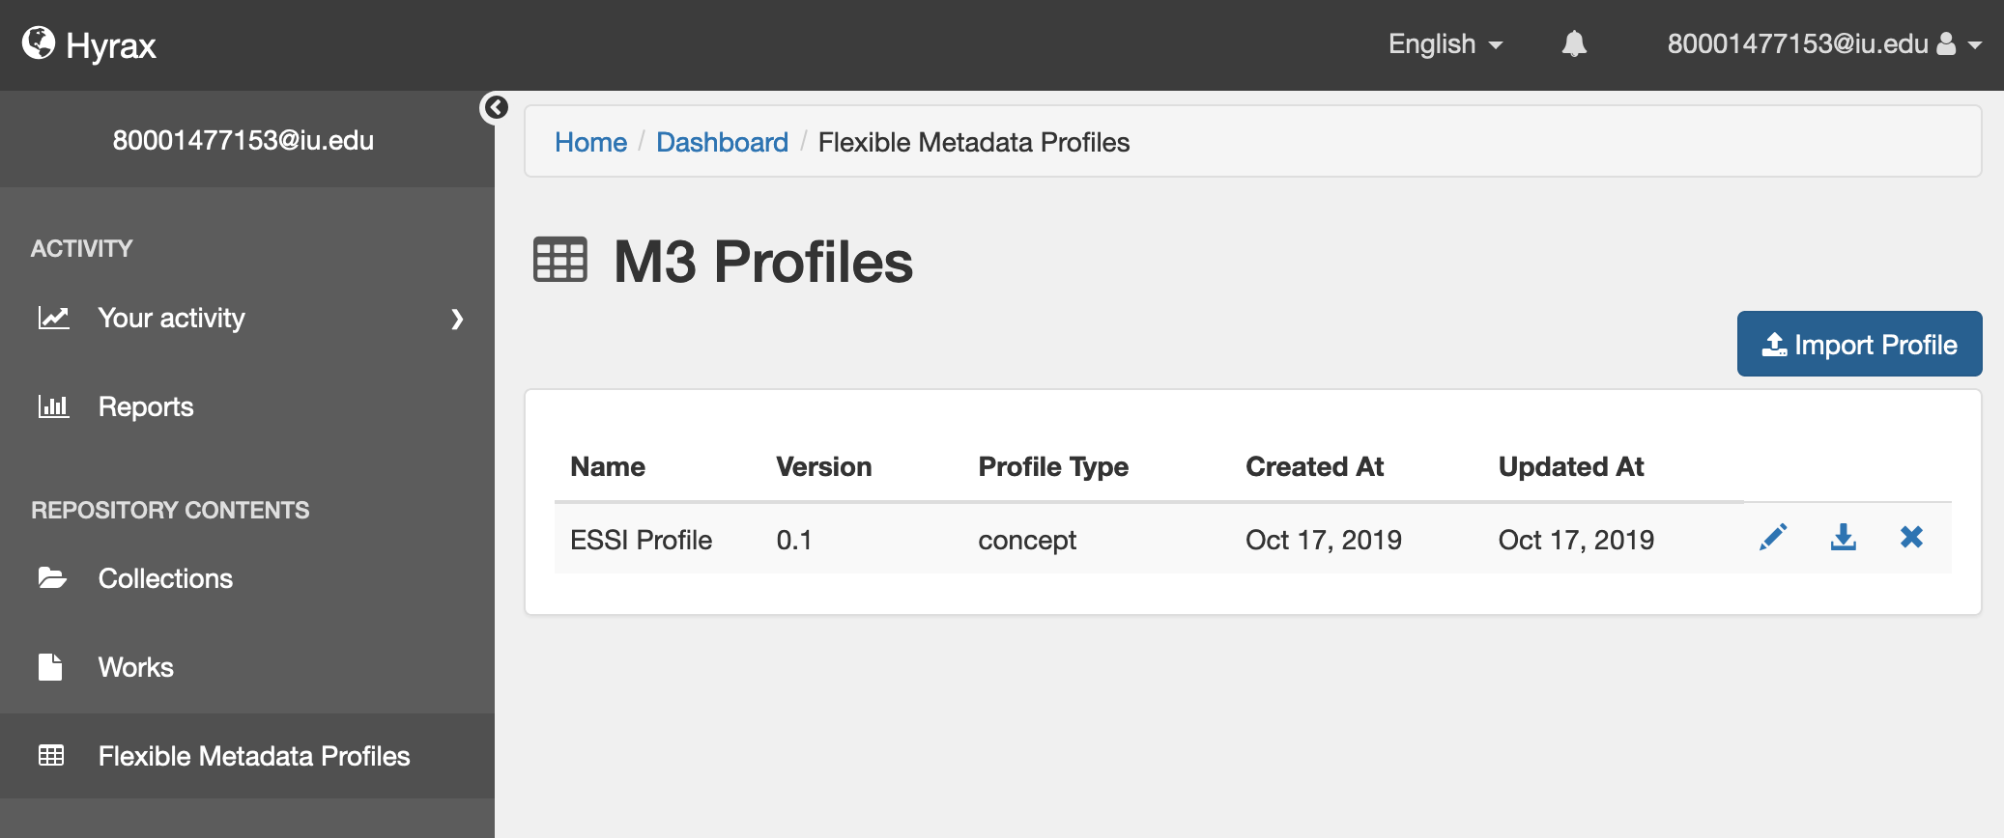
Flexible Metadata Modeling

Slide 19
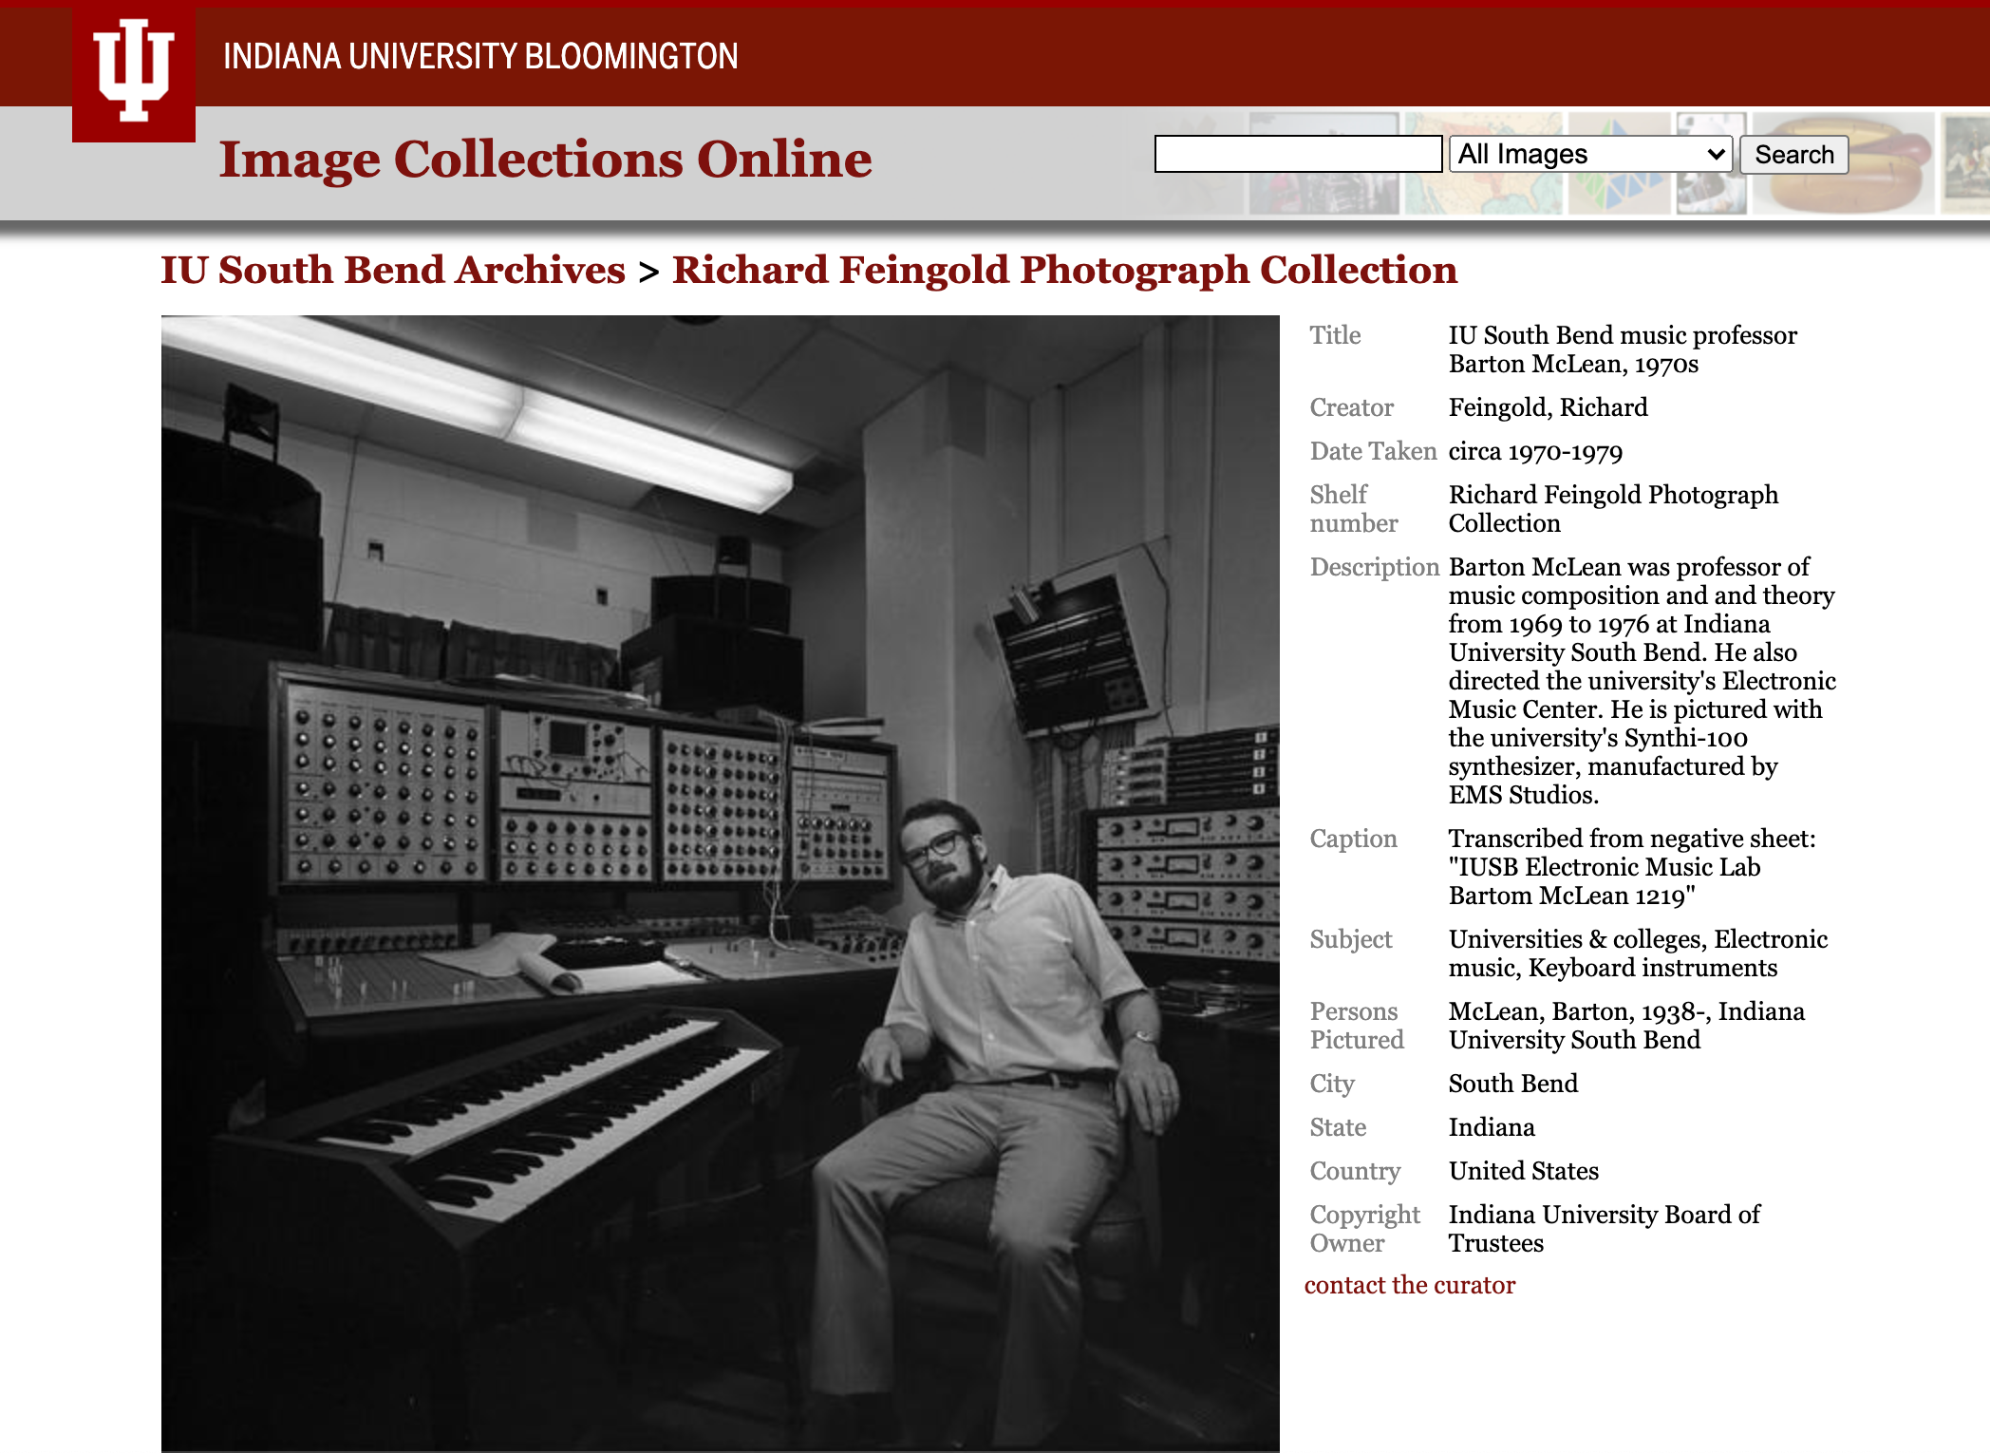
Different Contexts
https://staging-essi-web.notch8.cloud/concern/images/j3860692c?locale=en
https://staging-essi-web.notch8.cloud/concern/images/q524jn76v?locale=en

Slide 20
Next Steps

Slide 21
Next steps: Development
Complete public site design
Tailor user-upload workflow
Additional admin set and collection flexible behaviors
Investigate integration with Spotlight

Slide 22
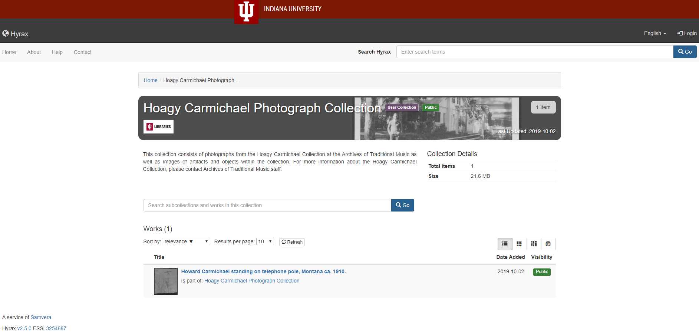
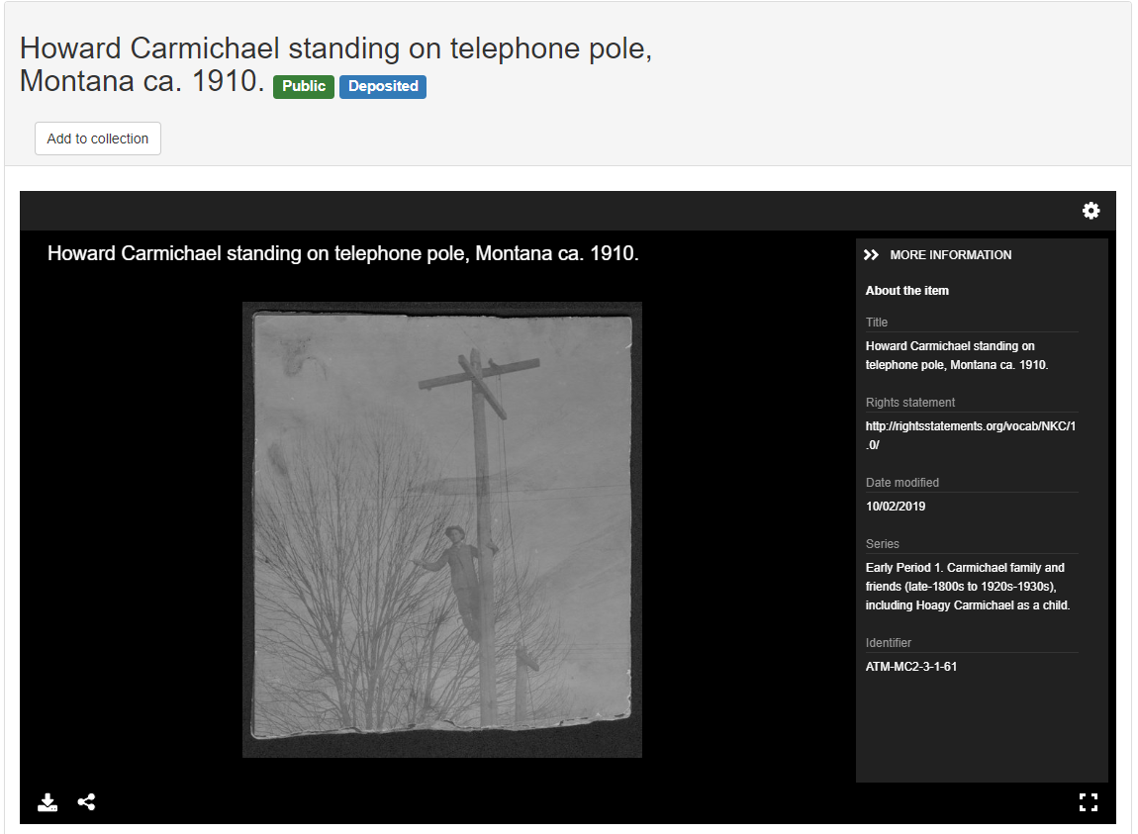
Image collections

Slide 23
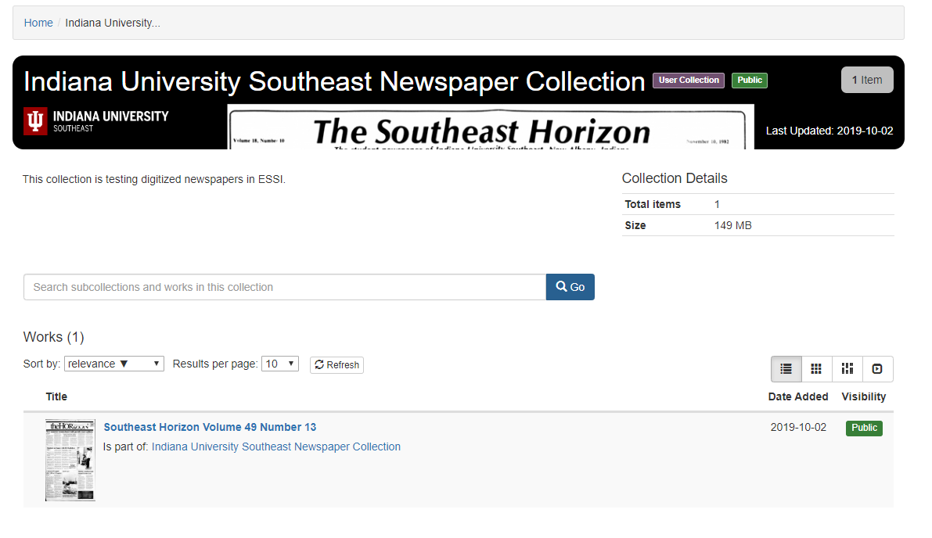
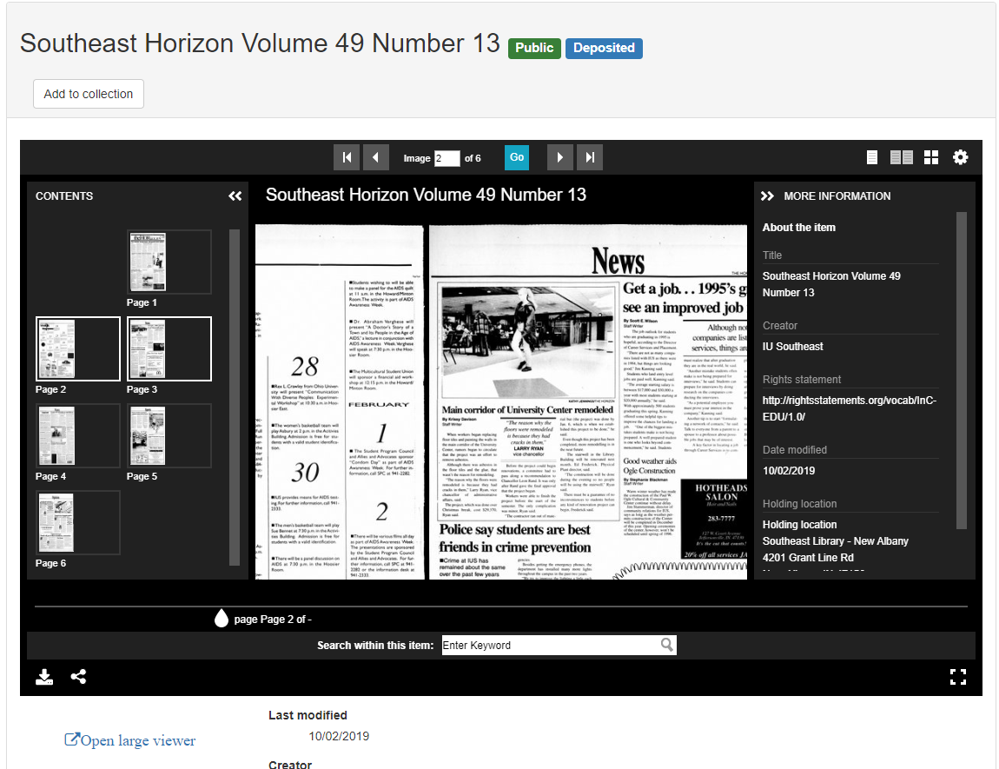
Newspaper collections

Slide 24
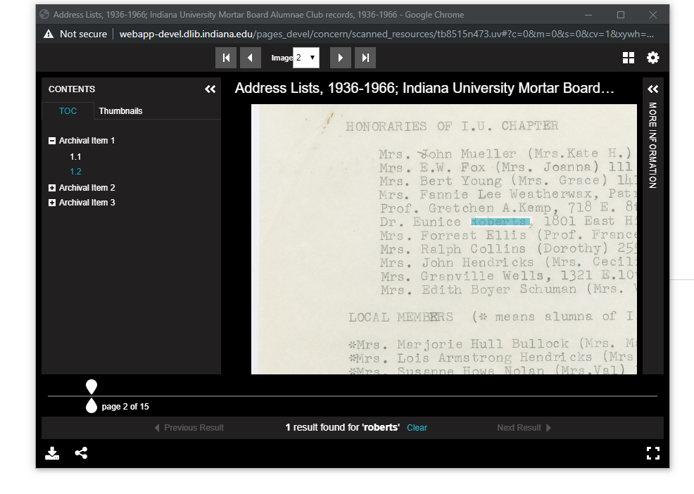
Archival paged content

Slide 25
Thanks:
Indiana University Purdue University Indianapolis
Notch8
Newspaper Works (Boston Public Library, University of Utah via IMLS)
https://github.com/IU-Libraries-Joint-Development/essi
https://github.com/samvera-labs/bulkrax
https://github.com/samvera-labs/allinson_flex

