Slide 1
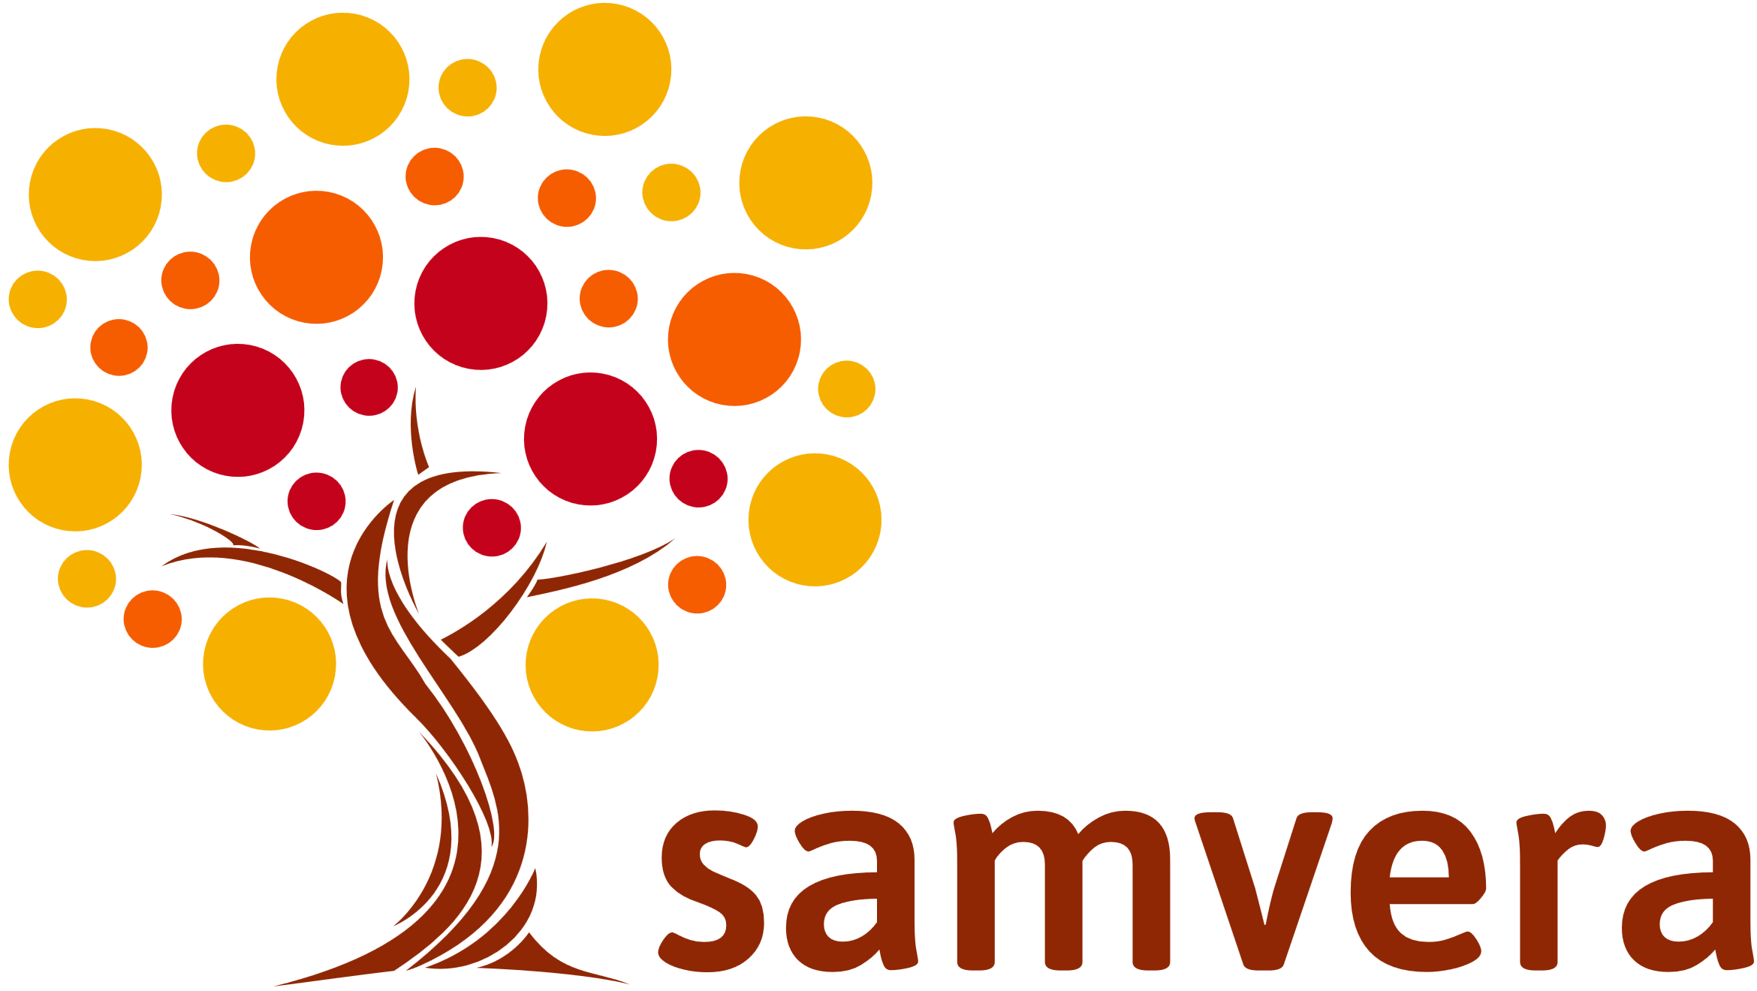
Workshop: An Introduction to Samvera
Samvera Connect University of Utah October 8, 2018
Steve Van Tuyl,
Julie Allinson,
Robin Ruggaber

Slide 2
Let’s Start with You
Introductions
What are your goals for this workshop?
What interested you in Samvera?
What are some things you would like to know more about?
Notes:
If less than 30 people, have people intro themselves. If we have a larger number, break into smaller groups to talk about why they are there. Count off for groups of 4-6, answer a set of questions, and then report back.
(Otherwise have them speak out what they are looking for.)

Slide 3
What we’ll cover
What is Samvera?
How We Work
Example Sites
Hands-On
Technical Details
The Samvera Pitch
What Next?
Q & A

Slide 4
Samvera Overview
What is it?
What does it do?
Why is it different?

Slide 5
What is Samvera?
A robust repository fronted by feature-rich, tailored applications and workflows
Collaboratively built “solution bundles” that can be adapted and modified to suit local needs.
e.g. Hyrax, Avalon, etc.
A community extending and enhancing the solutions
If you want to go fast, go alone. If you want to go far, go together.
Notes:
The only way to build a rich & robust solution is to engage a large community of developers. The only way to build a sustainable solution is to spur adoption by a community of institutions w/ vested interest in shared success.

Slide 6
Why Samvera?
Need a flexible, rich, robust repository solution
Be part of a community
Shared resources, shared risk, shared advances
The whole (we) is greater than its parts (each of us)
Especially in this crowd
Control your own destiny
Build institutional capacity
The way work is getting done now

Slide 7
Fundamental Assumption #1
No single system can provide the full range of repository-based solutions for a given institution’s needs,
…yet sustainable solutions require a common repository infrastructure.

Slide 8
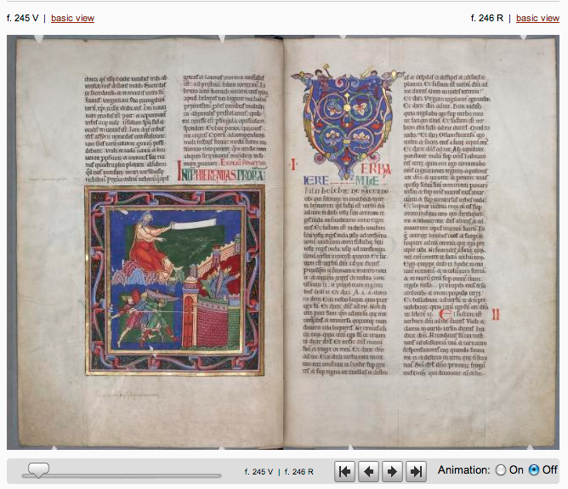
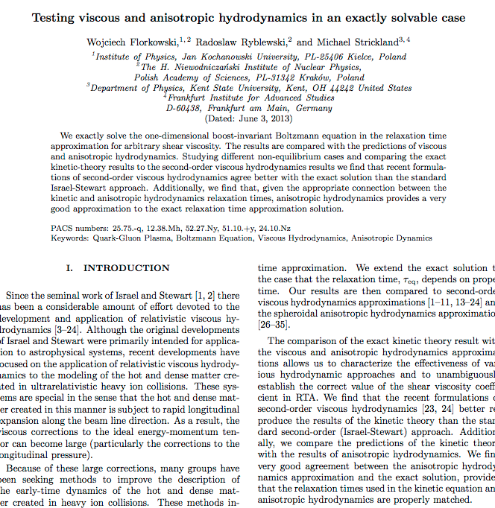
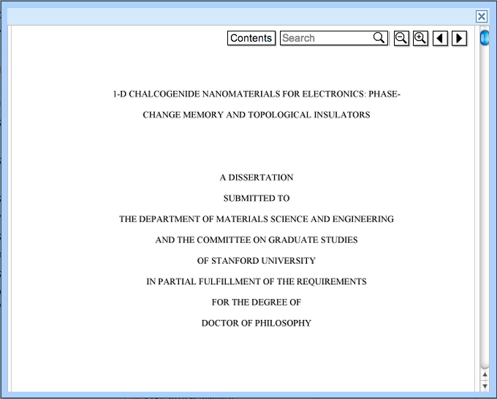
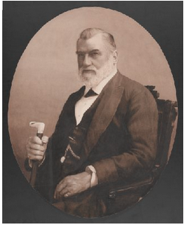
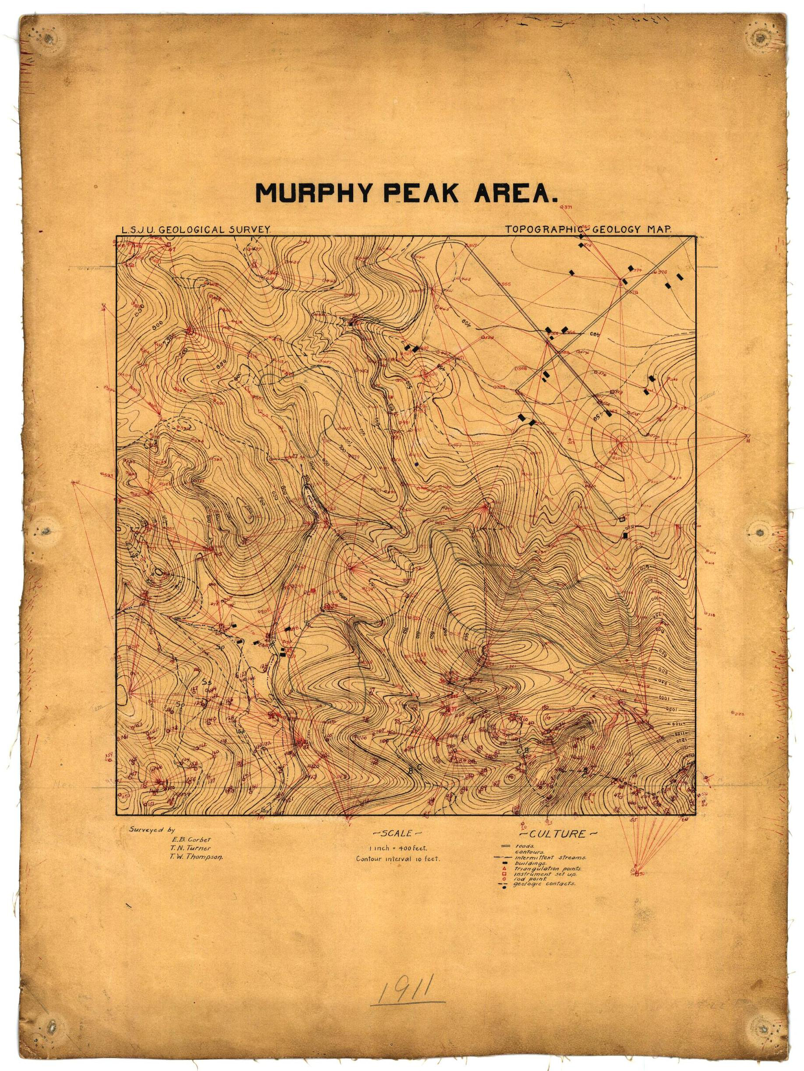
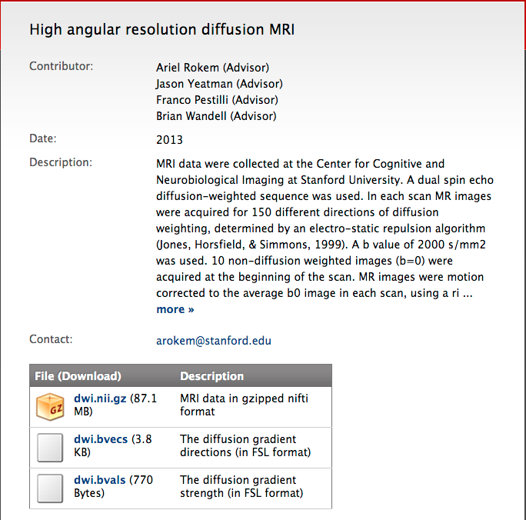
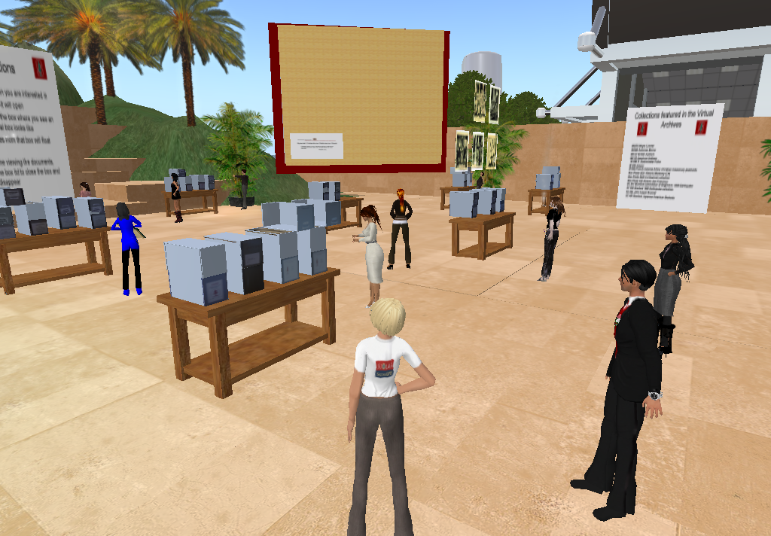
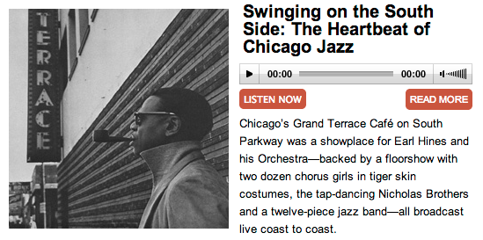
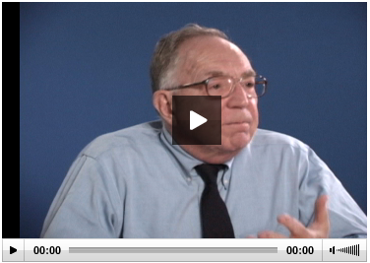
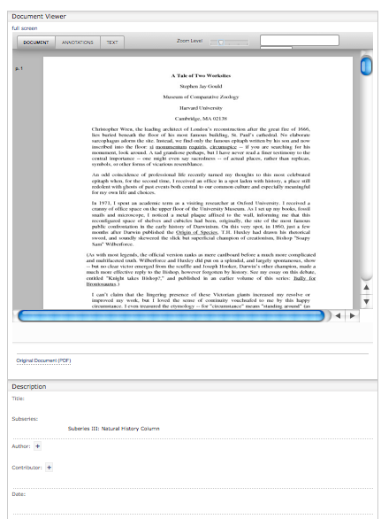
Books
Articles
Theses
Images
Maps
Data (Raster)
Data (Comp.)
Data (Observ.)
Audio
Video
Documents
Notes:
Theses are all the kinds of things that institutions want to keep and provide access to. They are different files formats, have different user access needs / UI, and are different sizes.

Slide 9
Point Solution Approach - Siloville!
ETD
IR
Image DB
DAM
?
Geospa-tial Inf.
Records Mgmt.
ETDs (Theses)
Books, Articles
Images
Audio-
Visual
Research Data
Maps & GIS
Documents
Management? Access? Preservation? Effective? Sustainable?
Notes:
So you could have a separate system solution for each type of item. and you would end up with many systems to support. probably all in a different code language, possibly managed by different depts, etc.

Slide 10
Repository Powered Approach
ETDs (Theses)
Books, Articles
Images
Audio-Visual
Research Data
Maps & GIS
Documents
Digital Repository
Scalable, Robust, Shared Management
and Preservation Services
Notes:
A single application could not effectively cope with these three use cases; however any institution would want to safeguard the outputs of all these disparate systems in a digital repository for management and preservation. Samvera gives a framework where ONE BODY (the repo) can support MULTIPLE HEADS (tailored applications)

Slide 11
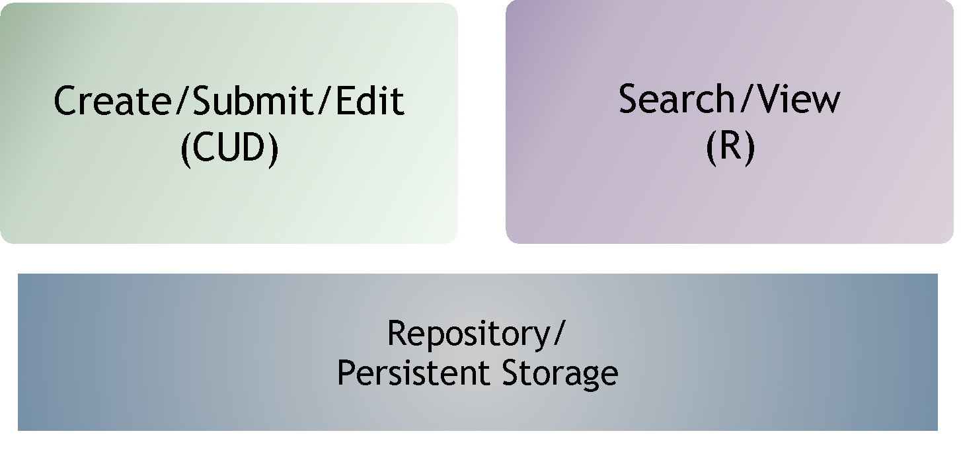
CRUD in Repositories

Slide 12
CRUD in Repositories

Slide 13
Used by: Used for:
Large Universities
Small Universities
Colleges
Public Broadcasting
Government Ministry
National Libraries
National Lab
Small Research Labs
National Digital Repository
Statewide Digital Libraries
Science History Institute
Museum of Performing Arts
A Shakespeare Festival
Self-deposit system
Digital Collections System
Sheet Music
Architectural resources
Electronic Theses & Dissertations
Digital Image System
Media Management
Media Preservation System
Research Data Management
Digitization Workflow System
Digital Preservation System
Digital Archives System
Library Monograph Acquisitions System
And more!
Notes:
Here are some of the current types of users and the use cases.

Slide 14
Next up:
How we work
How do I get involved?

Slide 15
Fundamental Assumption #2
No single institution can resource the development of a full range of solutions on its own,
…yet each needs the flexibility to tailor solutions to local demands and workflows.

Slide 16
Samvera Philosophy: A Community
An open architecture, with many contributors to a common core
Collaboratively built “solution bundles” that can be adapted and modified to suit local needs
A community of developers and adopters extending and enhancing the core
“If you want to go fast, go alone. If you want to go far, go together.”

Slide 17
The Samvera Way
Not a directed project
Investment in a framework, not an application
Contributions back to core code base
Investment in a community, not a vendor
Contributions back to community: Training, documentation, modeling, evangelism, support
Travel / face-time

Slide 18
Community
Conceived & executed as a distributed, collaborative, open source effort
Initially a joint development project between Stanford, Univ of Virginia, and Univ of Hull
Samvera Partners are the backbone of the project
Coalition of the willing
No fees or dues
Apache-style consensus and governance
Steering Group provides administration, continuity, and serves as backstop
But no central planning, no Project Director, no “one” architect

Slide 19
Community Structure
Steering Group (elected by partners) Stewards of the project - individual membership
Partners (Institutional) Formally committed institutional membership
Working & Interest Groups Topically aligned groups that span organizations & roles
Committers Developer community
Community adopters

Slide 20
Samvera Partners
…are individuals, institutions, corporations or other groups that have committed to contributing to the Samvera community; they not only use the Samvera technical framework, but also add to it in at least one of many ways: code, analysis, design, support, funding, or other resources.
Samvera Partners collectively advance the project and the community for the benefit of all participants.

Slide 21
Training & Connecting
Good: read the documentation and learn-by-doing
Better: connect through social channels
Email lists, IRC, weekly phone calls
Github interactions
Best: meet in person. Face time fuels collaboration!
Samvera Connect: annual, worldwide, community meeting
Samvera (Partner) meetings: 3-6 ad hoc, topic-based meetings per year (usually)
Regional Groups: convening ad hoc

Slide 22
Get Involved: Many Hands Make Light Work
Getting involved with Samvera can be at different levels:
Adopter
Developer
Partner
Need to ask:
What involvement is required to enable you to meet your needs?
But also,
If we contribute back, what more do we gain?

Slide 23
Stay Connected
Website (http://samvera.org)
Wiki page (https://samvera.org/wiki)
Partner meeting agendas & notes
Events & Details
Monthly Partner calls
Partner listserv
Samvera Partner meetings & Samvera Connect
Identify a Samvera Partner doing similar work and get in touch
Identify need for vendor input and make contact to discuss options
Come to events (like this one!)

Slide 24
Interest & Working Groups
Collection Extensions Working Groups
Component Maintenance Working Group (Phase 1)
DSpace/Samvera Interest Group
Hyrax Analytics Working Group
Repository Management Interest Group
Samvera Applied Linked Data Interest Group(formerly WG)
Samvera Archivists Interest Group (formerly WG)
Samvera Code Stability Working Group
Samvera CONTENTdm Migration Interest Group
Samvera Contribution Model Working Group
Samvera Data Mapper Working Group
Samvera Documentation Working Group
Samvera EZID to DataCite DOI Working Group
Samvera Geo Predicates Working Group
Samvera Geospatial Interest Group
Samvera Governance Working Group
Samvera Hyrax Batch Import Export Working Group
Samvera Marketing Working Group
Samvera Metadata Interest Group (formerly WG)
Samvera Newspapers Interest Group
Samvera Permissioning Analysis and Design Working Group
Samvera Interest Group for Advising the Hyrax Roadmap (SIGAHR)
Samvera URI Selection Working Group
Samvera User Experience Interest Group

Slide 25
Communication Channels
Slack - for real-time interaction
E-mail - for asynch and longer discussions
Community Calls - Samvera Tech & Community calls, Virtual Connect
In Person - Connect, regional meetings, other conferences, & workshops

Slide 26
Community Resources
Website - Introduction to the community: https://samvera.org
Wiki - Broad range of information types: https://samvera.org/wiki
Github - Code, code wikis, technical details:
https://github.com/samvera https://github.com/samvera-labs https://github.com/samvera-deprecated

Slide 27
Code Licensing
All Samvera code is available under Apache License, Version 2.0
All code commitments are being managed through Contributor License Agreements
Individual – each developer is clear about what they are contributing
Corporate – each institution is clear about what it is contributing
Code contributors maintain ownership of their IP
…and grant a non-exclusive license to the project and its users

Slide 28
Example sites
What are folks doing with Samvera?

Slide 29
Indiana University: Media Collections Online
Built using the Avalon Media System
Rich tool for management and discovery of audio and visual resources
Provides gated discovery and streaming authentication
Live Site: https://media.dlib.indiana.edu

Slide 30
Alexandria Digital Research Library
Fedora 4 + RDF based
Broadly focused Institutional Repository hosting multiple content types
Includes a mix of born digital and digitized content
Live Site: https://www.alexandria.ucsb.edu

Slide 31
Earthworks
Heterogeneous GIS Content
Search and browse augmented by spatial search functions
Includes content harvested from multiple sources
Live Site: https://earthworks.stanford.edu

Slide 32
King’s Fund Digital Archive
Running on Hyku software
Digitised publications by the King’s Fund
Heavy use of IIIF and Universal Viewer
Live Site: https://archive.kingsfund.org.uk/

Slide 33
Emory ETD Repository
Hyrax Development
Electronic Theses and Dissertations focus
Student submission and workflow focused
Live Site: https://etd.library.emory.edu

Slide 34
Hands-On
Any questions so far?

Slide 35
Create an account
Visit http://connect18.demos.leaf.ulcc.ac.uk
Click the Login link
Click on “Sign Up” (just under the Login button)
Enter your e-mail, choose a password, and click on “Sign Up”

Slide 36
Deposit a new work
Click on the logo in the upper left corner
Click on the “Share Your Work” button
Select a type of work
Add required metadata, attach a file, choose visibility, accept the deposit agreement
Save your work

Slide 37
Edit your work
Choose “Dashboard” from the menu in the upper right corner
Click on Works
Use the “Actions” dropdown to choose edit
Enter some data in “Additional Fields”
Add a file or two, update versions

Slide 38
Browse content
Click on the logo in the upper left
Click on the search icon to browse the repository
Use search and facet to narrow results
View some items
Is your item there?
Log-out - how does your experience differ?

Slide 39
Deposit a new work
Reminder: Logo, Share, Select
Add required metadata, attach a file, choose visibility, accept the deposit agreement
Save your work

Slide 40
View your work?
Reminder: dashboard, works
What do you see?
What does your administrator see?
Approve some works (Admins)
All Works
Review Submissions
Notifications

Slide 41
Other features to try
Everyone
Gated discovery: Public, UoL, Private
Collections
Admins
Featured works
Workflow / Review
Admin dashboard

Slide 42
Tech details
Any questions so far?

Slide 43
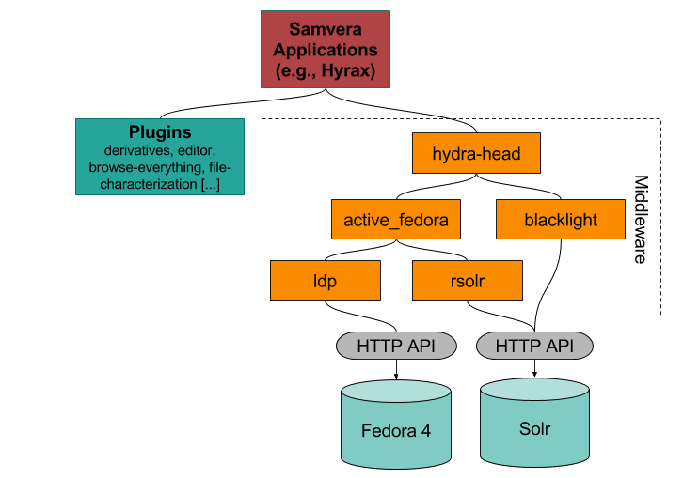
Major Components

Slide 44
A Note on Fedora
Flexible, Extensible, Durable Object Repository Architecture
Flexible: model and store any content types
Extensible: easy to augment with apps and services
Durable: foundation of preservation repository
Proven, sustained and successful digital repository
100’s of adopters; 13 years of development, 4 major releases
Vibrant community & funding under DuraSpace

Slide 45
Current status of Fedora
Fedora 4.0 released in Dec 2014
Major rewrite, incompatible with Fedora 3 and earlier
Current release: 4.7.5 as-of 12th February 2018
Fedora 5, in development
Compatible with Fedora 4
API specification to allow multiple Fedora software implementations

Slide 46
A Note on Rails
Rapid application development for web applications: “Convention over configuration”
10x productivity
Supportable: 14 years of production use with major implementations across the internet - Github, Airbnb, Square, and 1000s of others
Testable: Rspec & Capybara give powerful, automatable, testing tools
Learnable: Stanford went from 1 to 8 Ruby savvy developers in one year (no new hires)
1 week learning curve to basic proficiency

Slide 47
Hyrax Repository Engine
Feature Rich
Complex objects based on PCDM in Fedora 4
Evolved from Sufia 7, one of most actively maintained and widely used community gems

Slide 48
Hyku
Availability: DIY, Hosted (via several service providers)
Goal: turnkey ease of installation and management
Goal: Provide configured version of Hyrax with multitenancy

Slide 49
The Stack
Samvera is designed to provide a rich front-end framework for a Fedora based repository. We use Solr to index, search, and discover content in the application.
Fedora & Solr

Slide 50
The Stack
The ActiveFedora gem provides an interface for rails based applications to interact with Fedora and Solr. This allows developers to focus on user facing application features instead of re-inventing low-level repository interfacing.
ActiveFedora
Fedora & Solr

Slide 51
The Stack
Using the Portland Common Data Model (PCDM) gives the community a common data modelling tool-set. This, in turn, supports a much broader range of code reuse at higher levels.
PCDM simplifies the creation of complex works and collections.
Hydra::PCDM
ActiveFedora
Fedora & Solr

Slide 52
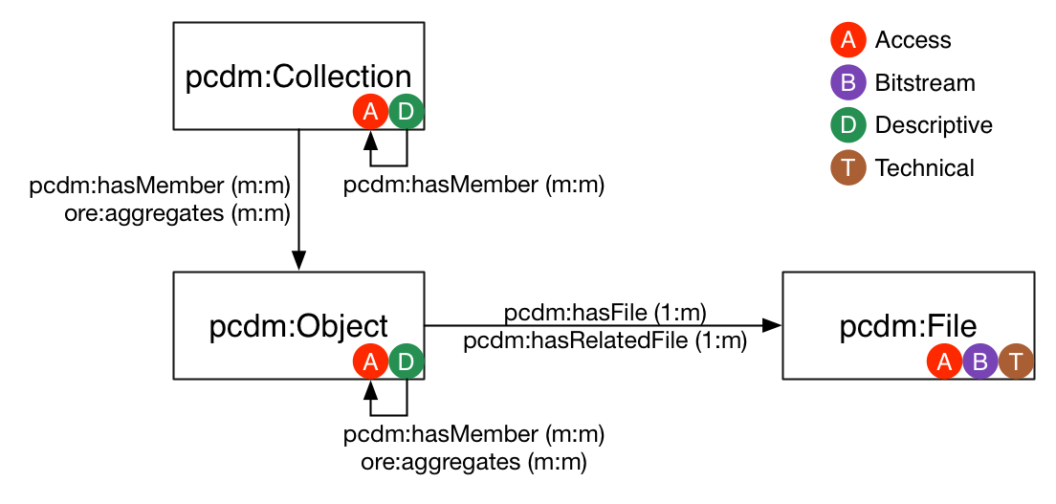
PCDM (interlude)

Slide 53
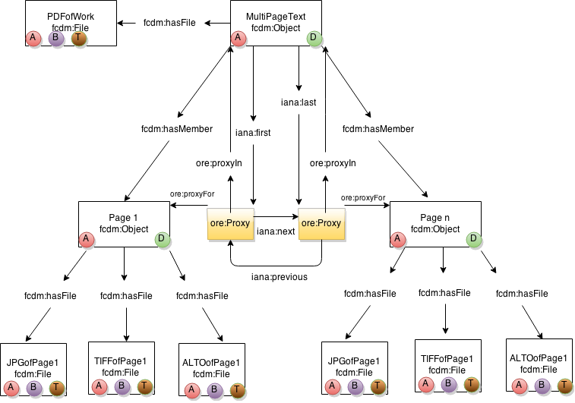
Book modelled in PCDM

Slide 54
The Stack
The Works gem provides the utility drawer for managing digital content by defining common patterns for:
File Characterization
Derivative Generation
Virus Scanning
Text Extraction
You can tailor any of these to local requirements, but get working solutions out of the box.
Hydra::Works
Hydra::PCDM
ActiveFedora
Fedora & Solr

Slide 55
The Stack
The Hyrax rails engine provides a fully featured repository front end with self-deposit and administrative workflow features along with:
User & Admin dashboards
Upload via cloud providers
Citation integration
File auditing & versioning
Access controls
Leases and embargoes
Hyrax (optional)
Hydra::Works
Hydra::PCDM
ActiveFedora
Fedora & Solr

Slide 56
The Stack
Your Application
Your own ruby-on-rails application can be a very lightweight wrapper around an existing application like Hyrax or Avalon, or a highly tailored in-house solution depending on your needs and your team’s capabilities.
Hyrax (optional)
Hydra::Works
Hydra::PCDM
ActiveFedora
Fedora & Solr

Slide 57
The Samvera Elevator Pitch
Who’s riding?
UL/Dean or CIO? Resources and Risk - doing more with less while control the runway, maturity
Content Specialists? Flexibility and Risk- reducing barriers to effective asset management & preservation
Management - The Churn - Architecture, flexibility, evolution in a vibrant community, staffing impact
Developers, PMs, DevOPs, -Connection, Time, Training, Visibility - It’s a Family Affair and you are not alone

Slide 58
Community sustainability
Core Purpose- We believe it is possible to provide and evolve solutions which reduce cost and risk in stewardship of digital assets for access and preservation.
Partners - The whole is greater than the sum of its parts - partners join equally to share the load for mutual gain and greater good.
Flexible Change with Steady Growth

Slide 59
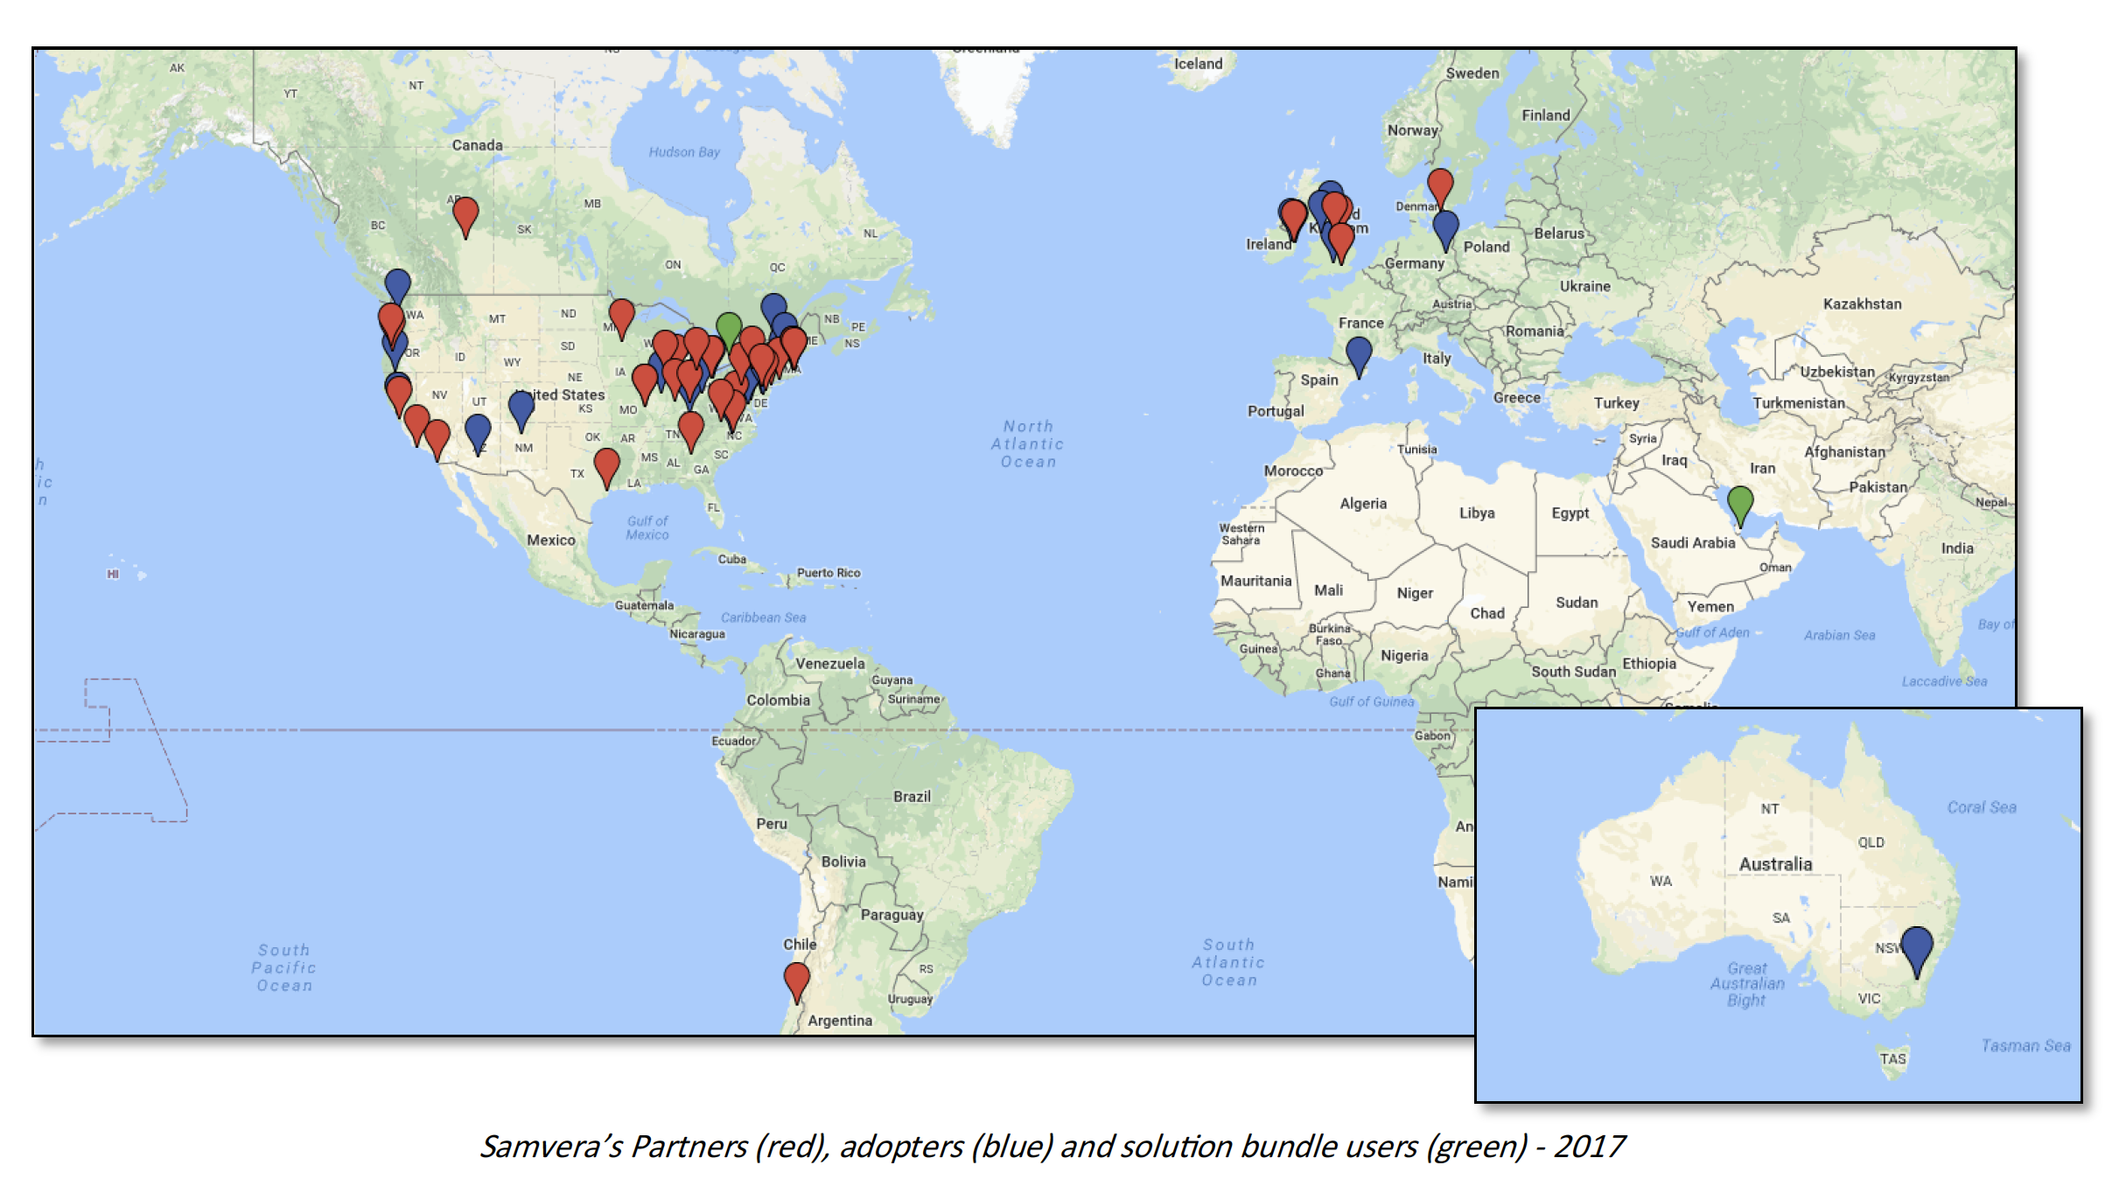
A Worldwide presence
Notes:
Adopters include: a theater institute, a Shakespeare Festival, Australian Dept of the Environment, a Chemical Heritage Foundation, Arizona State’s Nexus Lab for Humanities Research) ,
National Library (Ireland, Denmark), Art Museum (1), Art Institute (1), 1 National Lab, 1 National digital repository, 2.5 national libraries (DPLA = half), a boatload of universities.
Northwestern likes it so much, they adopted twice: once in the Library, once in the Galter Heatlh Science Library.

Slide 60
Samvera Partners
DuraSpace
Stanford University
University of Hull
University of Virginia
University of Notre Dame
Northwestern University
Columbia University
Penn State University
Indiana University
London School of Economics and Political Science
Data Curation Experts
WGBH
Boston Public Library
Duke University
Yale University
Virginia Tech
University of Cincinnati
Princeton University Library
Cornell University
Oregon State University
University of Oregon
Tufts University
University of Alberta
Digital Public Library of America (DPLA)
University of Michigan
University of California, San Diego
University of York
Lafayette College
Washington University in St. Louis (WUSTL)
The Digital Repository of Ireland
University of California, Santa Barbara
University of Houston Libraries
Emory University
CoSector, University of London
As at October 2018
Notes:
The only way to build a rich & robust solution is to engage a large community of developers. The only way to build a sustainable solution is to spur adoption by a community of institutions w/ vested interest in shared success.

Slide 61
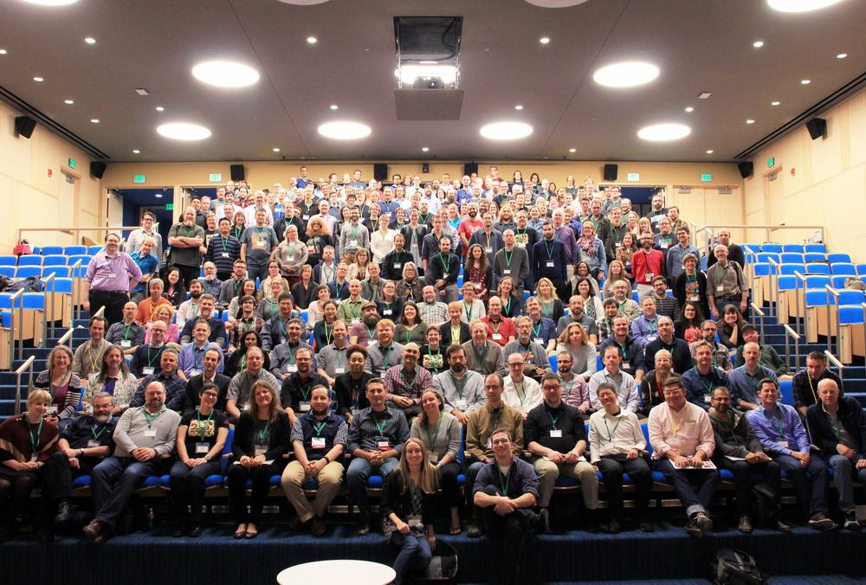
Notes:
In addition to project staff from DPLA, DuraSpace, and Stanford working on the repository product, we’ve had development contributions from Chemical Heritage Foundation, Indiana University, and Indiana University–Purdue University Indianapolis, Penn State and Northwestern.

Slide 62
Resource Sustainability
New Approach for Cross Training
Reducing Turnover Impact
Time - If you want to go fast … go alone Use Samvera!

Slide 63
Solution Sustainability
Protecting the partner & funders’ investment - together build, leverage & evolve
Organization & Governance
Adopt best practices

Slide 64
Samvera Code Snapshot (Oct 2018)
1.49M Lines of code
101 Current contributors
19 hours since the last commit
Activity Rating by Open Hub? Very High

Slide 65
What next?
What do I do back home?

Slide 66
Community Resources
Website - for the managers https://samvera.org
Wiki - for the doers https://samvera.org/wiki
Github - for the makers https://github.com/samvera https://github.com/samvera-labs https://github.com/samvera-deprecated

Slide 67
Try it out
https://github.com/samvera
Demo Sites:
https://tenejo.curationexperts.com/
http://connect18.demos.leaf.ulcc.ac.uk
Ask other partners for demos!
https://wiki.duraspace.org/display/samvera/Partners+and+Implementations

Slide 68
Questions
samvera-community@googlegroups.com
samvera-tech@googlegroups.com
Thank you

