Slide 1
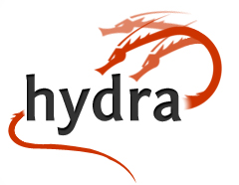
Hydra Technical Directions: Linked Data, Fedora 4, etc.
Mark Bussey
Chief Information Leafblower

Slide 2
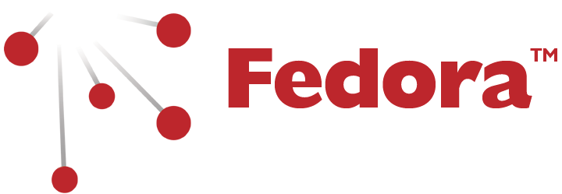
My View of Hydra
Preserve
Notes:
Fedora 3 was built from the ground up to support archival and preservation needs
Fedora 4 took the decade of experience with Fedora 3 and applied best practice and standards developed in the broader internet

Slide 3
My View of Hydra
Preserve
Discover

Slide 4
My View of Hydra
Preserve
Discover
Manage

Slide 5
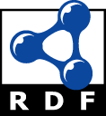
My View of Hydra
Preserve
Discover
Manage
Share
✚
✚
✚
Notes:
Hydra is making the changes necessary to make it a linked data ready platform

Slide 6
Where Hydra Is Headed
Continued collaboration & Recycling
Web-scale standards – RDF, WAC, IIIF, etc.
(Portland) Common Data Model - PCDM
Linked Data
Notes:
Hydra leverages the experience and insight of a diverse group of individuals across a diverse group of libraries, archives, museums, and other cultural heritage institutions. This broader perspective accelerates development, improves functionality, and increases sustainability
Hydra is building on a suite of widely adopted web standards in use both in and outside the library and cultural heritage community
This lets us take advantage of technologies and developments from a much broader community
This positions us to share our content with much broader communities
We’re at the cusp of a shift from iindividualized data exchange implementations to a suite of common, standards based tools that allow hydra to integrate with broader workflows and ecosystems
Hydra is in use to manage and deliver text, images, audio, video, specialized datasets, and arbitrary digital assets.

Slide 7
Broad Internet Standards
Europeana & DPLA metadata profiles
Fedora 4 on Modeshape datastore
IIIF Integrations – client & server
Increased Shared Vocabulary support
PCDM implementation based on LDP
RDF to support Linked Data
Resource sync
W3C Access Controls

Slide 8
Collaboration & Recycling
Audio + Video – HydraDAM2
WGBH + Indiana University project to extract and share features between HydraDAM (management focus) and Avalon (distribution)
Spotlight + Sufia
Yale University + DCE project to allow creation of exhibits using self-deposit content
Spotlight + Avalon
Indiana University + DCE project to allow creations of exhibits based on audio and video content from Avalon
“Turnkey” Hydra
DPLA + DuraSpace + Stanford project to produce a feature complete easy to deploy hydra-head

Slide 9
Why Linked Data In Libraries (from a technology standpoint)
Human and Machine friendly
Web of knowledge vs. Repository silos
Just a continuation of OAI PMH principles* *but using w3c standards
Notes:
Not just an HTML presentation of your content, and not just XML – jsonld, turtle, ntriples, rdfa, rdf-xml
Based on open world assumptions – the object URI is authoritative (and suggests who owns it), but anyone can make additional assertions about it. Encourages shared knowledge
The Open Archives Initiative Protocol for Metadata Harvesting (referred to as the OAI-PMH in the remainder of this document) provides an application-independent interoperability framework based on metadata harvesting. - from http://www.openarchives.org/OAI/openarchivesprotocol.html RDF is intended for situations in which information on the Web needs to be processed by applications, rather than being only displayed to people. RDF provides a common framework for expressing this information so it can be exchanged between applications without loss of meaning. - http://www.w3.org/TR/2014/NOTE-rdf11-primer-20140225/

Slide 10
Europeana LOD Overview
Click the link below to view the video: Linked Open Data - What is it?

Slide 11
In Summary
Hydra to-date
Sharable Code
Hydra from-here
Shared Code + Sharable Content

Slide 12
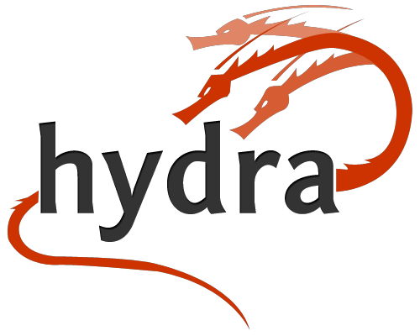
Thank You
http://projecthydra.org

Slide 13
Resources
RDF Primer: http://www.w3.org/TR/rdf11-concepts/
LDP Primer: https://dvcs.w3.org/hg/ldpwg/raw-file/default/ldp-primer/ldp-primer.html
Web Access Controls http://www.w3.org/wiki/WebAccessControl
Modeshape http://modeshape.jboss.org

