Slide 1
Patterns for Internationalization (i18n)
Bess Sadler
Hydra Connect 2014

Slide 2
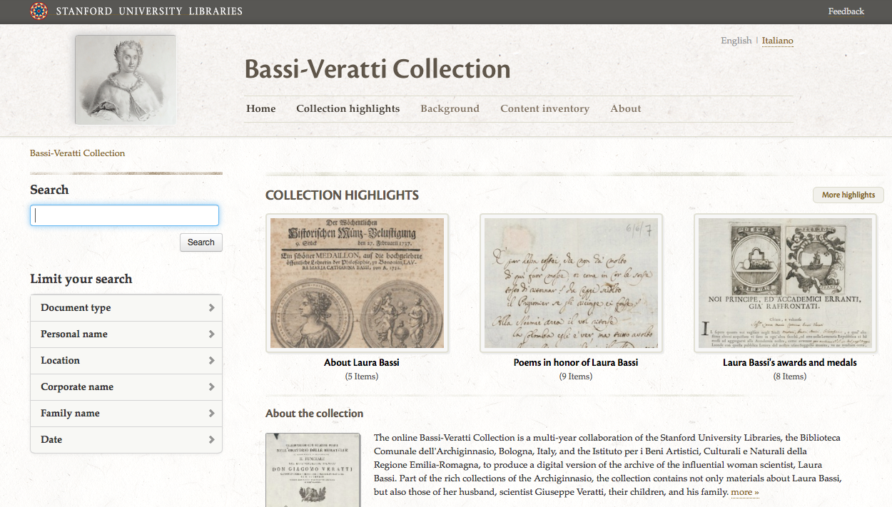
http://bv.stanford.edu

Slide 3
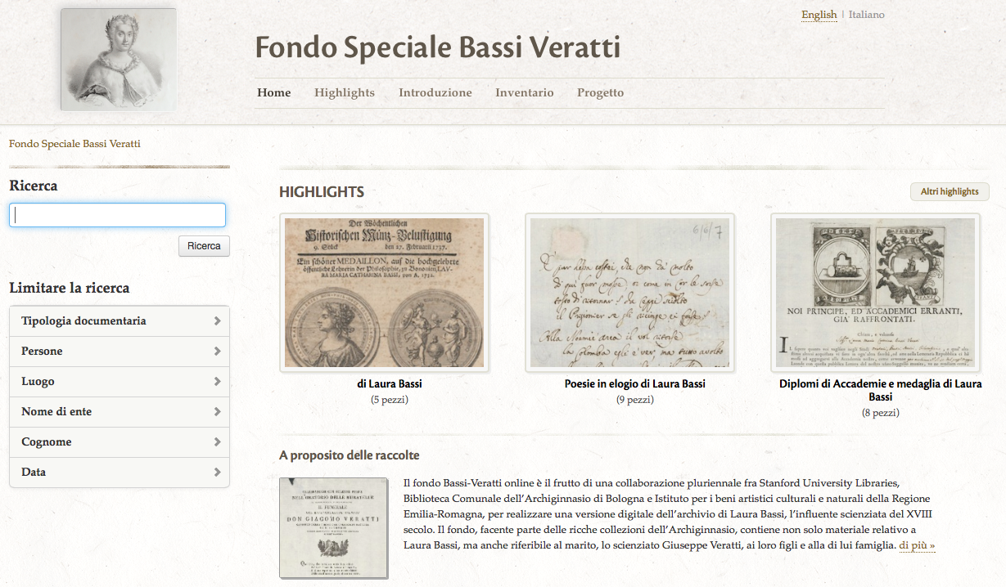
http://bv.stanford.edu/it/catalog

Slide 4
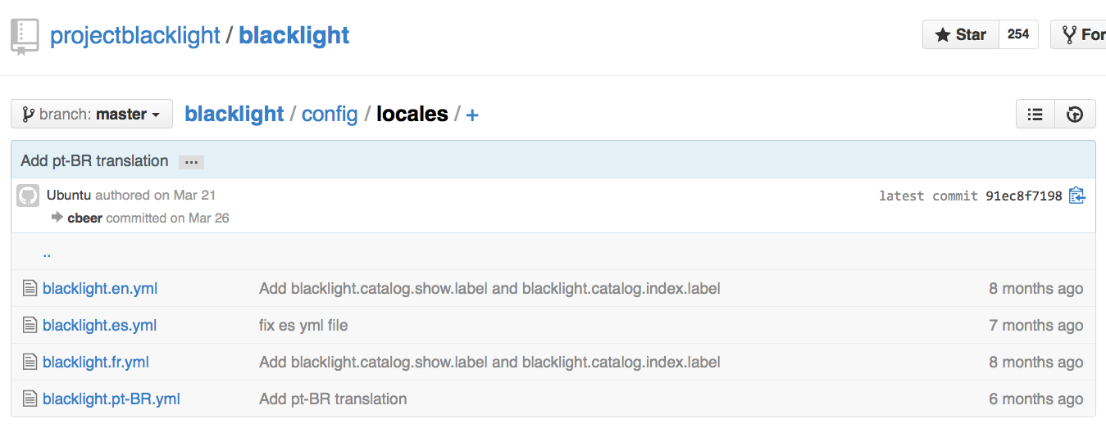
i18n in Blacklight
https://github.com/projectblacklight/blacklight/tree/master/config/locales

Slide 5
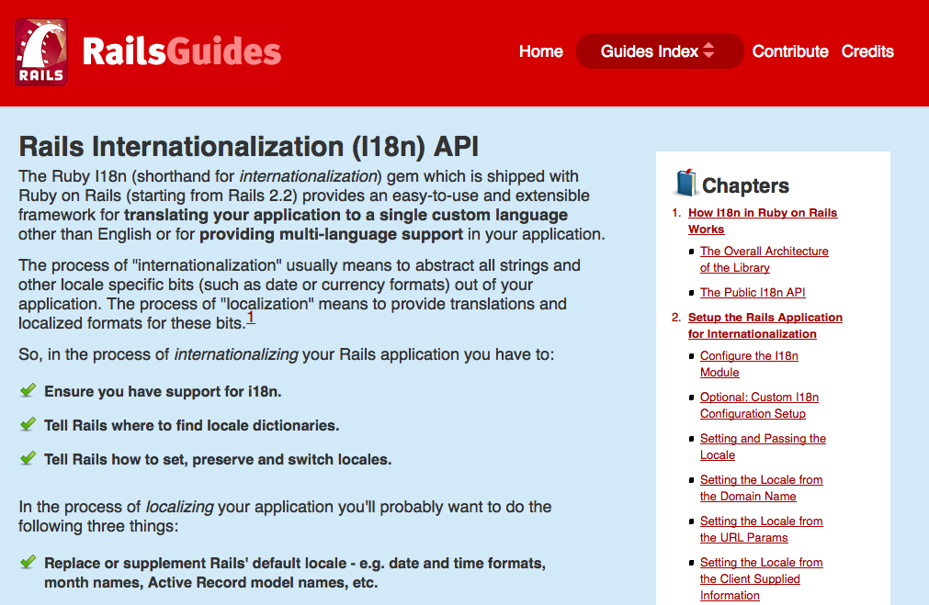
i18n in Rails

Slide 6
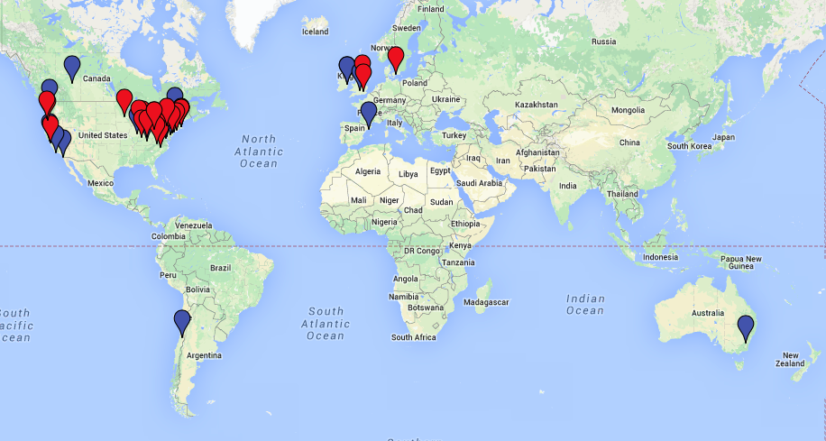
Hydra Worldwide

Slide 7
i18n for our community
http://www.duoc.cl

Slide 8
Next Steps
Please, i18n your code!
Website translation, restructuring of web resources for multi-lingual audiences
Expect more ESL speakers on mailing lists
Growth of local non-English communities
Other suggestions?
bess@stanford.edu

