Slide 1
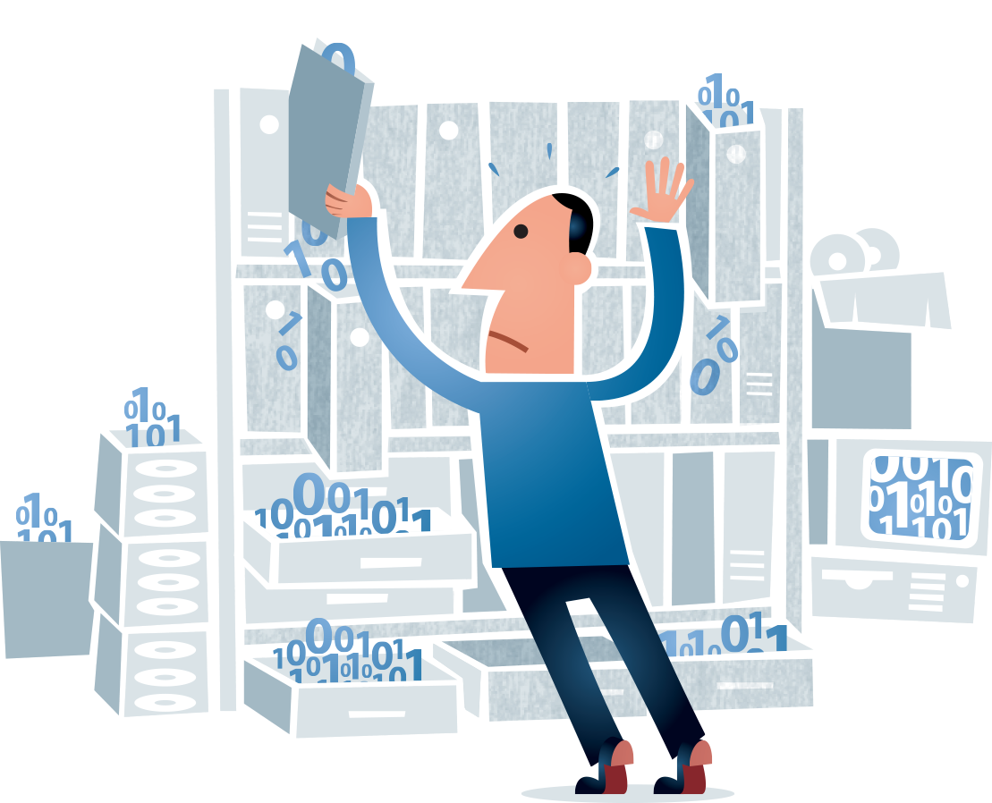
Hydra Digital Preservation Working Group
Chair of DPWG
Christen Hedegaard
The Royal Library
Copenhagen, Denmark

Slide 2
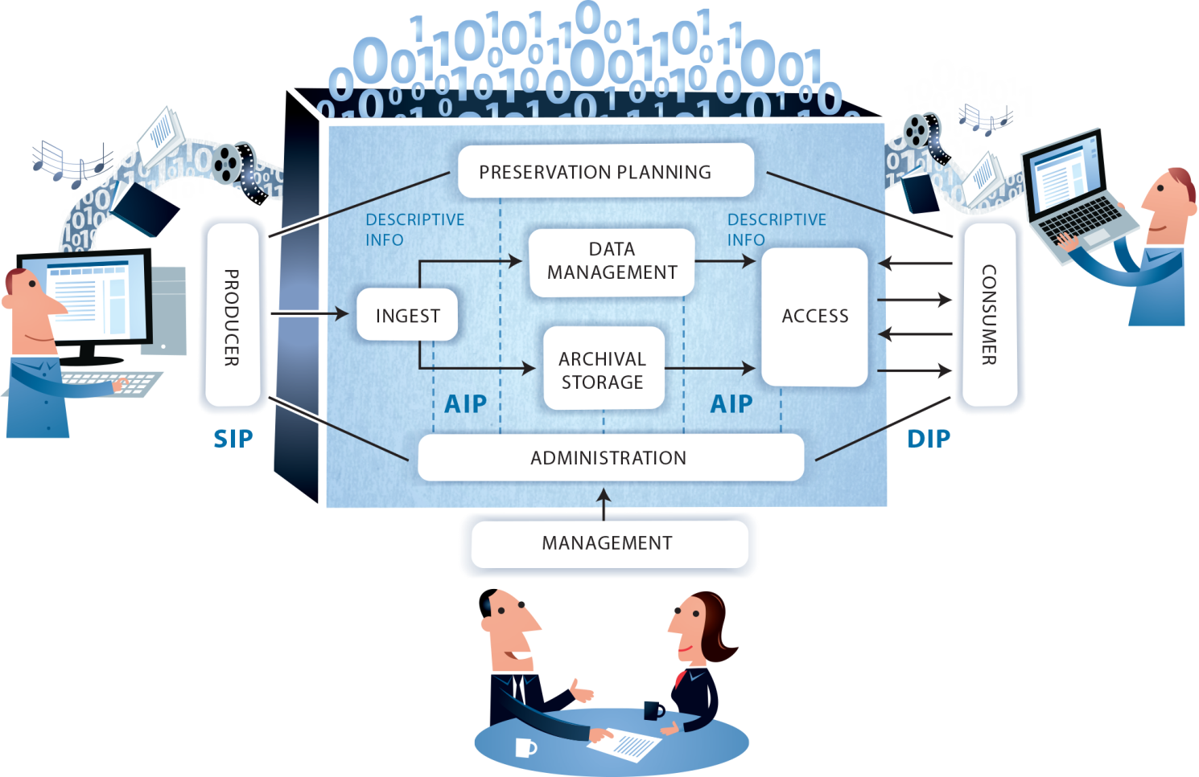
Hydra DPWG
What is Digital Preservation?
“Digital preservation is the active management of digital content over time to ensure ongoing access”. (loc.gov)

Slide 3
Hydra DPWG
Why Hydra DPWG?
Proposal from the Hydra Power Steering Group April 2014
At the June kick-off meeting a Charter for DPWG was agreed

Slide 4
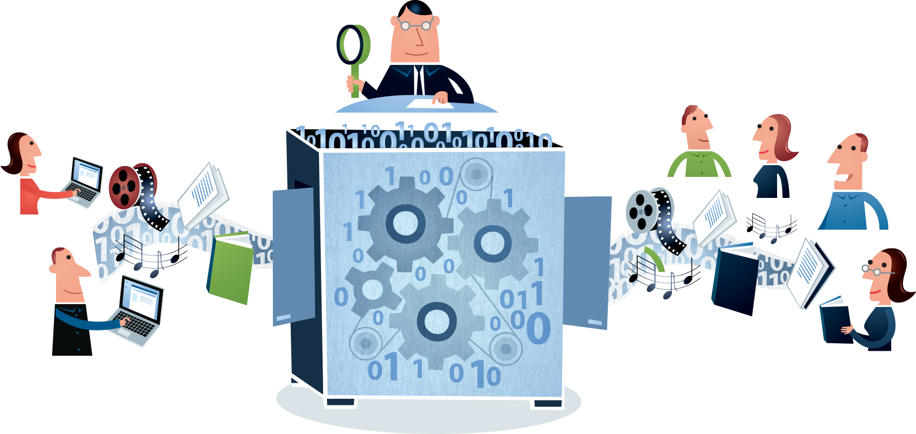
Hydra DPWG
Areas of interest for DPWG.
Preservation tools (Characterisation, validation, normalization....)
Bit Preservation and Functional Preservation
Digital preservation based on risk management
Trusted Digital Repositories
Preservation planning
Policy and strategy
Metadata

Slide 5
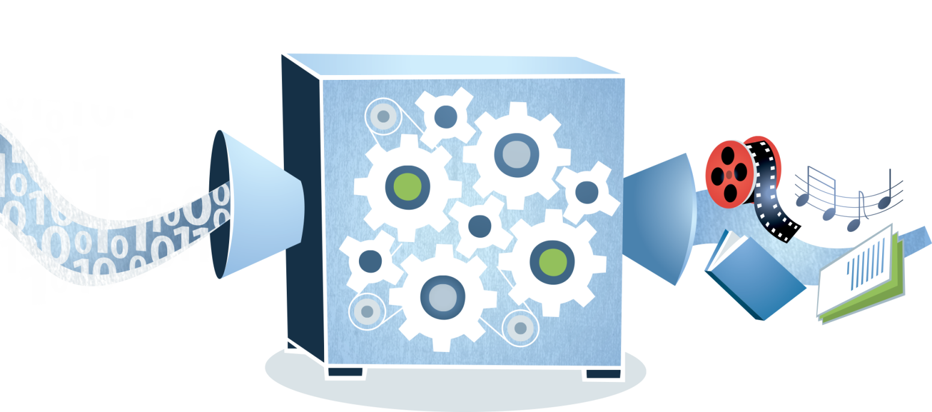
Hydra DPWG
The role of DPWG in the Hydra community.
Integrate tools from the Digital Preservation communities into the Hydra environment.
Find best practice for integration/wrapping of Digital Preservation tools in Hydra based systems
Integrate best practices from the Digital Preservation communities.

Slide 6
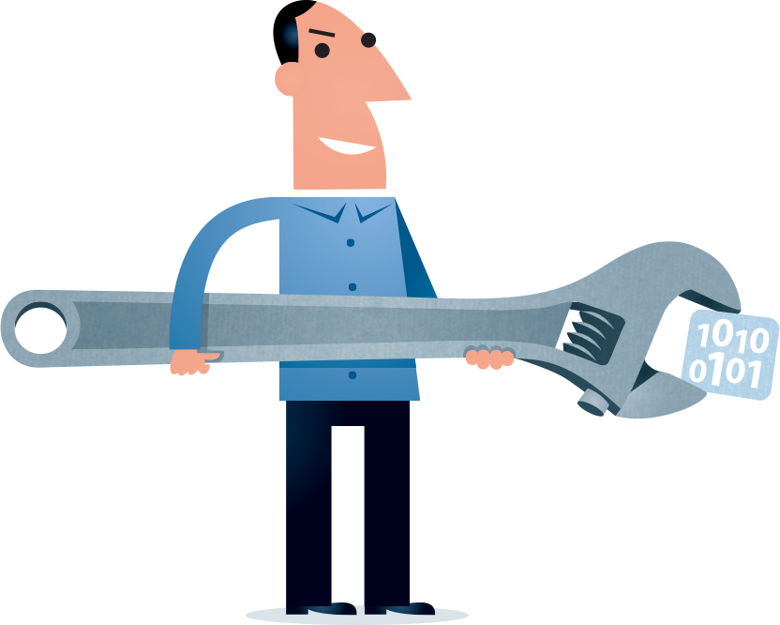
Hydra DPWG
Highlights DPWG agenda at Hydra Connect #2
Presentation of Digital Preservation activities in a Hydra environment
Example: Hydra system for digital accession and long term preservation of print ready PDF's
Discussion of Digital Preservation topics relevant to Hydra community
Example: Preservation planning

Slide 7
Hydra DPWG
Remember to mark your calendar out for the DPWG meeting.
Images by Jørgen Stamp from www.digitalbevaring.dk

