Slide 1
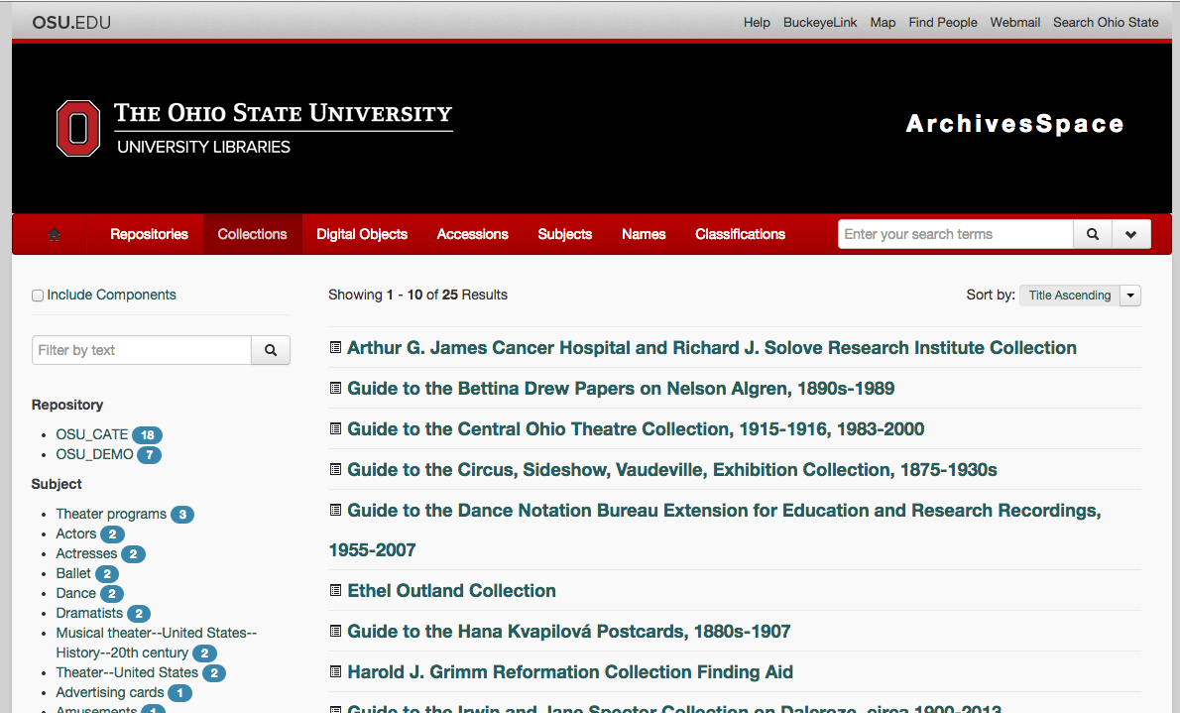
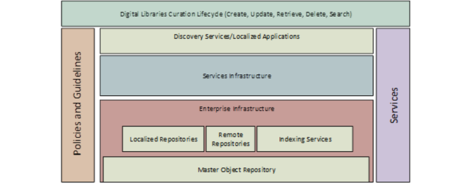
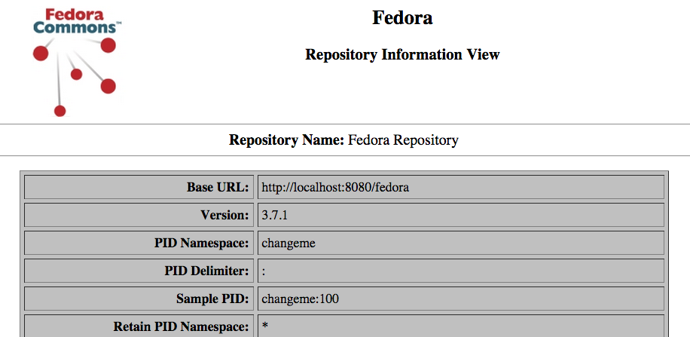
Digital Initiatives at Ohio State
Ousmane Kebe, Emilie Meade, Sarah Reid, Russell Schelby, Dwight Scott
–
University Libraries
Overview
Digital Initiatives
The Ohio State University Libraries has redoubled its commitment to digital initiatives, including:
Creating a Digital Initiatives Department
Increasing Staffing in IT
Developing a Program-focused model for DI
Purchasing Server & Storage network
Beginning Work
Developing Programs & Governance Structures
Establishing Guiding Principles
Framing Organizational Change
Who’s Who at OSU?
Beth Warner, Assistant Director of IT
Beth Snapp, Head of Applications, Development, & Support
Terry Reese, Head of Digital Initiatives
Ousmane Kebe, Developer AD&S
Emilie Meade, Developer AD&S
Sarah Reid, Developer AD&S
Dwight Scott, Developer AD&S
Russell Schelby, Scrum Master AD&S
Lots and lots of Stakeholders!
Archival Management System
ArchivesSpace
Software selected, branded, tweaked, installed
Special Collections Cataloging as Product Owner
8 Special Collections to be described here
Seeking Answers
Here are some questions that we’re looking for answers to while we’re here at Hydra Connect 2014. Please write suggestions, or a ‘me too’ !
How can we organize what Hydra ‘tools’ we use?
Is there a good ‘taxonomy’? Best Practices?
Can we add image workflows to Avalon?
What does a Best Practice backup and recovery strategy look like?
How can we integrate ArchivesSpace and our Hydra-based Image Management System?
How can we tie all of our Front End functionality together? Our Back End functionality?
What are the benefits of having multiple workflow engines, e.g. a Video and an Image ingest?
Archival Management System, Staging
CONTACT US
We have tried to come up with some conversation starters, so if you want to continue the conversation,
e-mail libwit@lists.osu.edu .
Architecture
Conceptual model of program
Certain technical decisions e.g. Hydra, ArchivesSpace
Convened working groups for metadata, workflows, preservation, governance
How We Roll
Agile
Project VS. Service
Development/Staging/Production
Single-Function Virtual Machines
JIRA/Confluence/AgileTBD
Image Management System
Hydra, Fedora, TBD
User-Story writing workshops with stakeholders
Sort & Prioritize ~250 User Stories
User Interface sketches
Begin identification of Tools
Digital Initiatives Conceptual Model
Default Fedora Instance, Development
http://library.osu.edu/blogs/it/

