Slide 1
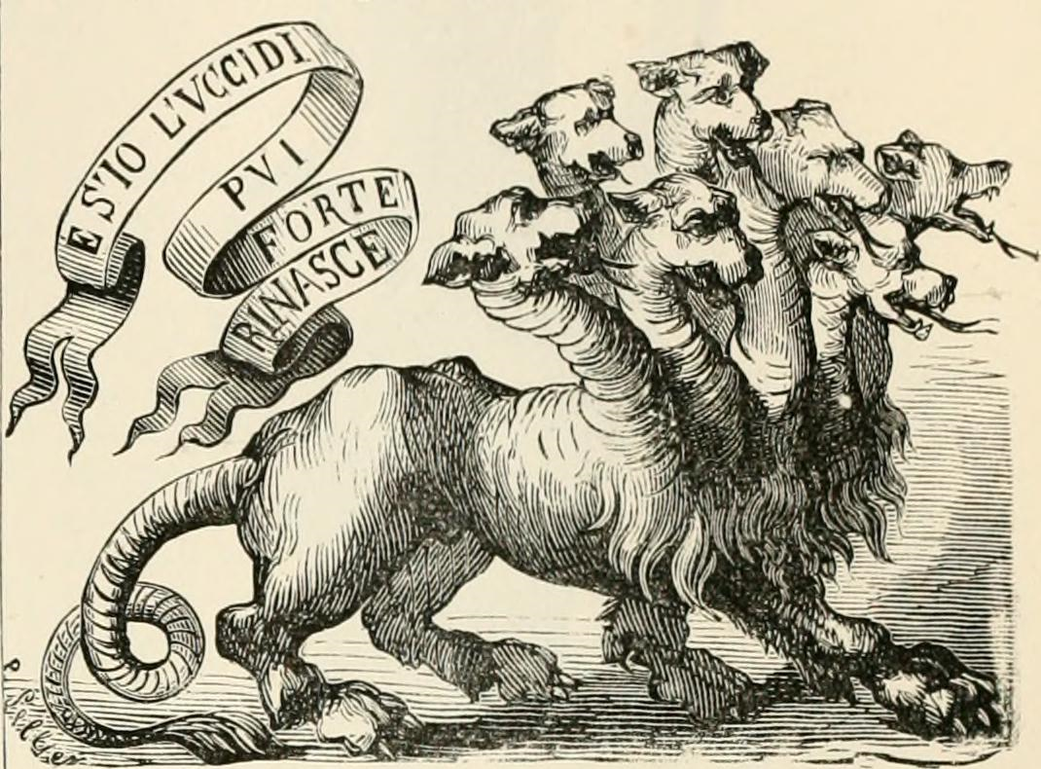
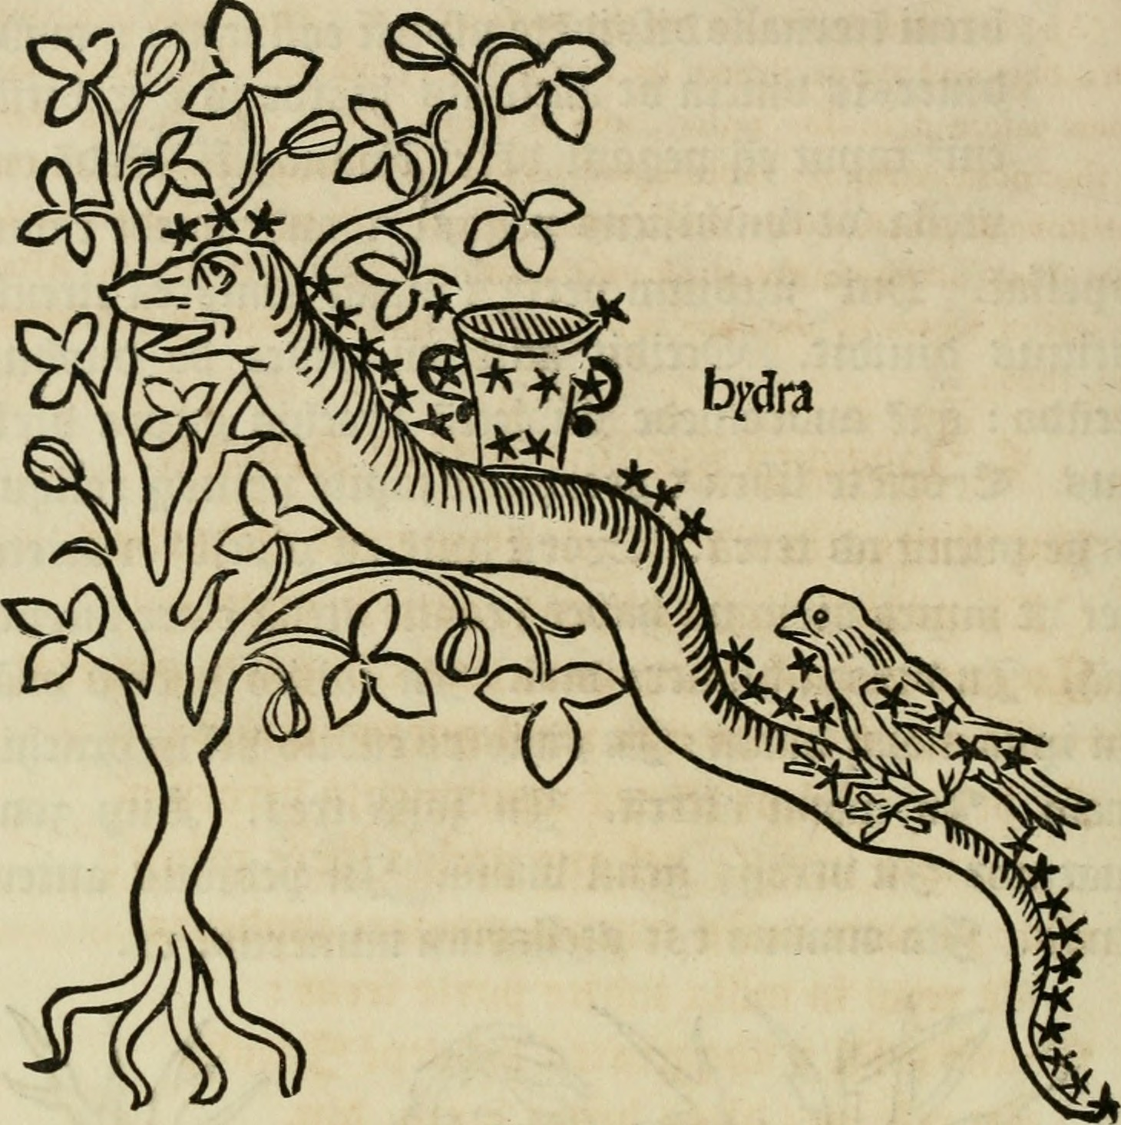
Hydra @ LSE: Where Next?
Neil Stewart, Digital Library Manager
Policy & organisational
New developer post
Process review
Embedding the Digital Library’s work across the Library
User analytics: who, why, how?
Greater Hydra community engagement- giving something back! E.g. new page-turner application
Technology
Consolidation: updating our Hydra codebase; better ingest tools; preservation & access repositories link-up
Blacklight at last (?), then Spotlight (??)
Content
Born digital collection: Women’s Parliamentary Radio archive
LSE Public Lectures
Digitisation for Exhibition Space- joined-up thinking!
Web presence & UX review
Ask me anything (Hydra/LSE-related)! n.stewart@lse.ac.uk @neilstewart #HydraConnect
Image credits: Internet Archive Book Images. No known copyright restrictions.

