Slide 1
Converting Metadata to Linked Data
Hydra Connect
October 2, 2014
Special thanks to Tom Johnson,
formerly of Oregon State University,
(tom@dp.la)
Karen Estlund,
Head, Digital Scholarship Center
Director, Oregon Digital Newspaper Program
kestlund@uoregon.edu
Notes:
See: https://github.com/OregonDigital/cdm2bag, https://github.com/OregonDigital/opaque_ns, http://goo.gl/omlsGE

Slide 2
Linked How?
Notes:
Misunderstandings on hand coding
Type-ahead vs. direct look-up
Human & Human
Machine vs. Human
Machine & Human

Slide 3
Complete Sentences
Subject
Predicate
Object
<http://example.org/object1>
<http://purl.org/dcterms/title>
“My Title”
<http://example.org/object1>
<http://id.loc.gov/authorities/subjects/sh85114250>
<http://purl.org/dc/terms/subject>

Slide 4
Incomplete Sentences
Subject
Predicate
Object
<http://example.org/object1>
<http://id.loc.gov/authorities/subjects/sh85114250>
“Subject”

Slide 5
New Tools for Catalogers
Git and Github shared collaboration
YML
JSONLD
Using range and domain
VIM
Bash
Python validations

Slide 6
Linked Open Data Principles
Use URIs as names for things
Use HTTP URIs so that people can look up those names.
When someone looks up a URI, provide useful information, using the standards (RDF*, SPARQL)
Include links to other URIs. so that they can discover more things.
Notes:
Not quite there, yet.

Slide 7
Oregon Digital Principles: 1
You should not be constrained by your schema.
DarwinCore, Archives citations (folder name), Petrarch Canzionere Poem
Notes:
Note: we’re not doing good enough yet, either
You should not be constrained by your schema.
DarwinCore, Archives citations (box), Petrarch Canzionere Poem
You are not that special.
Accepted Acronym
You do not know everything.
Ask the communities, contact within OD collaboration and dictionary owners (so many PDF schemas out there)
If your data isn’t reusable, shareable, and machine readable, then you’re not doing good enough.*
Follow linked open data principles
Use exemplary behavior and reuse from others so that they may also reuse from you.
We do not need to create an oregon:title predicate

Slide 8
Oregon Digital Principles: 2
You are not that special.
Accepted Acronym

Slide 9
Oregon Digital Principles: 3
You do not know everything.
Ask the communities, contact within OD collaboration and dictionary owners (so many PDF schemas out there)

Slide 10
Oregon Digital Principles: 4
If your data isn’t reusable, shareable, and machine readable, then you’re not doing good enough.*
Follow linked open data principles

Slide 11
Oregon Digital Principles: 5
Use exemplary behavior and reuse from others so that they may also reuse from you.
We do not need to create an oregon:title predicate

Slide 12
Previous Status of Fields (Predicates)

Slide 13
Selecting Terms
Terms, properties (predicates) and values (objects), should not be available elsewhere as linked data terms
If terms are available in other schemas or ontologies but not as linked data, contact schema / ontology owner before creating terms in opaque namespace
Search field, if term is not available but open linked data schema is, add to that schema, e.g. GeoNames
Create new terms if both specialized need and useful for a wider audience at: Opaque Namespace

Slide 14
Mapping Process
Copy <desc> files from CDM server (or export from other existing system)
Metadata Cleanup
Clean up field values through script (e.g. unicode problems, spelling, compacting like terms)
Map field values to LOD through script (e.g. geonames)
Use field mapping script for new predicates
Quality Review
BagIt!
Ingest (or re-ingest to existing System)
Notes:
2. Map to full resolution files (if applicable) – in migration process

Slide 15
Mapping File

Slide 16
Mapping Methods – Vocab Terms
Getty:
AAT
TGN
ULAN (forthcoming)
LC
LCSH
LCNAF
TGM
Ethnographic
Orgs
GeoNames
Language
Type
Format
Rights
Europeana
Creative Commons
Bio
uBio
IT IS
Locally Hosted

Slide 17
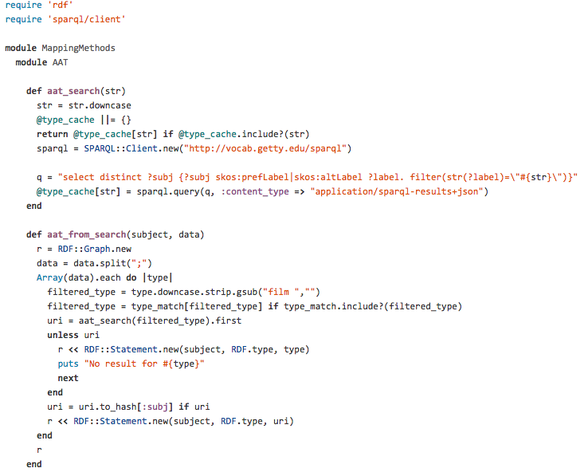

Slide 18
Specific Collection Mappings

Slide 19
Manual Work?
Notes:
(old environment to new)

Slide 20
Quality Review
Review Terms that didn’t match
Manually add
Throw out
Review n-triples
<http://oregondigital.org/resource/oregondigital:fj236216h> <http://purl.org/dc/terms/subject>
<http://id.loc.gov/authorities/subjects/sh85114250> .

Slide 21
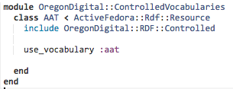
In Hydra
Configure vocabularies
Run Rake Task to Load Vocabularies
Add Class
Add Class to Model
Notes:
https://github.com/OregonDigital/oregondigital/wiki/Add-Controlled-Vocabularies-&-Properties

Slide 22
Data Dictionary / Application Profile
http://goo.gl/omlsGE
Notes:
150+ terms

Slide 23
Next Steps
Easy entry for new terms
Adding further definitions, enriching locally created terms
Making terms resolvable / hosting terms

