Slide 1
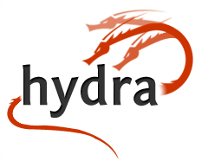
Get A head on Your Repository
Worldwide Hydra Connect #2
September 30 – October 2, 2014
Cleveland, Ohio
#hydraConnect

Slide 2
This is not a conference
…it’s a Connect.

Slide 3
What is Hydra Connect?
Hydra Connect is a chance for Hydra Project participants to gather in one place at one time, with an emphasis on synchronizing efforts, technical development, plans, and community links.
Notes:
The only way to build a rich & robust solution is to engage a large community of developers. The only way to build a sustainable solution is to spur adoption by a community of institutions w/ vested interest in shared success.

Slide 4
Contents and Structure
training opportunities for developers and managers
demonstrations & lightning talks
introductions & matchmaking
(lots of) unstructured times / open room format for...
coordinated development
taking action on strategic plan items
documentation updates
investigating patterns
Notes:
In other words, Connect is a big working group meeting!

Slide 5
How does
work?
Notes:
In other words, what is the true nature of the project?

Slide 6
State of the HydraSphere
September, 2014
Get A head on Your Repository

Slide 7
Hydra Goals -- 2008
Build a framework for repository-powered applications, with
multiple, tailored UIs, and a
robust repository back end
One body, many heads
Build a set of solution bundles
Build a community
If you want to go fast, go alone. If you want to go far, go together.
Notes:
The only way to build a rich & robust solution is to engage a large community of developers. The only way to build a sustainable solution is to spur adoption by a community of institutions w/ vested interest in shared success.

Slide 8
Hydra Partners
OR = Open Repositories Conference
Notes:
The only way to build a rich & robust solution is to engage a large community of developers. The only way to build a sustainable solution is to spur adoption by a community of institutions w/ vested interest in shared success.

Slide 9
Hydra Partners and Known Users
OR = Open Repositories Conference
Notes:
The only way to build a rich & robust solution is to engage a large community of developers. The only way to build a sustainable solution is to spur adoption by a community of institutions w/ vested interest in shared success.

Slide 10
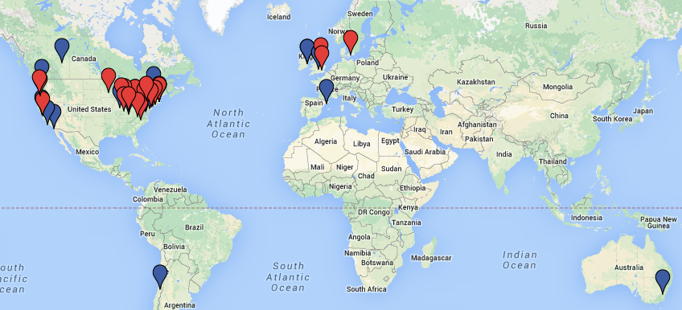
A Worldwide Presence
Notes:
The only way to build a rich & robust solution is to engage a large community of developers. The only way to build a sustainable solution is to spur adoption by a community of institutions w/ vested interest in shared success.

Slide 11
Trending

Slide 12
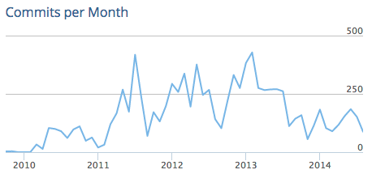
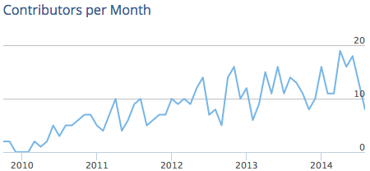
Trending

Slide 13
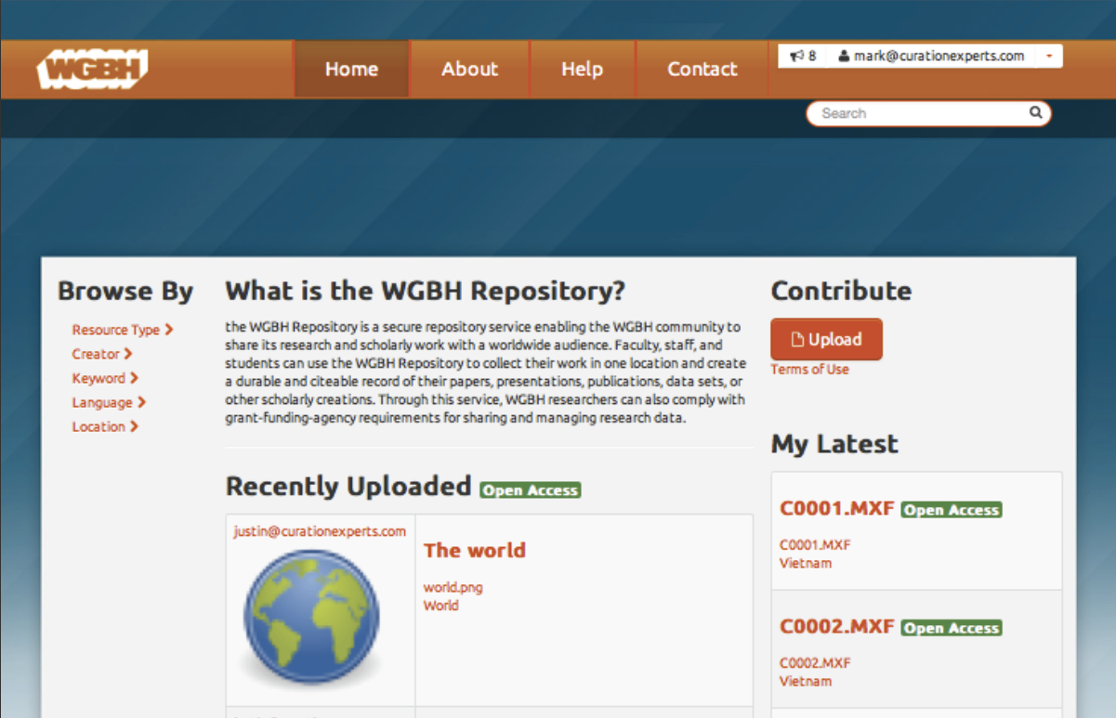
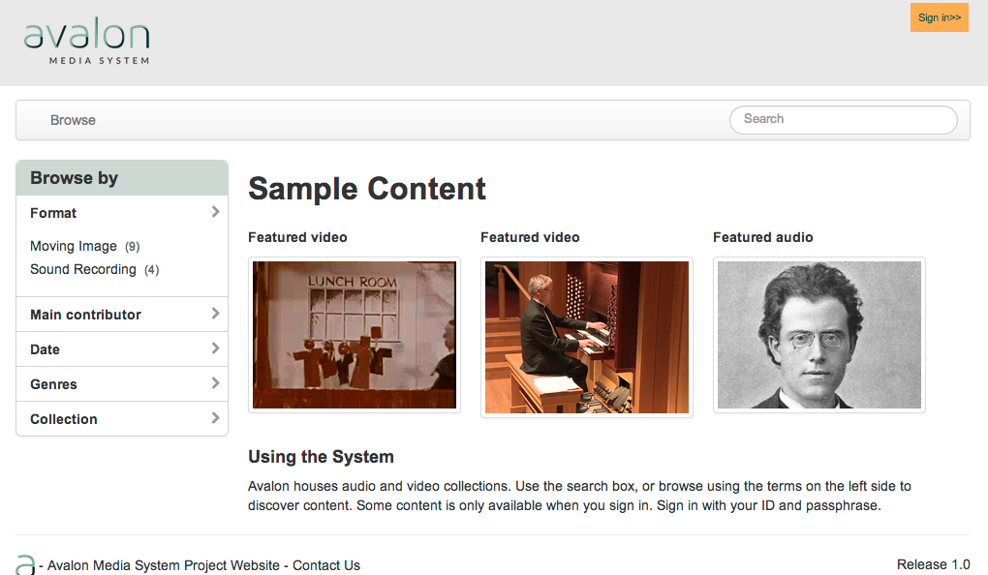
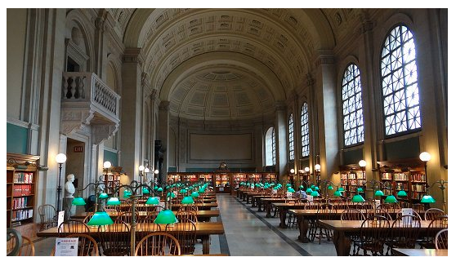
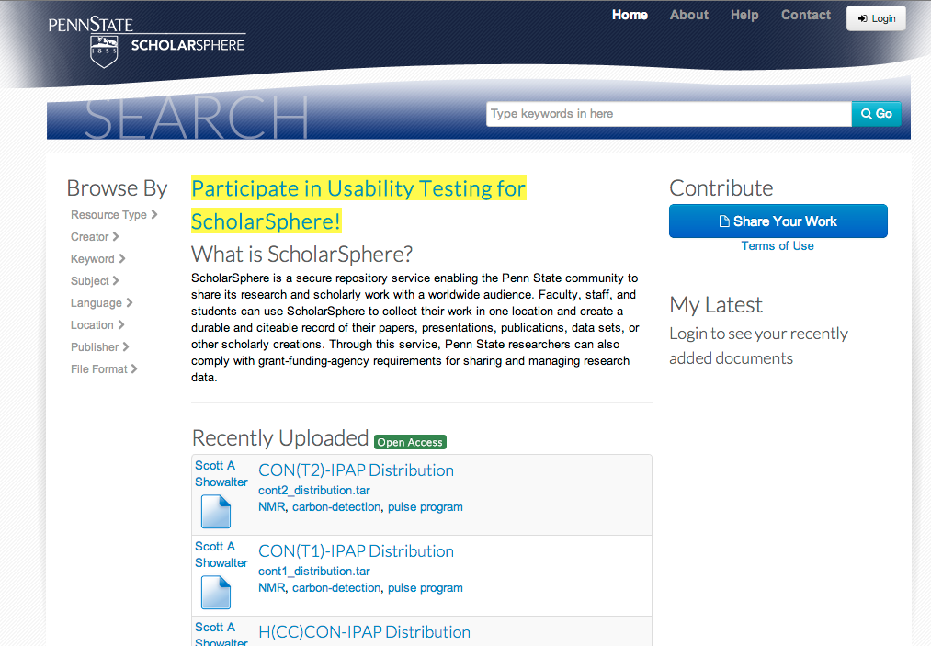
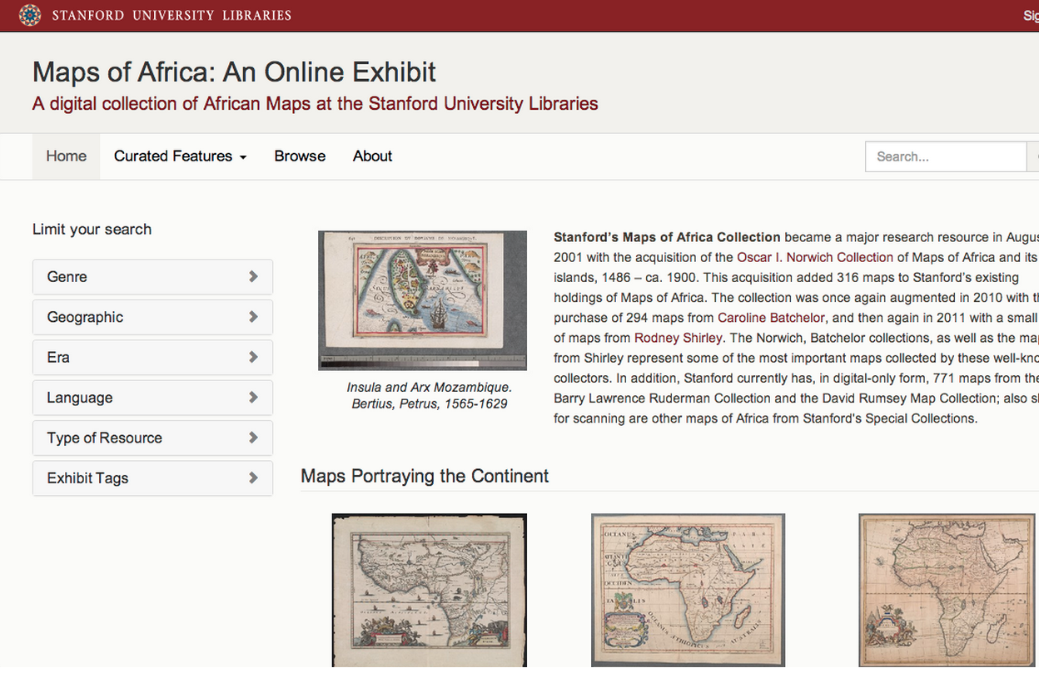
Hydra Heads of Note
UCSD DAMS
Avalon & HydraDAM for Media
BPL Digital Commonwealth
Sufia
Spotlight
Notes:
A single application could not effectively cope with these three use cases; however any institution would want to safeguard the outputs of all these disparate systems in a digital repository for management and preservation. HYDRA gives a framework where ONE BODY (the repo) can support MULTIPLE HEADS (tailored applications)

Slide 14
Current State of Hydra
Doubled in size, four times, since its founding
Achieved its original goals*
Entering a new phase
New opportunities
New needs: media, research data, et al.
Arguably the epitome of a vibrant, successful, open source project in libraries
For what we make
For how we make it

Slide 15
What Did We Get Right?
Objectives: one body, many heads
Platforms: RoR and Fedora
Architecture: loosely coupled components, repository as an ecosystem
Methodology: agile, test driven, face time
Culture: a goal-oriented, welcoming, learning, with shared purpose
Priority: the community

Slide 16
Three critical priorities from 2012
Technical framework continue to advance to enable easy code sharing and reuse
Community framework evolves to accommodate growth in…
partners and users
deographic range
diversity of interests and capacity
Create a full suite of solution bundles
Notes:
December 2012: strategic retreat to assess new current state and new directions

Slide 17
Seven Eight strategic priorities
Solution bundles
Turnkey applications
Vendor ecosystem
Training
Documentation
Code sharing
Community ties
Grow the User base
Notes:
The only way to build a rich & robust solution is to engage a large community of developers. The only way to build a sustainable solution is to spur adoption by a community of institutions w/ vested interest in shared success.

Slide 18
“Power Steering” Must Do’s – April 2014
Technical
Community
Make Hydra easier to adopt, share & maintain
Solution bundles
Shared code
Advance the platform
Fedora 4
Core gems
RDF
Grow!
Partners & users
Interest, Working & Regional Groups
Build the center
More intensive collaboration
Project admin?
Notes:
A big thank you to Power Steering members in April 2014

Slide 19
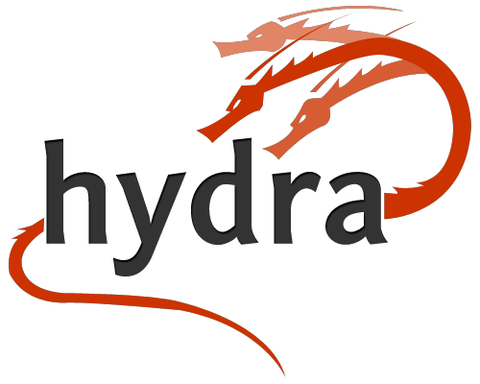
http://projecthydra.org

