Slide 1
One Year with Hydra What we know now What we wish we knew earlier
Thomas Scherz & Glen Horton
University of Cincinnati

Slide 2
System/Stack Deployment

Slide 3
Be careful what you put in git
Git history will remember passwords, keys, etc.
Use .example or .sample files instead
Use variables that will be swapped during deploy
Store real content in a safe location

Slide 4
Use Virtual Server Environments
Mimic a production environment locally
A reproducible, standard environment
Can be used before real servers are available
Use tools like Vagrant and Puppet

Slide 5
Learn Fedora and Solr
They are easy to use inside hydra-jetty
But harder when in production
Security needs to be addressed
Learn them early so it's not so hard later

Slide 6
Sysadmin Collaboration
Many of these tools are unfamiliar to sysadmins
Fedora, Solr, Rescue, etc.
Double-check and verify backup procedures
Negotiate how much terminal access you need

Slide 7
Developer Collaboration

Slide 8
Use a Development Workflow
"Gitflow" is a good one
Use good commit messages & branch names
Practice with a test project
Adapt it to your needs

Slide 9
Follow a Script for Quality Assurance
Don’t rely on spec tests alone
Don’t just focus on changes you made
Document the steps a user would take
Run though script in QA environment

Slide 10
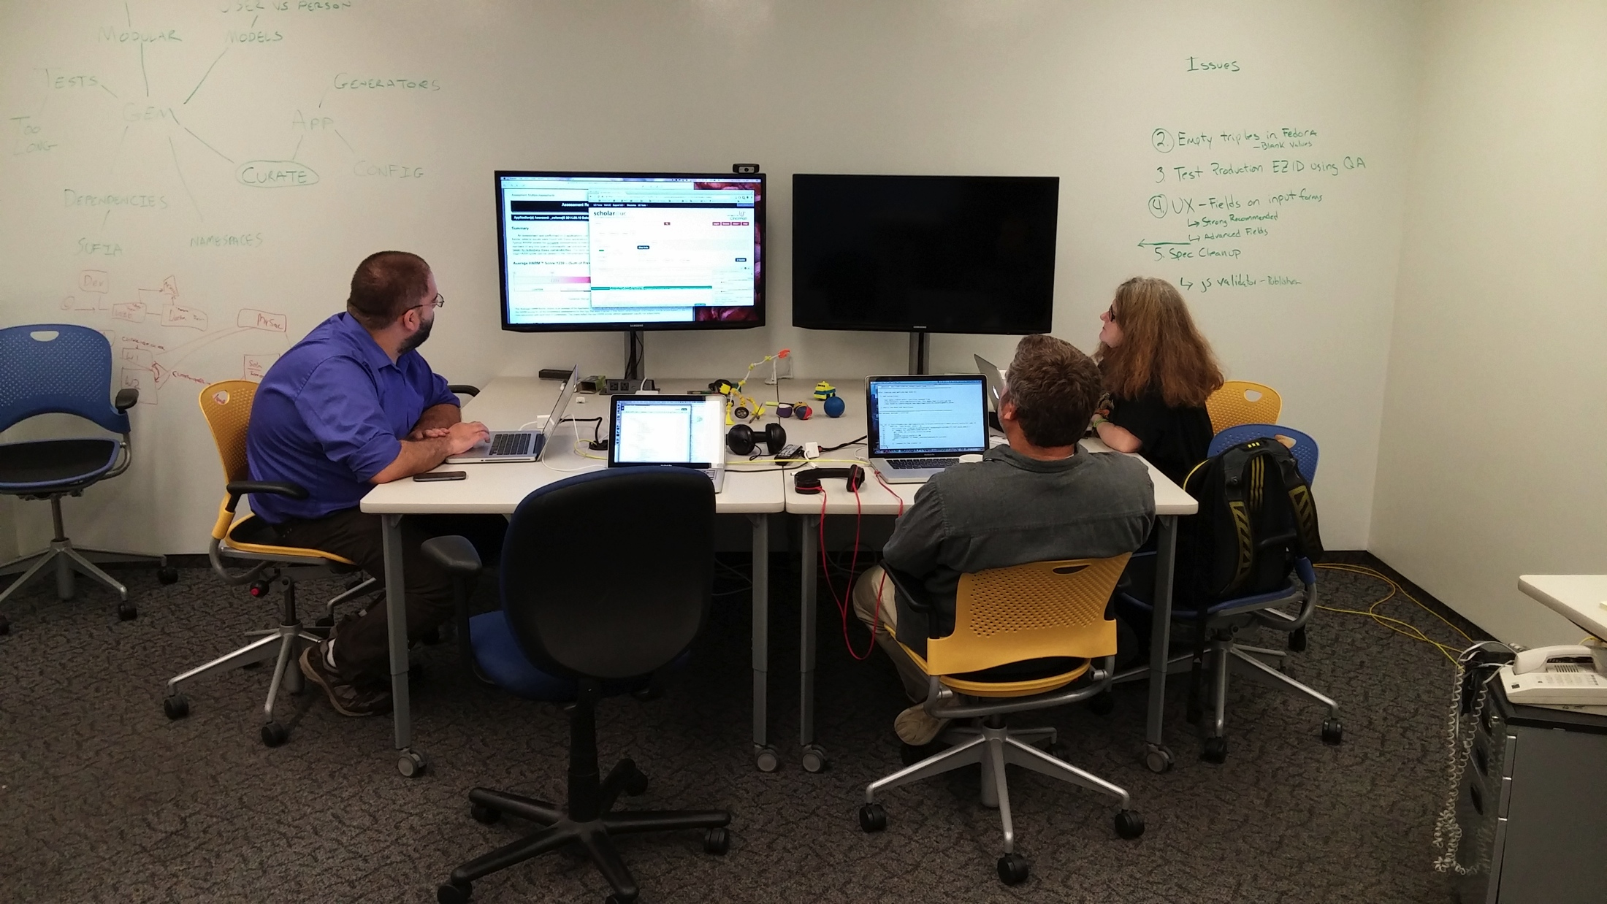
Collaboration Area

Slide 11
Rails Applications
Understanding rails conventions
Models, Views, and Controllers
Test driven development
DRY - don't repeat yourself
Rake tasks and Generators
Managing Updates – Things change.
Locking down Gem versions
Gem Dependencies

Slide 12
Hydra Community
Don’t reinvent the wheel
Look at what others have done.
rake task, config files, travis, …
Scholarsphere, DIL, Curate_ND,..
Get Involved : Get in Touch
IRC, Commiters’ Call, Hydra-Tech, Hydra Camps, github
Set up a Sandbox server
Try other Hydra apps and gems

