Slide 1
State of the Hydrasphere
Get A head on Your Repository
Open Repositories 2013
Charlottetown, Prince Edward Island
July 11, 2013
Tom Cramer
@tcramer

Slide 2
Notes:
The only way to build a rich & robust solution is to engage a large community of developers. The only way to build a sustainable solution is to spur adoption by a community of institutions w/ vested interest in shared success.

Slide 3
New Partners in the Last Year
Boston Public Library
Digital Curation Experts
Duke
Indiana
London School of Economics
Notre Dame
Penn State
Rock & Roll Hall of Fame
Royal Library of Denmark
Virginia Tech
WGBH
Yale
Notes:
The only way to build a rich & robust solution is to engage a large community of developers. The only way to build a sustainable solution is to spur adoption by a community of institutions w/ vested interest in shared success.

Slide 4
Users-But-Not-(Yet?)-Partners
UCSD
University of Oregon / Oregon State
Digital Repository of Ireland
Oxford
Tufts
Johns Hopkins University
Museum of Performing Arts (MAE), Barcelona
Notes:
The only way to build a rich & robust solution is to engage a large community of developers. The only way to build a sustainable solution is to spur adoption by a community of institutions w/ vested interest in shared success.

Slide 5
Hydra Partners
OR = Open Repositories Conference
Notes:
The only way to build a rich & robust solution is to engage a large community of developers. The only way to build a sustainable solution is to spur adoption by a community of institutions w/ vested interest in shared success.

Slide 6
Hydra Partners and Users
OR = Open Repositories Conference
Notes:
The only way to build a rich & robust solution is to engage a large community of developers. The only way to build a sustainable solution is to spur adoption by a community of institutions w/ vested interest in shared success.

Slide 7
UC San Diego, 2012

Slide 8
Trending

Slide 9
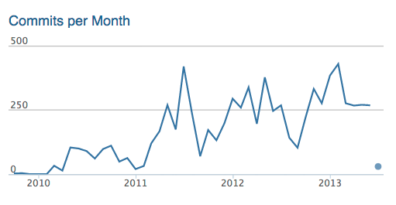
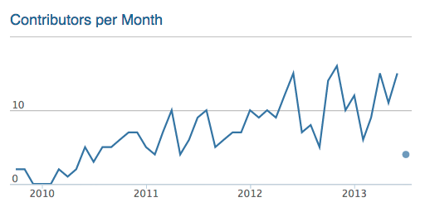
Trending

Slide 10
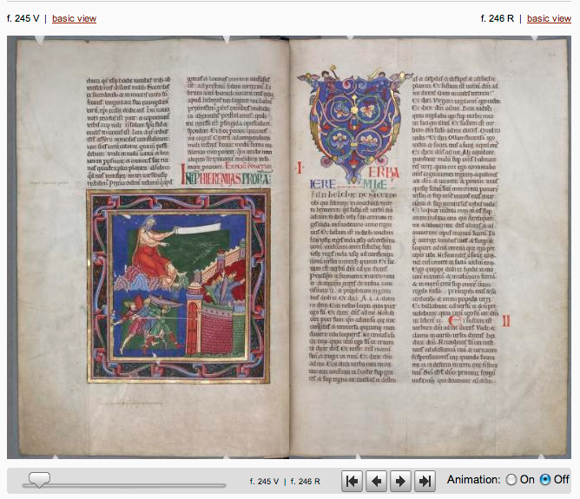
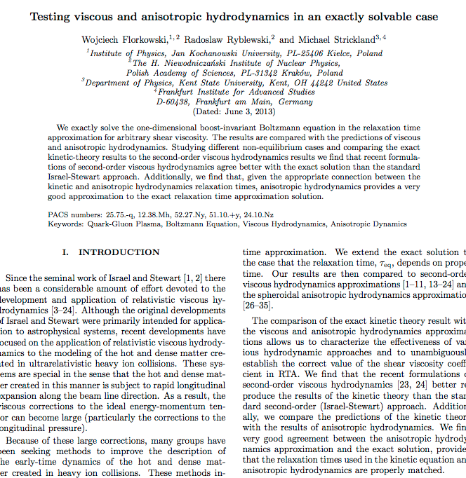
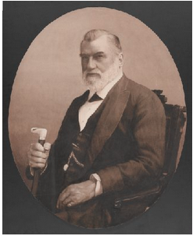
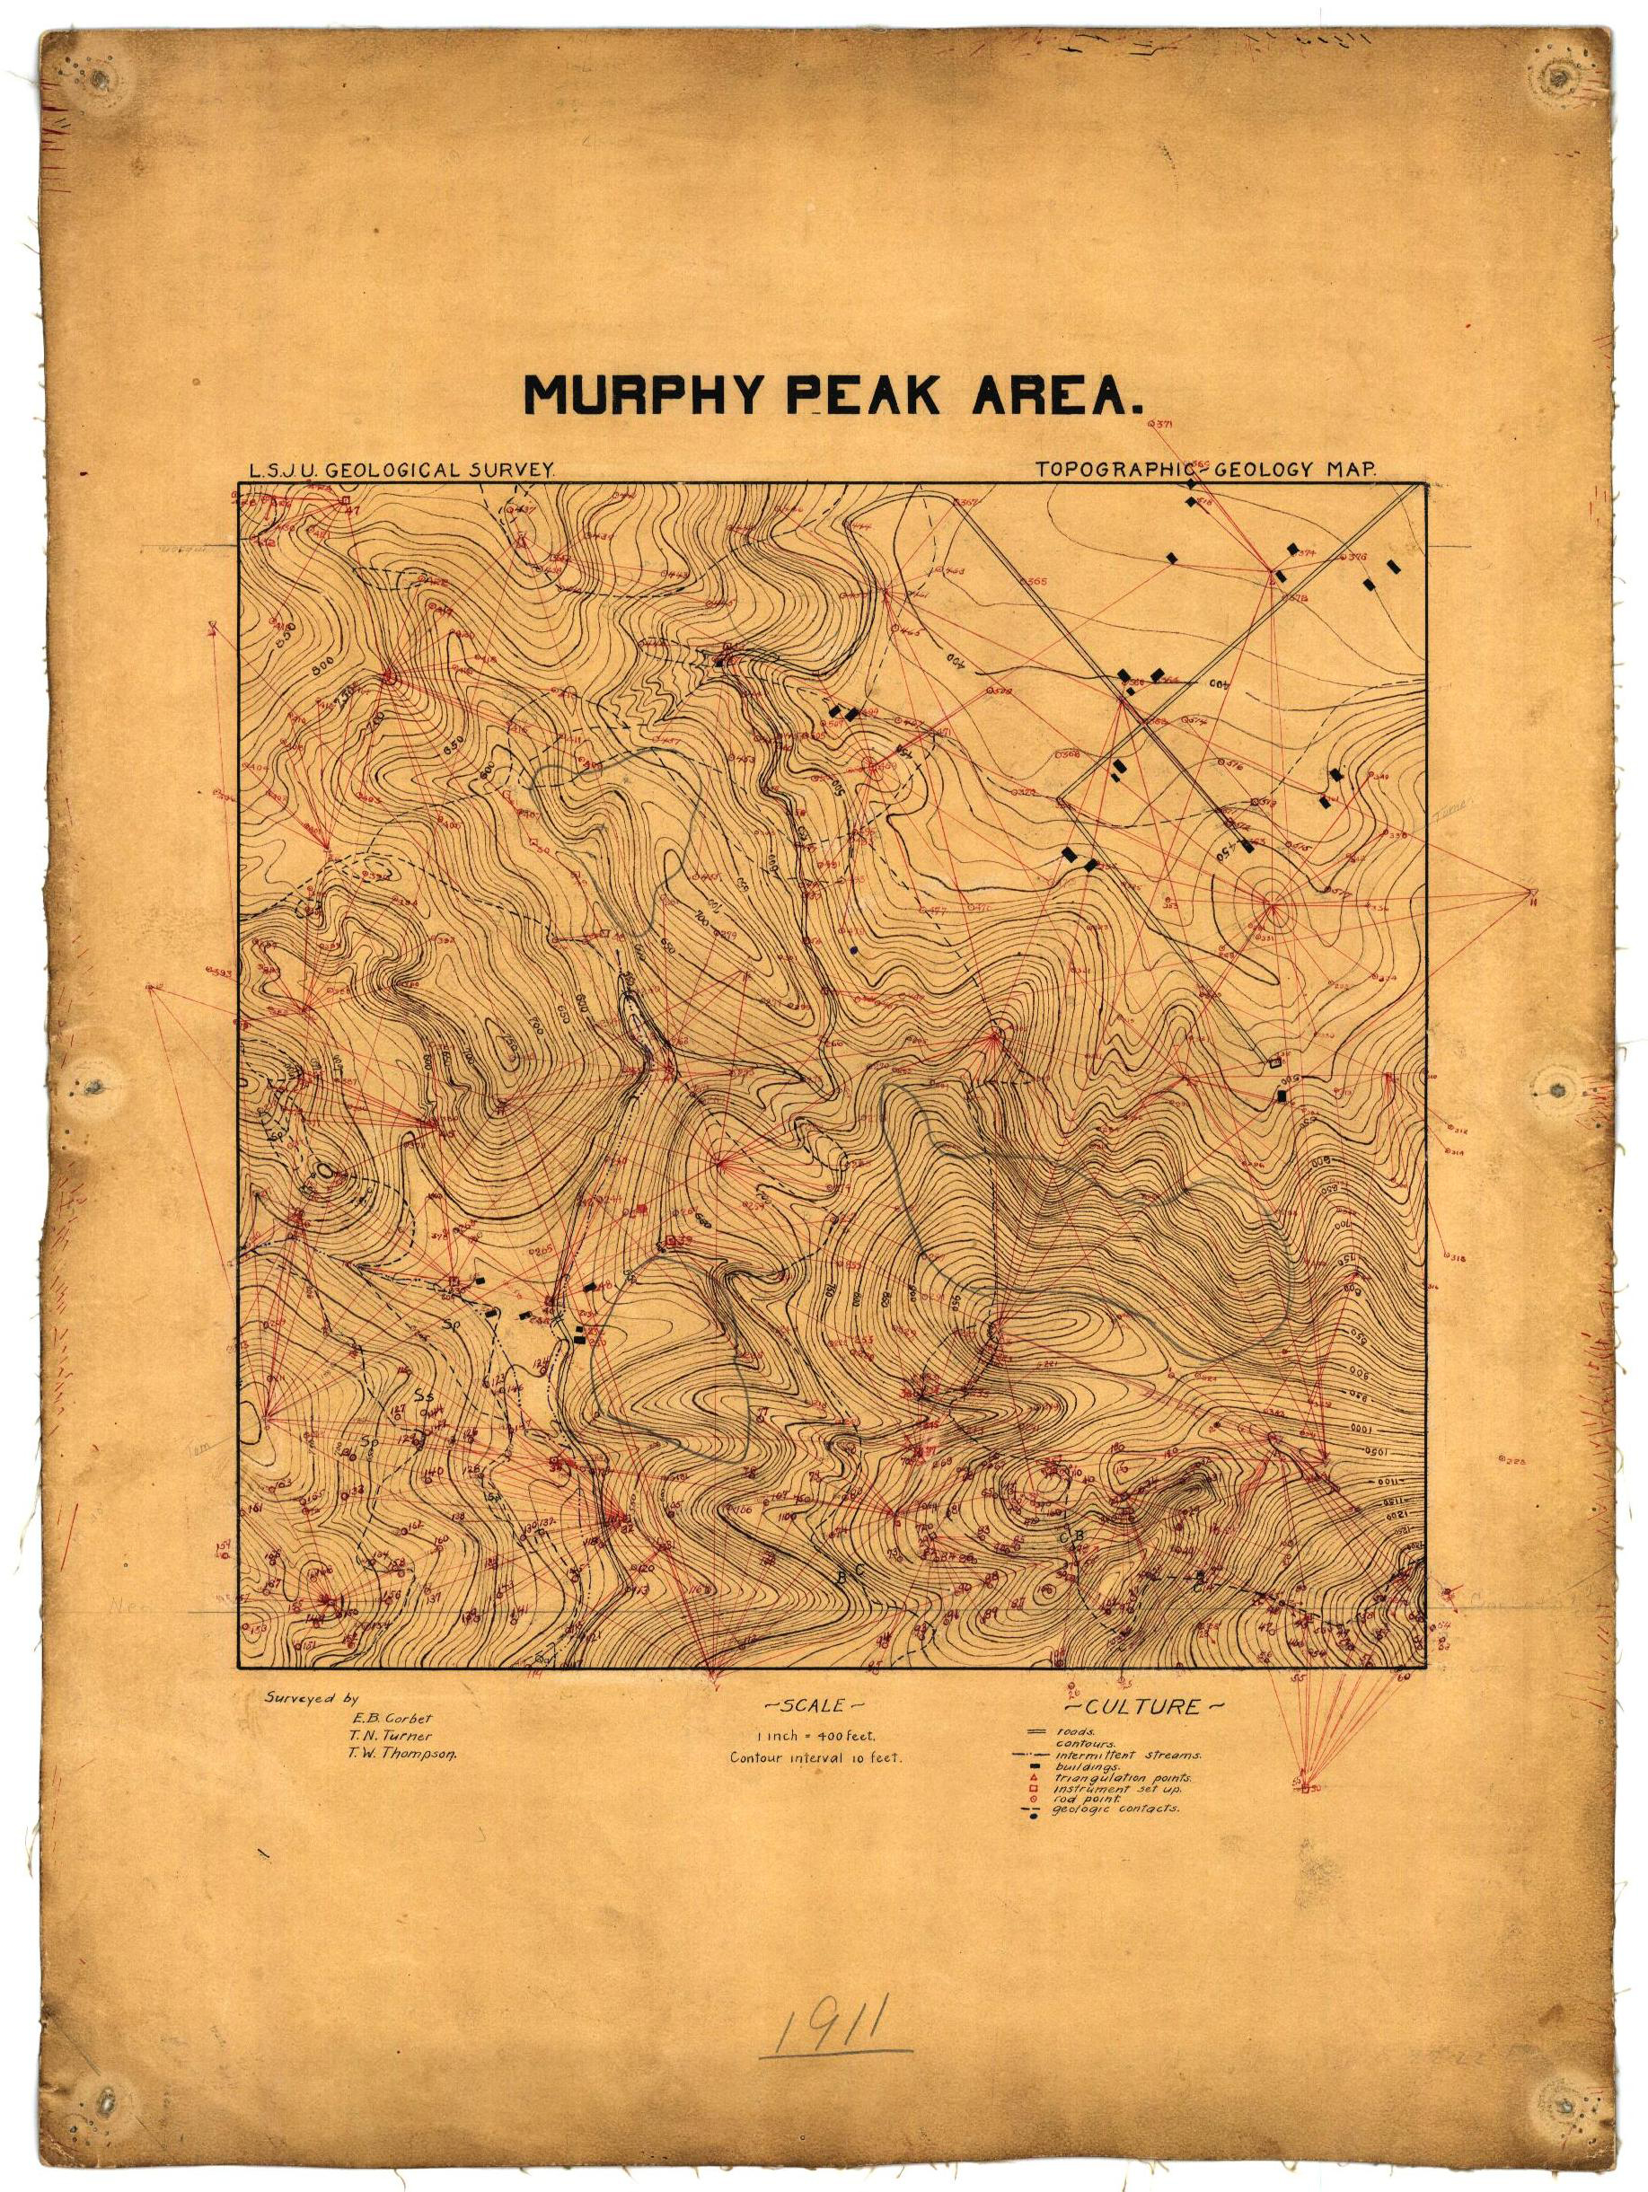
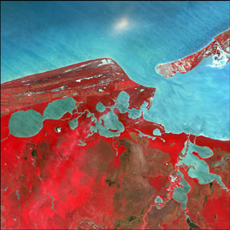
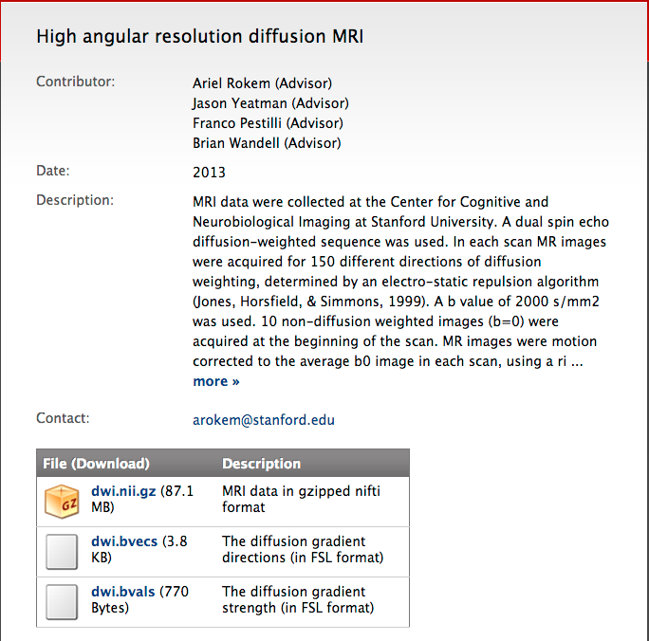
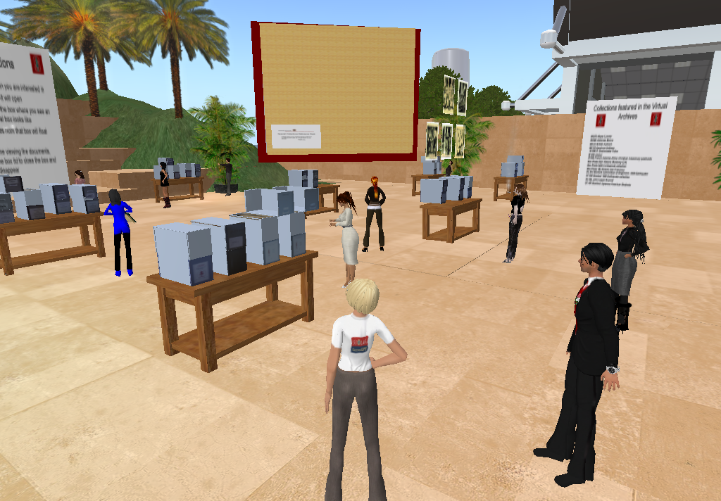
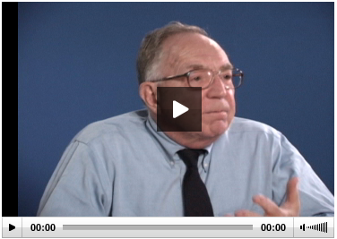
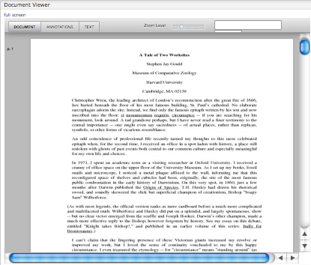
Books
Articles
Theses
Images
Maps
Data (Raster)
Data (Comp.)
Data (Observ.)
Audio
Video
Documents

Slide 11
Point Solution Approach …Welcome to Siloville
ETDs (Theses)
Books, Articles
Images
Audio-Visual
Research Data
Maps & GIS
Docu-ments
ETD
IR
Image DB
DAM
?
Geospa-tial Inf.
Records Mgmt.
Management
Access
Preservation?
Tailored?
Sustainable?

Slide 12
Repository-Powered Approach
ETDs (Theses)
Books, Articles
Images
Audio-Visual
Research Data
Maps & GIS
Docu-ments
Digital Repository
Scalable, Robust, Shared Management and Preservation Services
Notes:
A single application could not effectively cope with these three use cases; however any institution would want to safeguard the outputs of all these disparate systems in a digital repository for management and preservation. HYDRA gives a framework where ONE BODY (the repo) can support MULTIPLE HEADS (tailored applications)

Slide 13
One Body, Many Heads…
ETDs (Theses)
Books, Articles
Images
Audio-Visual
Research Data
Maps & GIS
Docu-ments
hydra
Scalable, Robust, Shared Management and Preservation Services
Notes:
A single application could not effectively cope with these three use cases; however any institution would want to safeguard the outputs of all these disparate systems in a digital repository for management and preservation. HYDRA gives a framework where ONE BODY (the repo) can support MULTIPLE HEADS (tailored applications)

Slide 14
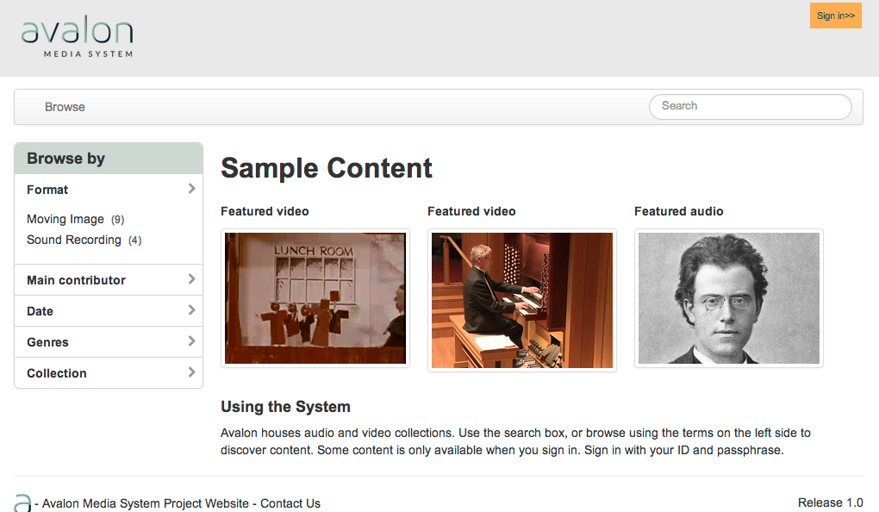
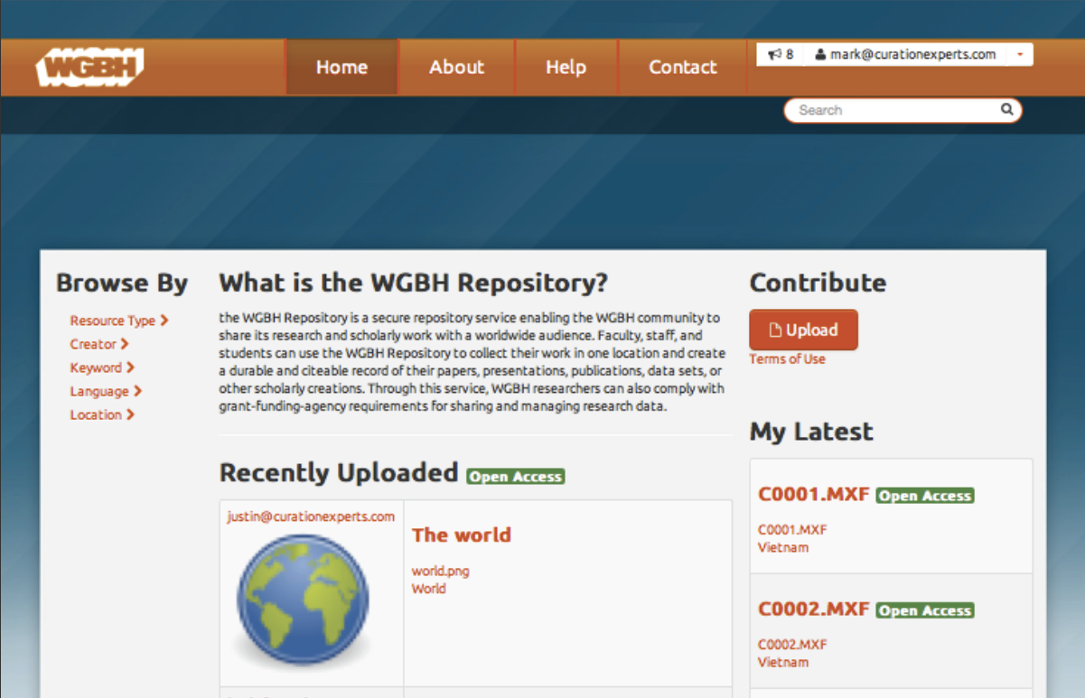
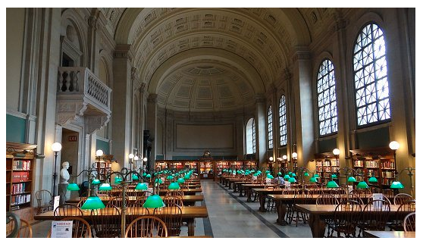
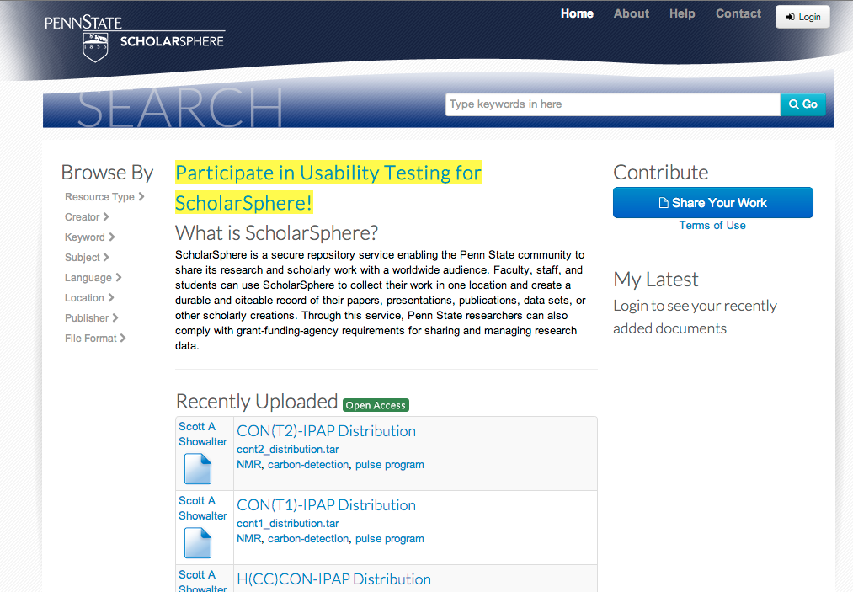
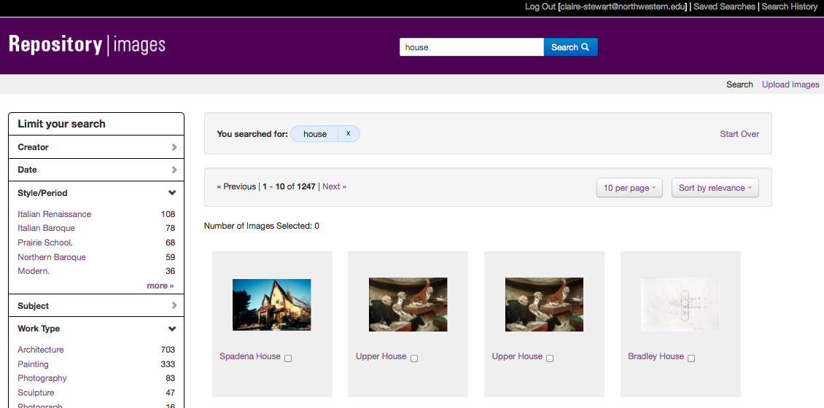
Heads
UCSD DAMS
Avalon & HydraDAM for Media
BPL Digital Commonwealth
Sufia
Digital Image Library
Notes:
A single application could not effectively cope with these three use cases; however any institution would want to safeguard the outputs of all these disparate systems in a digital repository for management and preservation. HYDRA gives a framework where ONE BODY (the repo) can support MULTIPLE HEADS (tailored applications)

Slide 15
Current State of Hydra
Doubled in size, thrice, since its founding
Achieved all its original goals
Entering a new phase
Notes:
The only way to build a rich & robust solution is to engage a large community of developers. The only way to build a sustainable solution is to spur adoption by a community of institutions w/ vested interest in shared success.

Slide 16
Three critical priorities
Technical framework continue to advance to enable easy code sharing and reuse
Community framework evolves to accommodate growth in…
Number of partners
Geographic range
Diversity of interests and capacity
Create a full suite of solution bundles
Notes:
The only way to build a rich & robust solution is to engage a large community of developers. The only way to build a sustainable solution is to spur adoption by a community of institutions w/ vested interest in shared success.

Slide 17
Seven strategic priorities
Develop solution bundles
Develop turnkey applications
Grow the Hydra vendor ecosystem
Codify a scalable training framework to fuel community growth
Develop a documentation framework
Ensure the technical framework allows code sharing
Refresh and intensify the community ties
Notes:
The only way to build a rich & robust solution is to engage a large community of developers. The only way to build a sustainable solution is to spur adoption by a community of institutions w/ vested interest in shared success.

Slide 18
Solution Bundles
IR Head with DSpace Equivalence by OR14
Notes:
The only way to build a rich & robust solution is to engage a large community of developers. The only way to build a sustainable solution is to spur adoption by a community of institutions w/ vested interest in shared success.

Slide 19
Training
Hydra Camps:
October 2012 in PSU
December 2012 in Yale
April 2013 in Dublin, Ireland
August 2013 in Charlottesville, VA
Sept/October 2013 in Ohio
Notes:
The only way to build a rich & robust solution is to engage a large community of developers. The only way to build a sustainable solution is to spur adoption by a community of institutions w/ vested interest in shared success.

Slide 20
Documentation
Consolidate
Prune
Notes:
Documentation won’t be the first thing anyone sees of your project, but it may be the last!
Particularly challenging in a fast-moving project; exacerbated by our distributed nature (no doc writer assigned)
Doc framework = consolidate all docs, make sure it’s fresh at regular camps & quarterly meetings,
Pegged gems

Slide 21
Community Framework
Users, Partners, Steering
Meetings
Notes:
The only way to build a rich & robust solution is to engage a large community of developers. The only way to build a sustainable solution is to spur adoption by a community of institutions w/ vested interest in shared success.

Slide 22
Technical Framework
Code Shredding & Gemification
Hydra Gem = stable distro
Notes:
The only way to build a rich & robust solution is to engage a large community of developers. The only way to build a sustainable solution is to spur adoption by a community of institutions w/ vested interest in shared success.

Slide 23
First Ever Hydra Awards
The Fleece Vest
Most Danish Award
Most Danish Award

Slide 24
The Fleece Vest
for the Partner demonstrating the greatest concern for practicality, with an iconoclastic flair
David Chandek-Stark!
Notes:
The only way to build a rich & robust solution is to engage a large community of developers. The only way to build a sustainable solution is to spur adoption by a community of institutions w/ vested interest in shared success.

Slide 25
Most Danish
for the Partner demonstrating the most Danish temperament and traits,* selected by a panel of experts.
(*All Danes exempt from consideration.)
Matt Zumwælt!
Notes:
The only way to build a rich & robust solution is to engage a large community of developers. The only way to build a sustainable solution is to spur adoption by a community of institutions w/ vested interest in shared success.

Slide 26
Most Danish
for the Partner demonstrating the greatest Dan-ness
1. Dan “of the Dans” Coughlin
2. Dan Brubaker-Horst
3. D*n Brower
4. DeclAN Fleming
Notes:
The only way to build a rich & robust solution is to engage a large community of developers. The only way to build a sustainable solution is to spur adoption by a community of institutions w/ vested interest in shared success.

Slide 27
http://projecthydra.org

