Slide 1
The Seaside Research Portal:
A Best of Breed Approach to Digital Exhibits and Collection Management
Rick Johnson, Head of Digital Library Services
University of Notre Dame
Open Repositories, 2012
Notes:
11
In Indiana in the States, Notre Dame pronunciation Americans have butchered

Slide 2
The Problem
How do we build and sustain rich digital exhibits without getting overwhelmed by maintenance?
Notes:
22
22
We have many collection exhibits we need to support and more coming to leverage the platform we have established here

Slide 3
The Problem (cont.)
How do you simplify maintenance without sacrificing quality and depth of your collection?
Notes:
33
33

Slide 4
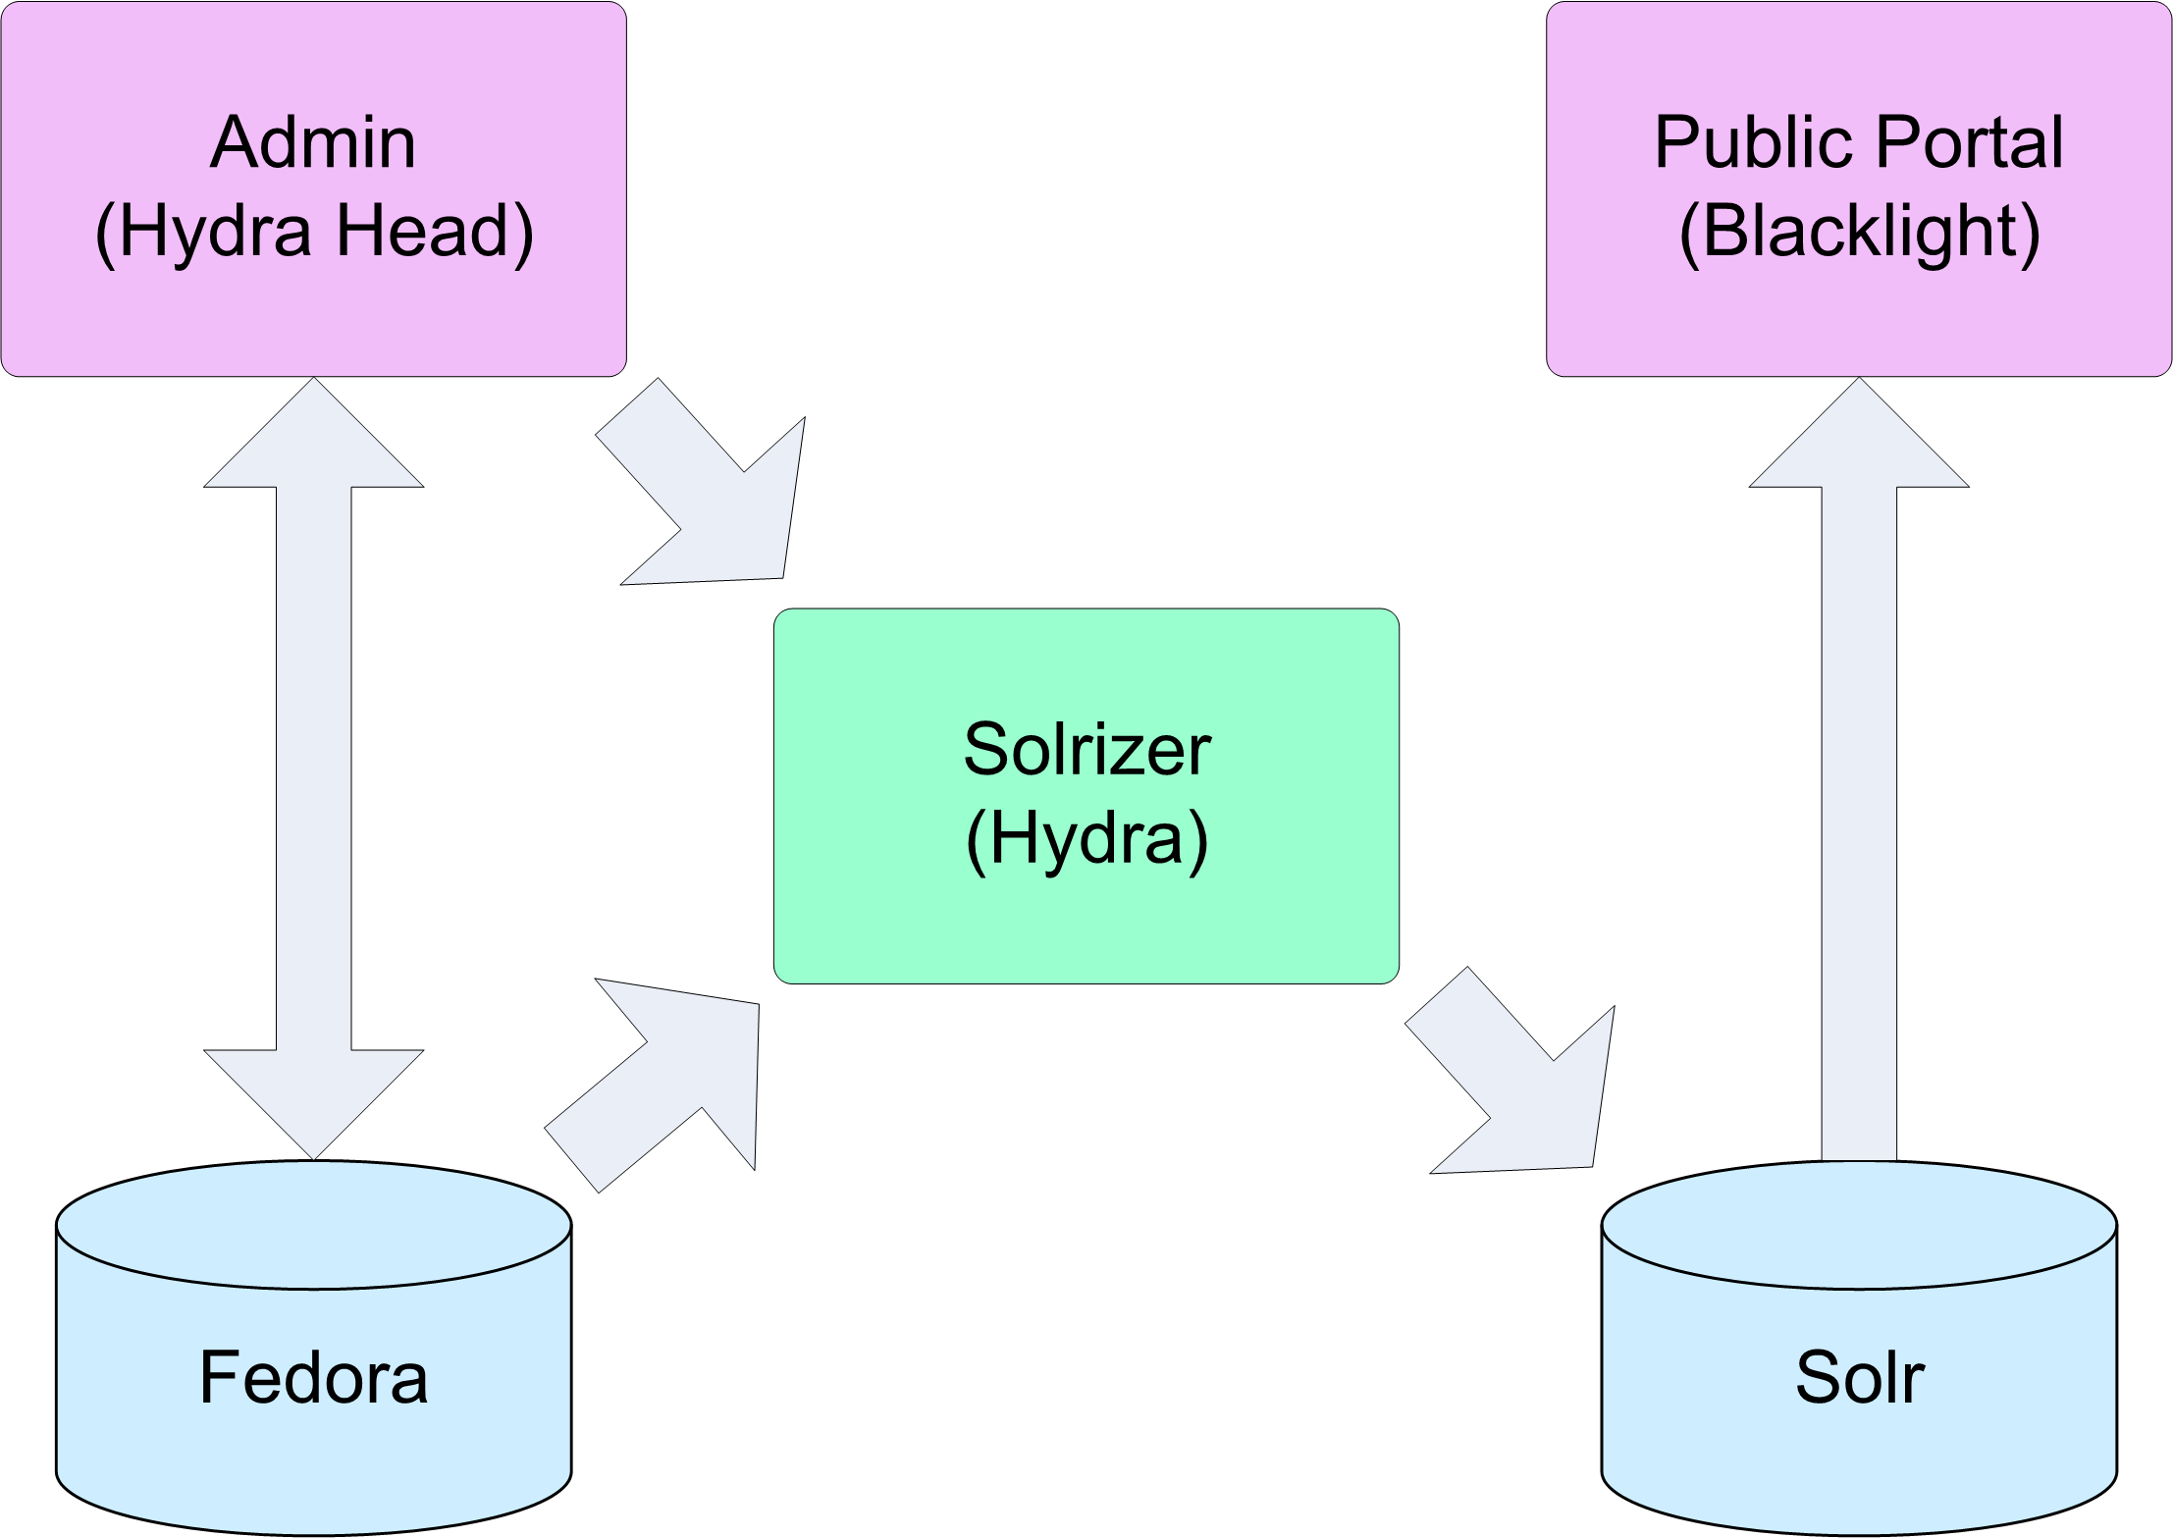
Hydra Brings it All Together
Notes:
44
44

Slide 5
Focus on the Audience
Hide the complexity of managing a collection from the public
Blacklight tailored to public
Hydra head tailored to content management
Instant updates with Hydra
It is about the experience, not the metadata schema
Notes:
55
55

Slide 6
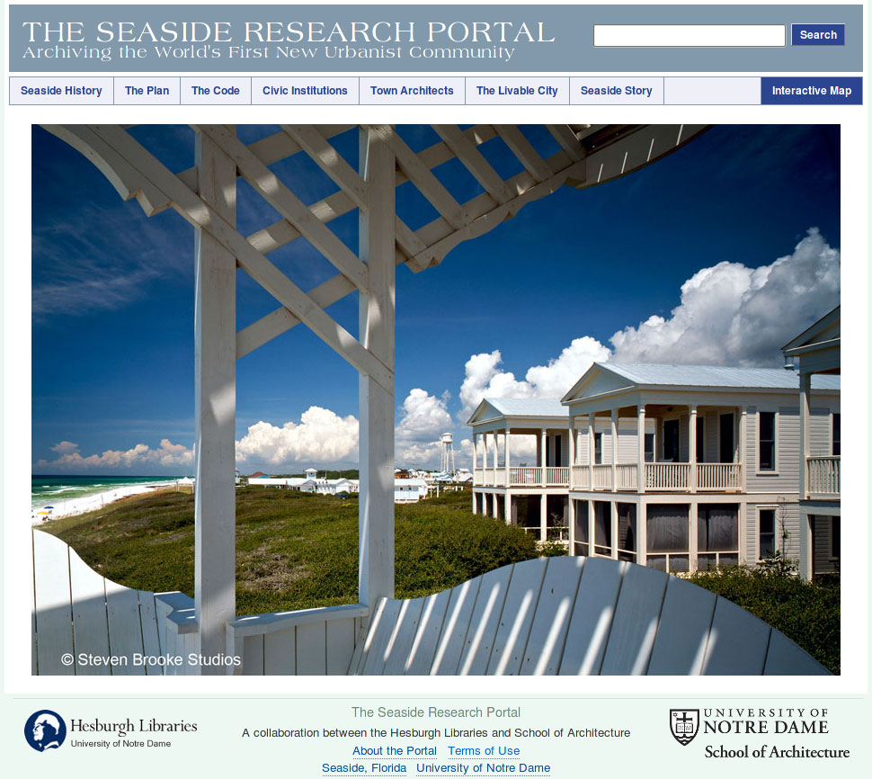
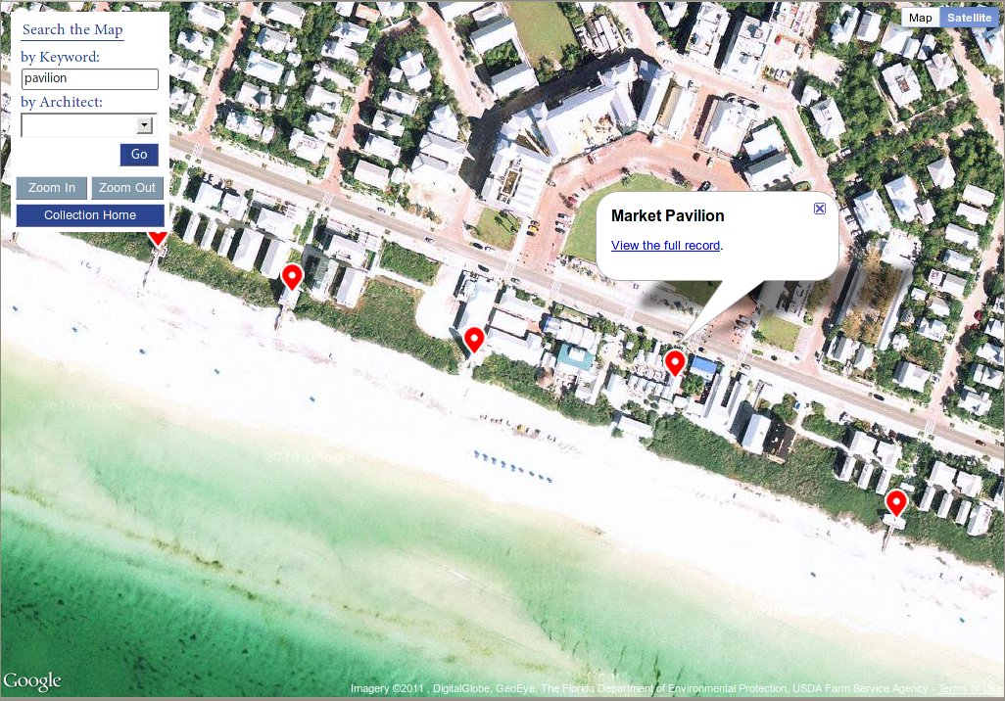
The Seaside Archive
Notes:
66
66
Able to tailor user experience to allow immersing yourself in the town by jumping to different properties via a map search, Regular blacklight search and search via a map

Slide 7
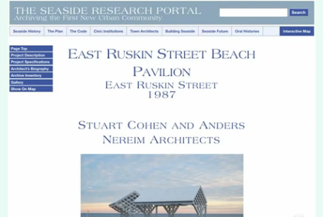
Go beyond the Schema
Notes:
77
77
Going to one the records there is a lot of mixing information including information about the architectural work, but also related archival holdings within the archive

Slide 8
Go beyond the Schema
Notes:
88
88

Slide 9
Go beyond the Schema
Mix metadata schemas to use what makes sense for the item, collection, and archival records
Represent your collection hierarchy with RELS-EXT RDF
Describe a collection item with the metadata schema that fits
Seamlessly manage EAD and VRA Core 4 within the same form
Notes:
99
99
Fedora and Hydra allowed us to mix metadata schemas and instead of relying on hierarchical elements within VRA Core 4, we rely on RDF to link objects in Fedora, and with Hydra we are able to mix and match metadata field being edited within one form

Slide 10
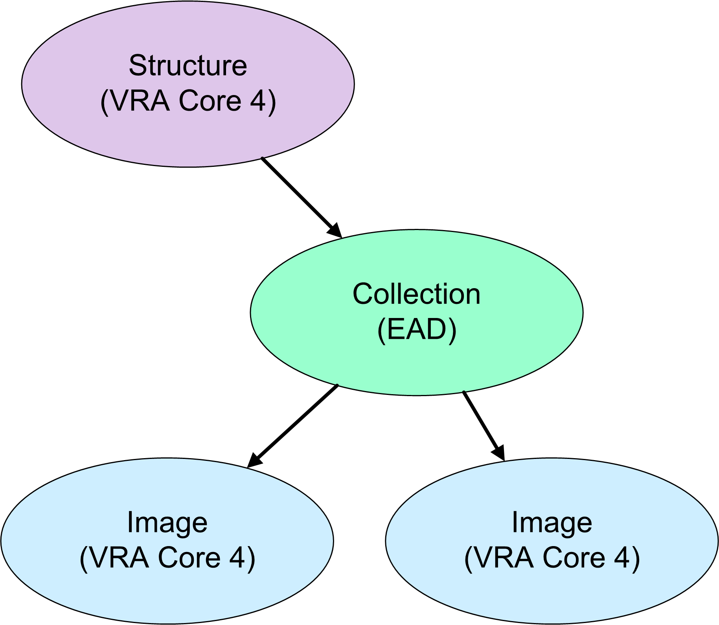
Go beyond the Schema
Notes:
1010
1010

Slide 11
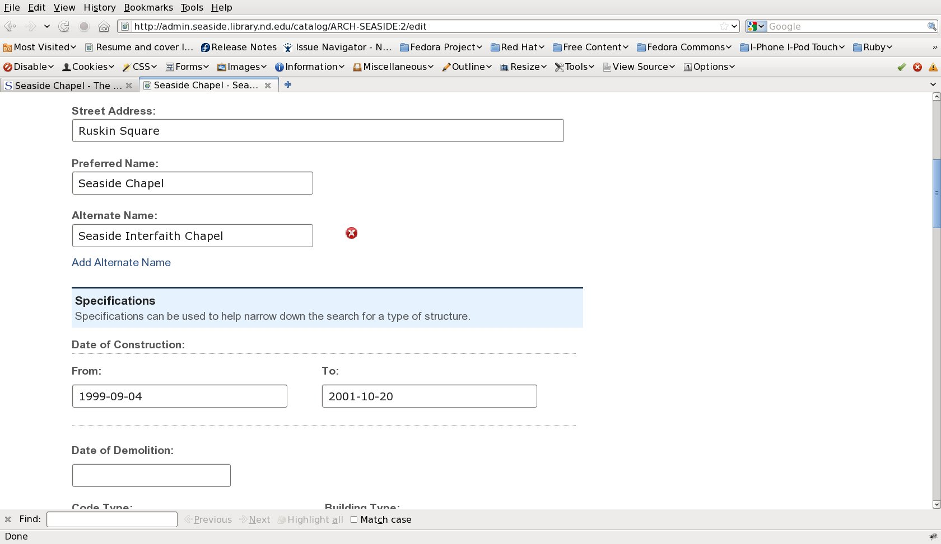
Go beyond the Schema
Notes:
1111
1111

Slide 12
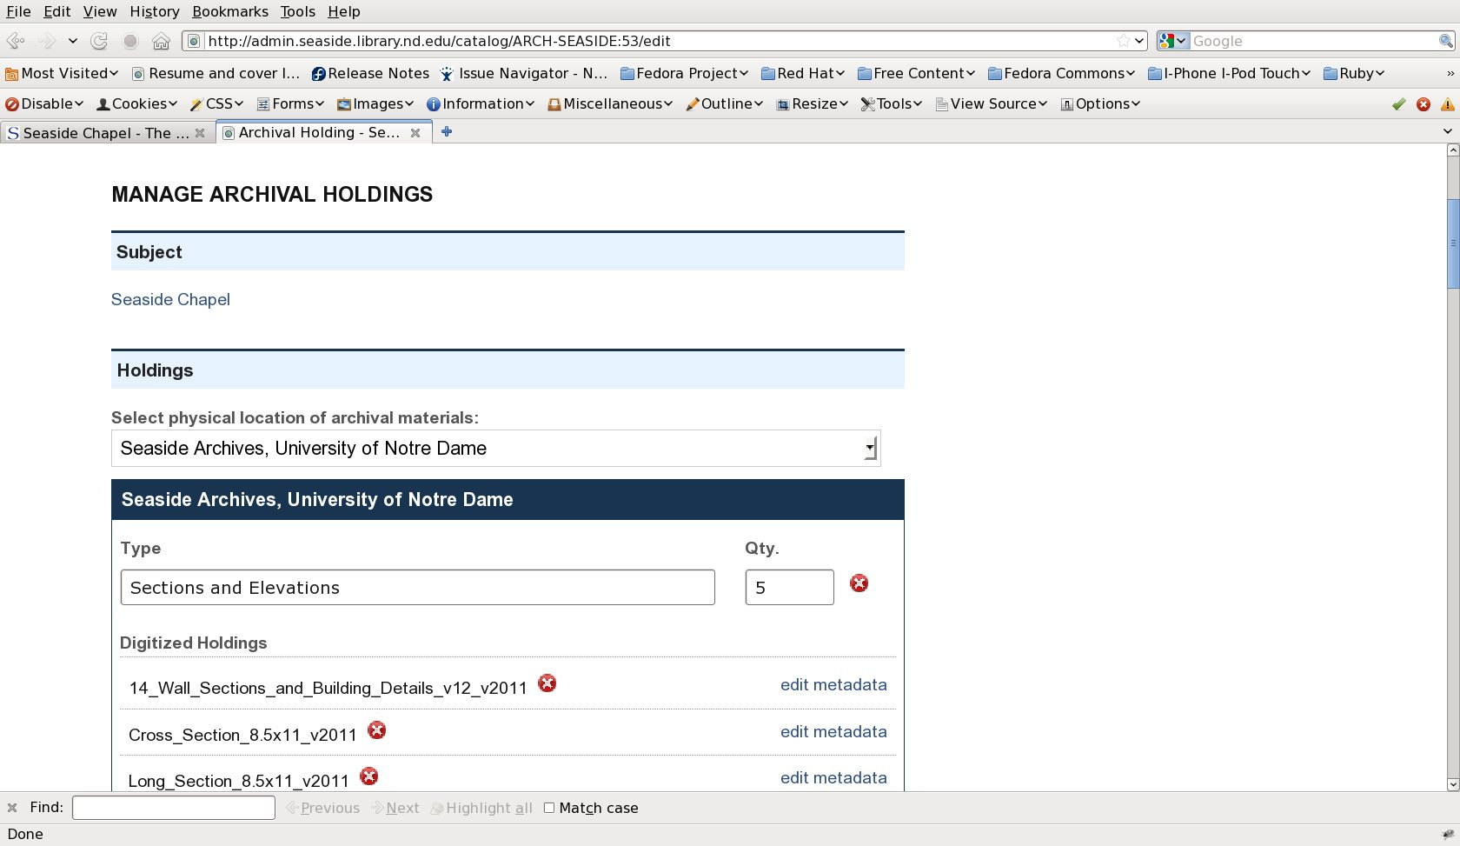
Go beyond the Schema
Notes:
1212
1212

Slide 13
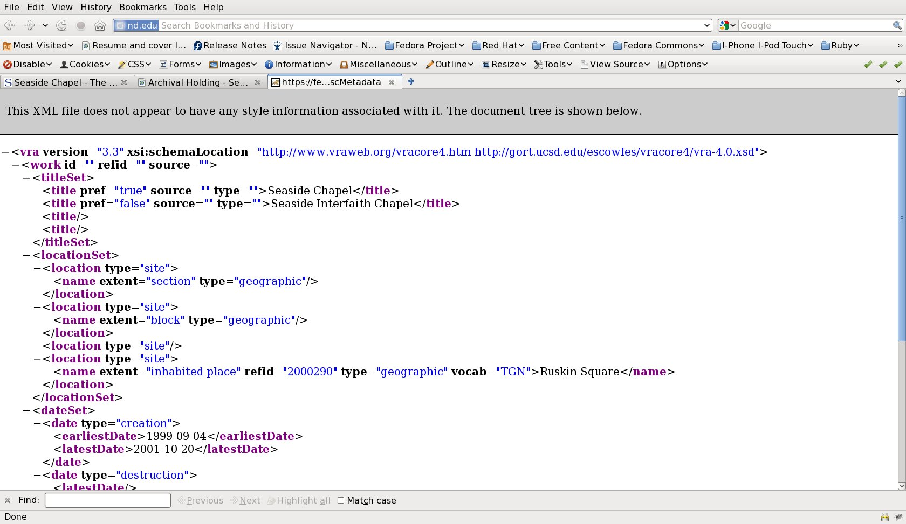
Go beyond the Schema
Notes:
1313
1313

Slide 14
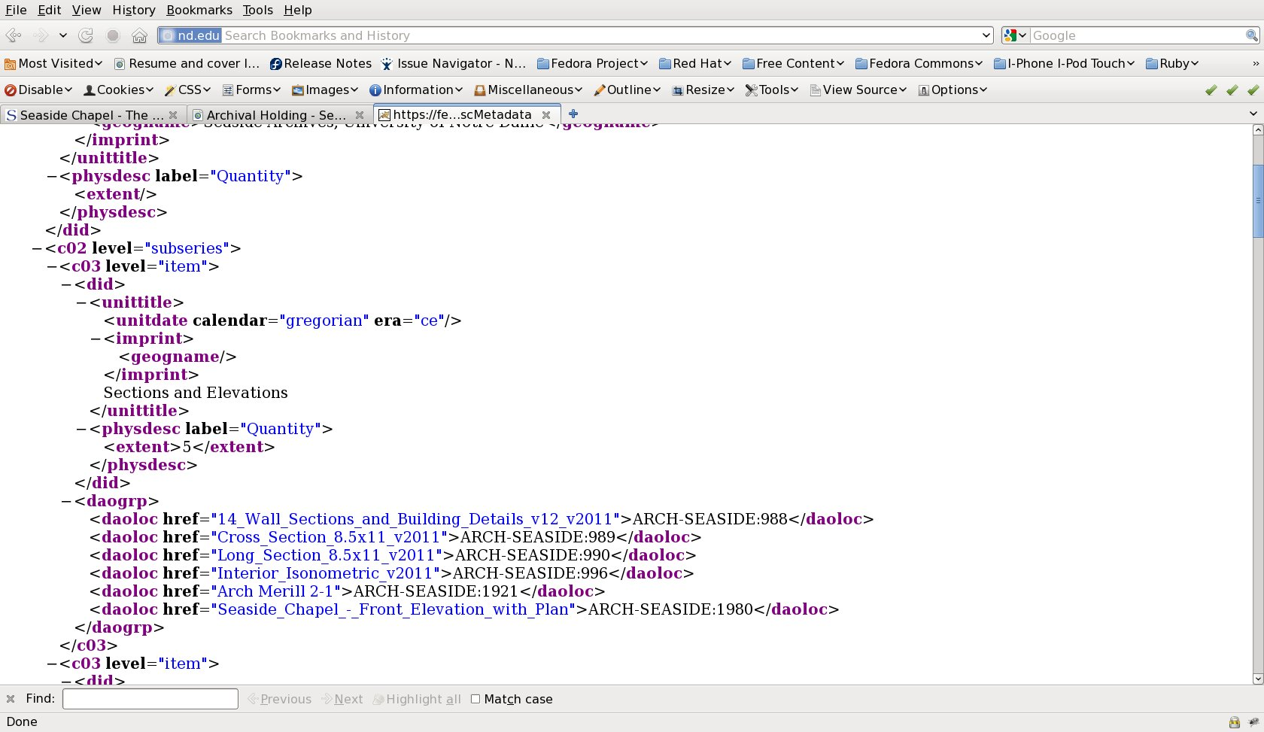
Go beyond the Schema
Notes:
1414
1414

Slide 15
Go beyond the Record
Notes:
1515
1515
We also wanted to move beyond just showing one record in the repository or catalog but really unifying them within the browse experience by what makes sense to someone exploring the collection

Slide 16
Go beyond the Record
Manage related records together
Link records and combine the presentation of related records to provide a rich browse experience
Notes:
1616
1616

Slide 17
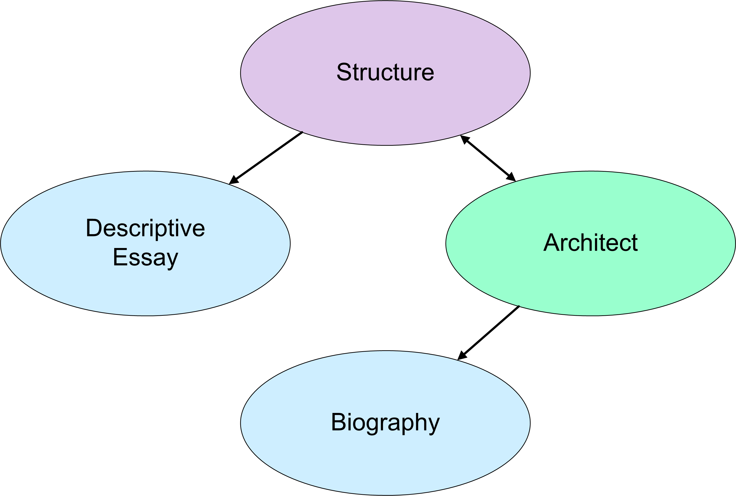
Go beyond the Record
Notes:
1717
1717

Slide 18
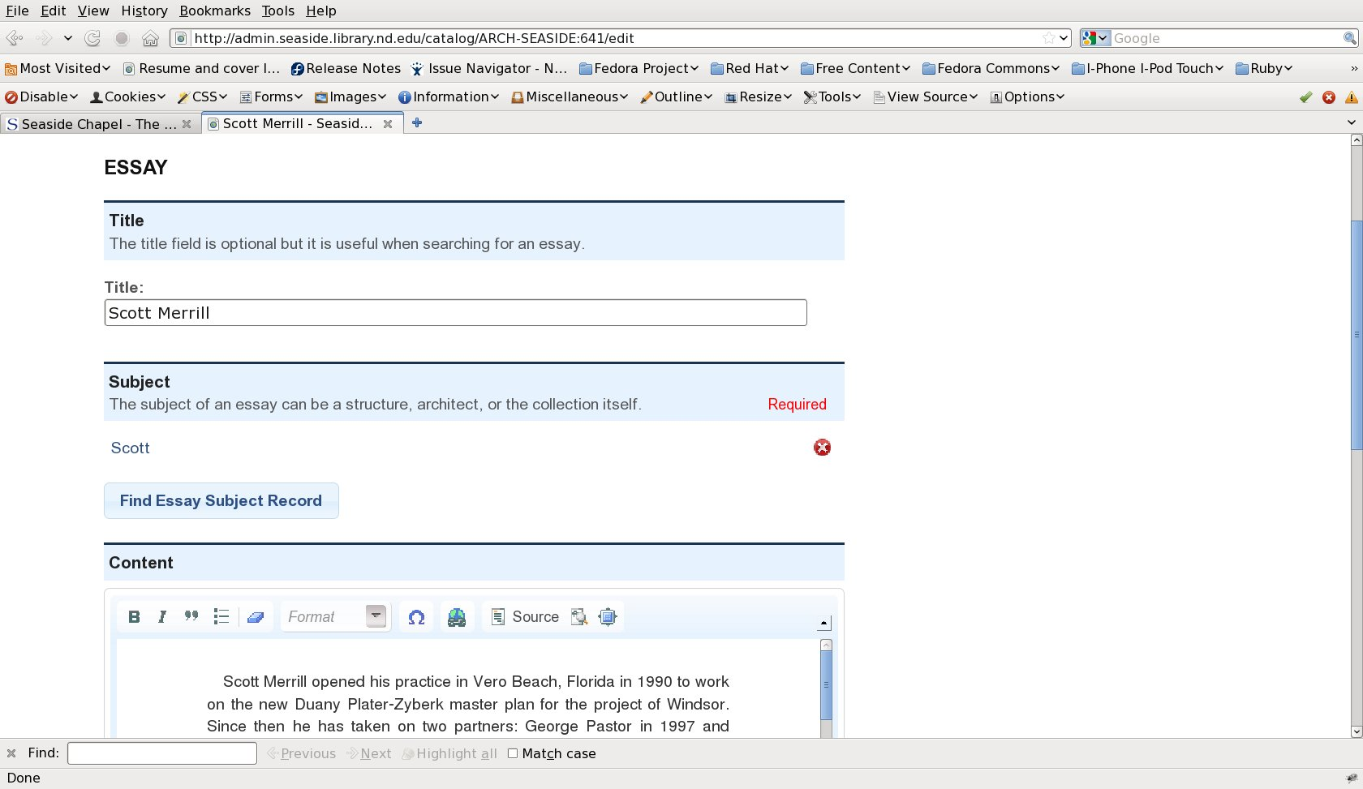
Go beyond the Record
Notes:
1818
1818
Manage essays within the collection management tool instead of relying on creating static html, which is tempting to do

Slide 19
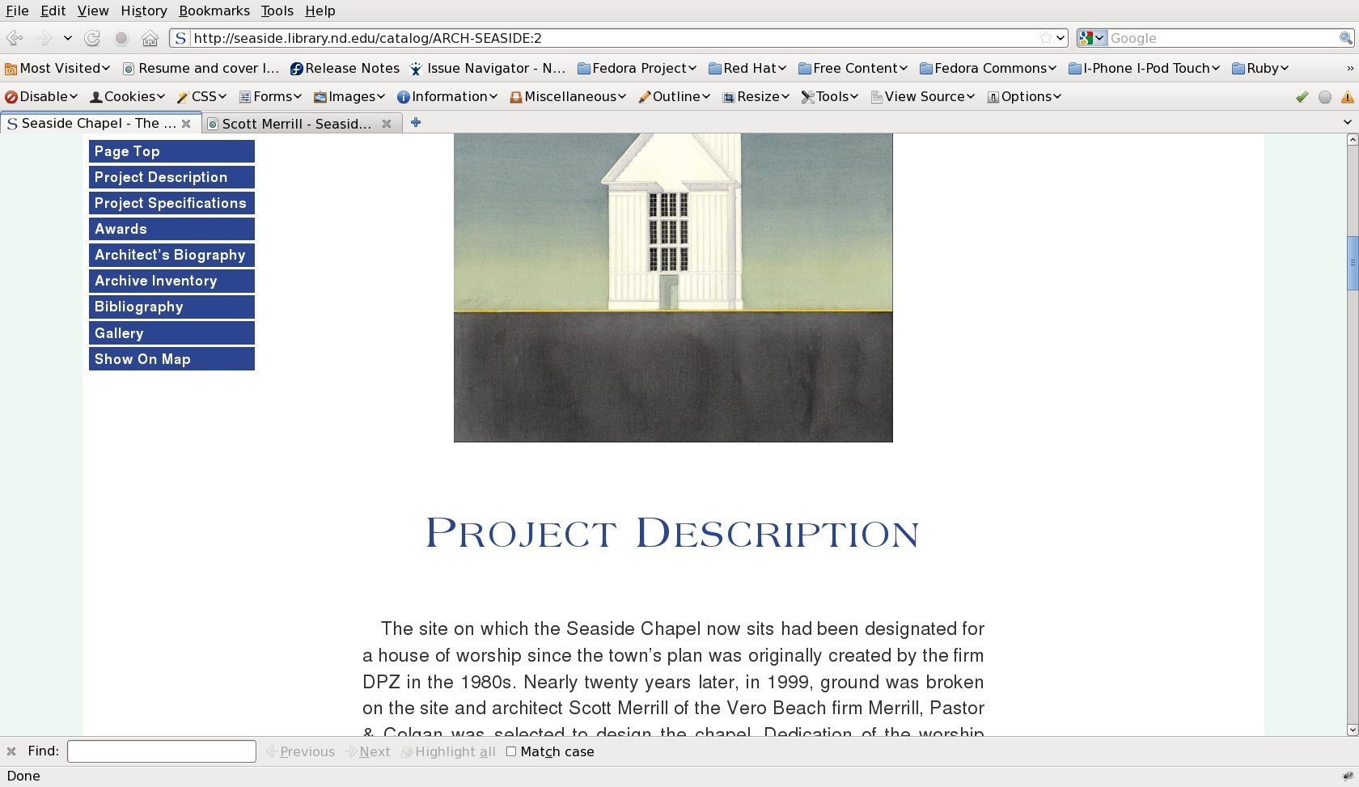
Go beyond the Record
Notes:
1919
1919

Slide 20
Go beyond the Record
Notes:
2020
2020

Slide 21
Give them the Power
Empower archivists and collection managers to update collections themselves
Manage your stories, metadata, and archival records together
Real-time updates to the public site
90% of the content loaded by archivists 3 weeks before launch
Let the coders code
Notes:
2121
2121
So this really empowers our archivists to manage the collection themselves

Slide 22
More About Hydra
Harness Fedora for digital collection management and Blacklight and Solr for Discovery
Multi-layered approach to digital content
Core framework
Map Metadata XML to web form fields
Blacklight provides search and discovery
Access and management UI may be combined
Index content in Solr for High Performance Search in Blacklight
Tailor Hydra application to the use case
Notes:
2222
2222

Slide 23
More About Seaside Research Portal
A tool for students, scholars, and the general public to engage in the town of Seaside, Florida and the New Urbanism movement
The collection contains original biographies, digitized photographs, sketches, plans, and archival documents
More at:
http://hydraproject.org/apps-demos/seaside-research-portal-at-notre-dame/
Screencast: http://www.youtube.com/watch?v=Bj5kn1D6uGM
http://seaside.library.nd.edu
rick.johnson@nd.edu
Notes:
2323
2323
Play some of screencast here…skip to 1:10, then go to 2:40 show other tools including noli map…mention separation of public portal allowed us to focus on additional features like this…kind of an ugly url but link available from apps and demos page on projecthydra.org

Slide 24
What’s Next?
Town plan and other sketch overlays over map search
Improved mobile device support
Panoramic and 3-D Interactive displays
Walking tour mobile application
Implement theme in Atrium Exhibits Framework
Notes:
2424
2424
Mention something about Atrium exhibits framework on top of Blacklight..working on initial early access of ruby gem to use on top of blacklight..interested to hear what features from sites like Seaside that we may want integrated into Atrium…currently primary focus is building custom collection browse landing pages quickly

Slide 25
Acknowledgments
I am just the messenger
Digital Library development team:
Dan Brubaker Horst, Banu Lakshimnarayan,
Rajesh Balekai
Our Architecture Library Colleagues:
Jennifer Parker, Adam Heet, Katy Springstead
The Hydra Community
The town of Seaside, FL
Duany Plater-Zyberk & Co, and other visionary architects of Seaside, Florida
Notes:
2525
2525
Dan primary designer behind the site and he created the great screencast that gives a good overview of the site as well…plug hydra table

Slide 26
Questions
?
http://hydraproject.org/apps-demos/seaside-research-portal-at-notre-dame/
Screencast: http://www.youtube.com/watch?v=Bj5kn1D6uGM
http://seaside.library.nd.edu
rick.johnson@nd.edu
Notes:
2626
2626
Go back to links at the end

