Slide 1
Samvera
an open source solution for
building digital repositories
Mark Bussey, Karen Cariani, and Robin Ruggaber
Notes:
3 hours: 45 mins each section, Q&A, 10 mins break

Slide 2
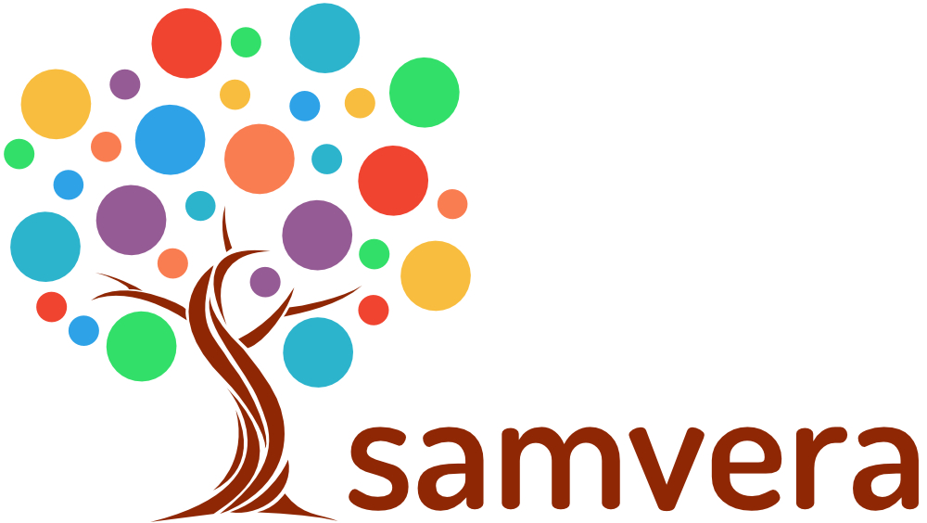
What we’ll cover
What is Samvera?
Community structure and resources
Hands on examples exploration
Technical Overview & Resourcing
Getting started with Samvera
How to pitch Samvera: Benefits
Q & A

Slide 3
from proposal submission
Hour 1: Introductions, overview of Samvera products and the community – what is it, why is it different, ask audience what they are looking for, show website and wiki, and discuss the how the community at large works.
Hour 2: The second hour will give a general technical overview designed for non-coders. Showcase some applications that exist. The staff skills needed to maintain and contribute a Samvera solution will be discussed, resources that exist to get started, and how to contribute code to the community. [Give a 10 minute break halfway through]
Hour 3: Personas (UL/Dean, Executive Tech Lead, Middle Managers, Software Engineers);Benefits of being part of a community, how is this and advantage; positive and negative risk assessment; how does it differ from other solutions; call to action; finish with an invitation to Virtual and physical connect; how to pitch Samvera and get institutional support. It will discuss the advantages of being part of the community and how that strengthens the sustainability of the tools, the applications, and the community overall.
Mark says: check out the “What is Samvera” presentation on the right side of this page https://wiki.duraspace.org/display/samvera/Events%2C+presentations+and+articles

Slide 4
Let’s Start with You
Introductions
What are your goals for the morning?
Where are you in the process?
What are your concerns about Samvera?
Notes:
If less than 30 people, have people intro themselves. If we have a larger number, break into smaller groups to talk about why they are there. Count off for groups of 4-6, answer a set of questions, and then report back.
(Otherwise have them speak out what they are looking for.)

Slide 5
Samvera Overview
what is it?
what does it do?
why is it different?

Slide 6
What is Samvera?
A robust repository fronted by feature-rich, tailored applications and workflows (“heads”)
One body, many heads
Collaboratively built “solution bundles” that can be adapted and modified to suit local needs.
A community of developers and adopters extending and enhancing the core
If you want to go fast, go alone. If you want to go far, go together.
Notes:
The only way to build a rich & robust solution is to engage a large community of developers. The only way to build a sustainable solution is to spur adoption by a community of institutions w/ vested interest in shared success.

Slide 7
Why Samvera?
Need a flexible, rich, robust repository solution
Be part of a community
Shared resources, shared risk, shared advances
“We” is smarter than “me”
Especially in this crowd
Control your own destiny
Build institutional capacity
Practice best practices
The way work is getting done now

Slide 8
Fundamental Assumption #1
No single system can provide the full range of repository-based solutions for a given institution’s needs,
…yet sustainable solutions require a common repository infrastructure.

Slide 9
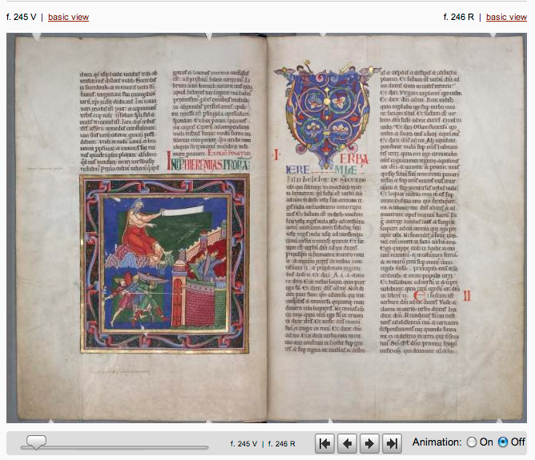
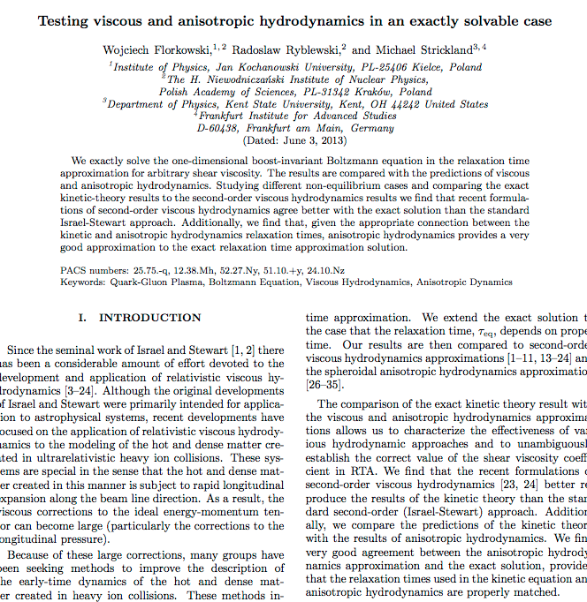
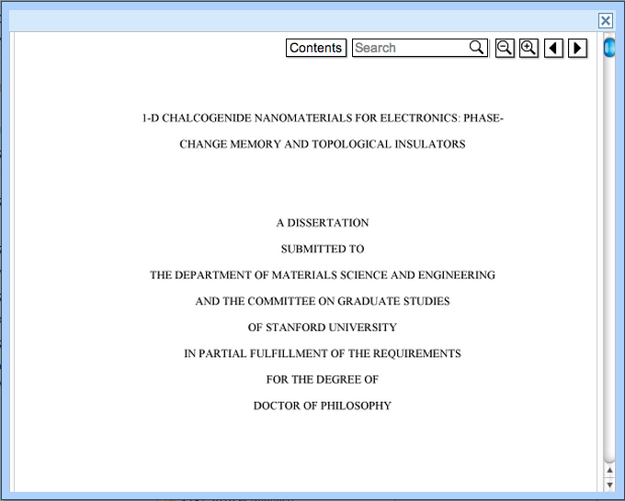
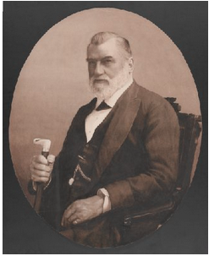
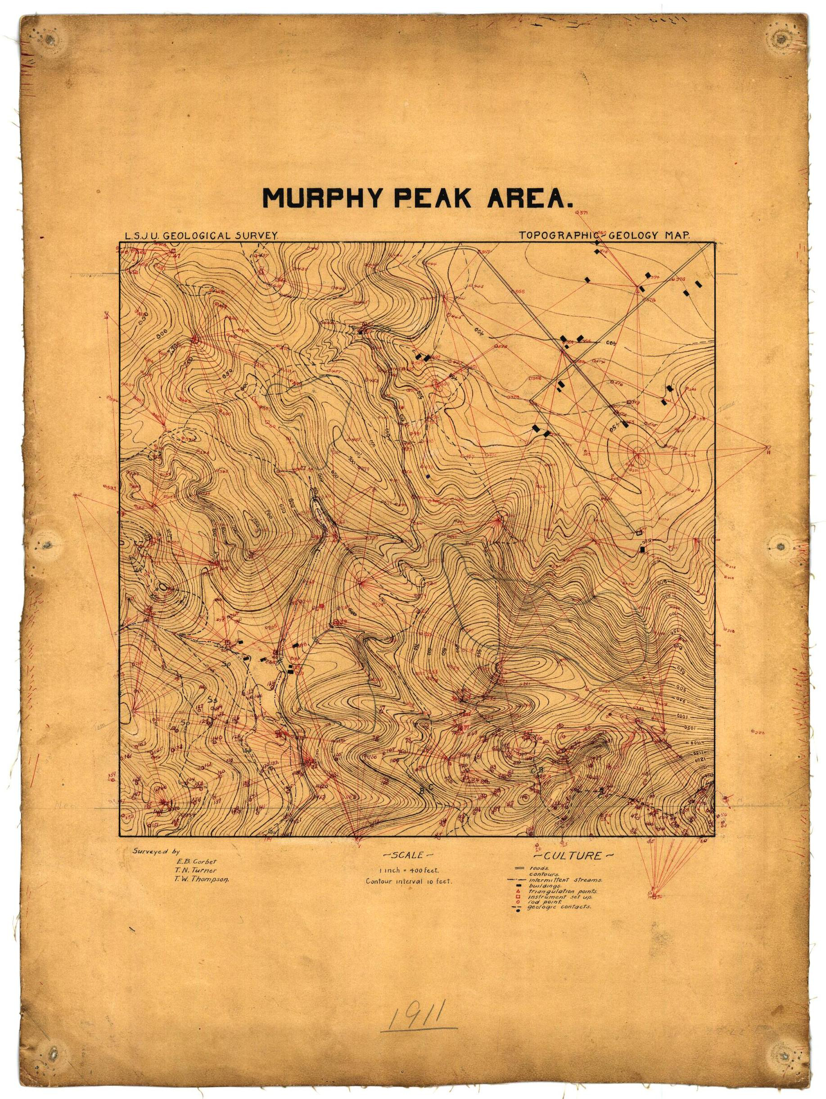
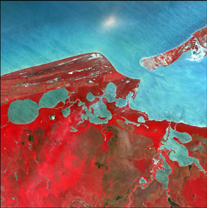
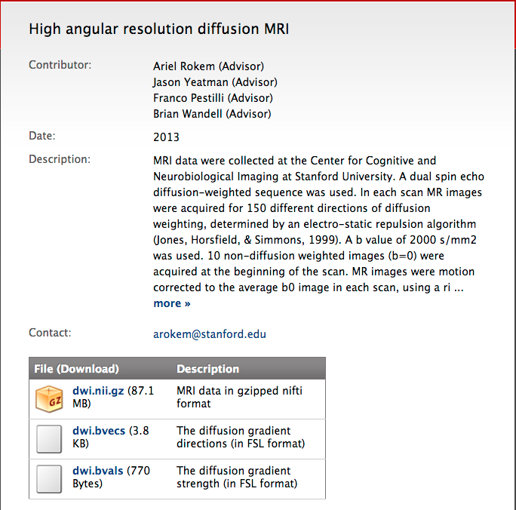
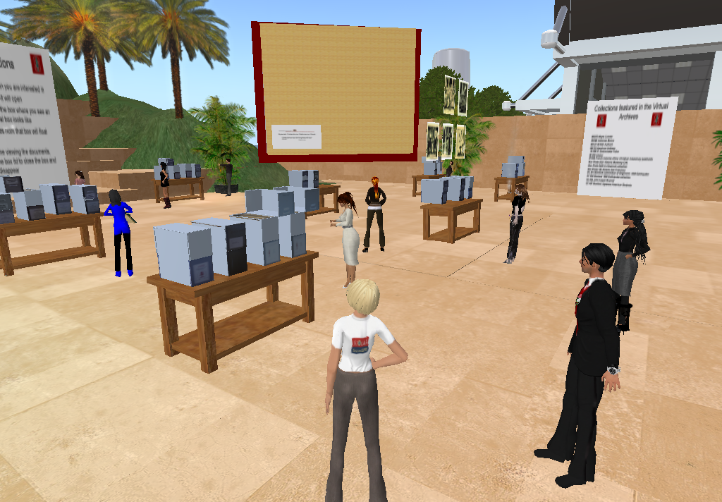
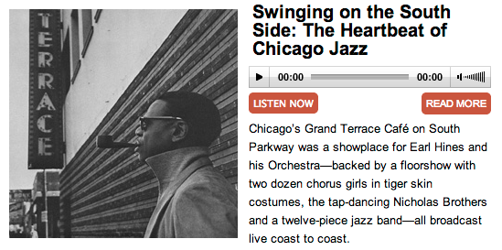
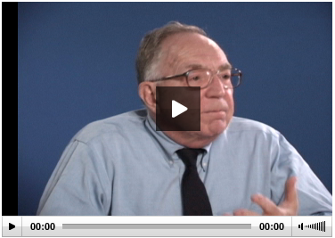
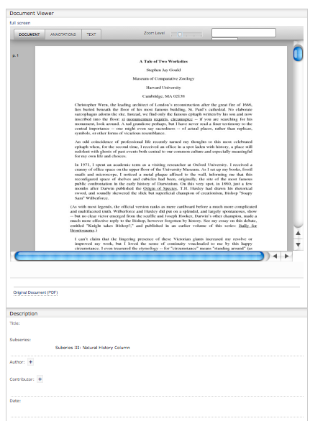
Books
Articles
Theses
Images
Maps
Data (Raster)
Data (Comp.)
Data (Observ.)
Audio
Video
Documents
Notes:
Theses are all the kinds of things that institutions want to keep and provide access to. They are different files formats, have different user access needs / UI, and are different sizes.

Slide 10
Point Solution Approach - Welcome to Siloville
ETD
IR
Image DB
DAM
?
Geospa-tial Inf.
Records Mgmt.
ETDs (Theses)
Books, Articles
Images
Audio-
Visual
Research Data
Maps & GIS
Documents
Management
Access
Preservation?
Effective?
Sustainable?
Notes:
So you could have a separate system solution for each type of item. and you would end up with many systems to support. probably all in a different code language, possibly managed by different depts, etc.

Slide 11
Repository Powered Approach
ETDs (Theses)
Books, Articles
Images
Audio-Visual
Research Data
Maps & GIS
Documents
Digital Repository
Scalable, Robust, Shared Management
and Preservation Services
Notes:
A single application could not effectively cope with these three use cases; however any institution would want to safeguard the outputs of all these disparate systems in a digital repository for management and preservation. Samvera gives a framework where ONE BODY (the repo) can support MULTIPLE HEADS (tailored applications)

Slide 12
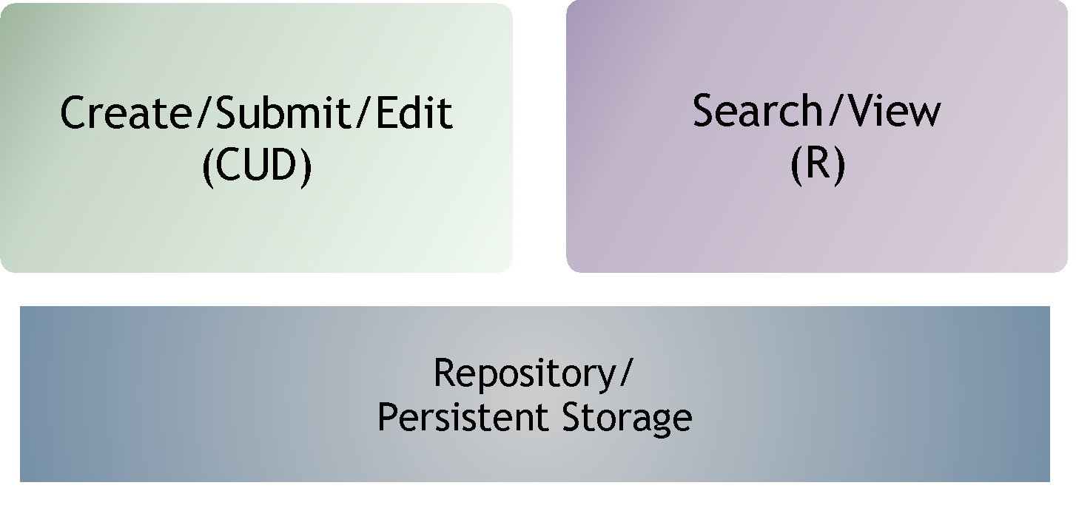
CRUD in Repositories

Slide 13
CRUD in Repositories

Slide 14
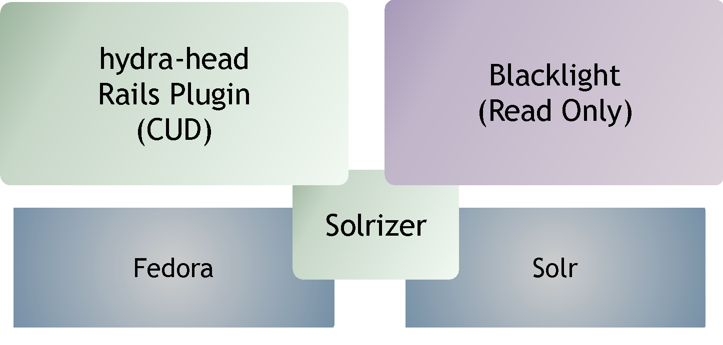
Major Samvera Components

Slide 15
Used by: Used for:
Large Universities
Small Universities
Colleges
Public Broadcasting
Government Ministry
National Libraries
National Lab
Small Research Labs
National Digital Repository
Statewide Digital Libraries
Rock & Roll Hall of Fame
Chemical Heritage Foundation
Museum of Performing Arts
A Shakespeare Festival
Self-deposit system
Digital Collections System
Sheet Music
Architectural resources
Electronic Theses & Dissertations
Digital Image System
Media Management
Media Preservation System
Research Data Management
Digitization Workflow System
Digital Preservation System
Digital Archives System
Library Monograph Acquisitions System
And more!
Notes:
Here are some of the current types of users and the use cases.

Slide 16
Next Up:
How we work
How do I get involved?

Slide 17
Fundamental Assumption #2
No single institution can resource the development of a full range of solutions on its own,
…yet each needs the flexibility to tailor solutions to local demands and workflows.

Slide 18
Samvera Philosophy: A Community
An open architecture, with many contributors to a common core
Collaboratively built “solution bundles” that can be adapted and modified to suit local needs
A community of developers and adopters extending and enhancing the core
“If you want to go fast, go alone. If you want to go far, go together.”

Slide 19
The Samvera Way
Not a directed project
Investment in a framework, not an application
Contributions back to core code base
Investment in a community, not a vendor
Contributions back to community: Training, documentation, modeling, evangelism, support
Travel / face-time

Slide 20
Community
Conceived & executed as a distributed, collaborative, open source effort
Initially a joint development project between Stanford, Univ of Virginia, and Univ of Hull
Samvera Partners are the backbone of the project
Coalition of the willing
No fees or dues
Apache-style consensus and governance
Steering Group provides administration, continuity, and serves as backstop
But no central planning, no Project Director, no “one” architect

Slide 21
Community Structure
Steering Group (elected by partners) Stewards of the project - individual membership
Partners (Institutional) Formally committed institutional membership
Working & Interest Groups Topically aligned groups that span organizations & roles
Committers Developer community
Community adopters

Slide 22
Samvera Partners
…are individuals, institutions, corporations or other groups that have committed to contributing to the Samvera community; they not only use the Samvera technical framework, but also add to it in at least one of many ways: code, analysis, design, support, funding, or other resources.
Samvera Partners collectively advance the project and the community for the benefit of all participants.

Slide 23
Training & Connecting
Good: read the documentation and learn-by-doing
Better: connect through social channels
Email lists, IRC, weekly phone calls
Github interactions
Best: meet in person. Face time fuels collaboration!
Samvera Connect: annual, worldwide, community meeting
Samvera (Partner) meetings: 3-6 ad hoc, topic-based meetings per year (usually)
Regional Groups: convening ad hoc

Slide 24
Get Involved: Many Hands Make Light Work
Getting involved with Samvera can be at different levels:
Adopter
Developer
Partner
Need to ask:
What involvement is required to enable you to meet your needs?
But also,
If we contribute back, what more do we gain?

Slide 25
Stay Connected
Website (http://samvera.org)
Wiki page (https://wiki.duraspace.org/display/samvera/)
Partner meeting agendas & notes
Events & Details
Monthly Partner calls
Partner listserv
Samvera Partner meetings & Samvera Connect
Identify a Samvera Partner doing similar work and get in touch
Identify need for vendor input and make contact to discuss options
Come to events (like this one!)

Slide 26
Code Licensing
All Samvera code is available under Apache License, Version 2.0
All code commitments are being managed through Contributor License Agreements
Individual – each developer is clear about what they are contributing
Corporate – each institution is clear about what it is contributing
Code contributors maintain ownership of their IP
…and grant a non-exclusive license to the project and its users

Slide 27
Interest & Working Groups
Collection Extensions Working Groups
Component Maintenance Working Group (Phase 1)
DSpace/Samvera Interest Group
Hyrax Analytics Working Group
Repository Management Interest Group
Samvera Applied Linked Data Interest Group(formerly Working Group)
Samvera Archivists Interest Group (formerly Working Group)
Samvera Code Stability Working Group
Samvera CONTENTdm Migration Interest Group
Samvera Contribution Model Working Group
Samvera Data Mapper Working Group
Samvera Documentation Working Group(enrolling)
Samvera EZID to DataCite DOI Working Group
Samvera Geo Predicates Working Group
Samvera Geospatial Interest Group
Samvera Governance Working Group
Samvera Hyrax Batch Import Working Group
Samvera Marketing Working Group
Samvera Metadata Interest Group (formerly Working Group)
Samvera Newspapers Interest Group
Samvera Permissioning Analysis and Design Working Group
Samvera Interest Group for Advising the Hyrax Roadmap (SIGAHR)
Samvera URI Selection Working Group
Samvera User Experience Interest Group

Slide 28
Community Resources
website
wiki
slack channels
e-mail lists
meetings- in person and virtual
the people themselves!

Slide 29
Communication Channels
Slack - for real-time interaction
E-mail - for asynch and longer discussions
Community Calls - Samvera Tech & Community calls, Virtual Connect
In Person - Connect, regional meetings, other conferences, & workshops

Slide 30
Community Resources
Website - for the managers https://samvera.org
Wiki - for the doers https://samvera.org/wiki
Github - for the makers https://github.com/samvera https://github.com/samvera-labs https://github.com/samvera-deprecated

Slide 31
Exercises
Search for a topic of interest to you from the samvera-tech or samvera-community Google Groups
Find a Samvera Interest or Working Group of interest to you; find the most recent meeting notes
Using the Samvera Wiki… https://wiki.duraspace.org/display/samvera/Samvera
Sign up for the samvera-tech or samvera-community Google Groups
Get a Samvera wiki account
Join the project-samvera Slack team

Slide 32
First Up:
Example Sites
What are folks doing with it?
Notes:
Mark Starts Here

Slide 33
Tufts Digital Library
Fedora content pre-dates Hydra & Samvera
Multi-app ecosystem (management, discovery, image library, others)
Supports multiple content types
Live Site: https://dl.tufts.edu

Slide 34
INDIANA UNIVERSITY
Media Collections Online
Built using the Avalon Media System
Rich tool for management and discovery of audio and visual resources
Provides gated discovery and streaming authentication
Live Site: https://media.dlib.indiana.edu

Slide 35
Alexandria Digital Research Library
Fedora 4 + RDF based
Broadly focused Institutional Repository hosting multiple content types
Includes a mix of born digital and digitized content
Live Site: https://www.alexandria.ucsb.edu

Slide 36
Earthworks
Heterogeneous GIS Content
Search and browse augmented by spatial search functions
Includes content harvested from multiple sources
Live Site: https://earthworks.stanford.edu

Slide 37
Next Up:
Hands-On
Any questions so far?

Slide 38
Create an account
Visit http://demo.curationexperts.com/
Click the Login link
Click on “Sign Up” (just under the Login button)
Enter your e-mail, choose a password, and click on “Sign Up”

Slide 39
Deposit a new work
Click on the logo in the upper left corner
Click on the “Share Your Work” button
Select a type of work
Add required metadata, attach a file, choose visibility, accept the deposit agreement
Save your work

Slide 40
Edit your work
Choose “Dashboard” from the menu in the upper right corner
Click on Works
Use the “Actions” dropdown to choose edit
Enter some data in “Additional Fields”
Add a file or two, update versions

Slide 41
Browse content
Click on the logo in the upper left
Click on the search icon to browse the repository
Use search and facet to narrow results
View some items
Log-out - how does your experience differ?

Slide 42
Deposit a new work
Reminder: Logo, Share, Select
Add required metadata, attach a file, choose visibility, accept the deposit agreement
Confirm “one step approval” is selected under Relationships
Save your work

Slide 43
View your work?
Reminder: dashboard, works
What do you see?
What does your administrator see?
Approve some works (Admins)
All Works
Review Submissions
Notifications

Slide 44
Other features to try
Gated discovery: Public, DCE, Private
Featured works (Admins)
Collections
Admin dashboard (Group Walkthrough)
Background Processing (Group)

Slide 45
Next Up:
The Samvera Pitch
Notes:
Robin picks up here with:Personas (UL/Dean, Executive Tech Lead, Middle Managers, Software Engineers);Benefits of being part of a community, how is this and advantage; positive and negative risk assessment; how does it differ from other solutions; call to action; finish with an invitation to Virtual and physical connect; how to pitch Samvera and get institutional support. It will discuss the advantages of being part of the community and how that strengthens the sustainability of the tools, the applications, and the community overall.

Slide 46
Repository Elevator Pitch
A (new) way to manage digital content
The best of Hydra in an easy-to-install, easy-to-configure, feature-rich solution
Reducing barriers to effective asset management
& preservation
For collections and content types of many kinds
Supports next-generation web technologies
Is supported by a vibrant and ever-growing open source community.
Notes:
So to sum it up, the Hydra-in-a-Box repository elevator pitch goes something like this:
For cultural heritage institutions,
Who seek a (new) way to manage their digital content,
The Hydra-in-a-Box repository offers the best of Hydra in a single, easy-to-install, easy-to-configure, feature-rich solution for collections of all kinds, thus reducing barriers to effective and affordable content management and preservation.
Unlike existing, aging repository solutions available in the market, our product supports several next-generation web technologies (RDF, IIIF, ResourceSync to start) and is supported by a vibrant and growing open-source community.

Slide 47
If You Want To Go Fast
…go alone.
…use Samvera
Notes:
Talk about Libra ETD, OA and Avalon - time- staff -etc

Slide 48
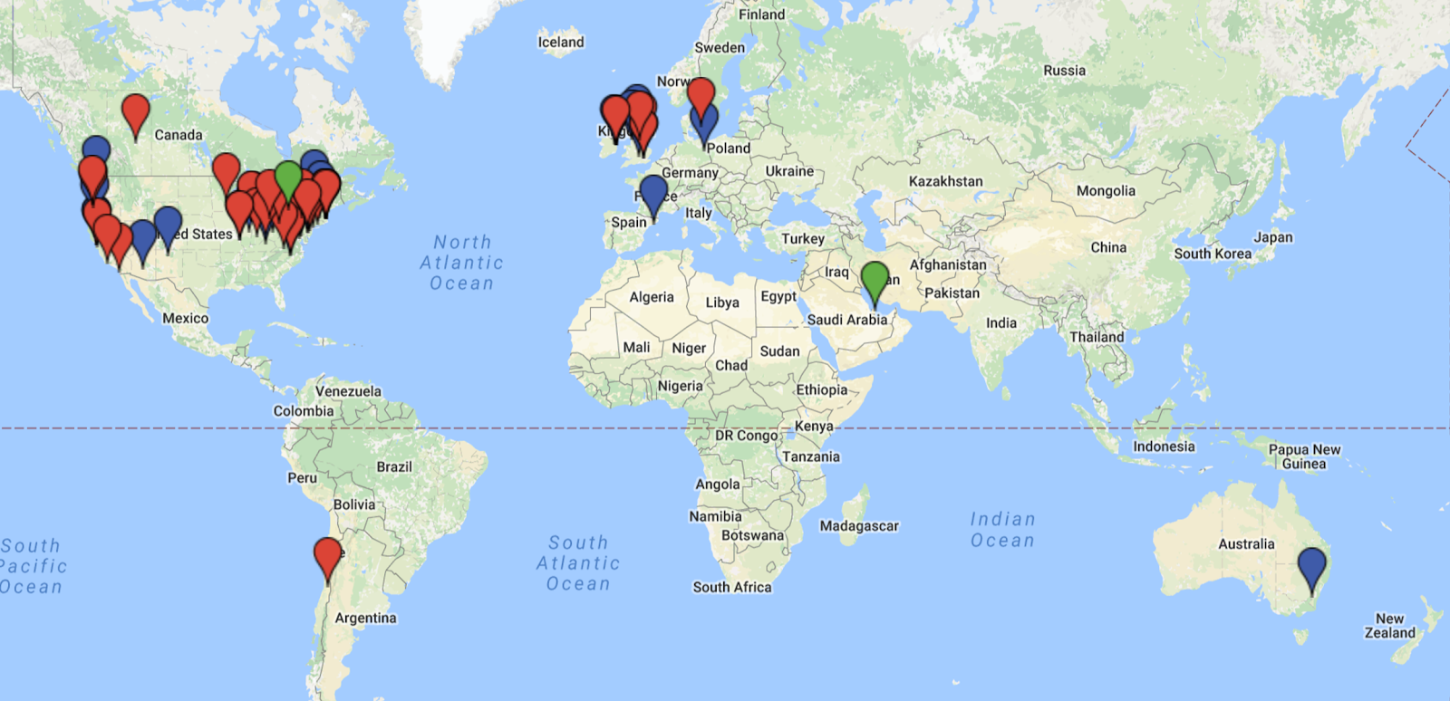
A Worldwide Presence
Notes:
Adopters include: a theater institute, a Shakespeare Festival, Australian Dept of the Environment, a Chemical Heritage Foundation, Arizona State’s Nexus Lab for Humanities Research) ,
National Library (Ireland, Denmark), Art Museum (1), Art Institute (1), 1 National Lab, 1 National digital repository, 2.5 national libraries (DPLA = half), a boatload of universities.
Northwestern likes it so much, they adopted twice: once in the Library, once in the Galter Heatlh Science Library.

Slide 49
By the Numbers….

Slide 50
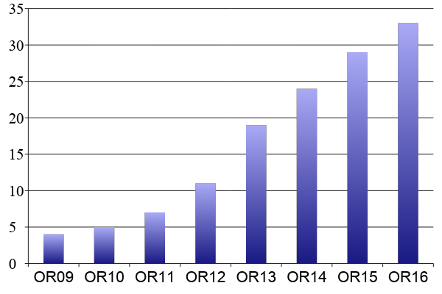
Samvera Partners
OR = Open Repositories Conference
Notes:
New partners since OR2015: York, UCSD, Lafayette, WUSTL

Slide 51
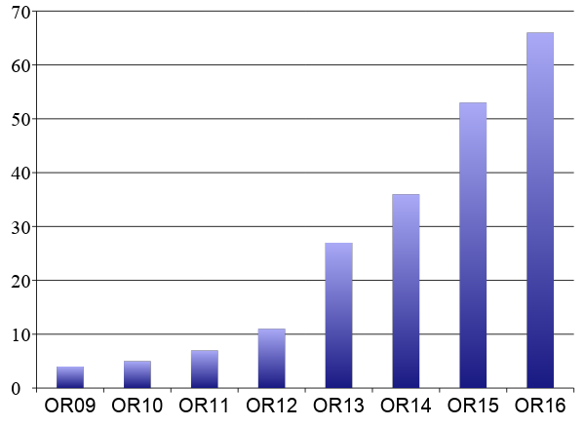
Samvera Partners and Known Users
OR = Open Repositories Conference
Notes:
The only way to build a rich & robust solution is to engage a large community of developers. The only way to build a sustainable solution is to spur adoption by a community of institutions w/ vested interest in shared success.

Slide 52
Samvera Partners and Known Users
64 Licensed Contributing Institutions
280 Licensed Contributing Individuals
OR = Open Repositories Conference
Notes:
Compared to 47 / 180 at HC15.

Slide 53
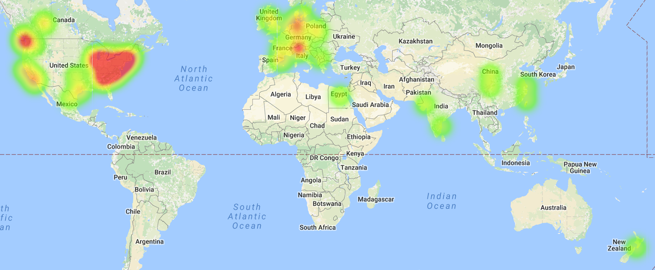
Samvera Code Activity
http://jrvis.com/red-dwarf/?user=samvera&repo=sufia
https://www.openhub.net/p/projecthydra

Slide 54
132 samvera-partners
748 samvera- tech
617 samvera-community
478 Slack Team Members project-hydra.slack.com
@HydraSphere 623 Followers
Notes:
vs. 2015
97-> 122
572 –>705
365 -> 509

Slide 55
Hydra Partners
Notes:
The only way to build a rich & robust solution is to engage a large community of developers. The only way to build a sustainable solution is to spur adoption by a community of institutions w/ vested interest in shared success.

Slide 56
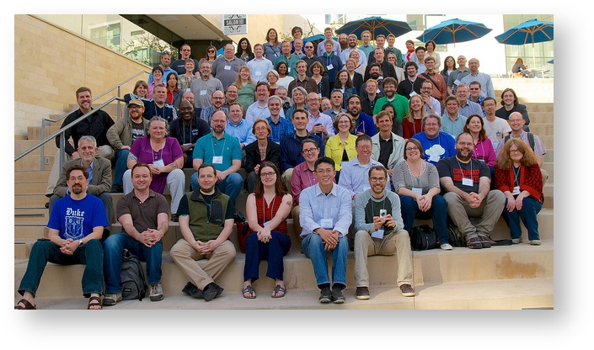
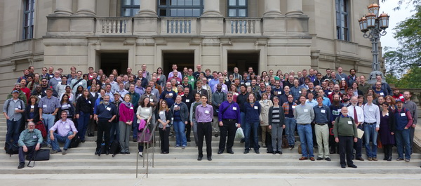
Going Far Together
University of Virginia, 2008
Hydra Partners @ UCSD, 2012
First Worldwide Hydra Connect @ UCSD, January 2014
2nd Worldwide Hydra Connect @ Cleveland, OH, September 2014 160 participants from 56 institutions
3rd Worldwide Hydra Connect @ Minneapolis, OH, September 2015 200 participants from 60 institutions
Notes:
Lots of systems fulfill same functionality. Biggest difference between other solutions is its community and commitment to community building.

Slide 57
Going Far Together
Notes:
Lots of systems fulfill same functionality. Biggest difference between other solutions is its community and commitment to community building.

Slide 58
University of Virginia, 2008
LibDevConX^3, Stanford, 2012: (Hydranauts and Fellow Travelers)
Hydra Partners @ UCSD, 2012

Slide 59
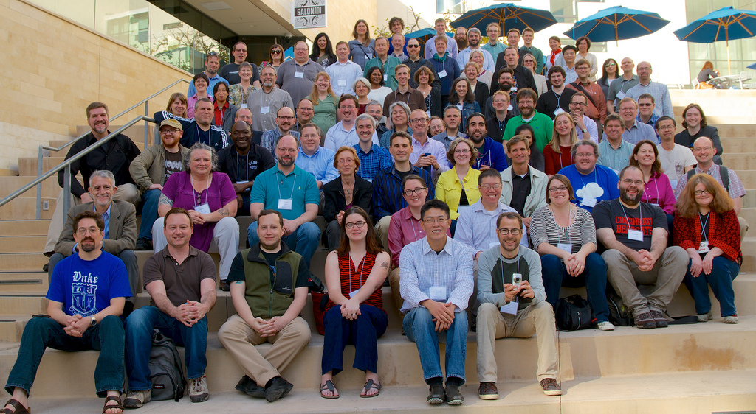
First Worldwide Hydra Connect @ UCSD, January 2014

Slide 60
2nd Worldwide Hydra Connect @ Cleveland, OH, September 2014 160 participants from 56 institutions
3rd Worldwide Hydra Connect @ Minneapolis, OH, September 2015 200 participants from 60 institutions

Slide 61
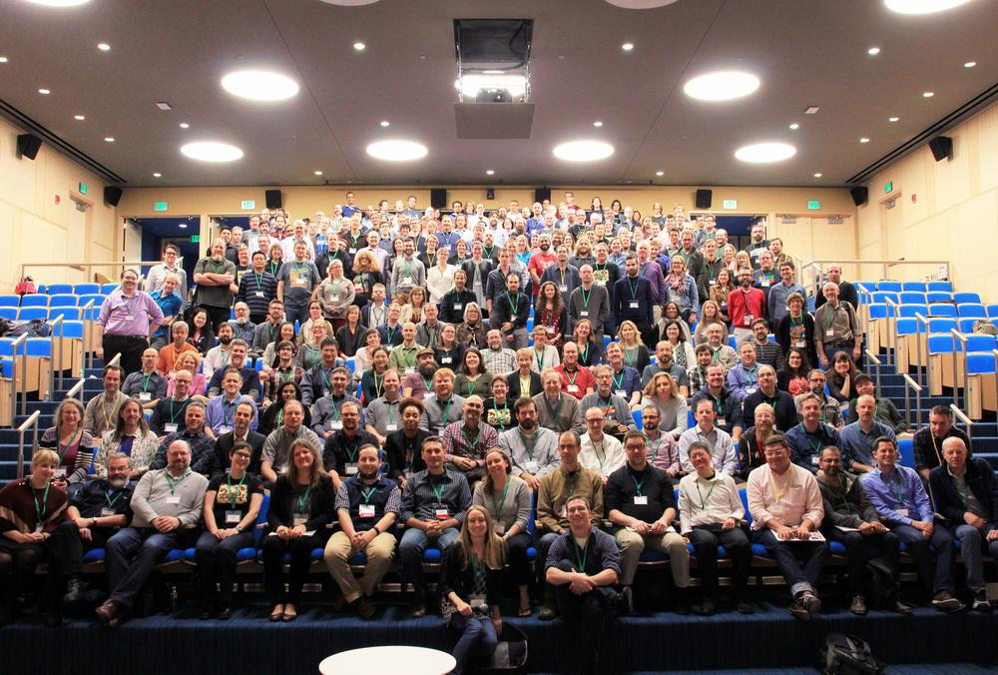
Notes:
Speaking of community: here are the attendees of the fourth annual Hydra Connect meeting in Boston last month. Good looking bunch, right?
In addition to project staff from DPLA, DuraSpace, and Stanford working on the repository product, we’ve had development contributions from Chemical Heritage Foundation, Indiana University, and Indiana University–Purdue University Indianapolis, Penn State and Northwestern.

Slide 62
Sustainability
No animals were harmed in the making of this film.
grants
abused
project / community

Slide 63
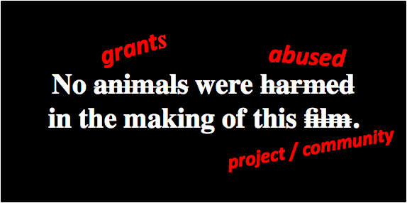
Sustainability…
For institutions Partners help shoulder the load
For other projects Post-project maintenance & governance
For leveraging funders’ investments Adoption by growing user community
Notes:
Avalon, ORCID, WGBH,

Slide 64
Next Up:
What next?
What do I do back home?

Slide 65
Community Resources
Website - for the managers https://samvera.org
Wiki - for the doers https://samvera.org/wiki
Github - for the makers https://github.com/samvera https://github.com/samvera-labs https://github.com/samvera-deprecated

Slide 66
Try it out
github.com/samvera
demo.curationexperts.com
ask other partners for demos!
Stanford University
Univ. of Notre Dame
Indiana University
Data Curation Experts
Yale University
Cornell University
Tufts University
University of Michigan
University of York
University of Hull
Northwestern University
London School of Economics
WGBH Boston
Virginia Tech
University of Oregon
Duoc UC (Chile)
Lafayette College
UC San Diego
Digital Repository of Ireland
University of Virginia
Columbia University
Boston Public Library
University of Cincinnati
Oregon State University University of Alberta
University of York
UC Santa Barbara
DuraSpace
Penn State University
Royal Library of Denmark
Duke University
Princeton University Library
Washington U. in St Louis
University of Houston
DPLA

Slide 67
Questions
Thank you
samvera-community@googlegroups.com
samvera-tech@googlegroups.com
karen_cariani@wgbh.org
robin.ruggaber@virginia.edu
Last resort… mark@curationexperts.com

Slide 68
Slides below from last years OR related to tech and may be of use as others were.

Slide 69
Agenda
What is Samvera?
Community Framework
Technical Framework
Data Modeling
Getting Started with Samvera
Discussion

Slide 70
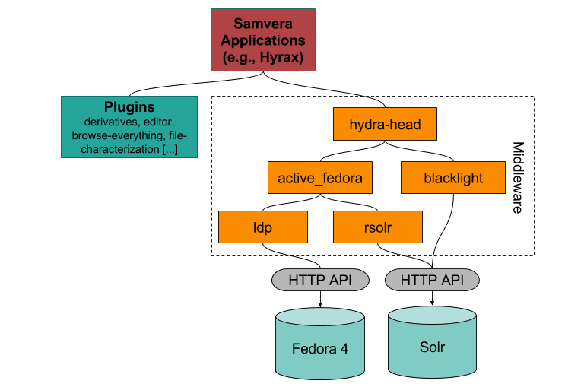
Major Components
Notes:
By picking industry standard components, Hydra leverages the best of the community technology and skill base, and concentrates its efforts on the value added workflows around digital asset management.

Slide 71
A Note on Fedora
Flexible, Extensible, Durable Object Repository Architecture
Flexible: model and store any content types
Extensible: easy to augment with apps and services
Durable: foundation of preservation repository
Proven, sustained and successful digital repository
100’s of adopters; 13 years of development, 4 releases
Vibrant community & funding under DuraSpace
Fedora 4.0 released in Dec ‘14; co-evolving with Hydra

Slide 72
A Note on Ruby on Rails
Rapid application development for web applications: “Convention over configuration”
10x productivity
Supportable: MVC (Model-View-Controller) and Rails framework make code well-structured, predictable
Testable: Rspec and Cucumber give powerful, automatable, testing tools
Learnable: Stanford went from 1 to 8 Ruby savvy developers in one year (no new hires)
1 week learning curve to basic proficiency

Slide 73
Hydra’s Core Gems
Interact with Fedora with a Rails/ActiveRecord pattern
ActiveFedora
Fedora
Notes:
By picking industry standard components, Hydra leverages the best of the community technology and skill base, and concentrates its efforts on the value added workflows around digital asset management.

Slide 74
Hydra’s Core Gems
Build digital objects using PCDM-based models
Hydra::PCDM
ActiveFedora
Fedora
Notes:
By picking industry standard components, Hydra leverages the best of the community technology and skill base, and concentrates its efforts on the value added workflows around digital asset management.

Slide 75
Hydra’s Core Gems
Work with files, like:
Characterize
Make derivatives
Virus check
Extract text
Group them to create “works” (or complex objects)
Hydra::Works
Hydra::PCDM
ActiveFedora
Fedora
Notes:
By picking industry standard components, Hydra leverages the best of the community technology and skill base, and concentrates its efforts on the value added workflows around digital asset management.

Slide 76
Hydra’s Core Gems
Get basic Ruby on Rails views, and more shared features:
Custom models
Routing for CRUD
File auditing
Versioning
Single-use links
Upload file sets
Access controls
Leases and embargoes
CurationConcerns
Hydra::Works
Hydra::PCDM
ActiveFedora
Fedora
Notes:
By picking industry standard components, Hydra leverages the best of the community technology and skill base, and concentrates its efforts on the value added workflows around digital asset management.

Slide 77
Sufia/Hydra App
Hydra’s Core Gems
A fully functional repository application, with:
Proxy deposit
User dashboard
User profile
Featured works & researchers
Contact form
WYSIWYG UI editing
Activity streams
Upload via cloud providers
Integration with Zotero
CurationConcerns
Hydra::Works
Hydra::PCDM
ActiveFedora
Fedora
Notes:
By picking industry standard components, Hydra leverages the best of the community technology and skill base, and concentrates its efforts on the value added workflows around digital asset management.

Slide 78
Sufia/Hydra App
Hydra’s Core Gems
A fully functional repository application
Build basic Rails views & shared features: custom models
CurationConcerns
Work with files; group them into digital objects
Hydra::Works
Build PCDM-based Models for Digital Objects
Hydra::PCDM
Interact with Fedora with a Rails/ActiveRecord pattern
ActiveFedora
Fedora
Notes:
By picking industry standard components, Hydra leverages the best of the community technology and skill base, and concentrates its efforts on the value added workflows around digital asset management.

Slide 79
Hyrax (formerly known as Sufia 7.x)
Lots of features already done
Complex objects based on PCDM in Fedora 4
Building on Sufia, one of most actively maintained and widely used Hydra gems
Notes:
The other major milestone over the past year was the decision to develop the repository using Sufia 7 code base as a starting point. Reasons for our selection are clear:
Many of the requirements revealed in the design process were already satisfied in Sufia features,
Its support for complex objects represented in PCDM data models with Fedora 4 provides both the natural foundation and direction that the Hydra-in-a-Box project needed out of the gate
And the fact that Sufia is one of the most actively maintained and widely used Hydra gems is an indicator of its good health.

Slide 80
Agenda
What is Samvera?
Community Framework
Technical Framework
Data Modeling
Getting Started with Samvera
Discussion

Slide 81
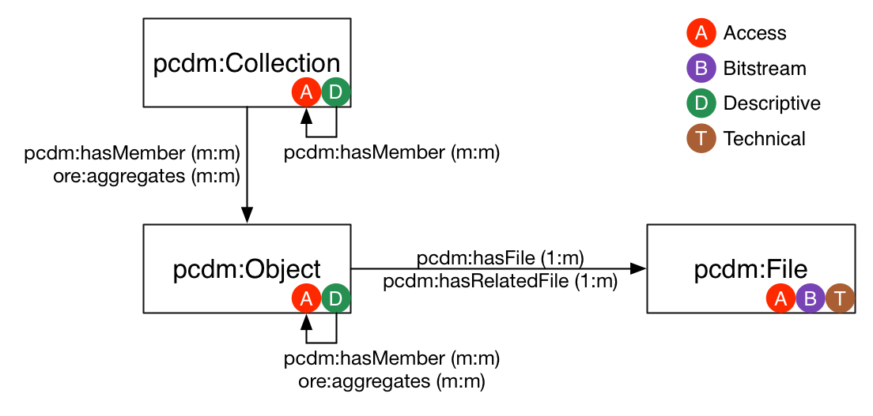
PCDM = Portland Common Data Model
x

Slide 82
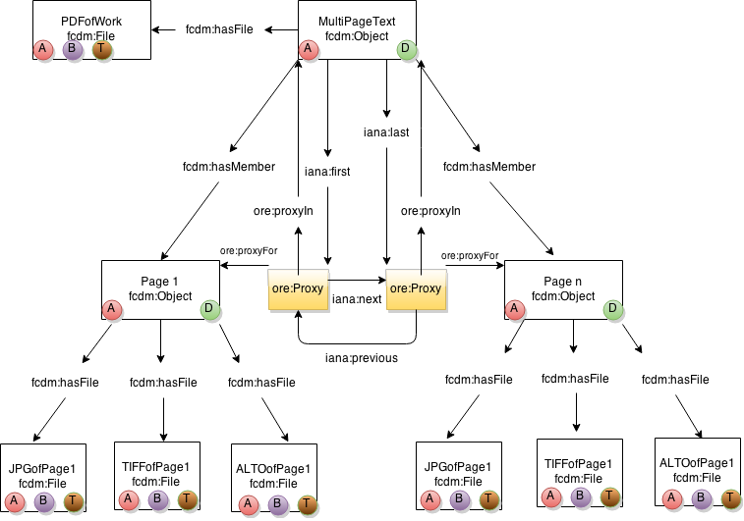
Book

Slide 83
Why PCDM?
1.) Best practices in data modeling
2.) Code interoperability
3.) Data interoperability

Slide 84
Agenda
What is Samvera?
Community Framework
Technical Framework
Data Modeling
Getting Started with Samvera
Discussion

Slide 85
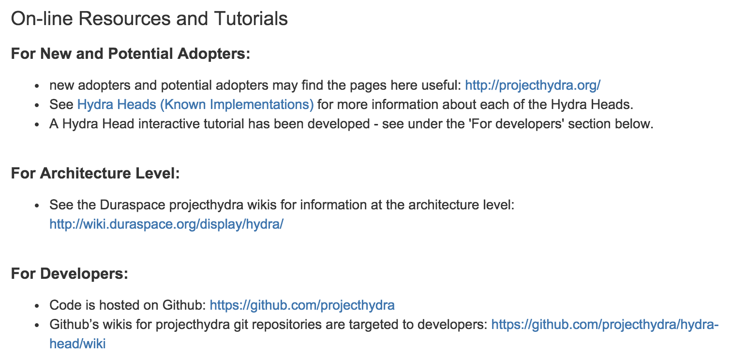
Getting Started
https://wiki.duraspace.org/display/hydra/Developers

Slide 86
Technical Engagement
Software: https://github.com/projecthydra
Developers should start here: https://github.com/projecthydra/hydra-head/wiki
Note: Most sites start from Sufia on Fedora 4 at this point
samvera-tech@googlegroups.com, Slack and weekly tech phone calls = best channels for tech support
Ask questions. Seek help. Commit back.
Professional social coding norms apply: Respect, courtesy, code review, consensus

Slide 87
Typical Staffing
Repository Manager
Typically serves as product owner & service manager. Essential to defining service goals, running service and working with users after set up
Developers: numbers ranges from
0: borrowed or contracted
1: many sites have a single dev
2-4: most Hydra teams don’t get above 4 developers, usually on sprints rather than dedicated full time
Optional:
UX Design, doing interface design / user studies
DevOps, doing system deploys & production support

Slide 88
Skills & Training
Technical Skills
Agile & social coding: Git, pull requests & code review, continuous integration are standard.
Ruby on Rails: eminently learnable. Rails Bridge is a good starting point if developers are new to Rails.
DevOps & Sys Admins: growing coterie of Hydra users leveraging each others’ skills for deployment and operations
Hydra Camps
Typically organize a camp 2-3 times a year
Many sites host one as a way to bootstrap rapid development
Data Curation Experts is our preferred training partner
Often tap community members for “train the trainer”

Slide 89
A word of (polite) warning
Hydra is open source – anyone can use it freely
Working with Hydra is not, though, free
As in ‘puppies are not free’
It requires investment
Towards achieving a goal
Towards sustaining a solution
Hydra recognises this and is seeking to provide a way to invest in a mutual direction of travel – come with us!

Slide 90
Agenda
What is Samvera?
Community Framework
Technical Framework
Data Modeling
Getting Started with Samvera
Discussion

