Slide 1
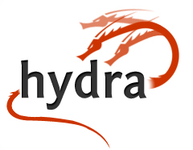
One Body, Many Heads
for Repository-Powered
Library Applications
Chris Awre
Head of Information Management
Library and Learning Innovation
University of Hull
Tom Cramer
Chief Technology Strategist
Stanford University Libraries
Open Repositories 2012, Edinburgh

Slide 2
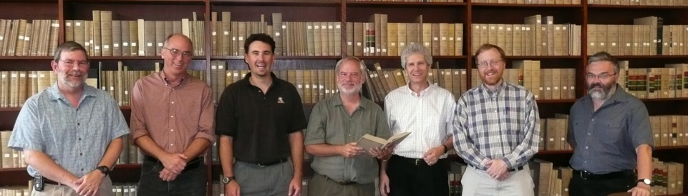
Repositories make strange bedfellows
University of Virginia, 2008
Virginia, Hull, Stanford & Fedora Commons / DuraSpace find common cause: leverage the power of a repository for the full range of application needs at our respective institutions.
.

Slide 3
Fundamental Assumption #1
No single system can provide the full range of repository-based solutions for a given institution’s needs,
…yet sustainable solutions require a
common repository infrastructure.
Fundamental Assumption #2
No single institution can resource the development of a full range of solutions on its own,
  …yet each needs the flexibility to tailor
  solutions to local demands and workflows.

Slide 4
Fundamental Assumption #2
No single institution can resource the development of a full range of solutions on its own,
  …yet each needs the flexibility to tailor
  solutions to local demands and workflows.

Slide 5
Hydra Philosophy -- Community
An open architecture, with many contributors to a common core
Collaboratively built “solution bundles” that can be adapted and modified to suit local needs
A community of developers and adopters extending and enhancing the core
“If you want to go fast, go alone. If you want to go far, go together.”
One body, many heads
Notes:
The only way to build a rich & robust solution is to engage a large community of developers. The only way to build a sustainable solution is to spur adoption by a community of institutions w/ vested interest in shared success.

Slide 6
Community
Conceived & executed as a collaborative, open source effort from the start
Initially a joint development project between Stanford, Univ of Virginia, and Univ of Hull
  Close collaboration with DuraSpace / Partnership with with MediaShelf, LLC
  Now includes Northwestern/Notre Dame/ Columbia
  LSE and University College Dublin are amongst adopters
Complementary strengths and expertise

Slide 7
Actively Participating Institutions
OR = Open Repositories Conference
Notes:
The only way to build a rich & robust solution is to engage a large community of developers. The only way to build a sustainable solution is to spur adoption by a community of institutions w/ vested interest in shared success.

Slide 8
Community
Model
Notes:
Partners commit to supporting the partnership as a partnership…

Slide 9
Managing the community
Founding partners have an MoU governing how the community is managed
  Subsequent partners have signed up to this MoU through a partner agreement addendum
All code contributions are being managed through Code Licensing Agreements
  Individual – so each developer is clear about what they are contributing
  Corporate – so each institution is clear about what they are contributing
All Hydra code is available under Apache Licence, Version 2.0

Slide 10
Sustainability
No animals were harmed
in the making of this film.
grants
abused
project / community

Slide 11
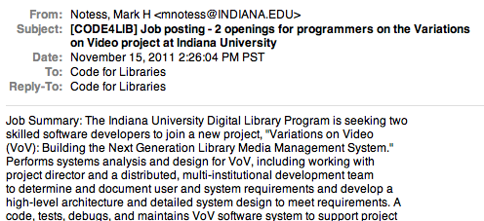
Job Postings

Slide 12
If you want to go fast…
…go alone.
…use Hydra?
Notre Dame deployed a video cataloguing head in 6 weeks, from scratch
Ohloh.net stats (as of July 2012)
  16 regular contributors in last 12 months (26 in total)
  Top 10% of open source teams
  ~8 person years of development
Notes:
An ETD app may hay have a very constrained data model, flow and presentation

Slide 13
Fundamental Assumption #1
No single system can provide the full range of repository-based solutions for a given institution’s needs,
…yet sustainable solutions require a
common repository infrastructure.

Slide 14
For instance…
ETD
Deposit
System
General Purpose Institutional Repository
Digitization
Workflow
system
Simple
Complex
Generally a single PDF
Simple, prescribed workflow
Streamlined UI for depositors, reviewers & readers
Heterogeneous file types
Simple to complex objects
One- or two-step workflow
General purpose user interfaces
Potentially hundreds of files type per object
Complex, branching workflow
Sophisticated operator (back office) interfaces

Slide 15
Distinct Application Needs
More than one dozen distinct repository application needs across three institutions.
Electronic theses & dissertations
Open access articles
Data curation application(s)
General purpose institutional repository
Manuscript & archival collection delivery
Library materials accessioning tools
Digitization workflow system
And more...
Notes:
An ETD app may hay have a very constrained data model, flow and presentation

Slide 16
Shared, Primitive Functions
Deposit
Manage
  Edit Objects
  Set Access
Search
Browse
Deliver
Plus
  Authentication
  Authorization
  Workflow
Notes:
These are the basic requirements for an app framework

Slide 17
Hydra Philosophy -- Technical
Tailored applications and workflows for different content types, contexts and user interactions
A common repository infrastructure
Flexible, atomistic data models
Modular, “Lego brick” services
Library of user interaction widgets
Easily skinned UI
One body, many heads

Slide 18
Content Framework
Key to enabling re-use of Hydra repository solutions is a common baseline to how objects are structured
  Objects must include rights metadata
  Objects must include a statement of what content models the objects adhere to
  That’s it!
The Hydra community has developed some basic building block content models (the Lego brick approach)
  Combine and/or extend these to meet your needs

Slide 19
Technical Framework - Components
Fedora provides a durable repository layer to support object management and persistence
Solr, provides fast access to indexed information
Blacklight, a Ruby on Rails plugin that sits atop solr and provides faceted search & tailored views on objects
Hydra Plugin, a Ruby on Rails library that provides create, update and delete actions against Fedora objects

Slide 20
Blacklight for Repositories
Repository-agnostic, feature-rich, content-aware, turnkey access interface for repositories
Aggregate content from multiple repositories, with links back to source systems
Vibrant, multi-institutional, open source community on its own
Can be used independently, or as the first component of, Hydra

Slide 21
CRUD in Repositories

Slide 22

CRUD in Repositories

Slide 23
Major Hydra Components

Slide 24
CRUD in Repositories

Slide 25
Inside the Hydra-Head Plugin

Slide 26
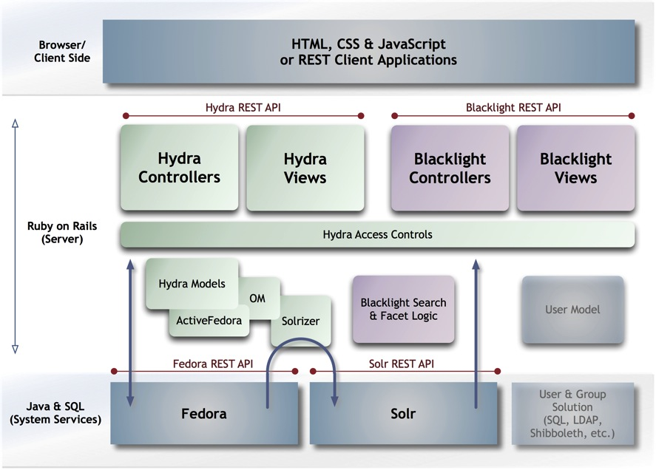
The Full Architecture

Slide 27
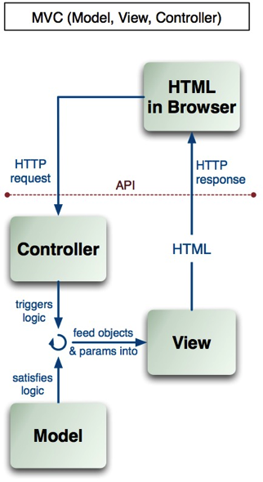
MVC Details

Slide 28
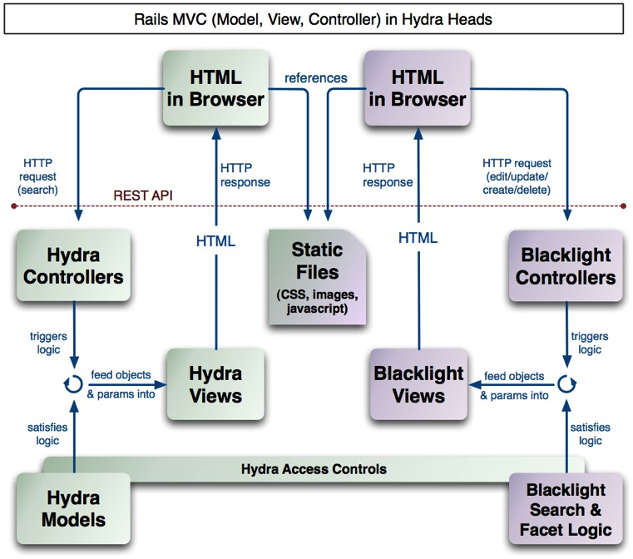
MVC
Details

Slide 29
A Note on Ruby on Rails
Rapid application development for web applications: “Convention over configuration”
  10x productivity
Supportable: MVC (Model-View-Controller) and Rails framework make code well-structured, predictable
Testable: Rspec and Cucumber give powerful, automatable, testing tools
Learnable: Stanford went from 1 to 8 Ruby savvy developers in one year (no new hires)
  1 week learning curve to basic proficiency

Slide 30
Fundamental Assumption #2
No single institution can resource the development of a full range of solutions on its own,
  …yet each needs the flexibility to tailor
  solutions to local demands and workflows.

Slide 31
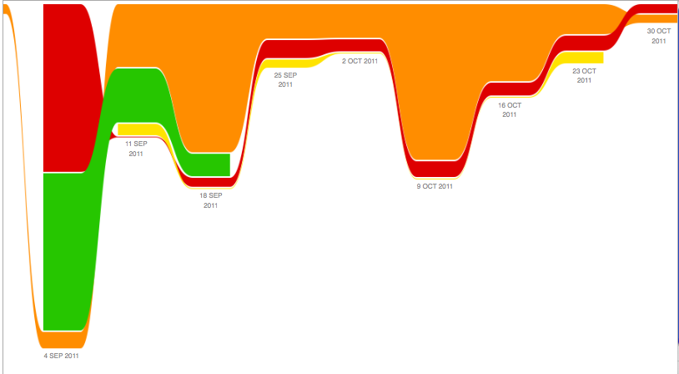
Hypatia Development – 8 week sprint
80/20 – 8 Weeks of Development
https://github.com/projecthydra/hypatia/graphs/impact
Notes:
An ETD app may hay have a very constrained data model, flow and presentation

Slide 32


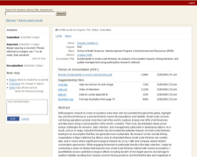
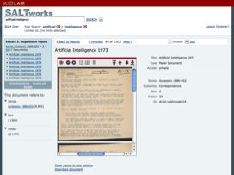
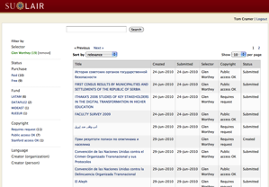
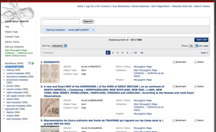
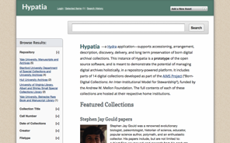
Hydra-based Applications at Stanford
ETD’s – Electronic Theses
& Dissertations
SALT – Self-Archiving Legacy Toolkit
EEMs – Everyday Electronic Materials
Argo – Repository Reporting and Management
Hypatia – Archives & Special Collections
Notes:
Future development progress will be 1) based on leveraging the existing toolsin the ecosystem to assemble new solutions, and 2) ongoing investments in and extensions to the infrastructure.

Slide 33
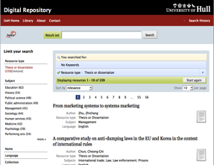
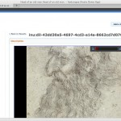
Emerging Solution Bundles
Institutional Repositories
University of Hull
University of Virginia
Penn State University
Images
Northwestern University
(Digital Image Library)
Notes:
Future development progress will be 1) based on leveraging the existing toolsin the ecosystem to assemble new solutions, and 2) ongoing investments in and extensions to the infrastructure.

Slide 34

Emerging Solution Bundles
Archives & Special Collections
Stanford University
University of Virginia
Rock & Roll Hall of Fame
Media
Indiana University
Northwestern University
Rock & Roll Hall of Fame
Etc.
Notes:
Future development progress will be 1) based on leveraging the existing toolsin the ecosystem to assemble new solutions, and 2) ongoing investments in and extensions to the infrastructure.

Slide 35
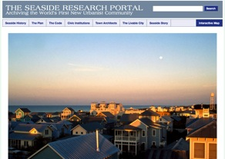
Emerging Solution Bundles
Workflow Management (Digitization, Preservation)
Stanford University
University of Illinois – Urbana-Champagne
Northwestern University
Exhibits
Notre Dame
Notes:
Future development progress will be 1) based on leveraging the existing toolsin the ecosystem to assemble new solutions, and 2) ongoing investments in and extensions to the infrastructure.

Slide 36


Emerging Solution Bundles
ETDs
Stanford University
University of Virginia
Etc.
(Small) Data
everyone…
Notes:
Future development progress will be 1) based on leveraging the existing toolsin the ecosystem to assemble new solutions, and 2) ongoing investments in and extensions to the infrastructure.

Slide 37
Philosophies
Building a framework, not an application (variation is part of the plan)
Opinionated software
Invest time & resources into collaborative community (face time!)
Trainings & workshops
Openness, transparency (code, designs, discussions)
Commit to contributing back to core
Design for re-use

Slide 38
Best Practices in Development
Agile, user-centric development process
Take a light touch when dealing with big topics
“Working software wins”
Distributed version control & github
Unit testing
Cucumber testing
User testing
Continuous builds
Notes:
Full test coverage is a core community principle
Unit tests with Rspec
Acceptance tests with Cucumber
Continuous integration testing with Hudson
Tests ensure…
Quality
Compatibility
Clarity of code and function
Confidence

Slide 39
Best Practices in Development (cont)
Weekly “stand up” meeting
Frequent deployment
JIRA, with user-centric tickets
Documentation (ruby docs, wiki, etc.)
Notes:
Active-fredora
Solrizer
OM
rightsMetadata
Fedora Models

Slide 40
So What is Hydra?
Framework for generating Fedora front-end applications w/ full CRUD functionality
That follows design pattern with common componentry and platforms
  Fedora, Ruby on Rails, Solr, ActiveFedora, Blacklight
That supports distinct UI’s, content types, workflows, and policies

Slide 41
So What is Hydra?
And a growing community of institutions and developers committed to framework and collaboration
  Not grant-based
  Distributed
  Robust
  Open
Notes:
Any single developer could walk away
Any single institution could walk away
People ask what’s your sustainability plan?
We say we’ve already passed the first hurdle—three years of self-funded productivity, and a growing code, contributor and user base, not dependent on a transition plan

Slide 42
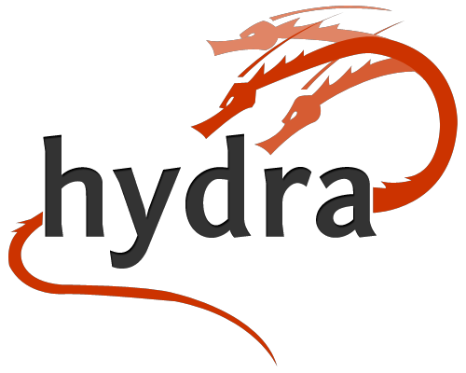
http://projecthydra.org

