Slide 1
Towards a mature, multi-purpose repository for the institution…
Chris Awre, Simon Lamb, Richard Green
Open Repositories 2012, Session RF6

Slide 2
A vision
“I believe that a mature and fully realized institutional repository will contain works of faculty and students – both research and teaching materials – and also documentation of the activities of the institution itself in the form of records of events and performance and of the ongoing intellectual life of the institution. It will also house experimental and observational data captured by members of the institution that support their scholarly activities.”
Cliff Lynch
“Institutional Repositories: Essential Infrastructure for Scholarship in the Digital Age”
ARL, no. 226 (February 2003): 1-7.
http://www.arl.org/resources/pubs/br/br226/br226ir.shtml

Slide 3
A vision (as interpreted by Hull)
“I believe that a mature and fully realized institutional repository will contain works of faculty and students – both research and teaching materials – and also documentation of the activities of the institution itself in the form of records of events and performance and of the ongoing intellectual life of the institution. It will also house experimental and observational data captured by members of the institution that support their scholarly activities.”
Cliff Lynch
“Institutional Repositories: Essential Infrastructure for Scholarship in the Digital Age”
ARL, no. 226 (February 2003): 1-7.
http://www.arl.org/resources/pubs/br/br226/br226ir.shtml

Slide 4
An institutional repository
One institution = one repository?
Repositories are infrastructure
  Maintaining infrastructure requires resource, which we need to minimise to justify costs in the long-term
Content doesn’t sit in silos
  One repository facilitates cross-fertilisation of use
Integration with one system
  Embedding the repository means linking to one place

Slide 5
Five principles
A repository should be content agnostic
A repository should be (open) standards-based
A repository should be scalable
A repository should understand how pieces of content relate to each other
A repository should be manageable with limited resource

Slide 6

Five principles (leading to our implementation)
Fedora is content agnostic
Fedora is (open) standards-based
Fedora is scalable
Fedora understands how pieces of content relate to each other
Fedora is manageable with limited resource
  With help from the community

Slide 7
Work of faculty and students
Faculty
Disseminate research outputs / learning materials
Manage research data
Archive event outputs
Students
Disseminate theses / dissertations
Provide exam papers
Student handbook archive
Granular security required to manage these different activities
The repository has been tied into our institutional CAS system
Materials can be open, internal, or restricted to user groups / users

Slide 8
Research and teaching materials
Sakai (VLE/VRE)
Converis (CRIS)
SharePoint
Repository

Slide 9
Records of events and performance
Creative writing – discussions with authors
Inaugural lectures
University Learning & Teaching Conference
Campus-based e-publishing
Integration with Open Journal Systems to enable archiving of publications

Slide 10
Experimental and observational data
Tiptoeing into data management
JISC History DMP project
  Identified ways to encourage and facilitate the planning of data management
EPSRC roadmap
  Highlighting ways forward to make the most of the data we produce

Slide 11

Taking the holistic view
An institutional repository
Records of events and
performances
Manageable
Standards-based
Content agnostic
Scaleable
Experimental and
observational data
Work of faculty and
students
Understands content
relationships
Research and teaching
materials

Slide 12
Hydra

Slide 13
Adapt to the content

Slide 14
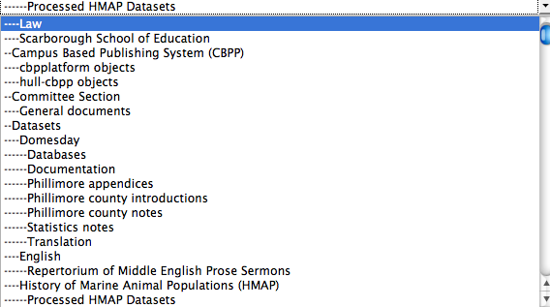
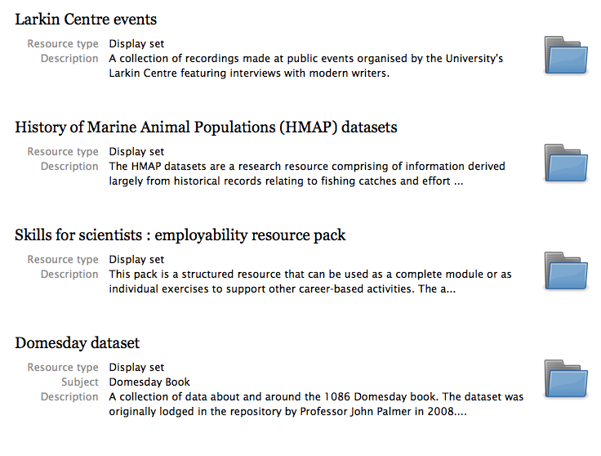
Organise the content
Structural sets
Display sets

Slide 15
Fulfilling institutional strategy
Impact globally through internationalisation
Growing research reputation
Inconnectedness of research and teaching
Enhancing the learning environment
Fostering innovation
Ensuring academic sustainability

Slide 16
Onwards… Library search integration
Staff and students
How to combine delivery?
Repository
Catalogue
Articles

Slide 17
Onwards… Digital archives management
Archives colleagues took part in Mellon-funded AIMS project
  An Inter-institutional Model for Stewardship of born-digital collections
Using Hydra to develop tools that help put the model into practice
Developing practice for archivists in dealing with born-digital collections through events and advocacy

Slide 18
Finch outcomes
Whatever you may think of the Finch Report (Government report on expanding access to research publications)
  It did highlight the valuable role repositories can play in providing supporting infrastructure
It focused on the need to have a way of managing:
  Different types of grey literature
  Theses/dissertations
  Links between research data and publications
  Preservation
Looks like an opportunity!

Slide 19
Towards…
Our repository is still a work in progress - probably always will be
…it is maturing
We have been able to apply it to a range of purposes
It is a repository for the institution as a whole

Slide 20
Thank you
Chris Awre – c.awre@hull.ac.uk
Simon Lamb – s.lamb@hull.ac.uk
Richard Green – r.green@hull.ac.uk
Hydra at Hull – http://hydra.hull.ac.uk
Hydra Project – http://projecthydra.org

