Slide 1

One Body,
Many More Heads,
One Year Later
Open Repositories 2012, Edinburgh

Slide 2
Fundamental Assumption #1
No single system can provide the full range of repository-based solutions for a given institution’s needs,
…yet sustainable solutions require a
common repository infrastructure.
Fundamental Assumption #2
No single institution can resource the development of a full range of solutions on its own,
  …yet each needs the flexibility to tailor
  solutions to local demands and workflows.

Slide 3
Hydra
A robust repository fronted by feature-rich, tailored applications and workflows (“heads”)
  One body, many heads
Collaboratively built “solution bundles” that can be adapted and modified to suit local needs.
A community of developers and adopters extending and enhancing the core
  If you want to go fast, go alone. If you want to go far, go together.
Notes:
The only way to build a rich & robust solution is to engage a large community of developers. The only way to build a sustainable solution is to spur adoption by a community of institutions w/ vested interest in shared success.

Slide 4
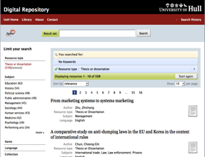
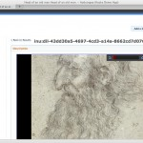
Emerging Solution Bundles
Institutional Repositories
University of Hull
University of Virginia
Penn State University
Images
Northwestern University
(Digital Image Library)
Notes:
Future development progress will be 1) based on leveraging the existing toolsin the ecosystem to assemble new solutions, and 2) ongoing investments in and extensions to the infrastructure.

Slide 5
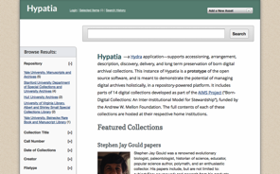

Emerging Solution Bundles
Archives & Special Collections
Stanford University
University of Virginia
Rock & Roll Hall of Fame
Media
Indiana University
Northwestern University
Rock & Roll Hall of Fame
Etc.
Notes:
Future development progress will be 1) based on leveraging the existing toolsin the ecosystem to assemble new solutions, and 2) ongoing investments in and extensions to the infrastructure.

Slide 6
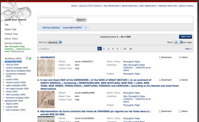
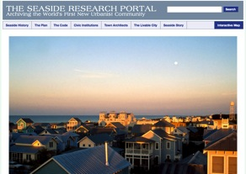
Emerging Solution Bundles
Workflow Management (Digitization, Preservation)
Stanford University
University of Illinois – Urbana-Champagne
Northwestern University
Exhibits
Notre Dame
Notes:
Future development progress will be 1) based on leveraging the existing toolsin the ecosystem to assemble new solutions, and 2) ongoing investments in and extensions to the infrastructure.

Slide 7
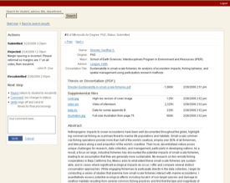

Emerging Solution Bundles
ETDs
Stanford University
University of Virginia
Etc.
(Small) Data
everyone…
Notes:
Future development progress will be 1) based on leveraging the existing toolsin the ecosystem to assemble new solutions, and 2) ongoing investments in and extensions to the infrastructure.

Slide 8

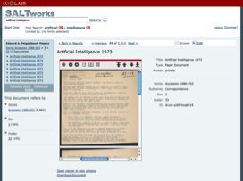
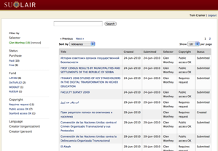
Hydra-based Applications at Stanford
ETD’s – Electronic Theses
& Dissertations
SALT – Self-Archiving Legacy Toolkit
EEMs – Everyday Electronic Materials
Argo – Repository Reporting and Management
Hypatia – Archives & Special Collections
Notes:
Future development progress will be 1) based on leveraging the existing toolsin the ecosystem to assemble new solutions, and 2) ongoing investments in and extensions to the infrastructure.

Slide 9
Actively Participating Institutions
OR = Open Repositories Conference
Notes:
The only way to build a rich & robust solution is to engage a large community of developers. The only way to build a sustainable solution is to spur adoption by a community of institutions w/ vested interest in shared success.

Slide 10
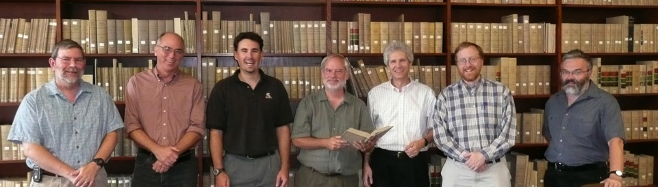
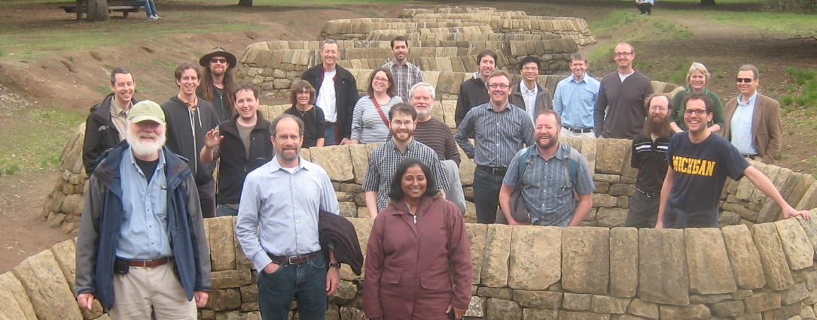
University of Virginia, 2008
LibDevConX^3, Stanford, 2012

Slide 11
Sustainability
No animals were harmed
in the making of this film.
grants
abused
project / community
Conceived & executed as a distributed, collaborative, self-funded, open source effort from the start.

Slide 12
Managing the community
Founding partners have an MoU governing how the community is managed
  Subsequent partners have signed up to this MoU through a partner agreement addendum
All code contributions are being managed through Code Licensing Agreements
  Individual – so each developer is clear about what they are contributing
  Corporate – so each institution is clear about what they are contributing
All Hydra code is available under Apache License, Version 2.0

Slide 13
Community
Model
Notes:
Partners commit to supporting the partnership as a partnership…

Slide 14
If you want to go fast, go alone …use Hydra
Notre Dame deployed a video cataloguing head in 6 weeks, from scratch
Usable Hypatia application developed in 8 weeks
Ohloh.net stats (as of July 2012)
  16 regular contributors in last 12 months (26 in total)
  Top 10% of open source teams
  ~8 person years of development
Notes:
An ETD app may hay have a very constrained data model, flow and presentation

Slide 15
CRUD in Repositories

Slide 16

CRUD in Repositories

Slide 17
Major Hydra Components

Slide 18
Blacklight for Repositories
Repository-agnostic, feature-rich, content-aware, turnkey access interface for repositories
Aggregate content from multiple repositories, with links back to source systems
Vibrant, multi-institutional, open source community on its own
Can be used independently, or as the first component of, Hydra

Slide 19
A Note on Ruby on Rails
Rapid application development for web applications: “Convention over configuration”
  10x productivity
Supportable: MVC (Model-View-Controller) and Rails framework make code well-structured, predictable
Testable: Rspec and Cucumber give powerful, automatable, testing tools
Learnable: Stanford went from 1 to 8 Ruby savvy developers in one year (no new hires)
  1 week learning curve to basic proficiency

Slide 20
Technical Development – Last Year
Simplify adoption and uptake process by new adopters
Clean separation of code among Hydra “core” components and head-specific logic
Increase the rigor, documentation, test-coverage and reliability of the code overall

Slide 21
Connect
Weekly developer calls
  Mondays 8:30 AM California time
Email list: hydra-tech@googlegroups.com
IRC: chat.freenode.net #projecthydra
Quarterly Hydra Partner meetings
Annual HydraCamp
  Next Up: 8-12 October ’12, Penn State
Annual LibDevConX Meeting
  Next Up: End of March ‘13 at Stanford
Notes:
Active-fredora
Solrizer
OM
rightsMetadata
Fedora Models

Slide 22

http://projecthydra.org

