Slide 1


CDL ~ February 2017
The Project Formerly Known as Hydra
Introductory Workshop
Open Repositories 2017

Slide 2
Agenda
What is Samvera?
Community Framework
Technical Framework
Data Modeling
Getting Started with Samvera
Discussion

Slide 3
Let’s start with you
What are you hoping to get out of today?
Notes:
We have a plan but our real purpose today is to answers the questions you have as a new Hydra Manager. We want to tailor this workshop to meet your needs.
Distribute cards and give 5 minutes.

Slide 4
Agenda
What is Samvera?
Community Framework
Technical Framework
Data Modeling
Getting Started with Samvera
Discussion

Slide 5
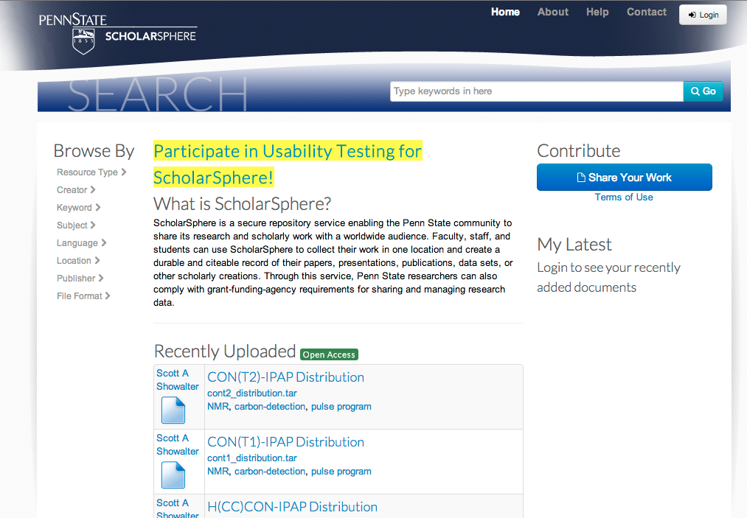
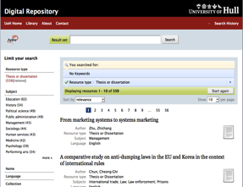
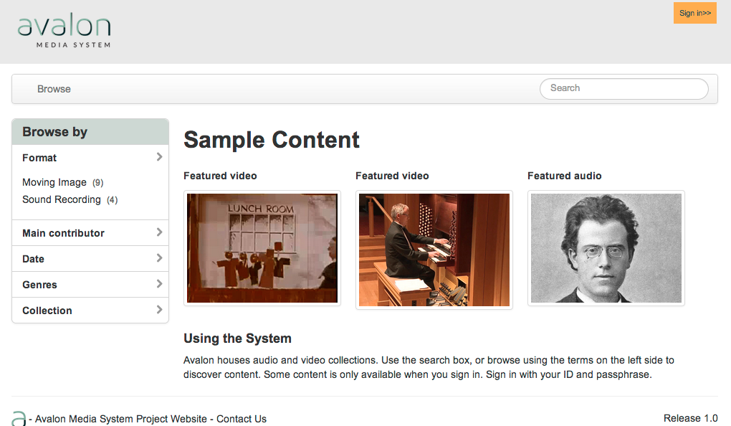
What is Hydra?
ScholarSphere / Sufia
Hydra at Hull
Avalon for Media

Slide 6
What Is Hydra?
A robust repository fronted by feature-rich, tailored applications and workflows (“heads”)
  One body, many heads
Collaboratively built “solution bundles” that can be adapted and modified to suit local needs.
A community of developers and adopters extending and enhancing the core
  If you want to go fast, go alone. If you want to go far, go together.
Notes:
The only way to build a rich & robust solution is to engage a large community of developers. The only way to build a sustainable solution is to spur adoption by a community of institutions w/ vested interest in shared success.

Slide 7
Fundamental Assumption #1
No single system can provide the full range of repository-based solutions for a given institution’s needs,
…yet sustainable solutions require a
common repository infrastructure.

Slide 8
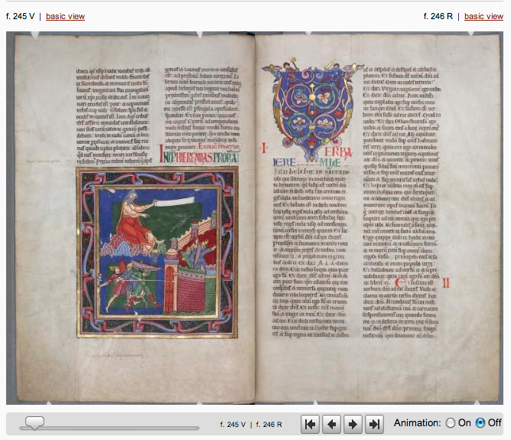
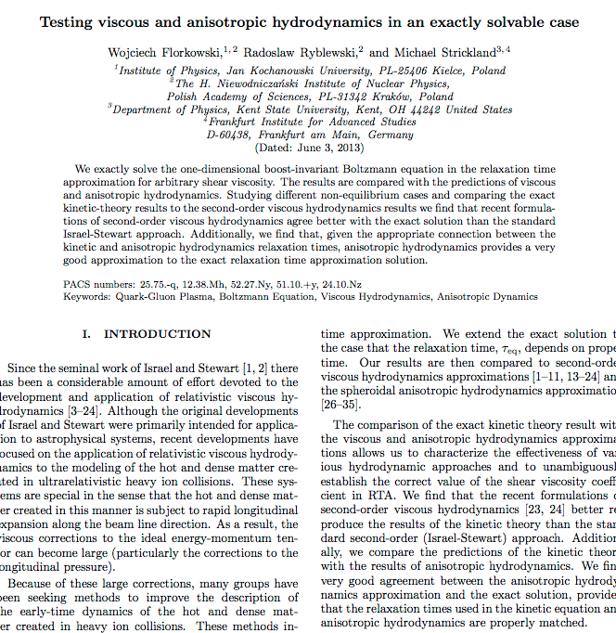
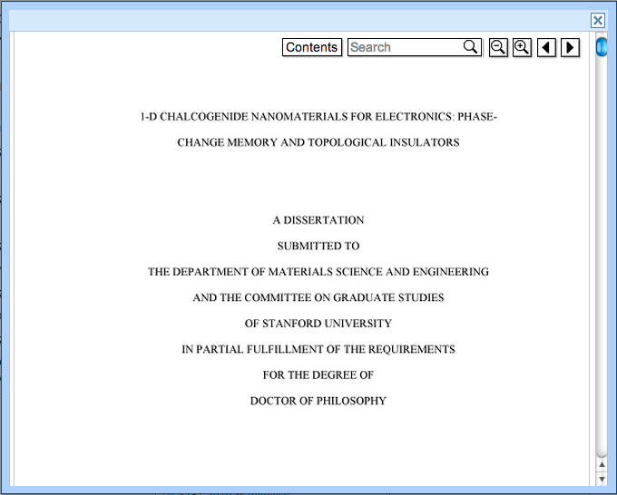
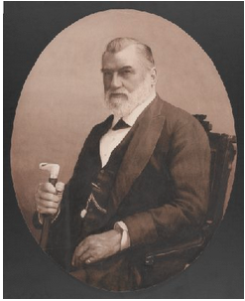
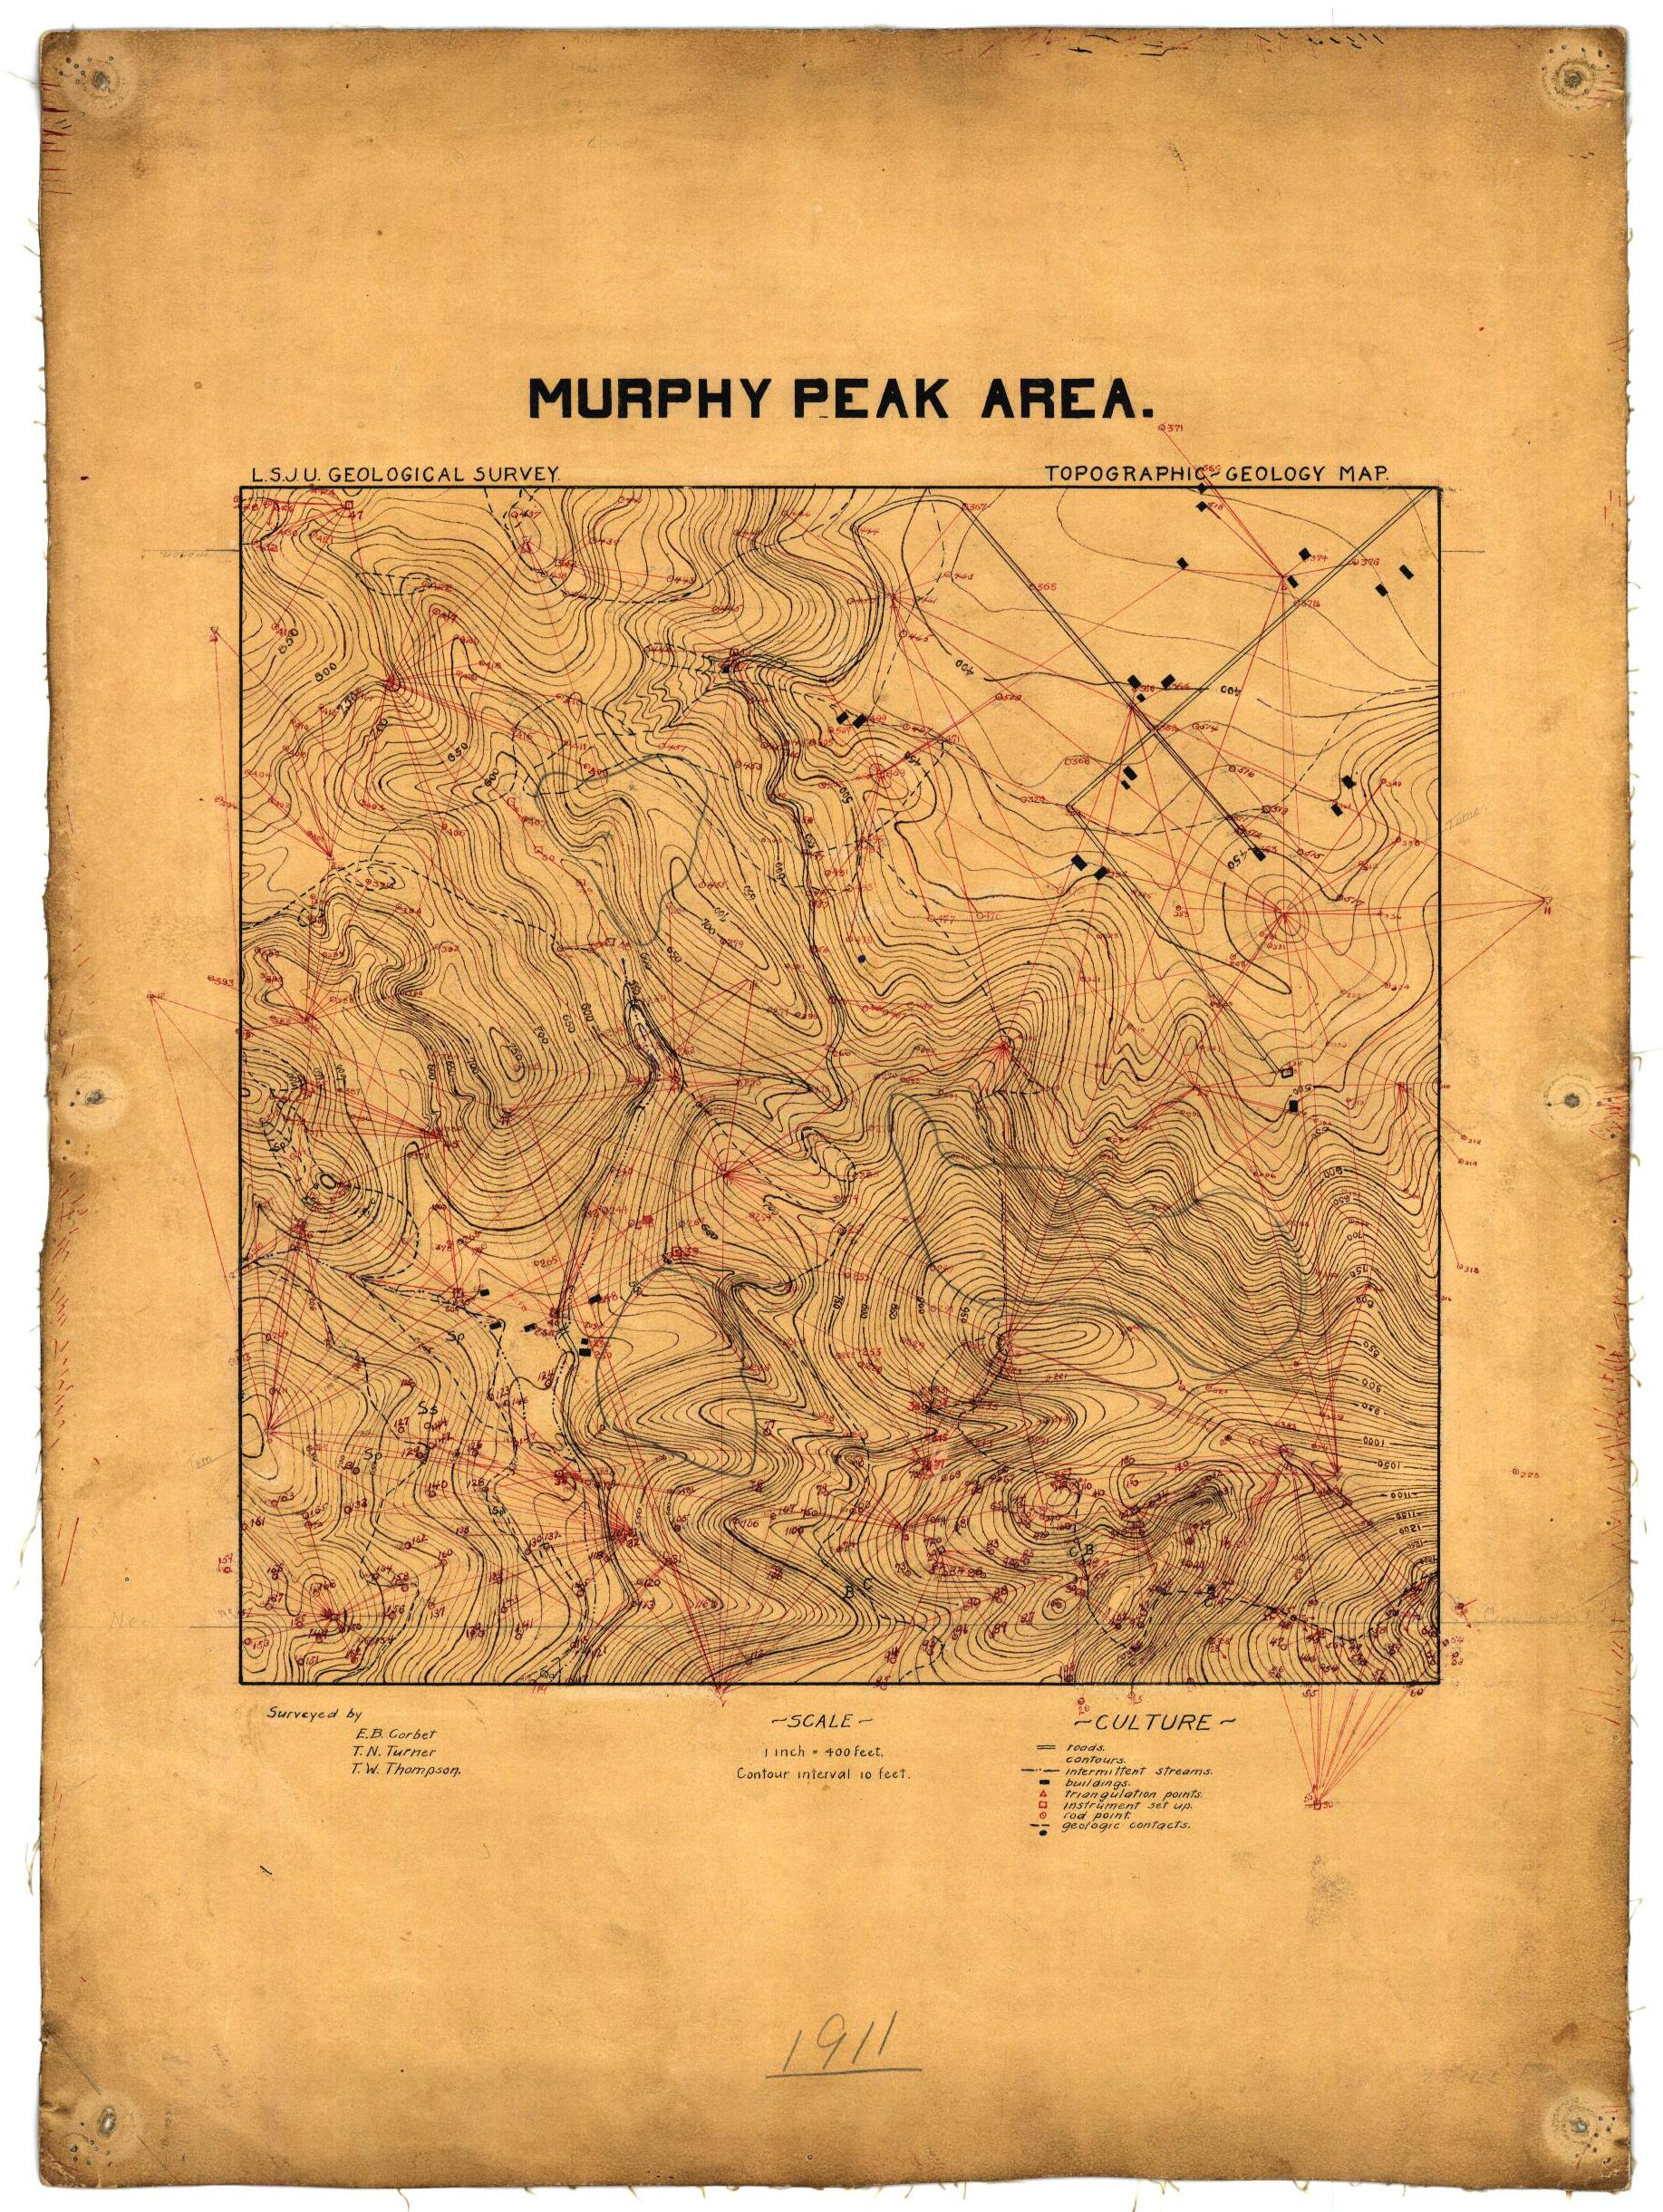
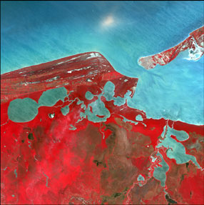
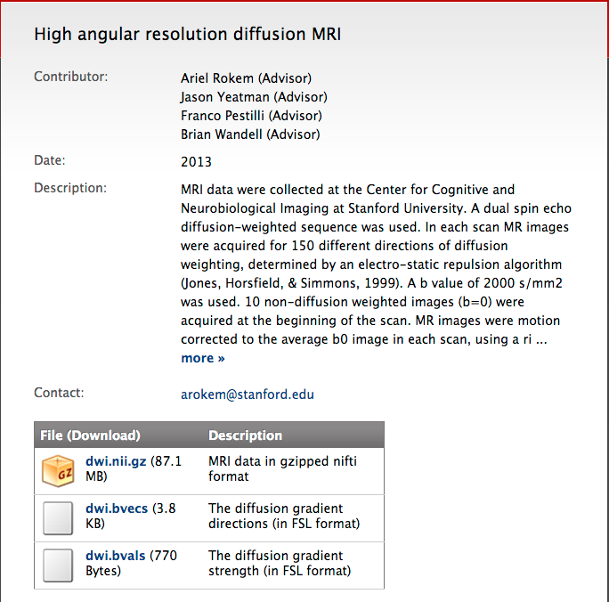
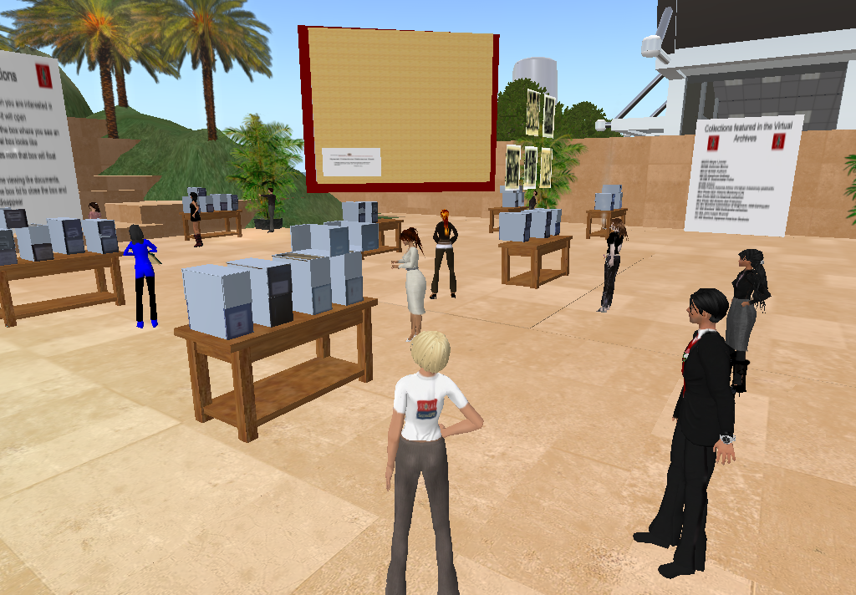

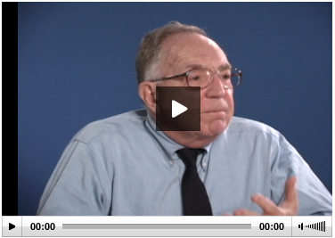
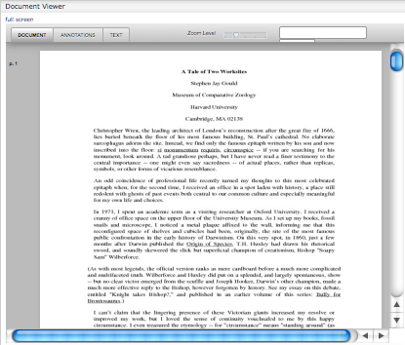
Books
Articles
Theses
Images
Maps
Data (Raster)
Data (Comp.)
Data (Observ.)
Audio
Video
Documents

Slide 9
Point Solution Approach …Welcome to Siloville
ETDs (Theses)
Books, Articles
Images
Audio-Visual
Research Data
Maps
& GIS
Docu-ments
ETD
IR
Image DB
DAM
?
Geospa-tial Inf.
Records Mgmt.
Management
Access
Preservation(?)
Effective?
Sustainable?

Slide 10
Repository-Powered Approach
ETDs (Theses)
Books, Articles
Images
Audio-Visual
Research Data
Maps
& GIS
Docu-ments
Digital Repository
Scalable, Robust, Shared Management and Preservation Services
Notes:
A single application could not effectively cope with these three use cases; however any institution would want to safeguard the outputs of all these disparate systems in a digital repository for management and preservation. HYDRA gives a framework where ONE BODY (the repo) can support MULTIPLE HEADS (tailored applications)

Slide 11


One Body, Many Heads…
ETDs (Theses)
Books, Articles
Images
Audio-Visual
Research Data
Maps
& GIS
Docu-ments
hydra
Scalable, Robust, Shared Management and Preservation Services
Notes:
A single application could not effectively cope with these three use cases; however any institution would want to safeguard the outputs of all these disparate systems in a digital repository for management and preservation. HYDRA gives a framework where ONE BODY (the repo) can support MULTIPLE HEADS (tailored applications)

Slide 12
Used by…
Used for…
Large Universities
Small Universities
Colleges
Public Broadcasting
Government Ministry
National Libraries
National Lab
Small Research Labs
National Digital Repository
Statewide Digital Libraries
Rock & Roll Hall of Fame
Chemical Heritage Foundation
Museum of Performing Arts
A Shakespeare Festival
Self-deposit system
Digital Collections System
  Sheet Music
  Architectural resources
Electronic Theses & Dissertations
Digital Image System
Media Management
Media Preservation System
Research Data Management
Digitization Workflow System
Digital Preservation System
Digital Archives System
Library Monograph Acquisitions System
And more!
Notes:
A single application could not effectively cope with these three use cases; however any institution would want to safeguard the outputs of all these disparate systems in a digital repository for management and preservation. HYDRA gives a framework where ONE BODY (the repo) can support MULTIPLE HEADS (tailored applications)

Slide 13
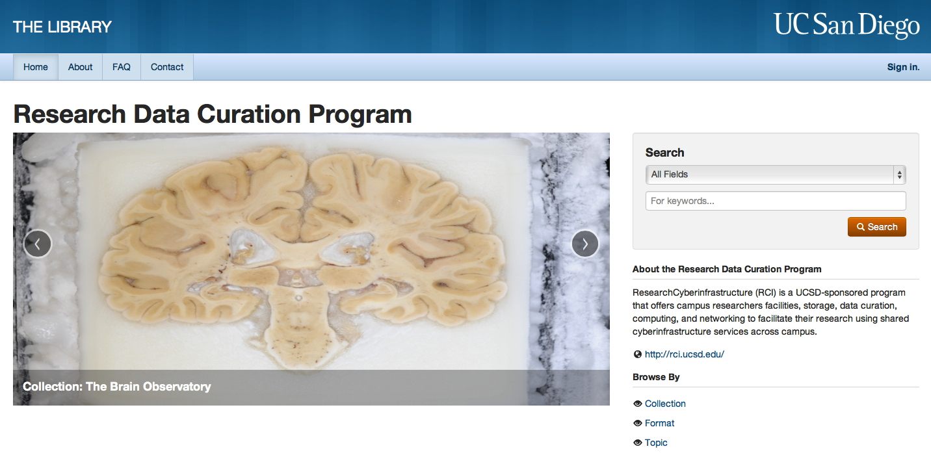
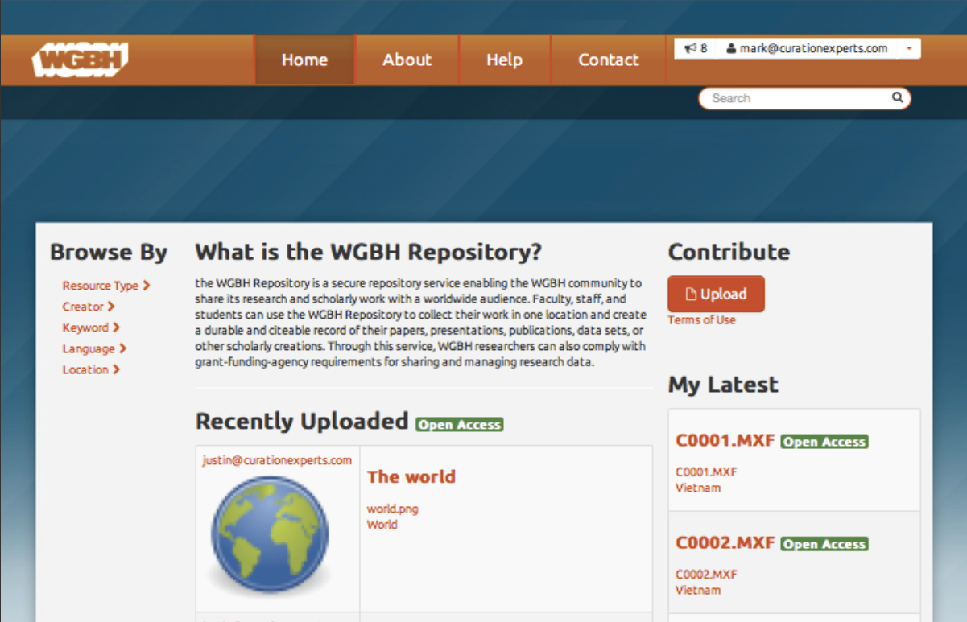
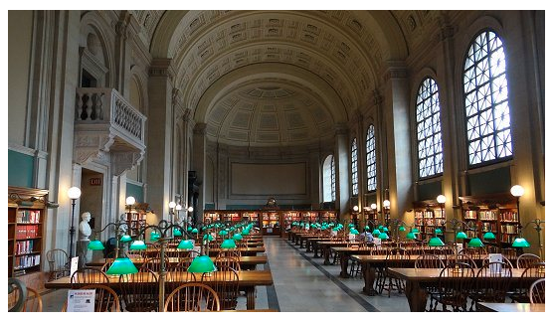
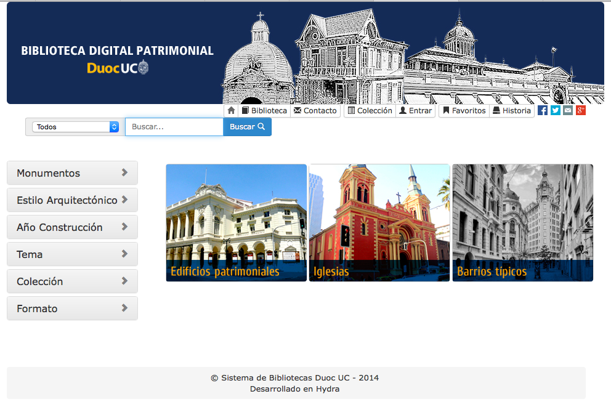
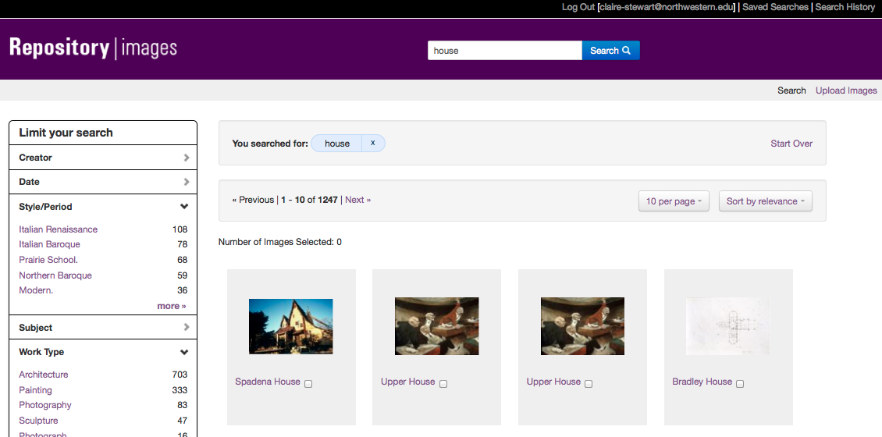
Hydra Heads of Note
UCSD DAMS
Avalon & HydraDAM for Media
BPL Digital Commonwealth
Digital Patrimony (DUOC Chile)
Northwestern Digital Image Lib.
Notes:
A single application could not effectively cope with these three use cases; however any institution would want to safeguard the outputs of all these disparate systems in a digital repository for management and preservation. HYDRA gives a framework where ONE BODY (the repo) can support MULTIPLE HEADS (tailored applications)

Slide 14
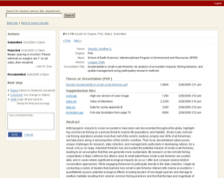
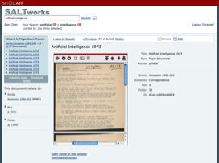
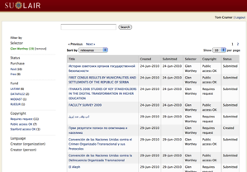
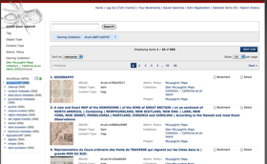
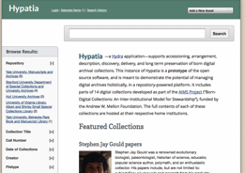
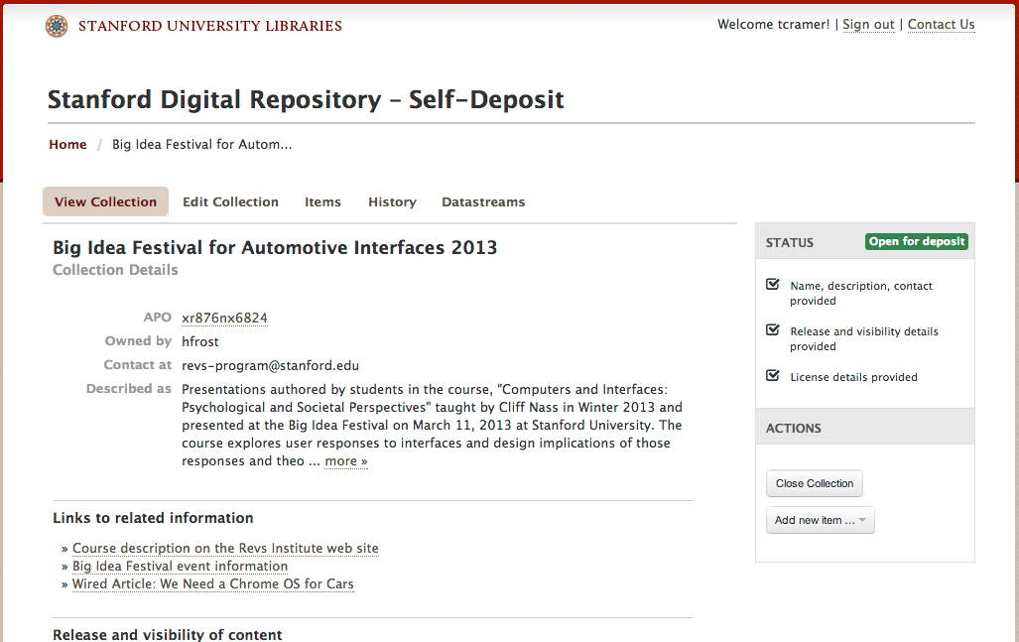
Hydra-based Applications at Stanford
ETD’s – Electronic Theses
& Dissertations
SALT – Self-Archiving Legacy Toolkit
EEMs – Everyday Electronic Materials
Argo – Repository Reporting and Management
Hypatia – Archives & Special Collections
SDR – Web UI (aka Hydrus)
Notes:
One body, many heads: Stanford has developed 5 distinct Hydra Heads, all fronting a Fedora repository—and each with their specialized interfaces and workflows for distinct audiences.

Slide 15
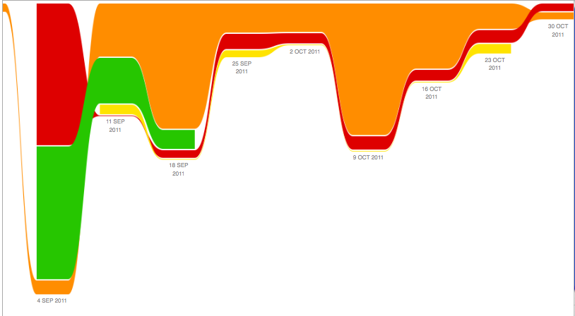
If You Want To Go Fast
…go alone.
…use Hydra
1) Notre Dame deployed a video cataloging head in 6 weeks, from scratch
https://github.com/projecthydra/hypatia/graphs/impact
2) Hypatia development at Stanford
  First 20% of project took 80% of time (modelling, data acquisition and preparation)
  80% of deliverables (coding) happened in
  8 week spurt, by leveraging Hydra
Notes:
An ETD app may hay have a very constrained data model, flow and presentation

Slide 16
Exercises
Discuss which Samvera applications are the most interesting / relevant to your local needs.
Identify potential starting points & collaborators within the Samvera community.
Create & test your own Samvera application at demo.hydrainabox.org

Slide 17
Agenda
What is Samvera?
Community Framework
Technical Framework
Data Modeling
Getting Started with Samvera
Discussion

Slide 18
Fundamental Assumption #2
No single institution can resource the development of a full range of solutions on its own,
  …yet each needs the flexibility to tailor
  solutions to local demands and workflows.

Slide 19
Hydra Philosophy -- Community
An open architecture, with many contributors to a common core
Collaboratively built “solution bundles” that can be adapted and modified to suit local needs
A community of developers and adopters extending and enhancing the core
“If you want to go fast, go alone. If you want to go far, go together.”
One body, many heads
Notes:
The only way to build a rich & robust solution is to engage a large community of developers. The only way to build a sustainable solution is to spur adoption by a community of institutions w/ vested interest in shared success.

Slide 20
Community
Conceived & executed as a distributed, collaborative, open source effort from the start
Initially a joint development project between Stanford, Univ of Virginia, and Univ of Hull
Hydra Partners are the backbone of the project
  Coalition of the willing
  No fees or dues
  Apache-style consensus and governance
Steering Group provides administration, continuity, and serves as backstop when needed
  But no central planning, no Project Director, no “one” architect

Slide 21
Hydra Partners…
…are individuals, institutions, corporations or other groups that have committed to contributing to the Hydra community; they not only use the Hydra technical framework, but also add to it in at least one of many ways: code, analysis, design, support, funding, or other resources.
Hydra Partners collectively advance the project and the community for the benefit of all participants.
https://wiki.duraspace.org/display/hydra/Hydra+Community+Framework

Slide 22
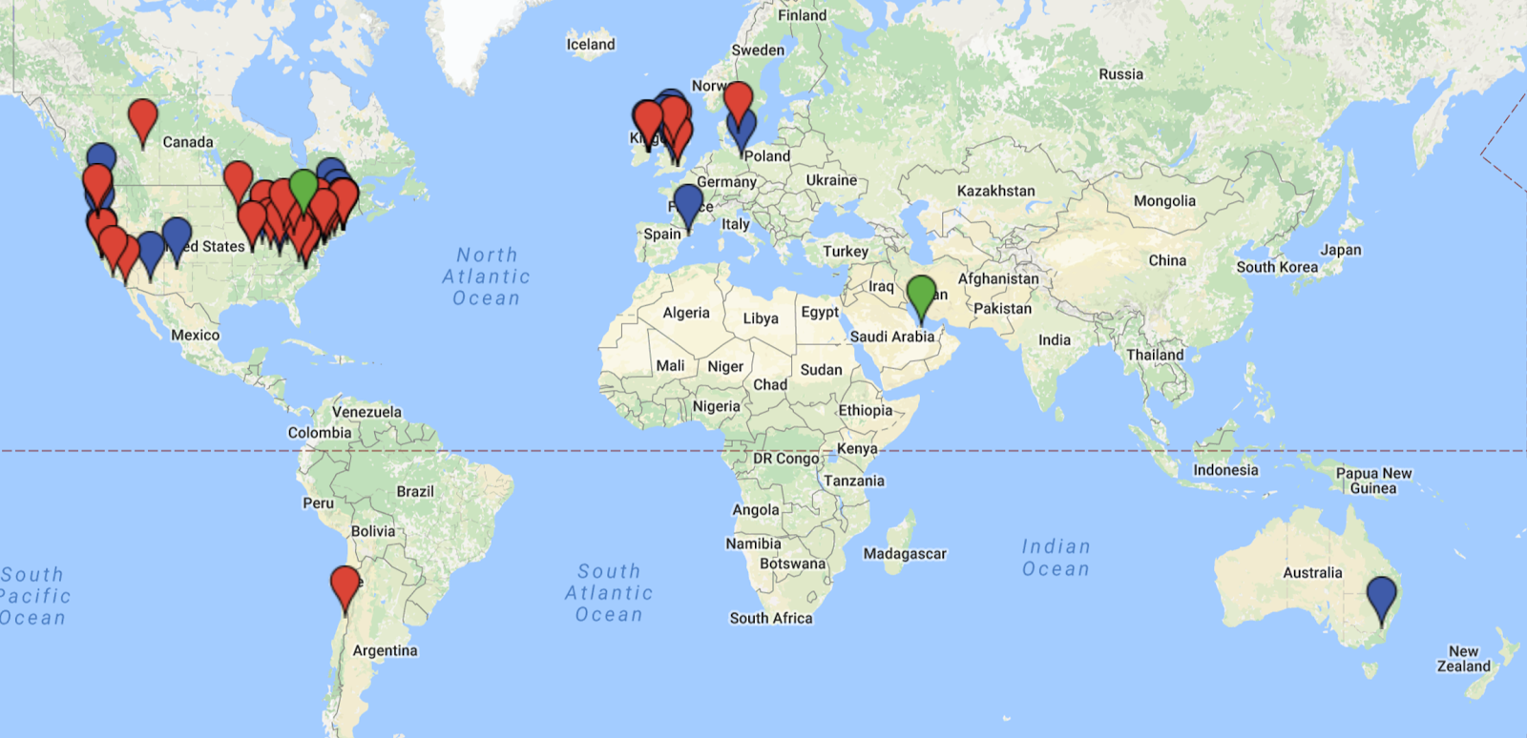
A Worldwide Presence
Notes:
Adopters include: a theater institute, a Shakespeare Festival, Australian Dept of the Environment, a Chemical Heritage Foundation, Arizona State’s Nexus Lab for Humanities Research) ,
National Library (Ireland, Denmark), Art Museum (1), Art Institute (1), 1 National Lab, 1 National digital repository, 2.5 national libraries (DPLA = half), a boatload of universities.
Northwestern likes it so much, they adopted twice: once in the Library, once in the Galter Heatlh Science Library.

Slide 23
By the Numbers….

Slide 24
Samvera Partners
OR = Open Repositories Conference
Notes:
New partners since OR2015: York, UCSD, Lafayette, WUSTL

Slide 25
Samvera Partners and Known Users
OR = Open Repositories Conference
Notes:
The only way to build a rich & robust solution is to engage a large community of developers. The only way to build a sustainable solution is to spur adoption by a community of institutions w/ vested interest in shared success.

Slide 26
Samvera Partners and Known Users
64 Licensed Contributing Institutions
280 Licensed Contributing Individuals
OR = Open Repositories Conference
Notes:
Compared to 47 / 180 at HC15.

Slide 27
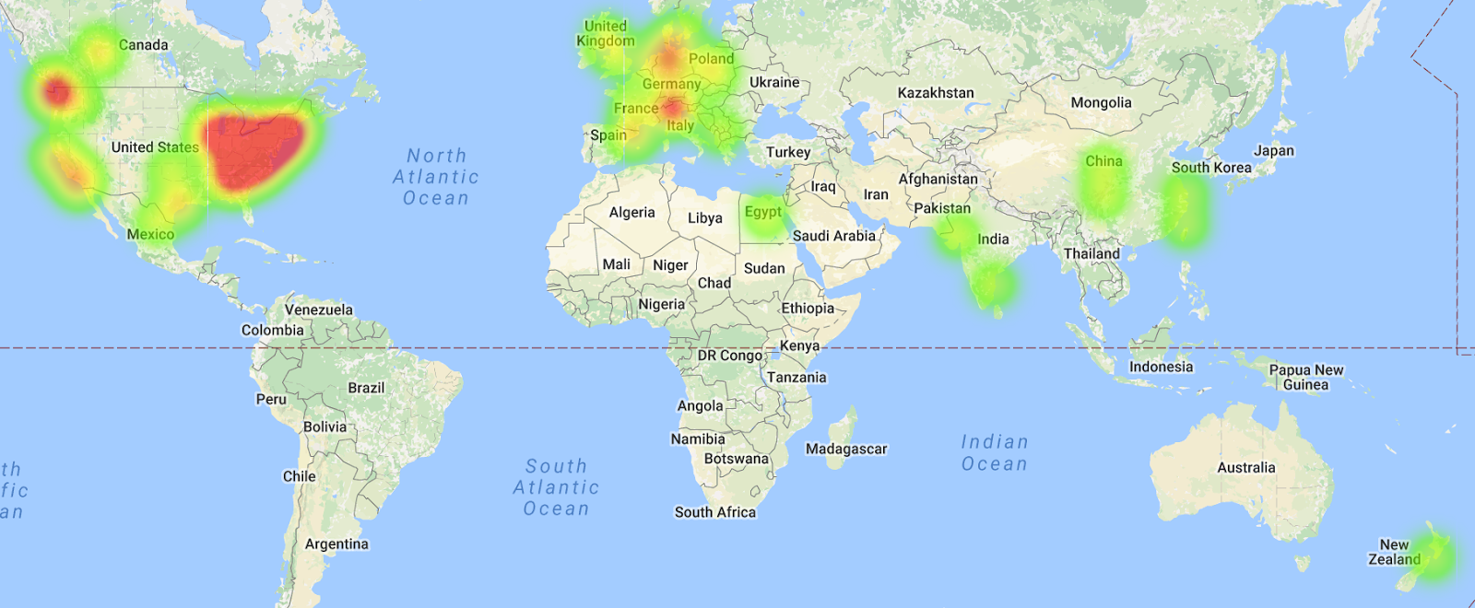
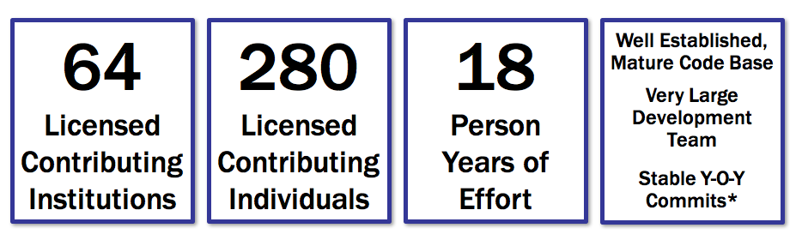
Samvera Code Activity
http://jrvis.com/red-dwarf/?user=samvera&repo=sufia
https://www.openhub.net/p/projecthydra

Slide 28

132 samvera-partners
748
samvera-
tech
617
samvera-community
478 Slack Team Members
project-hydra.slack.com
@HydraSphere
623 Followers
Notes:
vs. 2015
97-> 122
572 –>705
365 -> 509

Slide 29
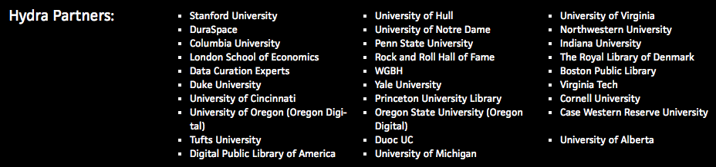
Hydra Partners
Notes:
The only way to build a rich & robust solution is to engage a large community of developers. The only way to build a sustainable solution is to spur adoption by a community of institutions w/ vested interest in shared success.

Slide 30
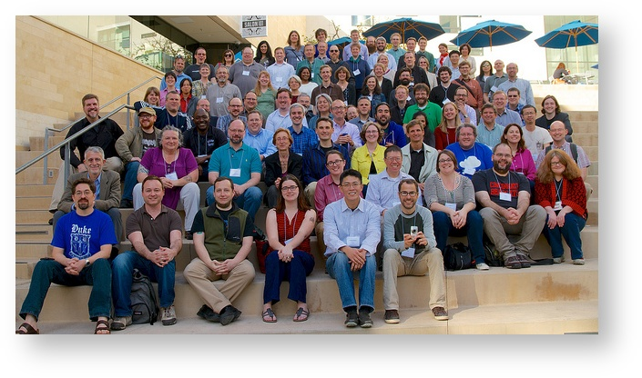
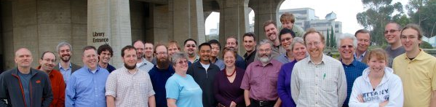
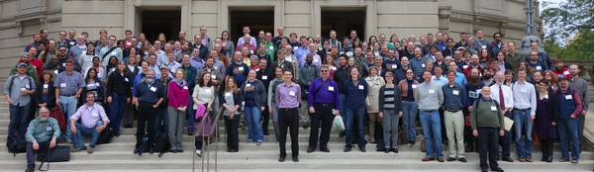
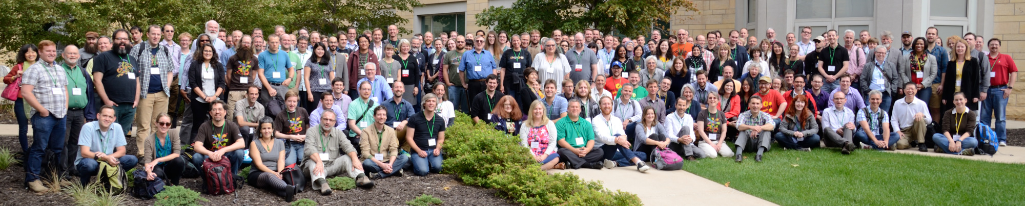
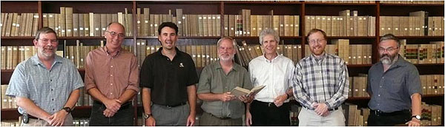
Going Far Together
University of Virginia, 2008
3rd Worldwide Hydra Connect @ Minneapolis, OH, September 2015
200 participants from 60 institutions
Hydra Partners @ UCSD, 2012
2nd Worldwide Hydra Connect @ Cleveland, OH, September 2014
160 participants from 56 institutions
First Worldwide Hydra Connect @ UCSD, January 2014
Notes:
Lots of systems fulfill same functionality. Biggest difference between other solutions is its community and commitment to community building.

Slide 31
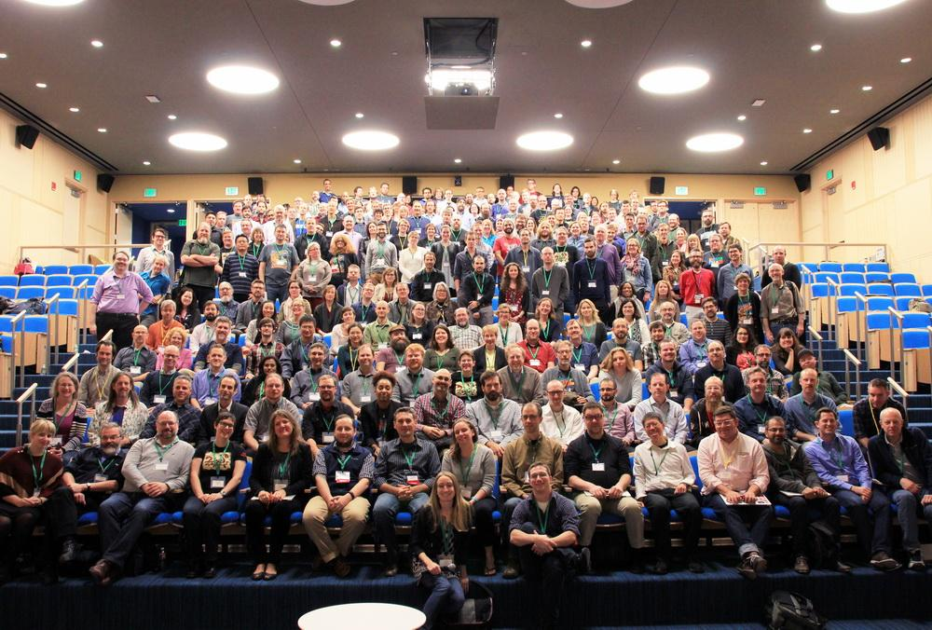
Notes:
Speaking of community: here are the attendees of the fourth annual Hydra Connect meeting in Boston last month. Good looking bunch, right?
In addition to project staff from DPLA, DuraSpace, and Stanford working on the repository product, we’ve had development contributions from Chemical Heritage Foundation, Indiana University, and Indiana University–Purdue University Indianapolis, Penn State and Northwestern.

Slide 32
The Hydra Way
Not a directed project
Investment in a framework, not an application
  Contributions back to core code base
Investment in a community, not a vendor
  Contributions back to community: Training, documentation, modeling, evangelism, support
Travel / face-time

Slide 33
Code Licensing
All Hydra code is available under Apache License, Version 2.0
All code commitments are being managed through Contributor License Agreements
  Individual – so each developer is clear about what they are contributing
  Corporate – so each institution is clear about what it is contributing
Code contributors maintain ownership of their IP
  …and grant a non-exclusive license to the project and its users

Slide 34
Interest & Working Groups
Fedora 3 to 4 Migration Interest Group
DSpace/Samvera Interest Group
Display Sets Working Group
Hyrax Analytics Working Group
Samvera Agile PM Interest Group
Samvera Archivists Interest Group
Samvera Data Mapper Working Group
Samvera DevOps Interest Group
Samvera Digital Preservation Interest Group
Samvera Documentation Working Group
Samvera Geospatial Interest Group
Samvera GIS Data Modeling Working Group
Samvera Metadata Interest Group
Samvera Applied Linked Data Interest Group
Samvera URI Selection Working Group
Samvera Metrics Interest Group
Samvera Newspapers Interest Group
Samvera Plugins Working Group
Repository Management Interest Group
Samvera Time-based Media Interest Group
Samvera User Experience Interest Group

Slide 35
Sustainability
No animals were harmed
in the making of this film.
grants
abused
project / community

Slide 36
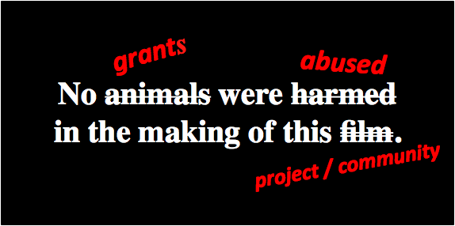
Sustainability…
For institutions
Partners help shoulder the load
For other projects
Post-project maintenance & governance
For leveraging funders’ investments
Adoption by growing user community
Notes:
Avalon, ORCID, WGBH,

Slide 37
Exercises
Search for a topic of interest to you from the samvera-tech or samvera-community Google Groups
Find a Samvera Interest or Working Group of interest to you; find the most recent meeting notes
Using the Samvera Wiki…
https://wiki.duraspace.org/display/samvera/Samvera
  Sign up for the samvera-tech or samvera-community Google Groups
  Get a Samvera wiki account
  Join the project-hydra Slack team

Slide 38
Agenda
What is Samvera?
Community Framework
Technical Framework
Data Modeling
Getting Started with Samvera
Discussion

Slide 39
CRUD in Repositories

Slide 40

CRUD in Repositories

Slide 41
Major Hydra Components
Notes:
By picking industry standard components, Hydra leverages the best of the community technology and skill base, and concentrates its efforts on the value added workflows around digital asset management.

Slide 42
Major Components
Notes:
By picking industry standard components, Hydra leverages the best of the community technology and skill base, and concentrates its efforts on the value added workflows around digital asset management.

Slide 43
A Note on Fedora
Flexible, Extensible, Durable Object Repository Architecture
  Flexible: model and store any content types
  Extensible: easy to augment with apps and services
  Durable: foundation of preservation repository
Proven, sustained and successful digital repository
  100’s of adopters; 13 years of development, 4 releases
  Vibrant community & funding under DuraSpace
Fedora 4.0 released in Dec ‘14; co-evolving with Hydra

Slide 44
A Note on Ruby on Rails
Rapid application development for web applications: “Convention over configuration”
  10x productivity
Supportable: MVC (Model-View-Controller) and Rails framework make code well-structured, predictable
Testable: Rspec and Cucumber give powerful, automatable, testing tools
Learnable: Stanford went from 1 to 8 Ruby savvy developers in one year (no new hires)
  1 week learning curve to basic proficiency

Slide 45
Hydra’s Core Gems
Interact with Fedora with a
Rails/ActiveRecord pattern
ActiveFedora
Fedora
Notes:
By picking industry standard components, Hydra leverages the best of the community technology and skill base, and concentrates its efforts on the value added workflows around digital asset management.

Slide 46
Hydra’s Core Gems
Build digital objects using
PCDM-based models
Hydra::PCDM
ActiveFedora
Fedora
Notes:
By picking industry standard components, Hydra leverages the best of the community technology and skill base, and concentrates its efforts on the value added workflows around digital asset management.

Slide 47
Hydra’s Core Gems
Work with files, like:
Characterize
Make derivatives
Virus check
Extract text
Group them to create “works” (or complex objects)
Hydra::Works
Hydra::PCDM
ActiveFedora
Fedora
Notes:
By picking industry standard components, Hydra leverages the best of the community technology and skill base, and concentrates its efforts on the value added workflows around digital asset management.

Slide 48
Hydra’s Core Gems
Get basic Ruby on Rails views, and more shared features:
Custom models
Routing for CRUD
File auditing
Versioning
Single-use links
Upload file sets
Access controls
Leases and embargoes
CurationConcerns
Hydra::Works
Hydra::PCDM
ActiveFedora
Fedora
Notes:
By picking industry standard components, Hydra leverages the best of the community technology and skill base, and concentrates its efforts on the value added workflows around digital asset management.

Slide 49
Sufia/Hydra App
Hydra’s Core Gems
A fully functional repository application, with:
Proxy deposit
User dashboard
User profile
Featured works & researchers
Contact form
WYSIWYG UI editing
Activity streams
Upload via cloud providers
Integration with Zotero
CurationConcerns
Hydra::Works
Hydra::PCDM
ActiveFedora
Fedora
Notes:
By picking industry standard components, Hydra leverages the best of the community technology and skill base, and concentrates its efforts on the value added workflows around digital asset management.

Slide 50
Sufia/Hydra App
Hydra’s Core Gems
A fully functional
repository application
Build basic Rails views & shared features: custom models
CurationConcerns
Work with files;
group them into digital objects
Hydra::Works
Build PCDM-based
Models for Digital Objects
Hydra::PCDM
Interact with Fedora with a
Rails/ActiveRecord pattern
ActiveFedora
Fedora
Notes:
By picking industry standard components, Hydra leverages the best of the community technology and skill base, and concentrates its efforts on the value added workflows around digital asset management.

Slide 51

Hyrax (formerly known as Sufia 7.x)
Lots of features already done
Complex objects based on PCDM in Fedora 4
Building on Sufia, one of most actively maintained and widely used Hydra gems
Notes:
The other major milestone over the past year was the decision to develop the repository using Sufia 7 code base as a starting point. Reasons for our selection are clear:
Many of the requirements revealed in the design process were already satisfied in Sufia features,
Its support for complex objects represented in PCDM data models with Fedora 4 provides both the natural foundation and direction that the Hydra-in-a-Box project needed out of the gate
And the fact that Sufia is one of the most actively maintained and widely used Hydra gems is an indicator of its good health.

Slide 52
Agenda
What is Samvera?
Community Framework
Technical Framework
Data Modeling
Getting Started with Samvera
Discussion

Slide 53
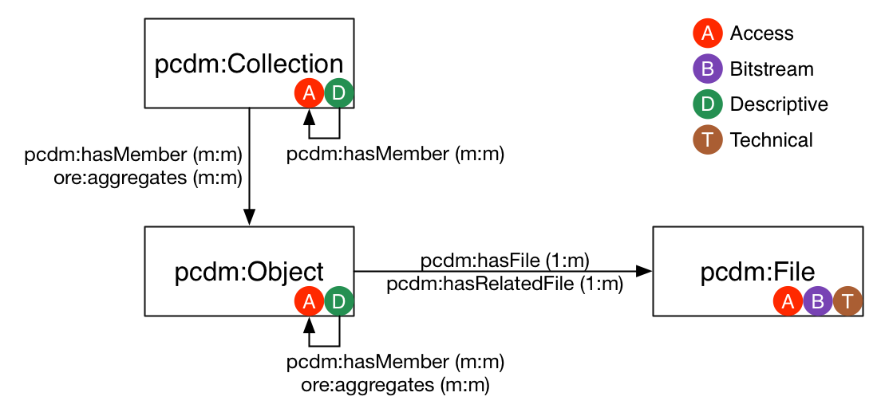
PCDM = Portland Common Data Model
x

Slide 54
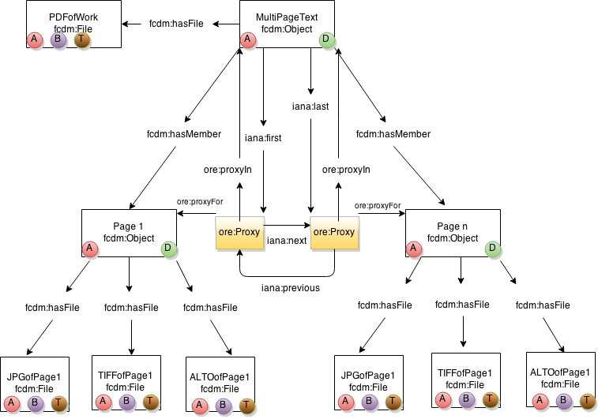
Book

Slide 55
Why PCDM?
1.) Best practices in data modeling
2.) Code interoperability
3.) Data interoperability

Slide 56
Agenda
What is Samvera?
Community Framework
Technical Framework
Data Modeling
Getting Started with Samvera
Discussion

Slide 57

Hydra-in-a-Box

Slide 58
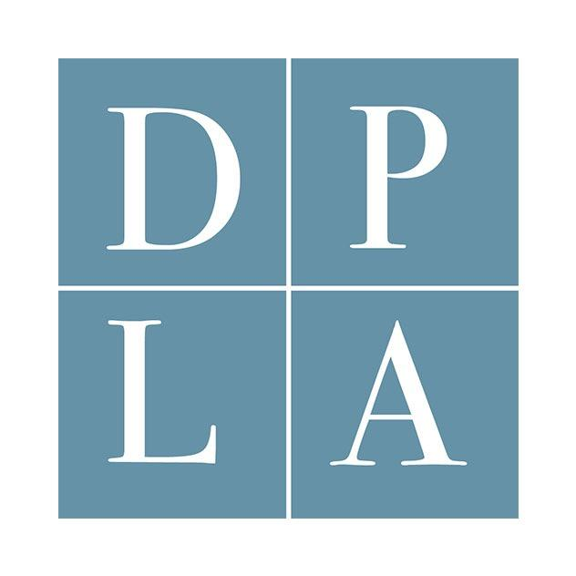
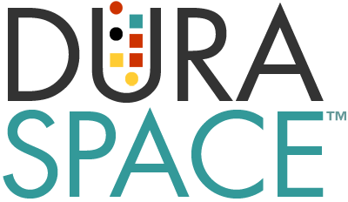


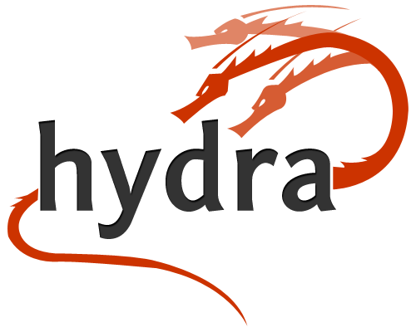
Project Background
30 month National Leadership Grant from IMLS
Foster a national digital platform through community-based repository infrastructure
Leverage & contribute to Hydra, both in code and community
Notes:
Let’s start with a brief review of the project origins and goals. In 2014 DPLA, DuraSpace, and Stanford shared conversations about the state of the world of repositories and digital collections. We realized that the management and publication of digital collections by cultural heritage institutions are poised for a generational change. And we recognized the promise of Hydra as a leader in this space, both in terms of the projects and components developed by the community, and the community itself.
Yet while Hydra offers a robust software framework and a lively community to sustain and advance it, it has not provided an easy-to-implement solution. This shortcoming has been contributing to the overall repository gap in the larger cultural heritage landscape.
Hydra implementations are also missing key pieces that allow aggregators such as DPLA and its hubs to easily harvest, reuse, and add value to digital collections and their metadata in a scalable, modern manner.
And there have been no service providers available to offer hosted service options for Hydra-based repositories. Together, these gaps hinder broad adoption of Hydra.
So, motivated to address these gaps, we sought -- and were successfully awarded -- a 30 month National Leadership Grant from the IMLS, one focused on fostering a national digital platform through community-based repository infrastructure.

Slide 59
Project Goals
  Develop turnkey, Hydra-based application that leverages and improves on core code components
  Develop metadata aggregation & enrichment tools
  Work toward a hosted service
  Connect components with DPLA hubs, current Hydra partners & prospective Hydra adopters
Notes:
The grant project has four goals:
to produce a turnkey Hydra-based application for next-generation digital asset management;
to improve and generalize DPLA’s metadata harvesting and enrichment tools into more reusable components,
to connect these key infrastructural pieces with DPLA hubs, current Hydra partners, and prospective Hydra adopters—creating a vibrant, participatory community of adopters and contributors;
and to work toward a hosted service, offering a cloud-based version of the application for use across multiple domains.

Slide 60
Work Accomplished to Date
Repository Product
Design Research (Jun 2015 - Jun 2016)
Two Development Work Cycles (Mar 2016 - present)
Hosted Service
Technical implementation in hand
Business planning underway
Aggregation Tooling
Requirements and prototyping
Notes:
Now we are 18 months into our project -- just past the halfway point -- and we’ve made demonstrable progress on these goals.
We undertook design research between June 2015 and June 2016 - including community survey, interviews, environmental scan, competitive analysis
We have had two development work cycles at Stanford since March of this year. We are currently working toward our first software release in Winter 2017.
For the Hosted Service
We have a solid technical implementation
And Business Planning, led by DuraSpace, is well underway.
I’m going to present more detail about this work, and then Gretchen will take the stage to report on DPLA’s aggregation tool improvements.

Slide 61
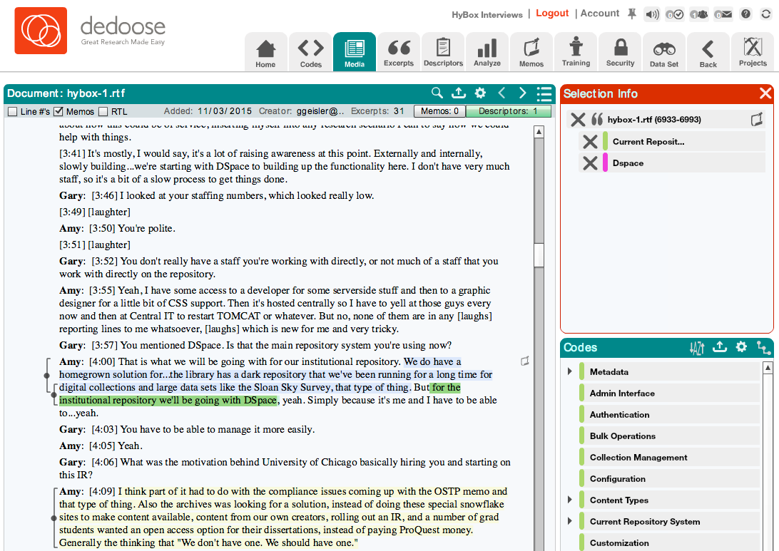
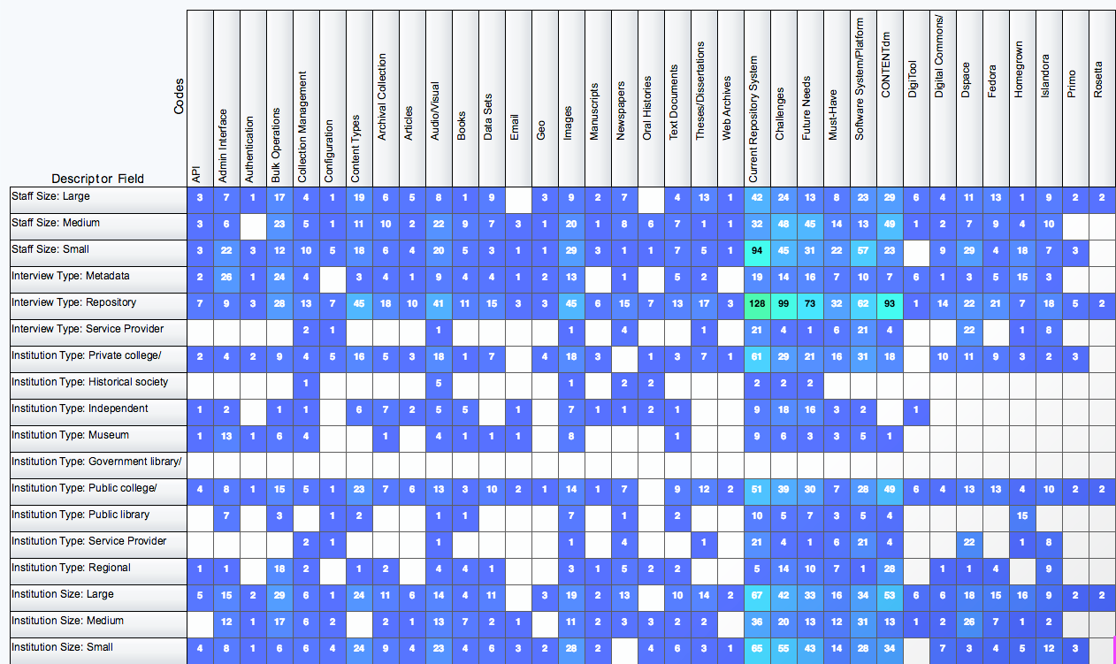
Design Research - User Interviews
Methodology
22 interviews, 4 focus groups
55 people in total, from 46 institutions
All interviews audio-recorded
and transcribed
Developed coding scheme
Total of 93 codes applied to 1258 passages from 49 transcripts
Dedoose content analysis tool
Notes:
As I mentioned, one component of our design phase entailed a series of user interviews.
All told, we spoke with 55 people from 46 institutions - including a number of one-on-one interviews that took place at DLF last year in Vancouver. (Show of hands - who in the audience participated?)
I don’t have enough time to dive into our process and the outcomes of this work -- including the intensive content analysis work, illustrated in screenshots here, after the recorded interviews were transcribed and a coding scheme -- but it’s worth emphasizing that the interviews and focus groups were highly productive, revealing, and validating. We were able to extract a great deal of information to build a detailed picture of the requirements of our broad community.

Slide 62
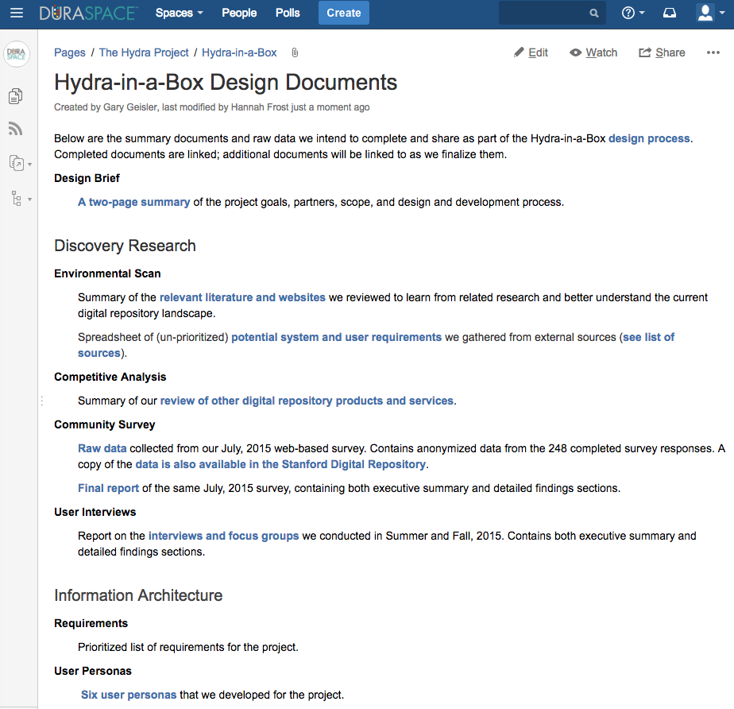
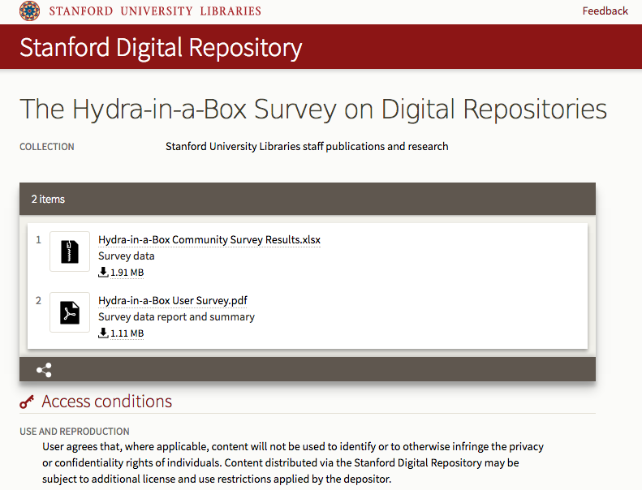
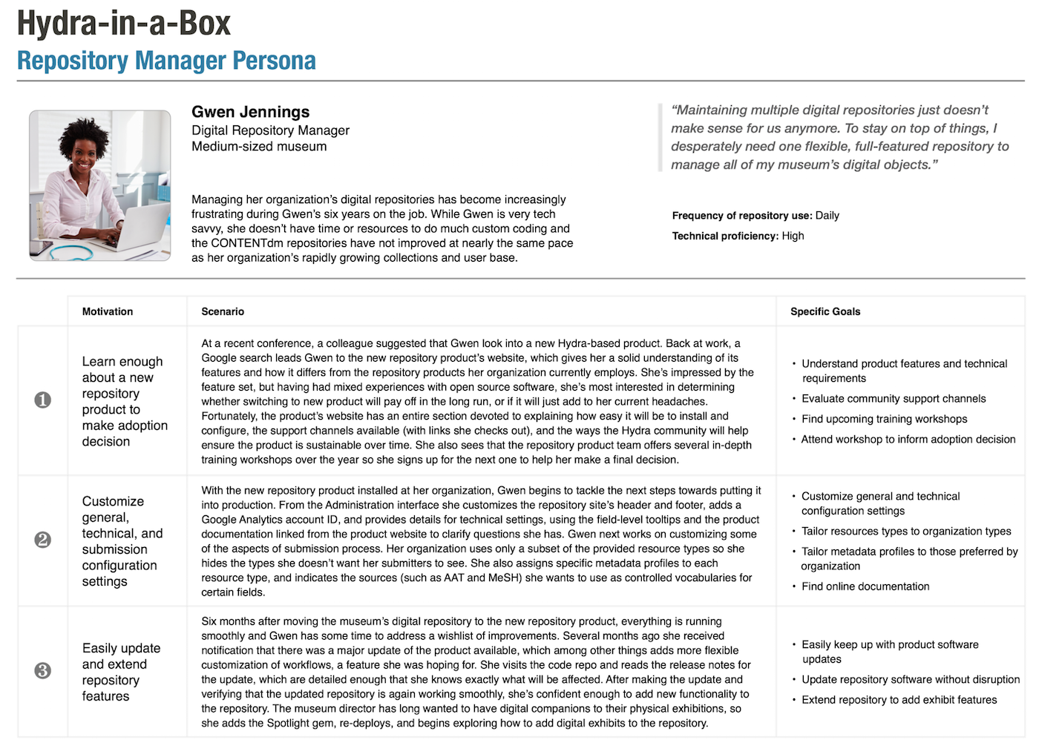
Design Research, Survey Data Online
All available on the project wiki:
http://bit.ly/hybox-design-docs
Notes:
The artifacts of our design process -- including 6 personas, and all detailed summaries of our findings -- are posted on the project wiki hosted by DuraSpace, and survey data and analysis are archived in the Stanford Digital Repository.
Also posted on our wiki are:
- a freshly prioritized list of requirements based on the environmental scan,
- a feature list for our repository product along with a high-level road map,
- and soon, our growing set of mock-ups.

Slide 63



Repository in a Nutshell
Can be deployed to AWS - but does not depend on AWS
Multi-tenant - one installation, many separate instances
Settings UI - configure it in the UI, not in code
IIIF - Image API, Presentation API, Universal Viewer
Notes:
Initial technical work focussed largely on infrastructure development to enable installing Hydra in the cloud and other related improvements and enhancements under the hood.
We are using AWS for hosting the repository, but the repository is not dependent on AWS.
The repository is multi-tenant, meaning one installation can support several separate repository instances.
We are moving configurations into a user interface so that you don’t need to be a developer to configure the repository.
And we added support for IIIF (the International Image Interoperability Framework) through its APIs, so adopters can readily participate in IIIF, the most exciting way to share images online since Flickr or Instagram.

Slide 64
Features of Note
Batch import, batch metadata editing
Administrative dashboard
ResourceSync for harvesting
Import/export Bags from Fedora
Complex objects re-ordering
Multi-step deposit workflow
“Administrative Sets”
Notes:
We have documented over 350 potential requirements from the broader cultural heritage community -- volume beyond what we can tackle under the current IMLS grant. So we are agile and opportunistic, actively informing and participating in current development efforts within the Hydra community that directly intersect with our road map -- such as mediated deposit, and the administrative dashboard. This approach has effectively and positively driven some of our development and UI design priorities.
This slide lists the top user-oriented features we have been working on since March of this year to extend what has been available in Sufia. I want to highlight four of them:
Batch import and batch metadata editing are two features that will be critically useful to folks working with content at any kind of scale in Hydra in a Box, including those migrating to Hydra in a Box from an existing repository system.
Advanced reporting and an administrative dashboard, to provide repository admins with immediate access to real-time stats about the status and contents of the repository and its users
Native support for publishing metadata to DPLA’s metadata application profile PLUS an implementation supporting ResourceSync for harvesting, which has great potential as a next generation harvesting protocol, and the added benefit of search engine optimization.
The ability to import and export bags of content directly to/from Fedora, to address the need to deliver content to preservation services like APTrust, Digital Preservation Network (DPN), private LOCKSS networks, and the like.

Slide 65
Repository Elevator Pitch
A (new) way to manage digital content
The best of Hydra in an easy-to-install, easy-to-configure, feature-rich solution
Reducing barriers to effective asset management
& preservation
For collections and content types of many kinds
Supports next-generation web technologies
Is supported by a vibrant and ever-growing open source community.
Notes:
So to sum it up, the Hydra-in-a-Box repository elevator pitch goes something like this:
For cultural heritage institutions,
Who seek a (new) way to manage their digital content,
The Hydra-in-a-Box repository offers the best of Hydra in a single, easy-to-install, easy-to-configure, feature-rich solution for collections of all kinds, thus reducing barriers to effective and affordable content management and preservation.
Unlike existing, aging repository solutions available in the market, our product supports several next-generation web technologies (RDF, IIIF, ResourceSync to start) and is supported by a vibrant and growing open-source community.

Slide 66
Community Sprints
Complex objects - Princeton, Oregon State, Chemical Heritage Foundation
Mediated deposit - Oregon State, Cincinnati, Indiana, Michigan, Cal State, Penn State, Notre Dame
Admin dashboard - Princeton, Penn State, Cincinnati, Cornell
Fedora Import/Export - York, Columbia, Princeton, UVa, Penn State, DuraSpace
FileSets - Art Institute of Chicago and others
Notes:
Community sprints have been key to making substantive progress on new key functionality in relatively short amount of time. These sprints are not motivated by our project alone - they emerge from common needs - though our project’s energy and technical leadership, in the form of Mike Giarlo specifically, certainly has helped to feed the momentum and guide the process towards successful outcomes.
I count 15 institutions here who provided real resources -- staff time and expertise and travel time -- across these five fronts, and the fruits of this work are shared back into the core gems for all of the Hydra community.

Slide 67
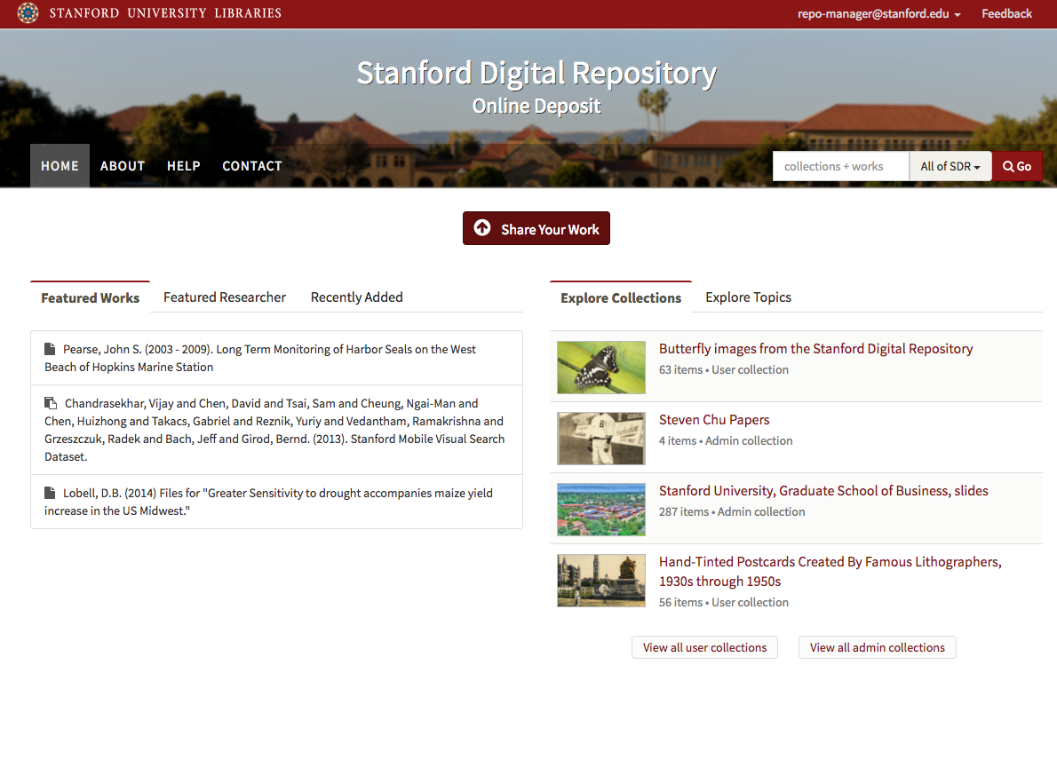
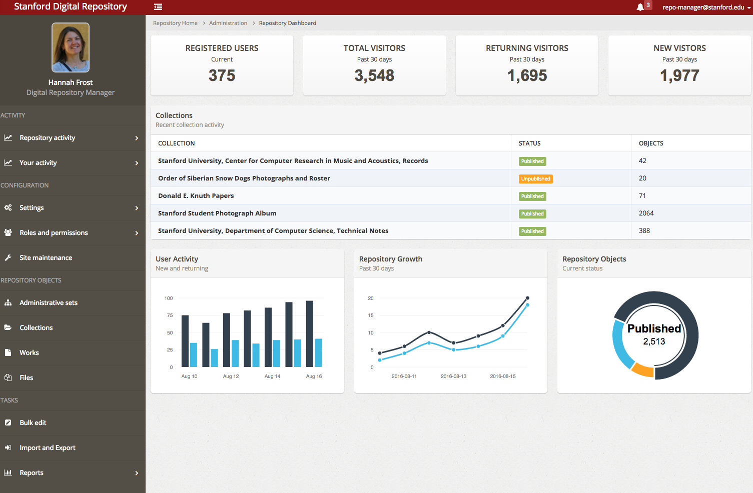
User Interface Designs
Notes:
UI Designs are happening. Examples here show the self-configured home page … and part of the repository administrator’s dashboard. I don’t have time to do them justice in this very brief presentation. Look for them implemented in our sprint demo videos.

Slide 68
2017 Plans
Features, features, features
  Content type support
  APIs
  Exhibits
Pilots
  Locally-installed repository
  Hosted service pilot
Notes:
Finally, an outline of our plans beyond the current work cycle, into 2017.
Spoiler alert: there’s going to be more development.
We have feature aspirations in a few big areas, including
Specific metadata and presentation/delivery behavior support for targeted content types - such as datasets and books,
More APIs
And we plan to integrate exhibit features, borrowing from the Spotlight project, with Hydra-in-a-Box
Also we are planning pilots, both with folks interested in locally installing Hydra-in-a-Box or folks interested in trying out our service hosted by DuraSpace.

Slide 69
Why Samvera?
Need a flexible, rich, robust repository solution
Be part of a community
  Shared resources, shared risk, shared advances
“We” is smarter than “me”
  Especially in this crowd
Control your own destiny
Build institutional capacity
Practice best practices
The way work is getting done now

Slide 70
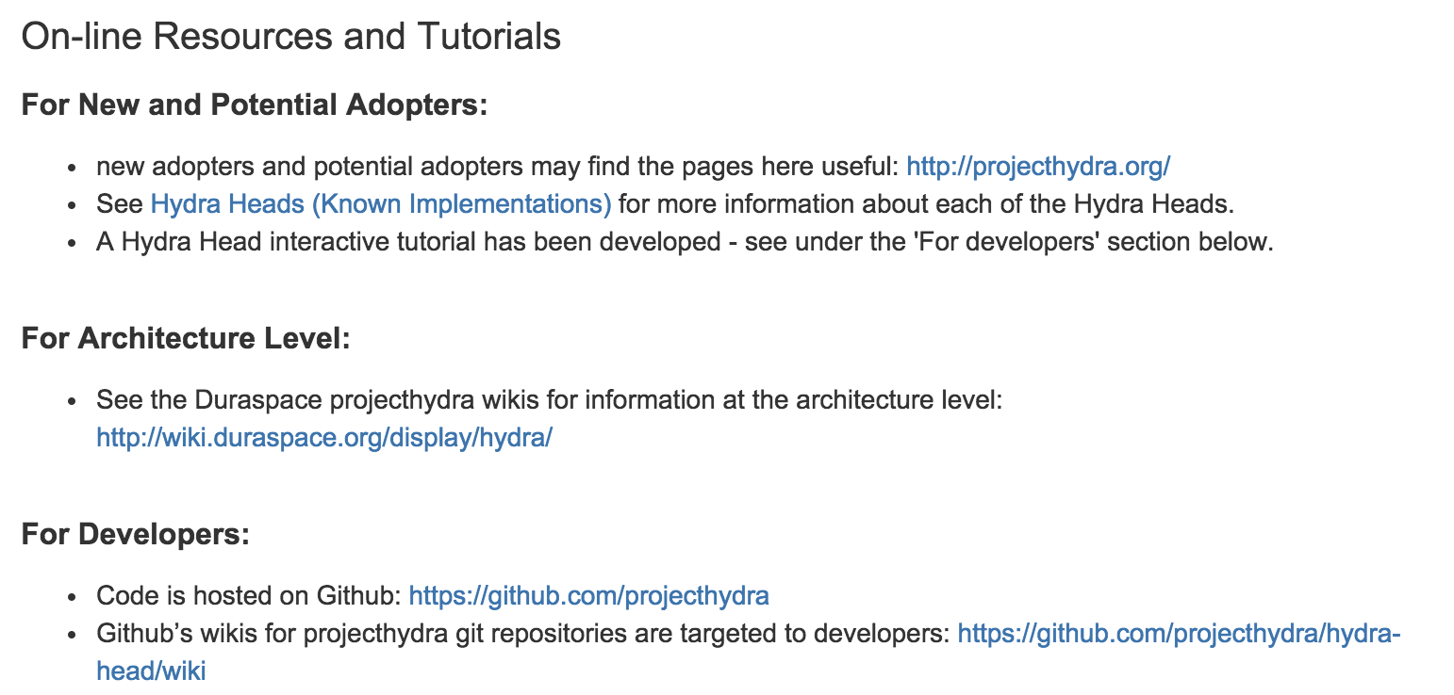
Getting Started
https://wiki.duraspace.org/display/hydra/Developers

Slide 71
Technical Engagement
Software: https://github.com/projecthydra
  Developers should start here:
  https://github.com/projecthydra/hydra-head/wiki
Note: Most sites start from Sufia on Fedora 4
at this point
samvera-tech@googlegroups.com, Slack and weekly tech phone calls = best channels for tech support
Ask questions. Seek help. Commit back.
  Professional social coding norms apply: Respect, courtesy, code review, consensus

Slide 72
Typical Staffing
Repository Manager
  Typically serves as product owner & service manager. Essential to defining service goals, running service and working with users after set up
Developers: numbers ranges from
  0: borrowed or contracted
  1: many sites have a single dev
  2-4: most Hydra teams don’t get above 4 developers, usually on sprints rather than dedicated full time
Optional:
  UX Design, doing interface design / user studies
  DevOps, doing system deploys & production support

Slide 73
Skills & Training
Technical Skills
  Agile & social coding: Git, pull requests & code review, continuous integration are standard.
  Ruby on Rails: eminently learnable. Rails Bridge is a good starting point if developers are new to Rails.
  DevOps & Sys Admins: growing coterie of Hydra users leveraging each others’ skills for deployment and operations
Hydra Camps
  Typically organize a camp 2-3 times a year
  Many sites host one as a way to bootstrap rapid development
  Data Curation Experts is our preferred training partner
  Often tap community members for “train the trainer”

Slide 74
Training & Connecting
Good: read the documentation and learn-by-doing
Better: connect through social channels
  Email lists, IRC, weekly phone calls
  Github interactions
Best: meet in person. Face time fuels collaboration!
  Hydra Connect: annual, worldwide, community meeting
  Hydra (Partner) meetings: 3-6 ad hoc, topic-based meetings per year (usually)
  Regional Groups: now beginning to convene

Slide 75
Get involved: Many hands make light work
Getting involved with Hydra can be at different levels:
  Adopter
  Developer
  Partner
Need to ask:
  What involvement is required to enable you to meet your needs?
But also,
  If we contribute back, what more do we gain?
Notes:
Communication to the larger community
Spread the word about Hydra
Help with strategic planning
Particularly around community growth and management
Meeting planning
Offer to facilitate or take notes!
Speak up!
About issues you as a manager are facing

Slide 76
Stay connected
Website (http://projecthydra.org)
Wiki page (http://wiki.duraspace.org/display/hydra/The+Hydra+Project)
  Partner meeting agendas & notes
  Events & Details
Monthly Partner calls
Partner listserv
Hydra Partner meetings & Hydra Connect
Identify a Hydra Partner doing similar work and get in touch
Identify need for vendor input and make contact to discuss options
Come to events (like this one!)

Slide 77
A word of (polite) warning
Hydra is open source – anyone can use it freely
Working with Hydra is not, though, free
  As in ‘puppies are not free’
  It requires investment
    Towards achieving a goal
    Towards sustaining a solution
Hydra recognises this and is seeking to provide a way to invest in a mutual direction of travel – come with us!

Slide 78
Agenda
What is Samvera?
Community Framework
Technical Framework
Data Modeling
Getting Started with Samvera
Discussion

Slide 80

Going Far Together
Notes:
Lots of systems fulfill same functionality. Biggest difference between other solutions is its community and commitment to community building.

Slide 81

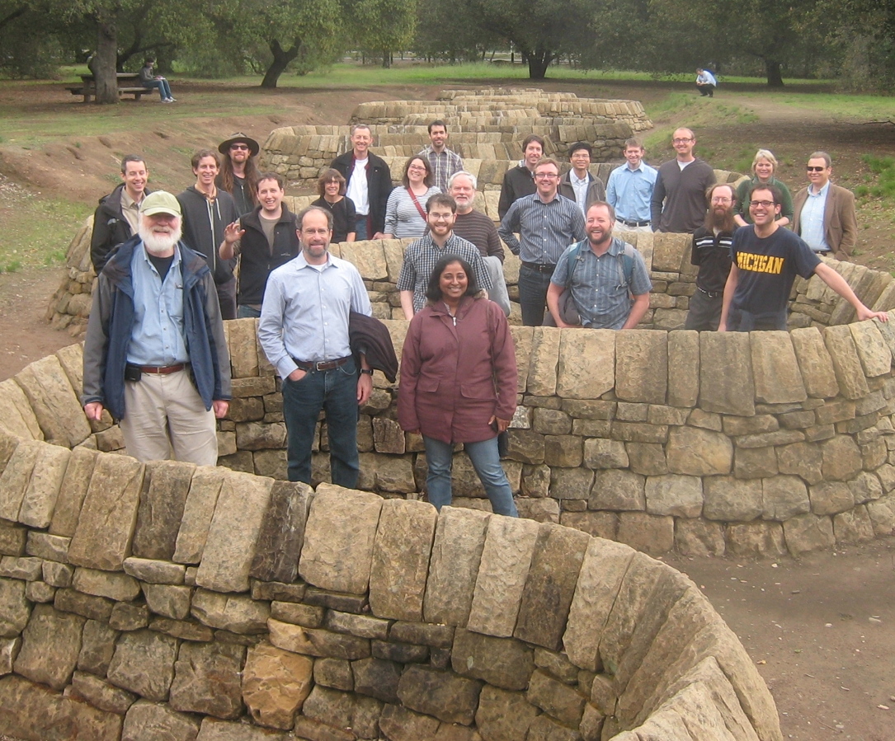
University of Virginia, 2008
LibDevConX^3, Stanford, 2012: (Hydranauts and Fellow Travelers)
Hydra Partners @ UCSD, 2012

Slide 82

First Worldwide Hydra Connect @ UCSD, January 2014

Slide 83
2nd Worldwide Hydra Connect @ Cleveland, OH, September 2014
160 participants from 56 institutions
3rd Worldwide Hydra Connect @ Minneapolis, OH, September 2015
200 participants from 60 institutions

