Slide 1
Avalon Update
Jon Cameron
Indiana University Libraries
Samvera Virtual Connect 2022
May 4, 2021

Slide 2
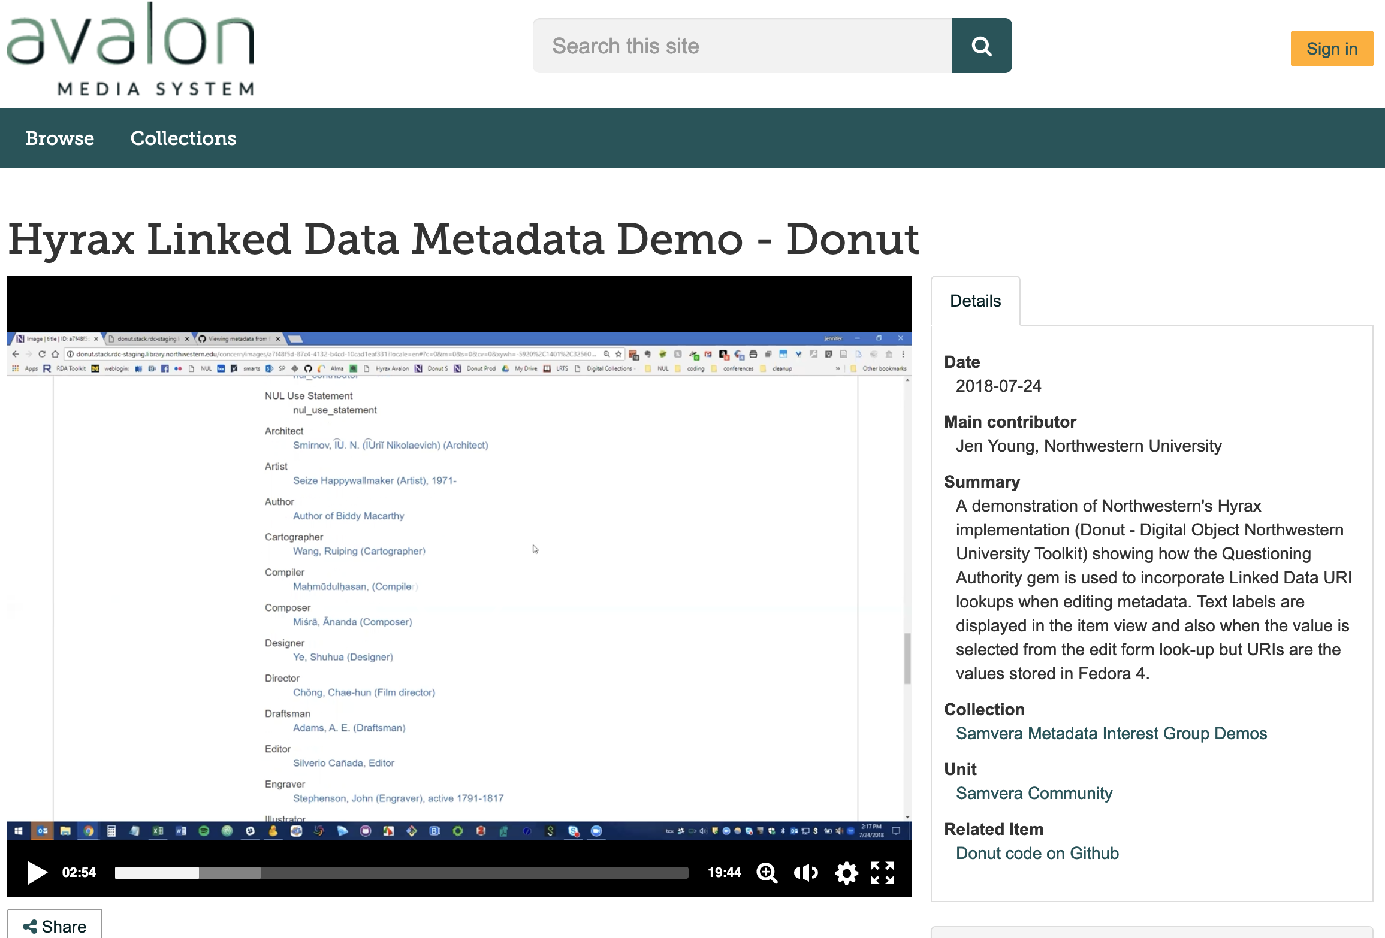
What is Avalon?
Samvera solution bundle for audio and video access
Features include easy transcoding, granular access control, and much more
Supported by grants from the Mellon Foundation and IMLS
Latest release: Avalon 7.3

Slide 3
Avalon Team Changes – Welcome Mason
Mason Ballengee joins the Avalon team!
Previously worked with Julie Hardesty on metadata coding projects
Please say hello

Slide 4
Open Position
Head, Digital Media Software Development
Jim Halliday currently filling in for this role since Maria Whitaker’s retirement
https://go.iu.edu/4irc
Notes:
Maria Whitaker retired October 2021, and this job is currently open.

Slide 5
Remembering Michael
Notes:
I do have some sad news to share. Our colleague Michael Johnson passed away a few weeks ago. Michael had taken the role of lead developer on the Avalon team in February 2021. In his time with us he’d been involved in the community, he participated in community sprints and development work and some of you may have met or worked with him. He was was a wonderfully nice person, a congenial colleague and he will be missed. If you were able to meet him please take a moment to remember Michael. If you’re interested, donations in his memory can be made to a college fund for his son.

Slide 6
What’s New in Avalon
Release 7.3 – March 2022
Includes support for uploading files from Google Drive, a new component that allows users to view and download transcripts on the item page, and a variety of dependency updates and bug fixes.
Notable updates and bug fixes
Ruby 2.7 support
Updated Docker build
Fix for broken copy functionality on playlists
Fix for file handling when a collection folder is missing or misnamed

Slide 7
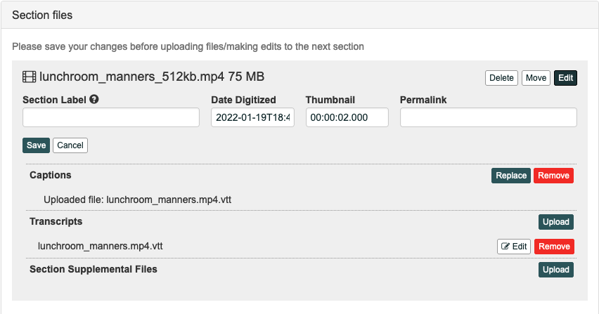
Transcript Files and Viewer
Transcripts are now a typed file category
Any number of transcript documents can be added
Upload in VTT or or DOCX format to view the transcript on the item page
Notes:
Transcripts added to sections.

Slide 8
Transcript Viewer
Users can download transcript files and click VTT timestamps to seek in the viewer
The transcript component of the Avalon IIIF React Media Player renders on the item page when a transcript document is present
Notes:
This is taken from our demo site. Note that Microsoft Word documents also are reformatted to show inline as well, in addition to the VTT example in the slide. Users can click the drop-down select box to change which transcript they’d like to view/download.

Slide 9
Google Drive Integration
Works really well… but won’t be widely adopted at IU due to Google Service changes
Simple to set up
Maintenance is a concern
Other providers in Browse Everything?

Slide 10
What’s Next for Avalon
Migration of the Avalon documentation wiki to Samvera Confluence
Avalon 7.4
Rails, Bootstrap, Blacklight upgrades
Controlled Digital Lending
Avalon IIIF React Media Player
Hyrax-based Avalon
Notes:
CDL- working with MSU on a project. IIIF media player – working with the IIIF community to increase interoperability for IIIF Presentation 3.

Slide 11
Get in Touch With Us
#avalon channel on Samvera Slack
avalon-discuss-l@iu.edu list
More at avalonmediasystem.org/connect

