Slide 1
Hyrax and Archivematica: Central to Implementing Digital Preservation Workflows
Chris Awre, University of Hull
Laura Giles, University of Hull
Rory McNicholl, CoSector
Samvera Virtual Connect
May 14th 2020

Slide 2
The UK City of Culture
The UK Government awards the title of UK City of Culture every four years
In 2017 the title was awarded to Hull
The title is conferred for a four year period, but there is a focus in the first year on showcasing the culture of the city and using culture as a means to stimulate re-generation and growth.
Over 2,800 events across the city throughout the year

Slide 3
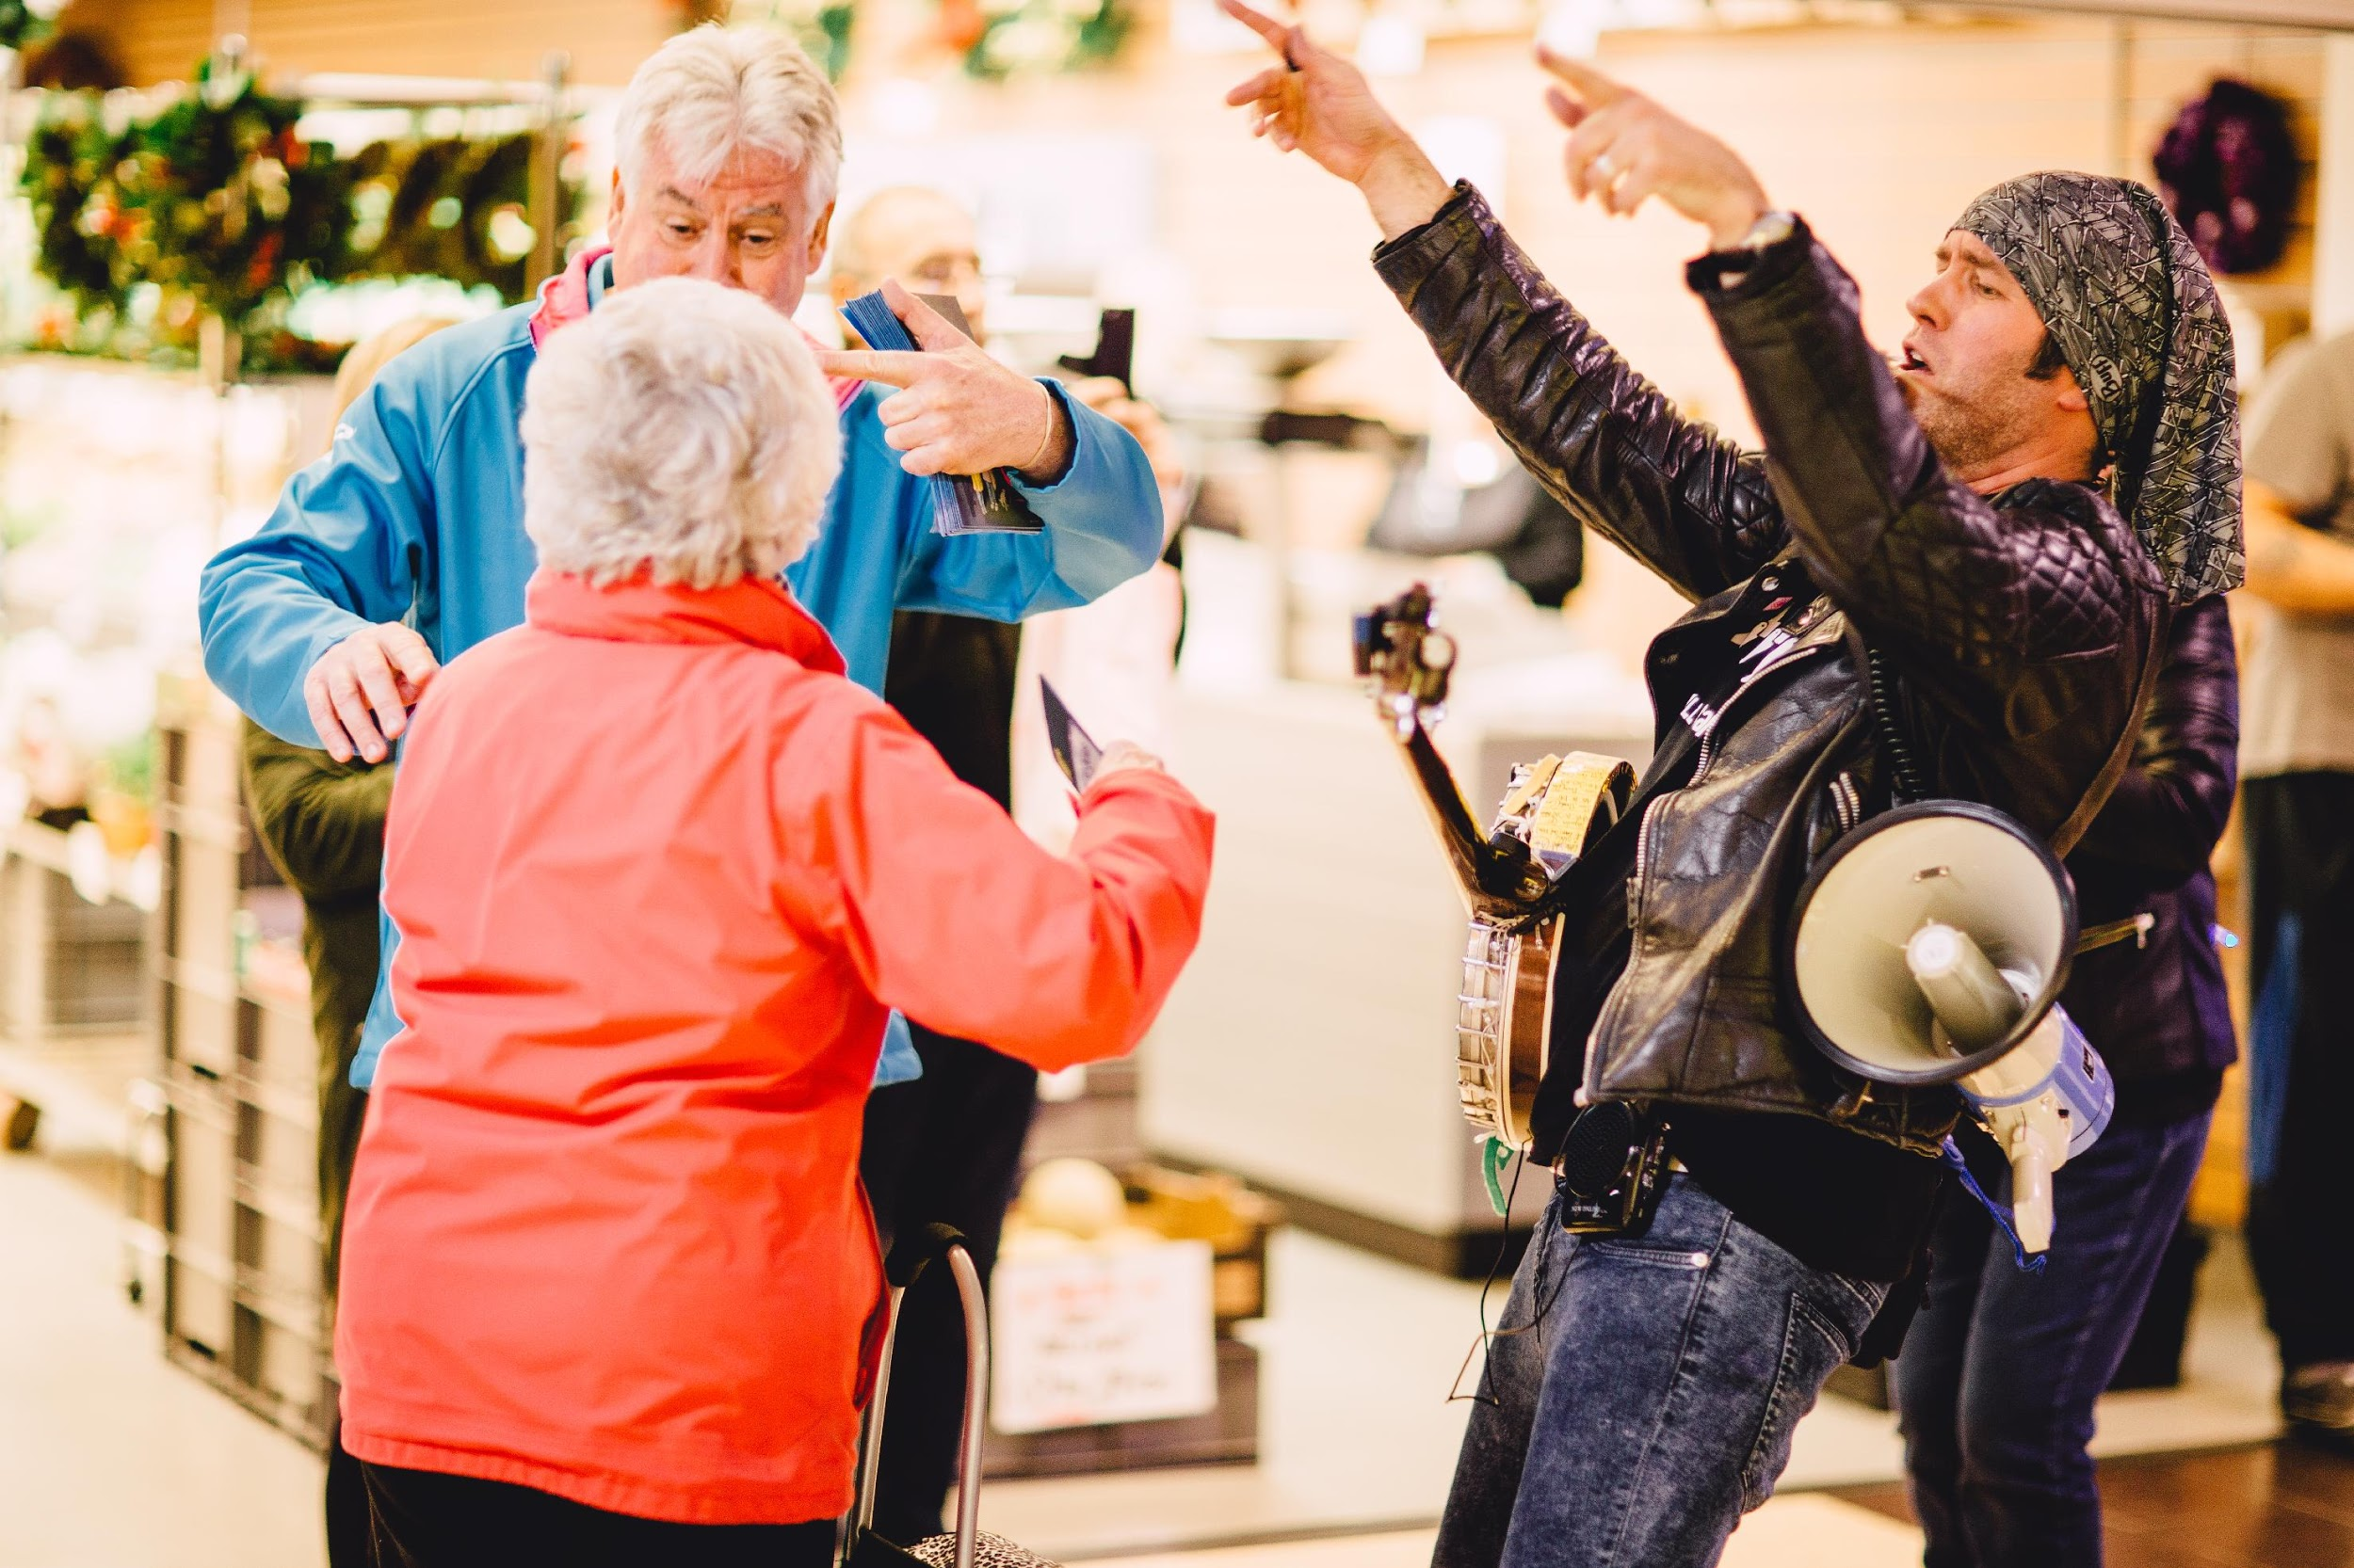
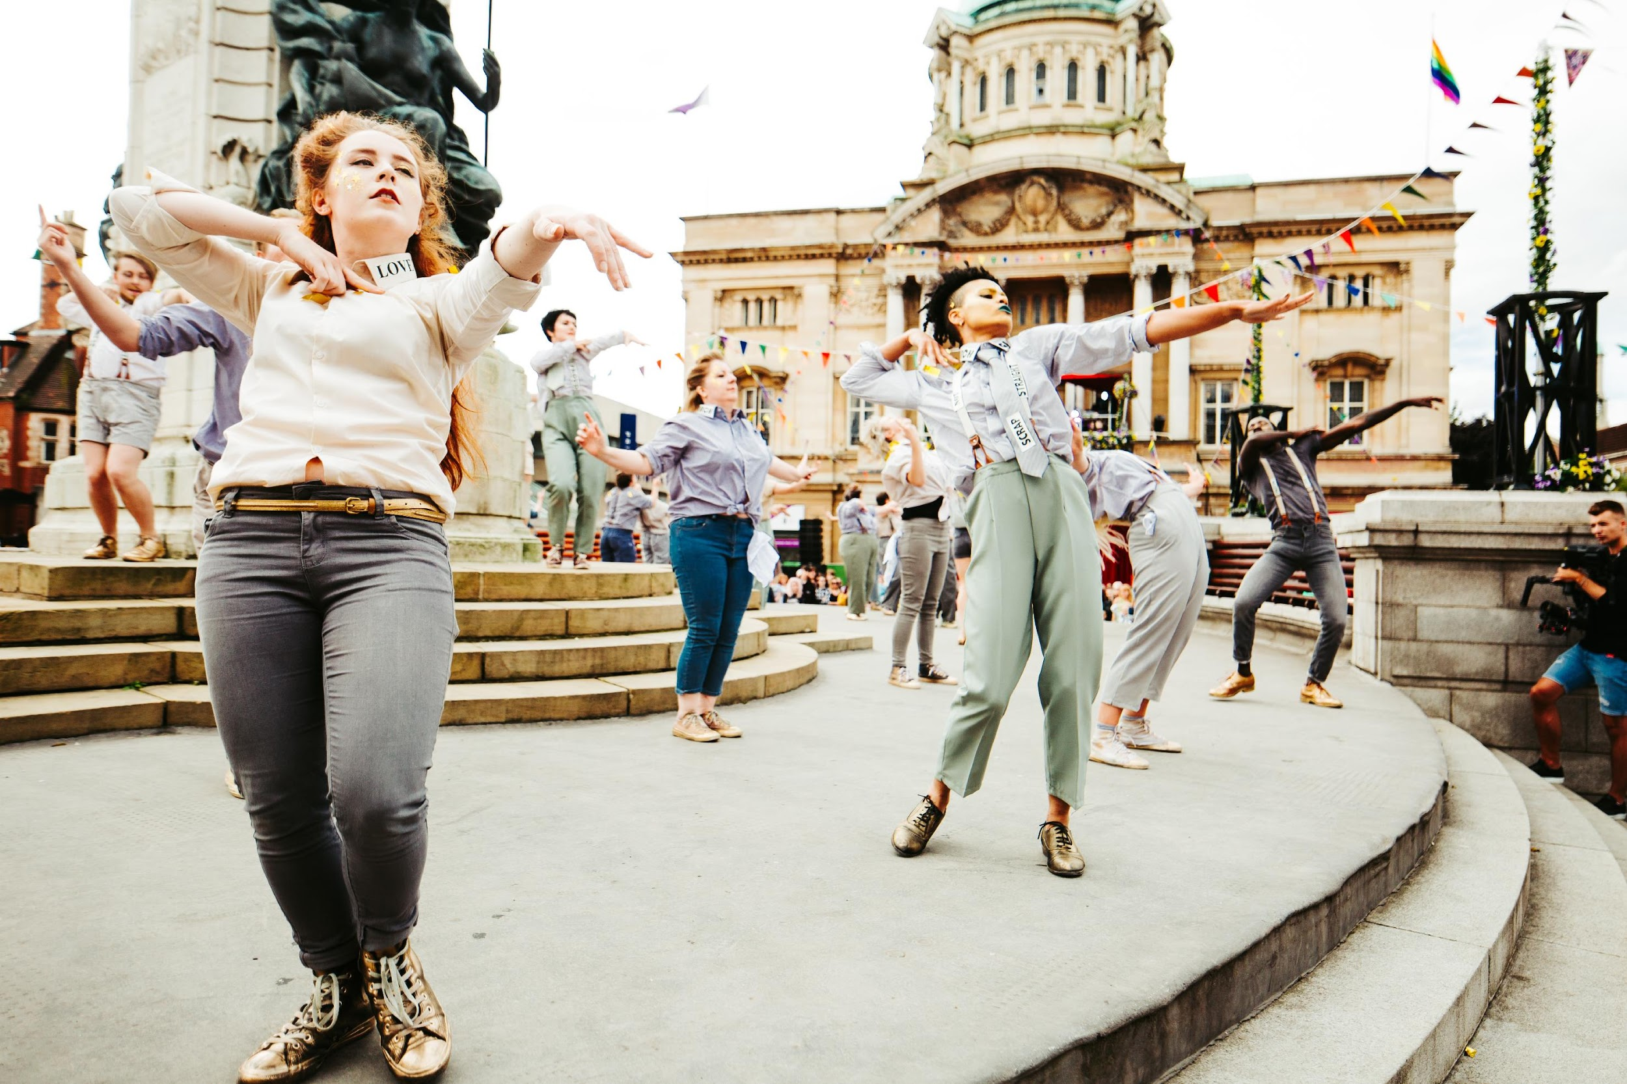
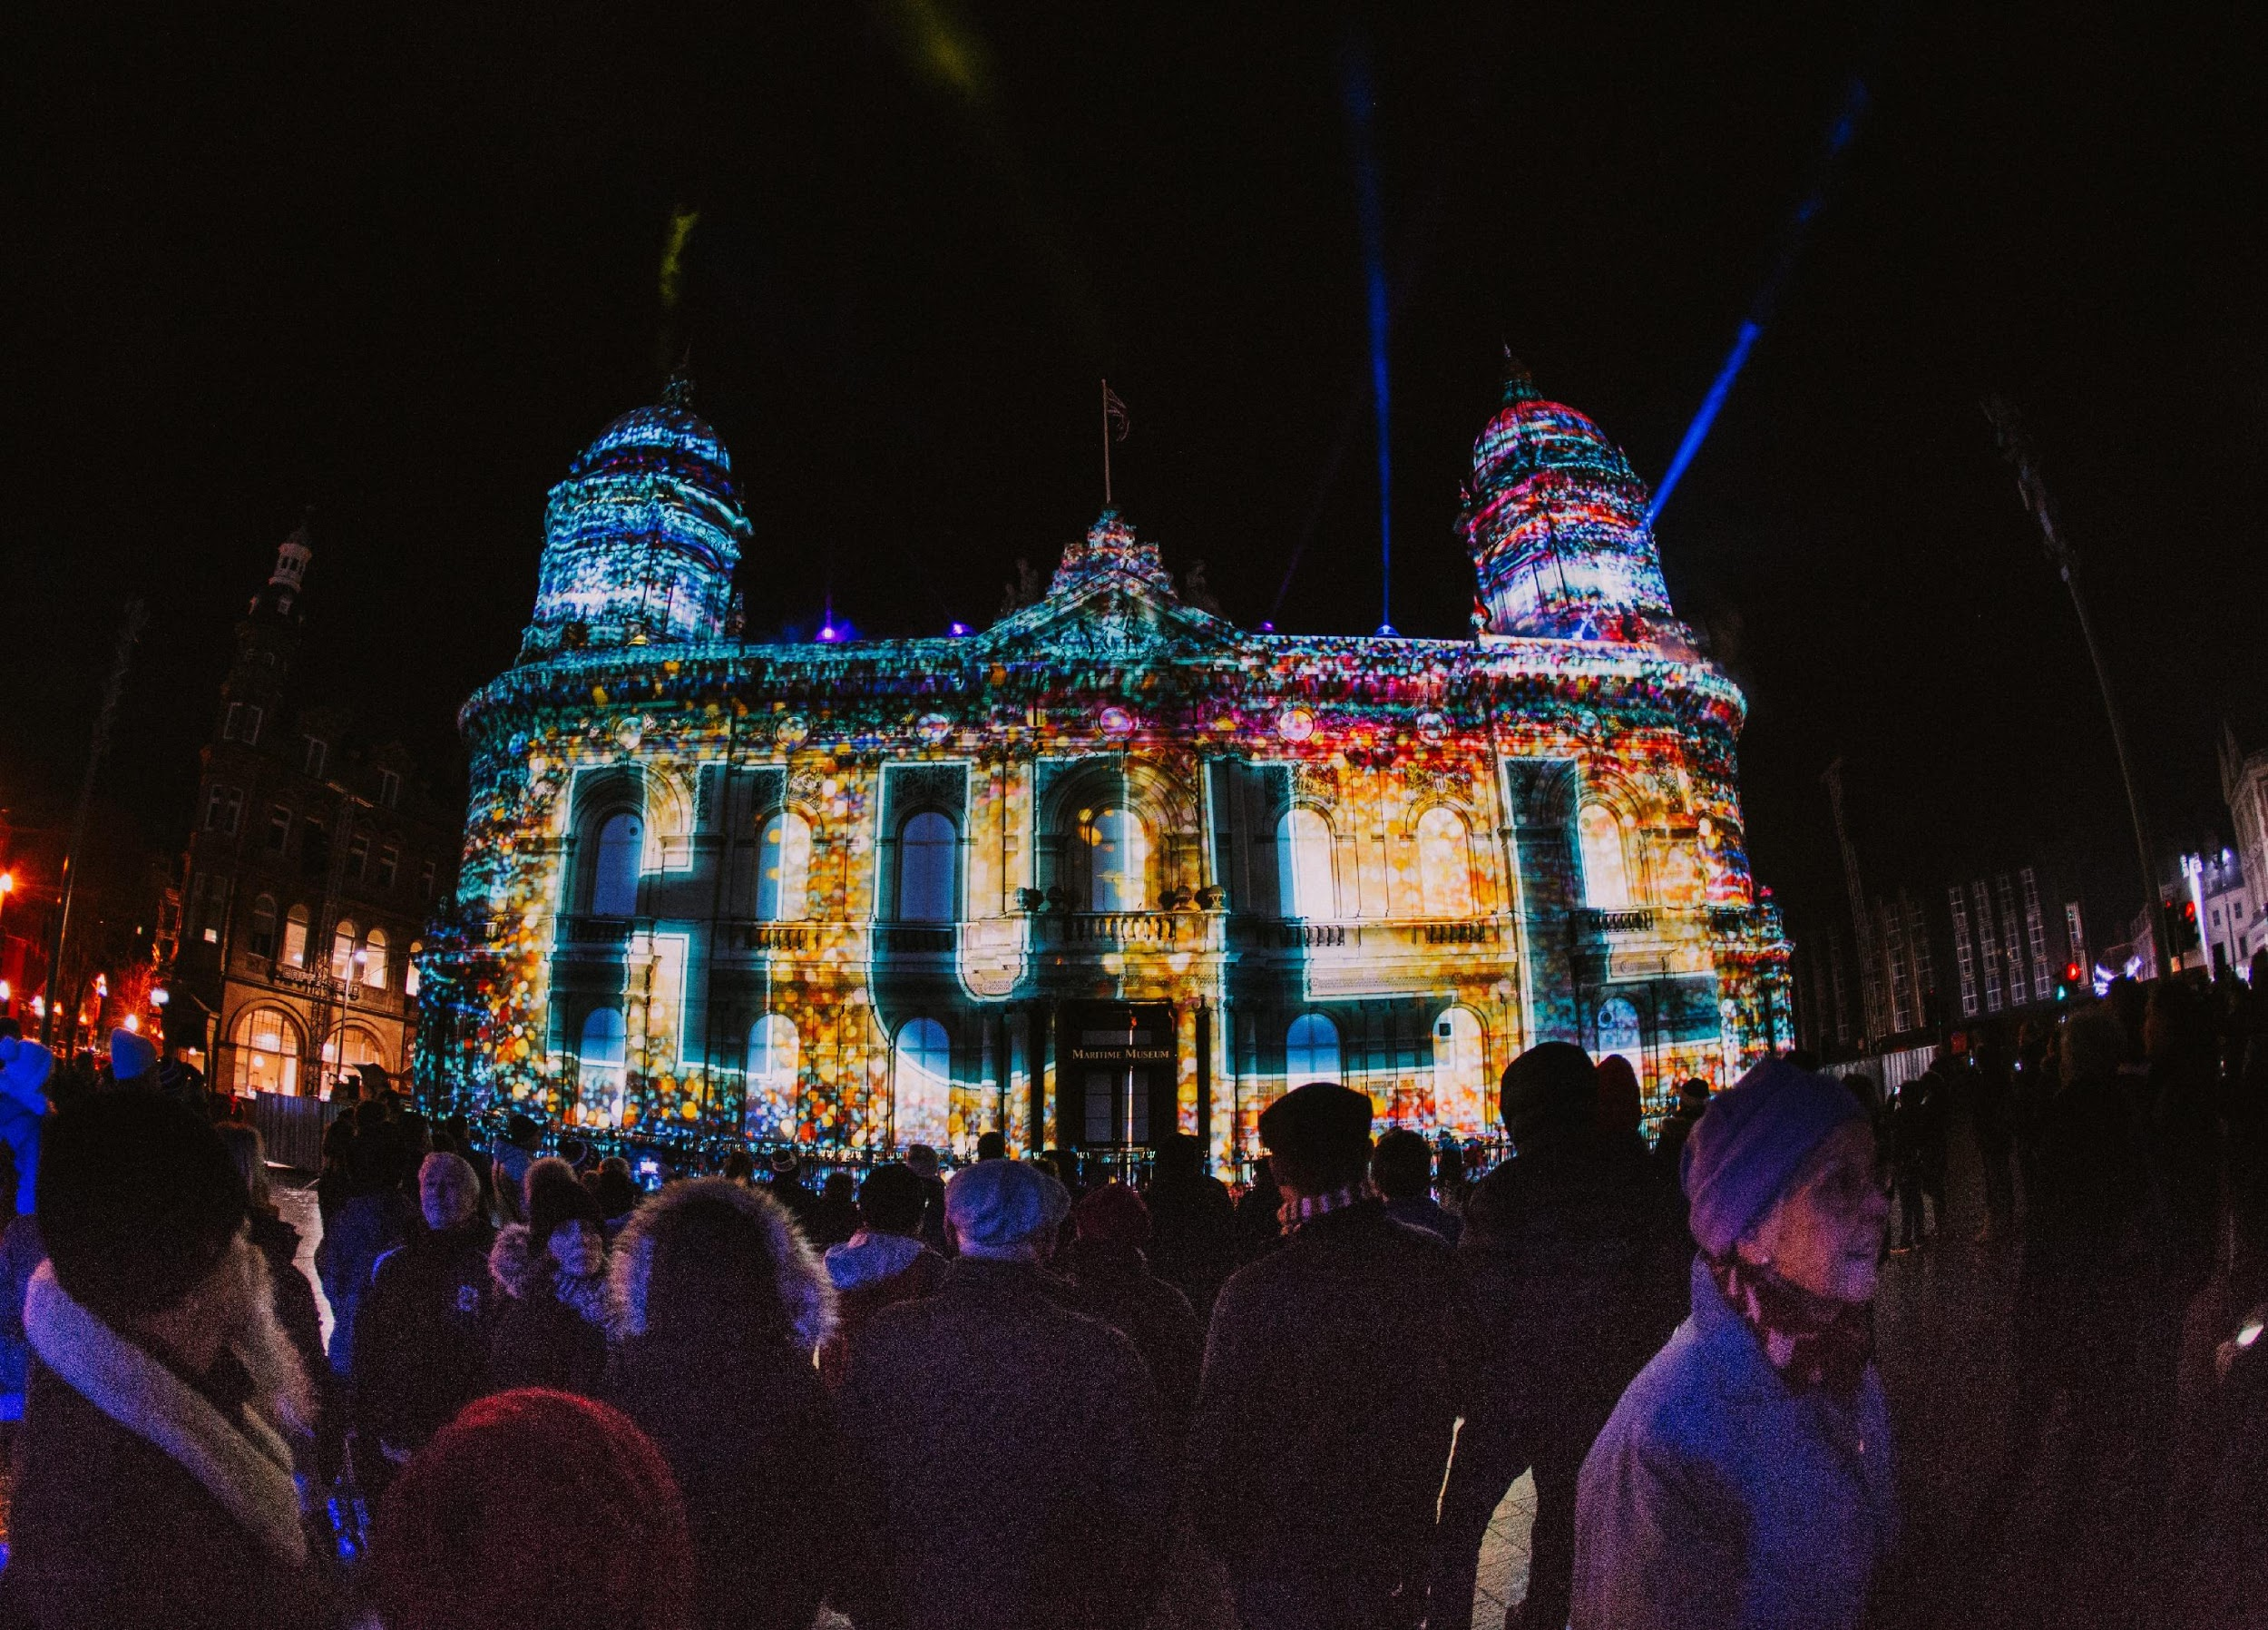
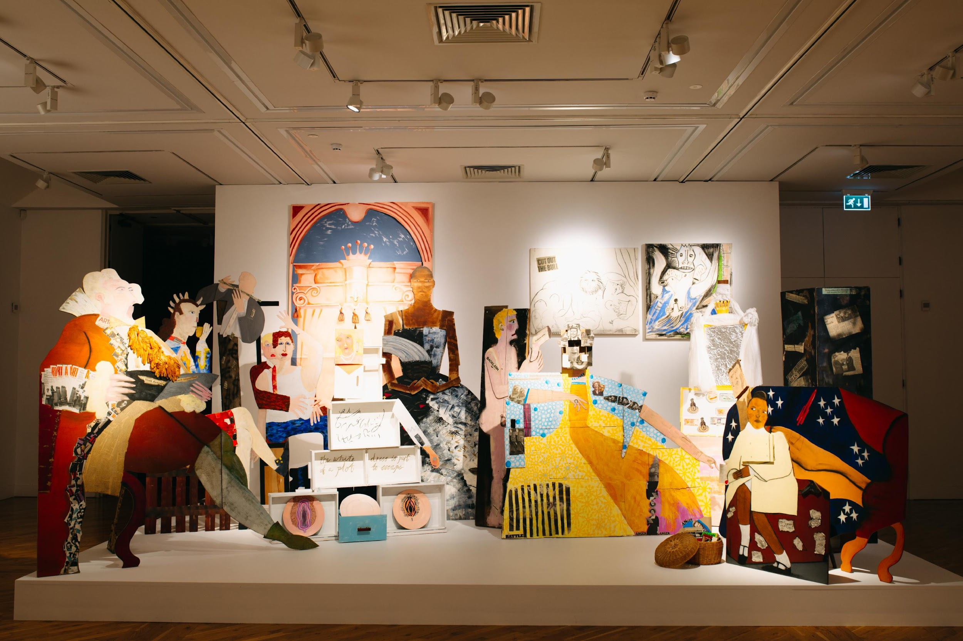
2017

Slide 4
The records
Various depositors, including the university and artists, with the Culture Company being the biggest
Almost exclusively digital
Main systems we are harvesting records from:
Asset Bank (DAMS) c18,000 HQ photos and videos
SharePoint c80,000 organisational records
Box
Email
Over 150,000 files in total

Slide 5
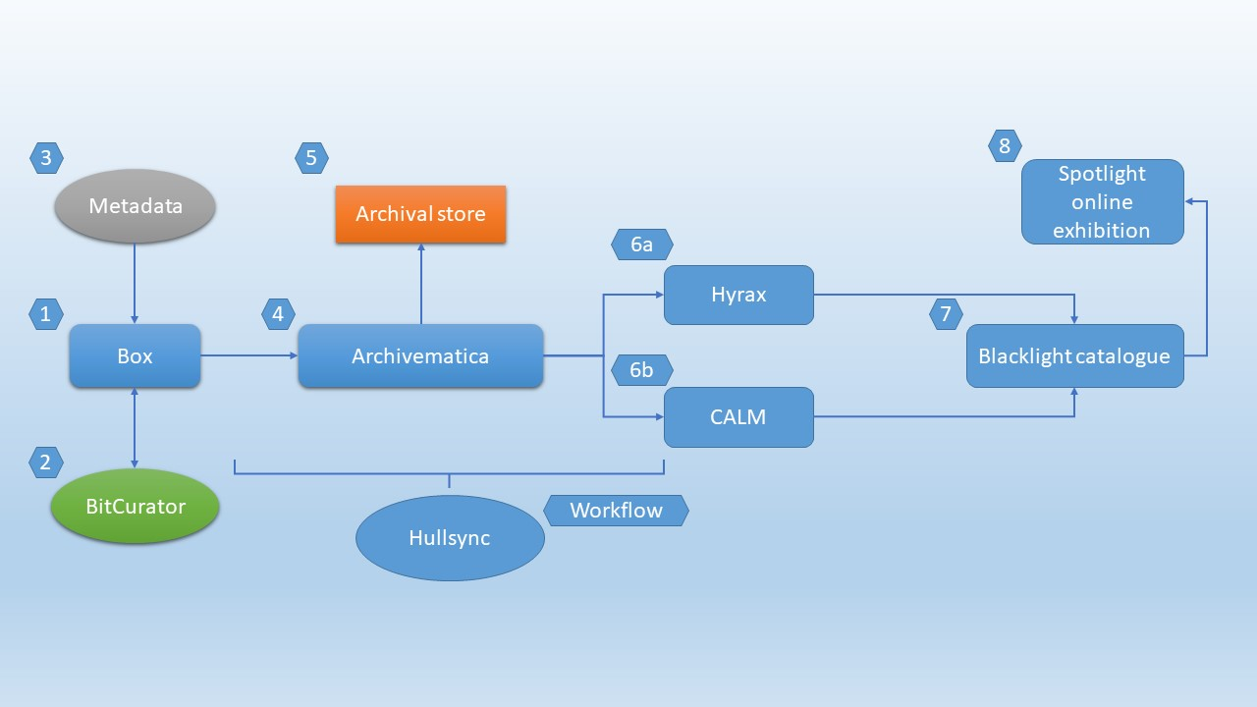
Building a solution

Slide 6
Hull Synchronizer
Transfer
Messages on progress written back to text file in box folder
Transfer to synchronizer started by sharing folder with special user
Administrator has view of process via a simple web UI
User uploads files and CSV files to box
Review
Check collection exists in Calm
Check validity of transferred material
Ingest
Creates “Bag” containing preservation material for submission to Archivematica
Create item level record in Calm
Transfer Bag to Archivematica and track progress of AIP and DIP creation
Creates “Bag” containing dissemination material for submission to Hyrax
Create package and Digital Archival Objects
Sword Deposit of Bag to Hyrax
EAD from Calm (including Hyrax work ids) imported to blacklight

Slide 7
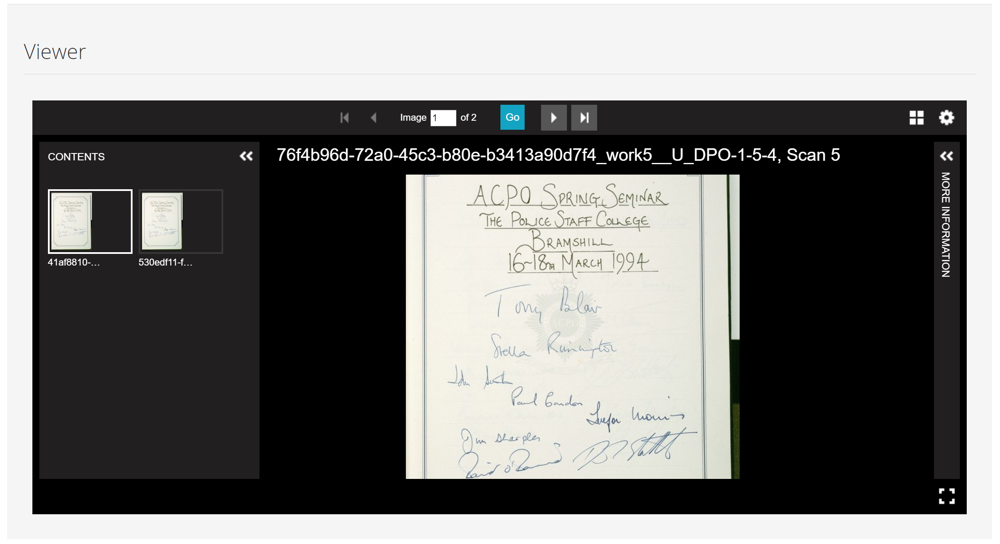
Putting it into practice
User doesn’t have to leave the History Centre Catalogue
They don’t know (and don’t need to know that) these files are derivatives, managed by Hyrax, with preservation copies stored elsewhere by Archivematica

Slide 8
Lessons learned
Archivematica and Hyrax do what they do very well
Focus of attention has been on the joins, through Hullsync, and making effective use of different gems to serve the overall need
Willow-SWORD, hydra-derivatives, dogbiscuits, boxr
Commercial elements (CALM, Box) had flaws in their documentation
But were good to responding to calls for help

Slide 9
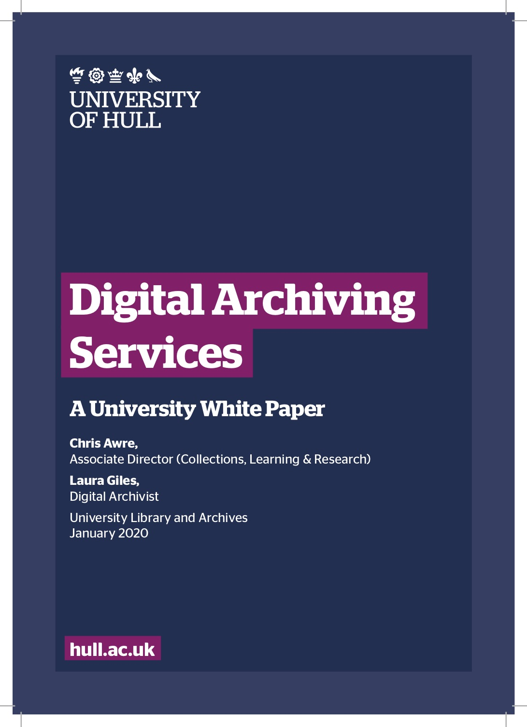
White Paper
Captures the background and work undertaken
Describes the technical infrastructure
Outlines the digital preservation services that can be offered around this solution
https://hydra.hull.ac.uk/resources/hull:17757/content1
Contact us to discuss further…

Slide 10
Onward
Continue implementation and development of the City of Culture Digital Archive – leading into City of Culture 2021 in Coventry
Apply the solution to University digital archiving needs
Engage with partner organisations around ways the University can support their digital archiving requirements
Develop use cases for Hyrax and Spotlight

